Slide 1
OICA HCV industry input to
ACSF informal Group #1
Informal Document ACSF-01-10
Meeting 2015-04-29 & 30 in Bonn

Slide 2
Automation targets
Safety
Energy Efficiency
Productivity

Slide 3
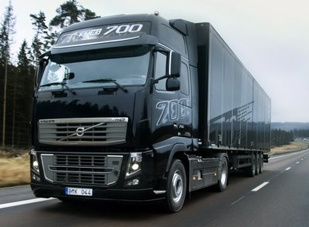

Automation areas
On Road Automation
Automatic Manoeuvring
Automation in Confined Areas

Slide 4
Automation areas
Main focus of the ACSF informal group
On Road Automation
Automatic Manoeuvring
Automation in Confined Areas

Slide 5
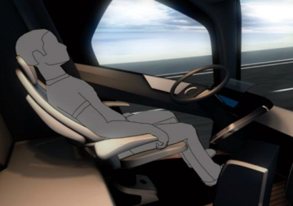
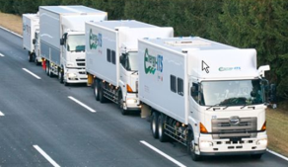
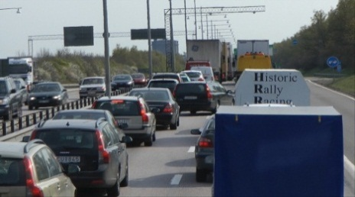
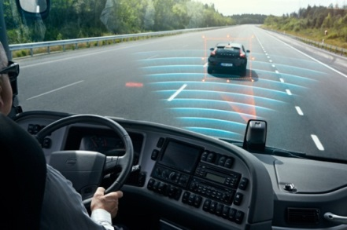
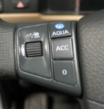



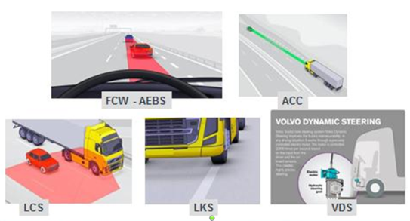
On Road Automation
Highway Autopilot
Platooning
Enhanced LK / LC &
Traffic jam Assist
Degree of Automation
LKAS & Traffic jam assist
Current Systems
- LCS, LKS, ACC…
- Active Steering
- AEBS & LDWS
mandatory
time

Slide 6
On Road Automation
Highway Autopilot
Focus of the ACSF informal group
Platooning
Enhanced LK / LC &
Traffic jam Assist
Degree of Automation
LKAS & Traffic jam assist
Current Systems
- LCS, LKS, ACC…
- Active Steering
- AEBS & LDWS
mandatory
ACSF > 10
CSF + ACSF < 10
time

