Slide 1
EVS-GTR TFG5
Cell/Module/System test
3rd June. 2015

Slide 2
EVS-GTR TFG5 Cell/Module/System test
Cell test : Nail penetration
Thermal propagation

Slide 3
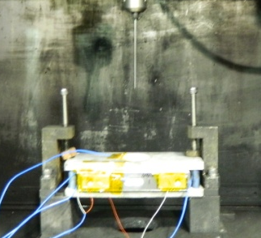
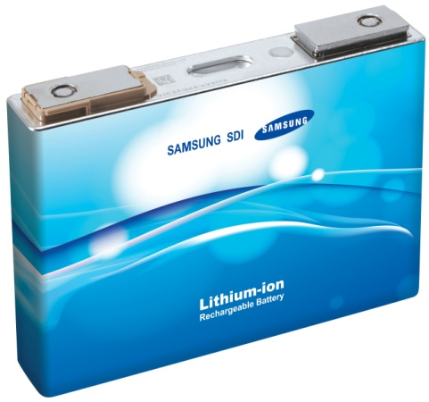

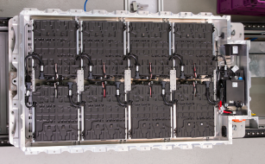
Cell test : Nail penetration
□ Nail penetration test
- Test method
Cells are punctured by sharp/steel(conducting) nail,
through positive/negative electrodes,
which leads excessive hard short and sparks.
- Test objective
Internal
short
Cell
puncture
Nail
What abusive condition
does nail penetration test simulate?
Abusive condition is derived by
Particle
Dendrite growth
Separator damage
Cell penetration by nail
System safety?
Test method
Nail penetration
Severe hard short induced.
Ext. short + full-layer short
➔Roadblock for new development
Internal short
Easy to control short area
Do-able? Reproducible?
➔New method required.
Hardly happens
Protection by outer case.

Slide 4
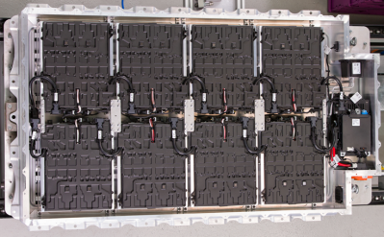
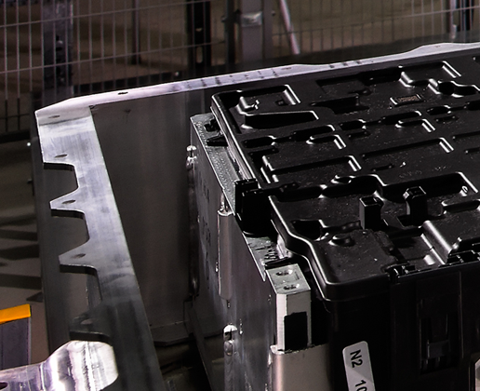
Cell test : Nail penetration
□ xEV Vehicle Field issue summary
 | Case 1 | Case 2 | Case 3
Date | 2011.5/12 | 2013.10/1 | 2013.3/21
Outcome | Fire 3wks after side crash | Fire, vehicle bottom impact by stone | Fire after system charging
Root cause | Coolant leakage → Ext. short with control board | Stone impact → Int/ext short by impact damage | Particle screening process error → internal short by cell drop & abnormal vibration test.
 | Crush, (External Short Circuit) |  | Internal Short
Implement | Reinforce of outer case |  | Screening process correction
Field issues are related to external short induced by crush and vehicle collision.
For field issues above, industry decided to reinforce system case, add protecting shield to improve safety.
System is getting more protective against mechanical damage from outside. ➔ A nail will not be able to penetrate the system case.
Only one objective remain for nail penetration : simulating internal short ➔ internal short circuit test
<BMW i3 Battery system>
System case is designed for mechanical damage from outside.

Slide 5
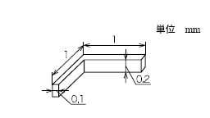
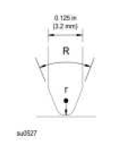
Cell test : Nail penetration
□ Internal short circuit test methods
Parameters |  |  | Particle | Blunt nail | Pure Ceramic | Ceramic nail w metal tip
 |  |  | Adopted in ISO/IEC | Candidates for alternative test in ISO/IEC
Nail/indenter size |  |  | 5x5x2 | Dia. 3.2mm | Dia. 3mm | 1.0mm
Nail material |  |  | Acryl + Nytril | Tungsten carbide steel (SKD-11) | Ceramic | ←
Tip/particle size |  |  | 0.1x0.2x1.0 (L shape) | R = 45˚ r=0.9~1.2mm | Tip angle = 45˚ | Tip angle : 28~45˚ Tip length : 350μm
Tip/particle material |  |  | Ni | Tungsten carbide steel (SKD-11) | - | Nickel
Test speed |  |  | 0.1mm/sec | 0.1±0.01mm/sec | ~0.1 mm/sec | ←
Location |  |  | Center/edge | Center | ← | ←
Test stop at |  | Force | 400N | 1500N | - | -
 |  | Volt drop | 50mV | 100mV | ~ 5mV | ←
Others |  |  | on J/R | With out case puncture | Case weakened | ←
Consideration | Correlation to real world |  | ● | ● | ● | ●
 | Do-able? |  | ● | ● | ● | ●
 | Reproducibility |  | ● | ● | ● | ●

Slide 6
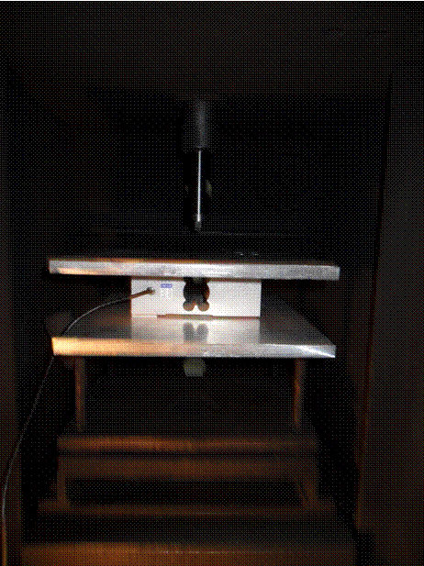
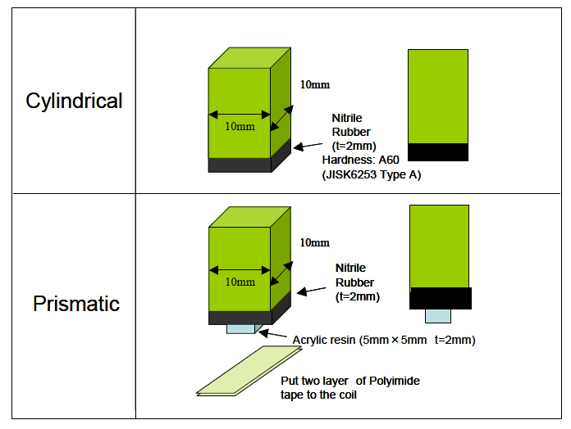
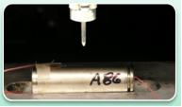
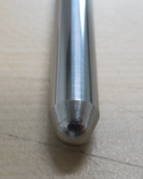
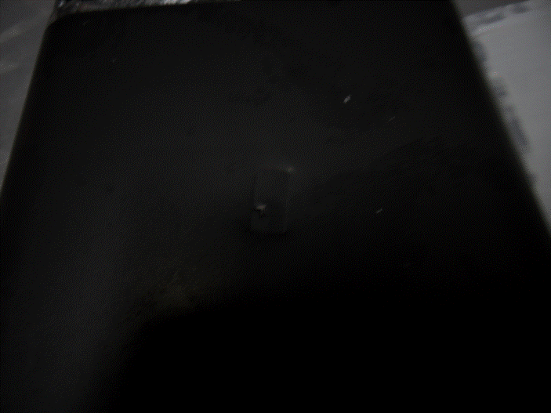
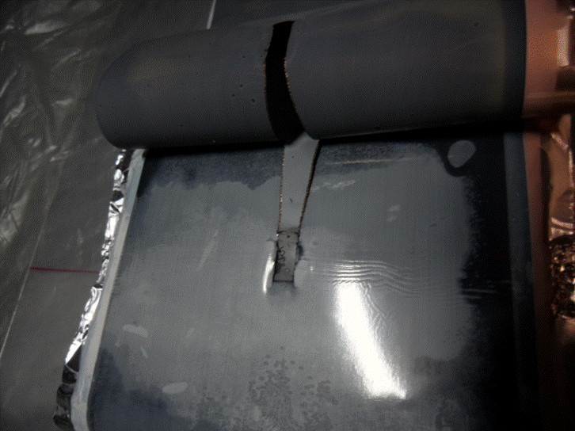
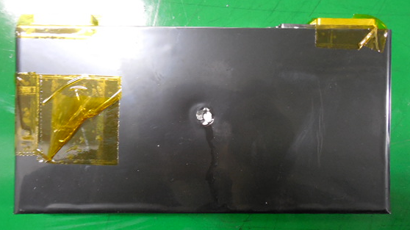
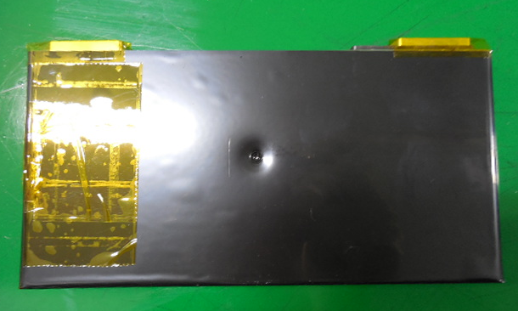
Cell test : Nail penetration
□ Considerations on test methods
Parameters | Particle method | Blunt nail
Test schematics
Test result
Drawbacks | Impossible to produce specified voltage drop with given force limit.(400N, 50mV) Without force limit, cannot make desired internal short ; by case puncture or electrode torn. Reproducibility is low and test control is difficult.
Dia. 6mm
R 2.2mm
Modified for short
w/o puncture
Electrode torn
Puncture
No puncture
Puncture with std indenter
Test stop at 2mV drop(3kN)
(2mV↑ : puncture)
400N, 20mV drop
3000N, 30mV drop

Slide 7
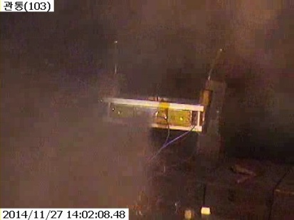
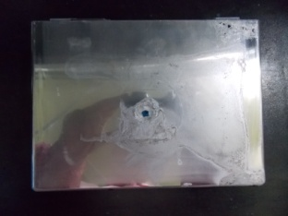
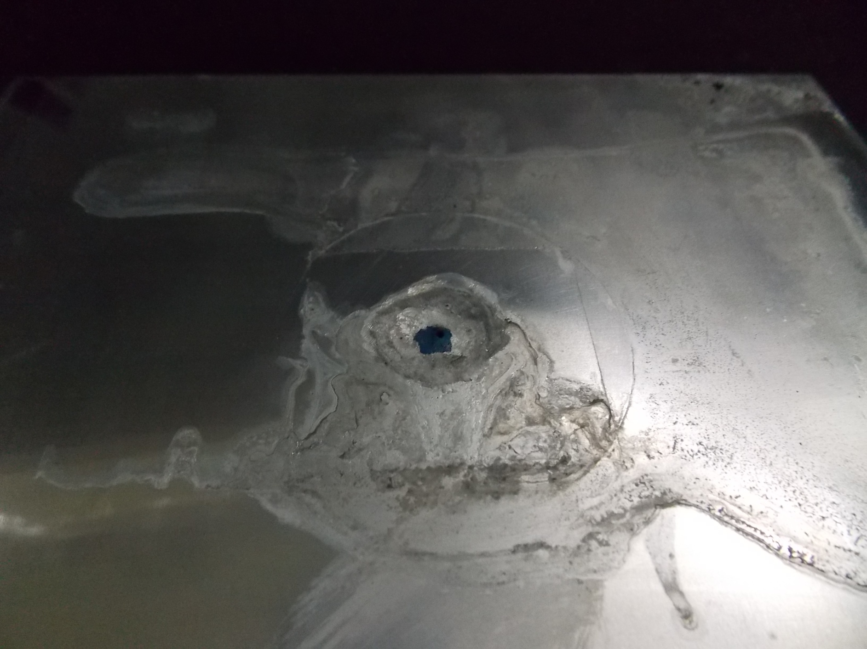
Cell test : Nail penetration
□ Considerations on test methods
Parameters | Pure ceramic | Ceramic nail with metal tip
Test schematics
Short by | electrode burr(nail dia. 3mm) | metal particle + electrode burr↓(nail dia.1mm)
Test result
Benefit | Induce significant internal short for safety testing. Provide good reproducibility
Drawback | Difficult case weakening for third-party test institute. 5mV end condition will lead short on multiple layers. ➔ Precision control required with voltage drop less than 5mV.
Remarks | Short by electrode burr, no short by particle. | Provides good simulation of internal short by particle.
Case weakening required to minimize short by case burr
Case removed to maximize short by tip and minimize case short effect
1st layer
at cell surface
1st layer
at cell surface
.
.
.
.
.
.
.
.
.
.
Test result was dependent to amount of case weakening.
- High-weakened : L3~4
- Mid-weakened : L4
- Not-weakened : L5
Case(grind)
Nail entry point
<Mid weakened : L4>
<Test result : L3>
Case removed area
Ceramic nail with metal tip test simulates internal short by particle & separator damage well.
And also do-able for test institute as well.

Slide 8
Cell test : Nail penetration
□ Conclusion
What abusive condition
does nail penetration test simulate?
Cell
puncture
Hardly happens. ➔ not required.
- Field issues are by vehicle collision or crush.
- System case reinforcement and protecting shield.
Nail
Nail penetration test to be replaced with internal short circuit test.
- Alternative test method can solve safety issue on
tear down process of particle test method
- Without tear down, samples can be used in product state
Internal
short
Parameters |  | Ceramic nail with metal tip
Nail/indenter size |  | 1.0mm
Nail material |  | Ceramic
Tip angle/length |  | 28~45˚, 350μm
Tip/particle material |  | Ni
Test speed |  | ~ 0.1 mm/sec
Location |  | Center
Test stop at | Volt drop | ~ 5mV
Others |  | Case can be weakened

Slide 9
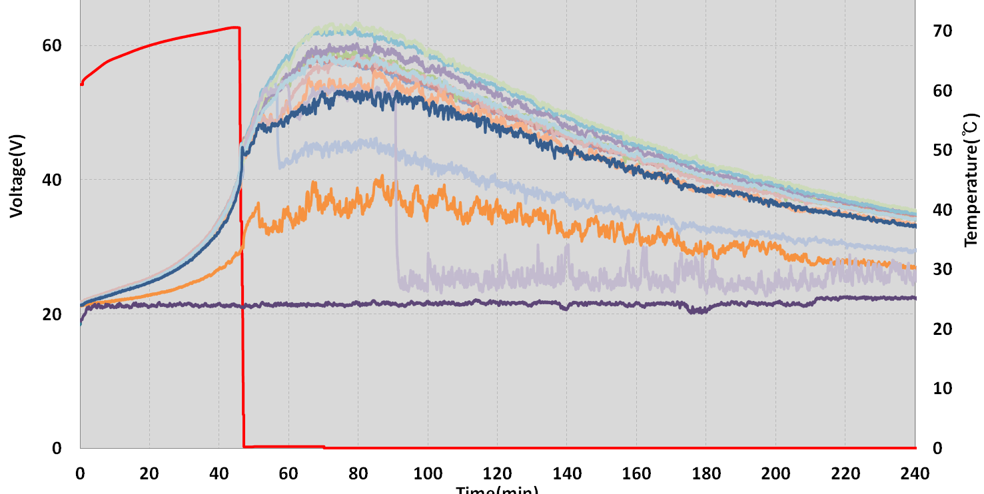
Thermal propagation
□ Propagation area
- Cell can be in un-safety condition, this should not be propagate to total system.
□ Abusive condition
- The cases that system in abusive condition.
Condition | Single cell thermal runaway?
Crush | Multiple cells crushed in field
Internal short | Yes
Over-charge | Multiple cells in abuse condition
Over-discharge
Ext. short
High temp.
Thermal runaway trigger
should be :
Internal
short

Slide 10
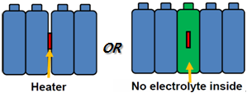
Thermal propagation
□ Test method for thermal runaway trigger
 | Test condition | Drawbacks
Heating | 400W heater within the cells Heating until thermal runaway | Heating power Severity of thermal runaway ∝ heating temperature Max temp. ∝ 1/cell size (constant heater power) ➔ Difficult to specify heater power for various cell design
Overcharge | 1cell overcharging - 1C charging until thermal runaway | Usually multiple cells are exposed in overcharge condition. Not applicable for cells with overcharge protection.
Internal short | Ceramic nail with metal tip - Test on single cell in module - Test condition : same with cell level ceramic nail test. | Same issues with cell test. - Case weakening. - Precision control (less than 5mV).
<Schematic>
Thermal runaway trigger should be internal short circuit test.
Alternative test method of ceramic nail with metal tip can be applicable on module level for propagation test purpose.

