Slide 1
INFO Slides for AVC 10th Session

Slide 2

AVC 10th Session–Visa Application
Visit China Visa Application Service Center website for visa application process and requirements:
https://cova.mfa.gov.cn
Visa Support: Mr. Zhang Miao, zhangmiao@catarc.ac.cn

Slide 3
AVC 10th Session–Transportation
Arriving airport:
Option 1 - Shanghai Hongqiao International Airport
Option 2 - Shanghai Pudong International Airport
Destination (venue):
Shanghai Yingyi Crowne Plaza Hotel
No. 6555 Bo Yuan Road, Jiading District, Shanghai, China
Local transportation:
From Hongqiao Airport, take the metro line10 to Transport University station, then change to line11 to Shanghai Motor City station
From Pudong Airport, take the metro line2 to Jiangsu Road station, then change to line11 to Shanghai Motor City station

Slide 4
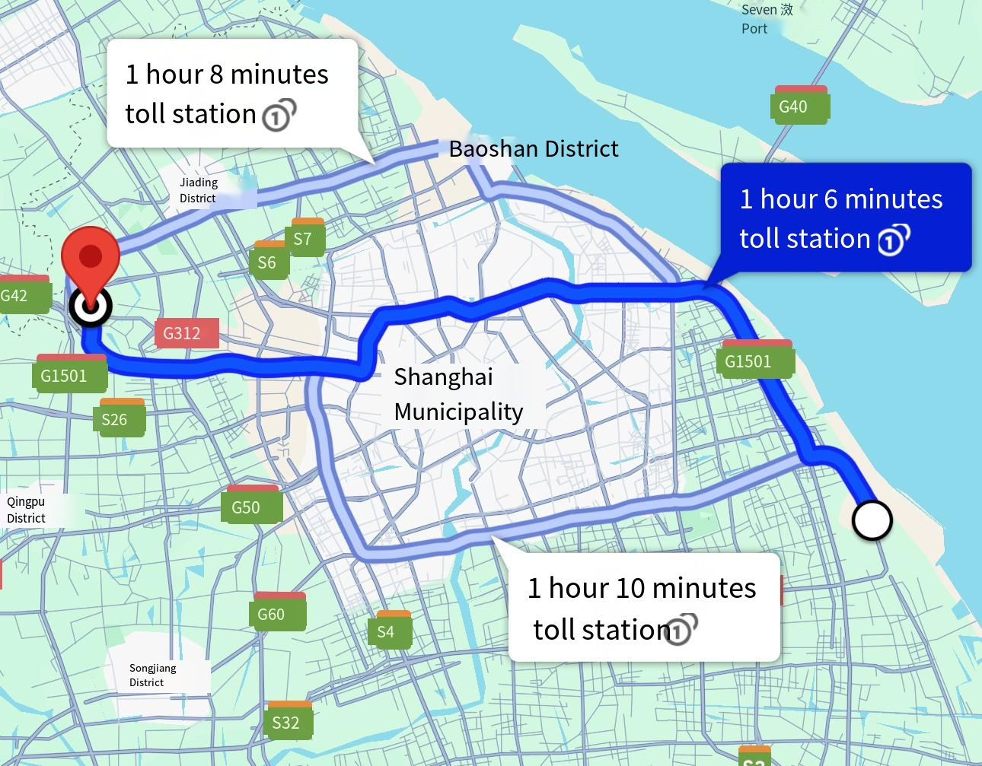
AVC 10th Session–Transportation
MAP For Transportation
Approximately 80 kms

Slide 5

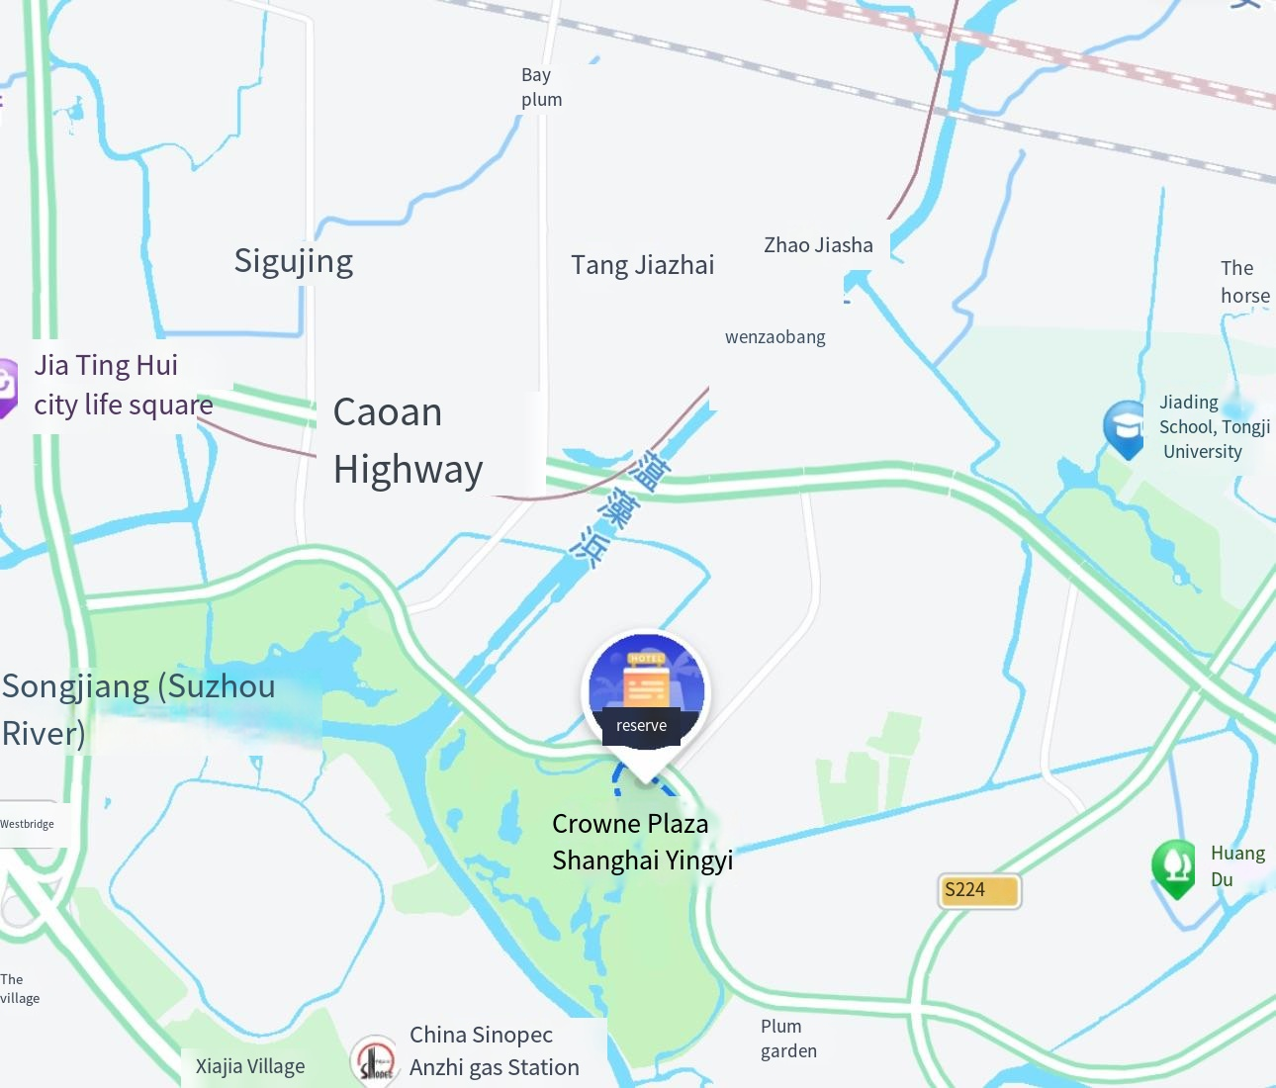
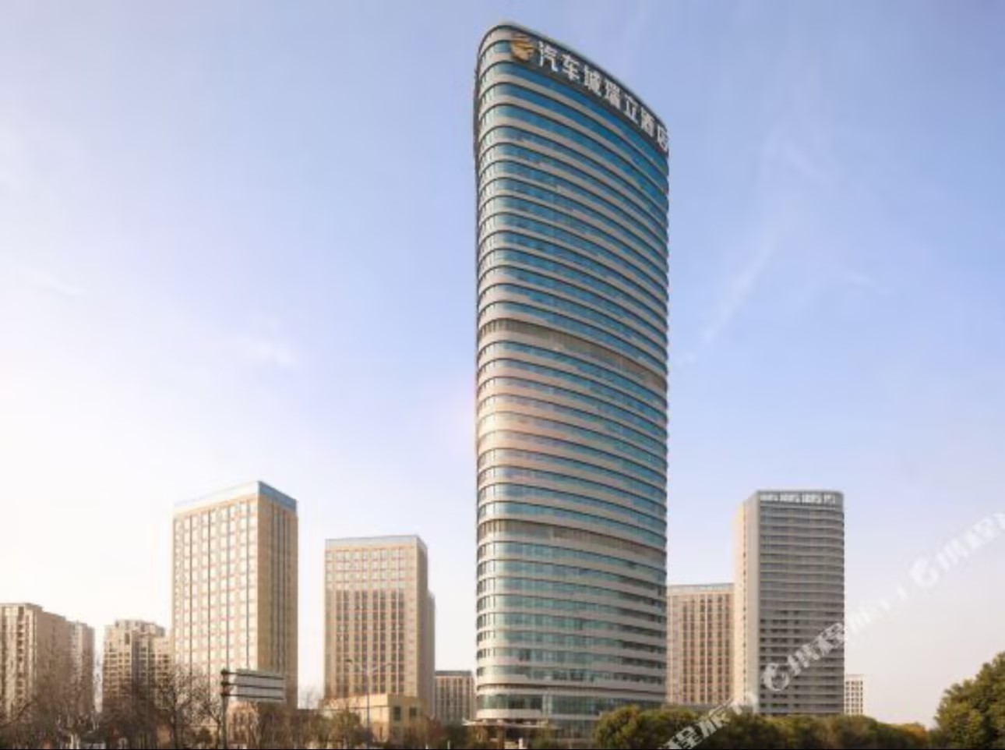
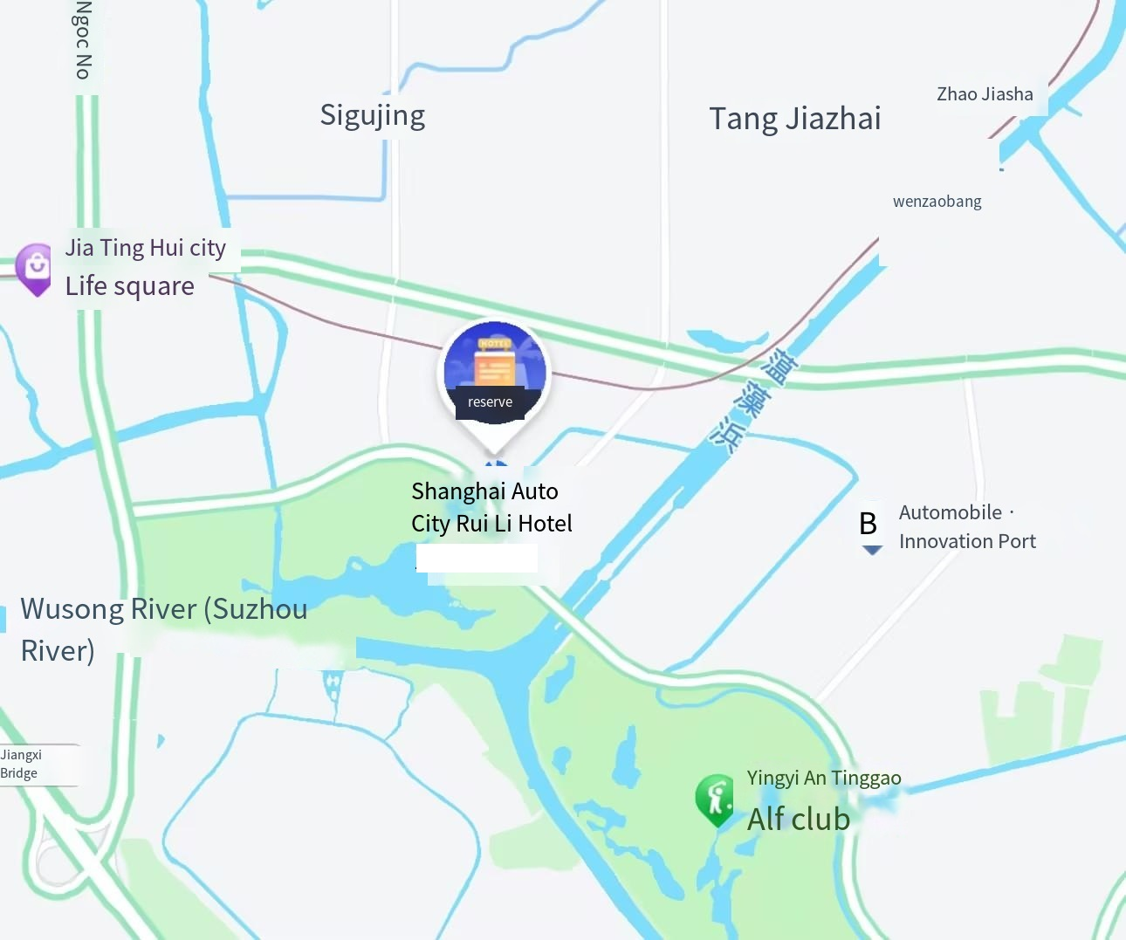
AVC 10th Session-Hotels
Shanghai Yingyi Crowne Plaza Hotel
Location
No. 6555 Bo Yuan Road, Jiading District, Shanghai
Shanghai Automotive City Ruili Hotel
Location
No. 6966, Bo Yuan Road, Jiading District, Shanghai

Slide 6
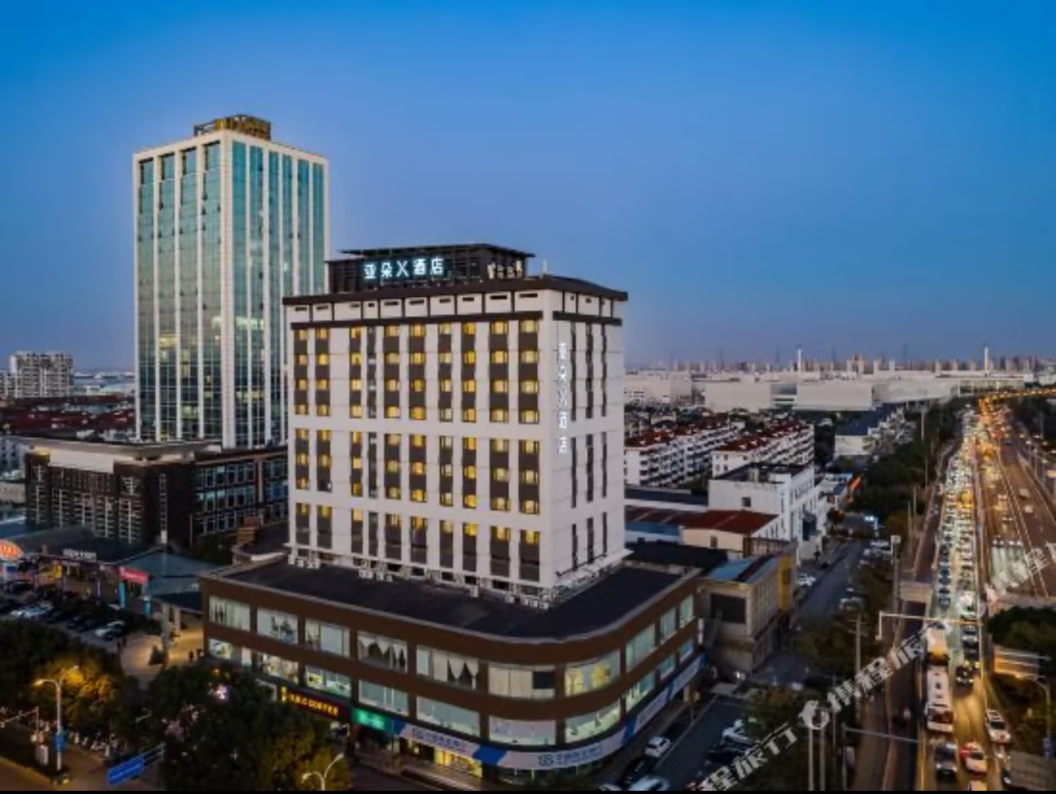
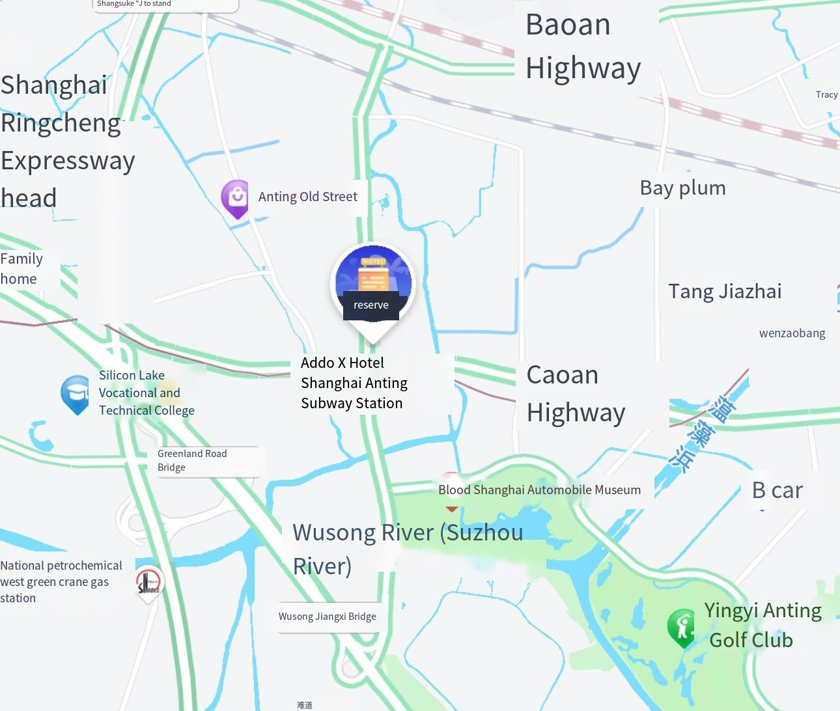
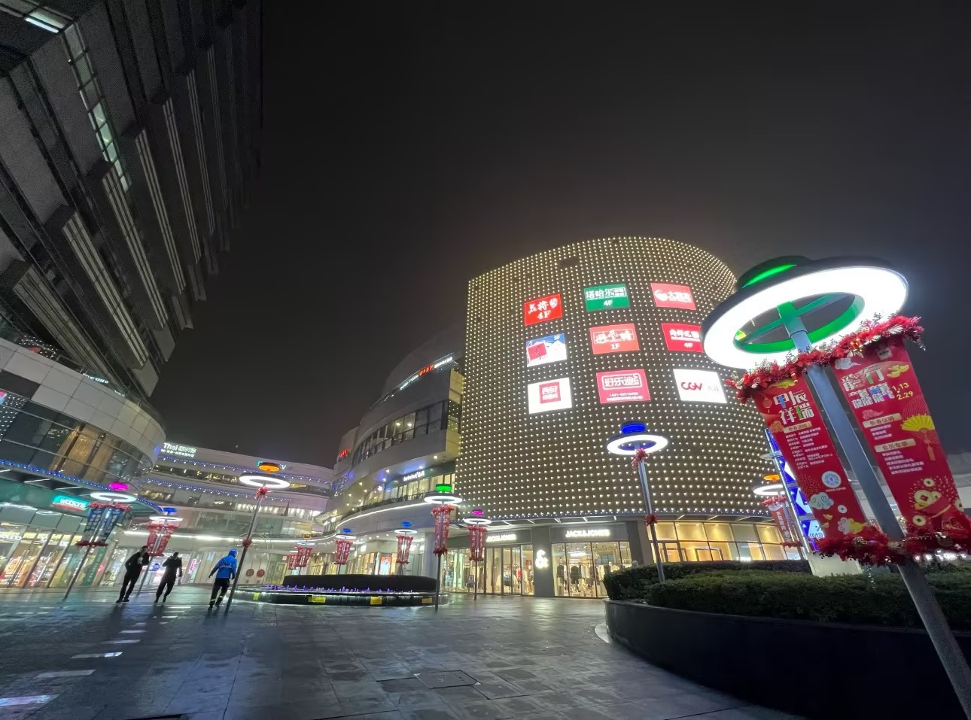
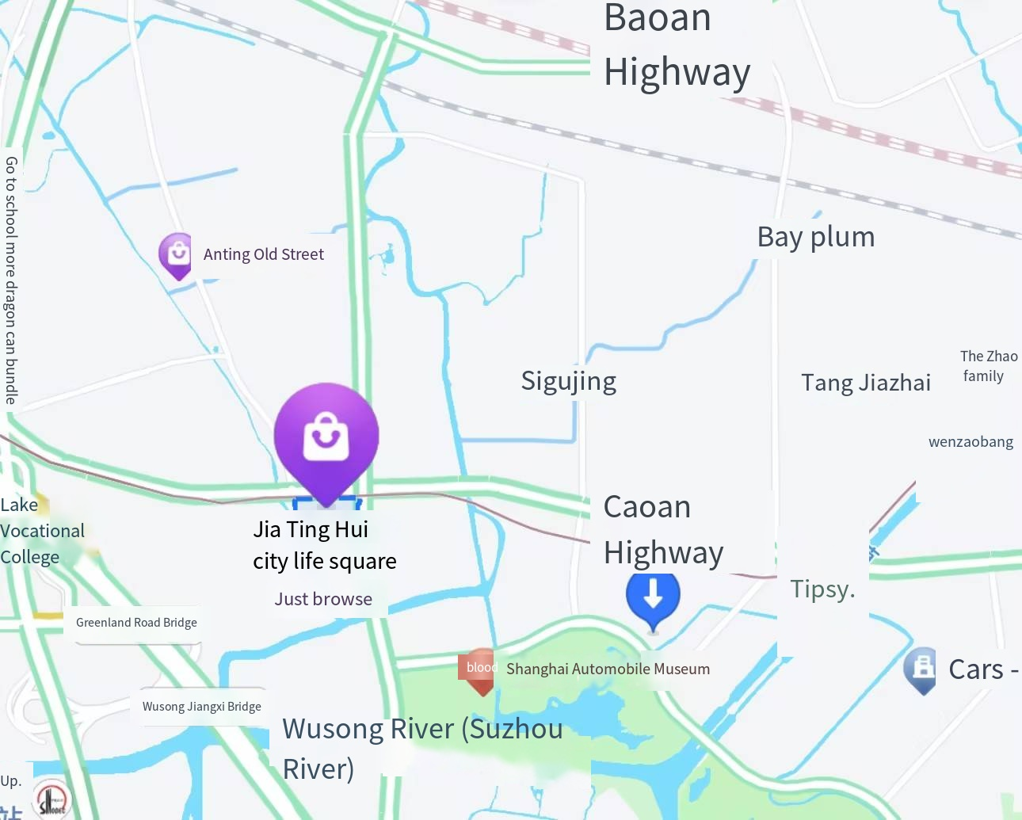
AVC 10th Session–Hotels &Business district
Continued (Hotels)
Atour X Hotel in Anting Metro Station
Location
No. 29 Mowuyu Road, Anting Town, Jiading District, Shanghai (where Mowuyu Road intersects with Caolan Highway)
Business district nearby
Jia Tinghui Urban Life Square
Location
No. 1055-1077, Moyu South Road, Jiading District, Shanghai

Slide 7
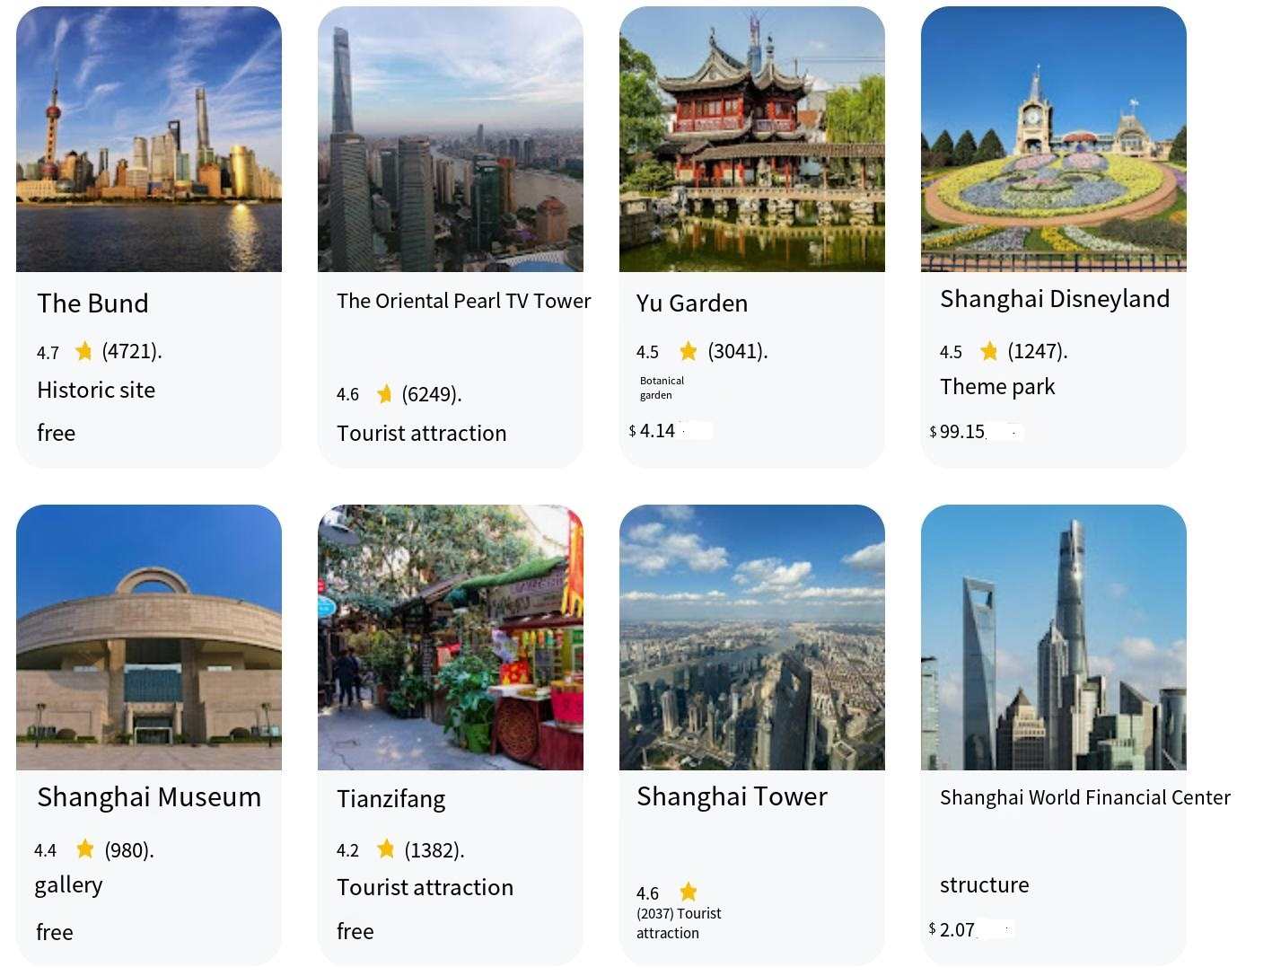
AVC 10th Session–Sights

