Slide 1
TASK FORCE ON AUTOMATED VEHICLE CATEGORISATION (TF-AVC)
Submitted by the Chairs of the Task Force on Automated Vehicle Categorisation (TF-AVC)
Informal document WP29-194- XX
Provisional agenda item XX
WP29 STATUS REPORT II
Copyright 08/11/24, Chairs of TF-AVC, all rights reserved. For reproduction permission and all other issues, please contact geena.rait@dft.gov.uk and thies.weinand@kba.de

Slide 2
TF-AVC progress
Established by 191st WP.29 (Nov 2023)
Meeting 1: Jan 2024 (online)
Meeting 2: Feb 2024 (online)
Meeting 3: March 2024 (hybrid)
  GRSG status report 1 presentation
Meeting 4: April 2024 (online)
Meeting 5: May 2024 (online)
  GRVA status report 1 presentation
Meeting 6: June 2024 (hybrid)
  WP.29 status report 1 presentation
Meeting 7: July 2024 (online)
Meeting 8: September 2024 (online)
Meeting 9: October 2024 (hybrid)
  GRSG status report & informal document presentation
Meeting 10: November 2024 (hybrid)
  WP.29 status report presentation
All relevant documents can be found on the TF-AVC UNECE Wikipage.
Copyright 08/11/24, Chairs of TF-AVC, all rights reserved. For reproduction permission and all other issues, please contact geena.rait@dft.gov.uk and thies.weinand@kba.de

Slide 3
TF-AVC future look
Monthly meetings continue, planned until July 2025
Next meeting: online (2nd December 2024)
  Status report presentation to 194th session of WP.29 in November 2024
  Informal document to 21st session of GRVA in January 2025
  Formal document to 129th session of GRSG in April 2025
  Formal document to 22nd session to GRVA in May 2025
Copyright 08/11/24, Chairs of TF-AVC, all rights reserved. For reproduction permission and all other issues, please contact geena.rait@dft.gov.uk and thies.weinand@kba.de

Slide 4
GRSG Feedback
Submitted informal documents:
  GRSG-128-39 - Rev.1 - Status Report
  GRSG-128-40 - S.R1 draft amendment
  GRSG-128- 41- RE3 draft amendment
Positive feedback on amendments
Proposal to submit formal documents to 129th session of GRSG in April 2025 accepted
Copyright 08/11/24, Chairs of TF-AVC, all rights reserved. For reproduction permission and all other issues, please contact geena.rait@dft.gov.uk and thies.weinand@kba.de

Slide 5
R.E.3 – Definition amendments
Minimal amendments required
Remove references to 'the driver'
Change references to the number of seating positions
2.2. Category M - Power-driven vehicles having at least four wheels and used for the carriage of passengers
2.2.1. "Category M₁": Vehicles used for the carriage of passengers and comprising not more than eight seats in addition to the driver’s seat nine seats.
…
2.2.4. Vehicles of categories M2 and M3 belong to:
2.2.4.1. For vehicles having a capacity exceeding 22 passengers in addition to the driver, 23 occupants, there are three classes of vehicles:
…
Copyright 08/11/24, Chairs of TF-AVC, all rights reserved. For reproduction permission and all other issues, please contact geena.rait@dft.gov.uk and thies.weinand@kba.de

Slide 6
R.E.3 – Category X
New section, aligned with text and format of R.E.3:
2.9. Category X
2.9.1. Definition.
Category X vehicles are vehicles of categories M, N, L and T meeting all of the following conditions:
(a) They are equipped with an ADS
(b) They are not capable of being driven manually at speeds exceeding 6 km/h
(c) They are designed to carry occupants
Copyright 08/11/24, Chairs of TF-AVC, all rights reserved. For reproduction permission and all other issues, please contact geena.rait@dft.gov.uk and thies.weinand@kba.de

Slide 7
R.E.3 – Category Y
New section, aligned with text and format of R.E.3:
2.10. Category Y
2.10.1. Definition.
Category Y vehicles are vehicles of categories N, L and T meeting all of the following conditions:
(a) They are equipped with an ADS
(b) They are not capable of being driven manually at speeds exceeding [6] km/h.
(c) They are not designed to carry occupants at any time
Copyright 08/11/24, Chairs of TF-AVC, all rights reserved. For reproduction permission and all other issues, please contact geena.rait@dft.gov.uk and thies.weinand@kba.de

Slide 8
S.R.1 – Category X and Y
New section, aligned with text and format of S.R.1:
4. [CATEGORY X AND Y] VEHICLES
4.1. “Category X vehicle” means a vehicle of category 1, 2 or 3 which:
i) is equipped with an ADS and
ii) is not capable of being driven manually at speeds exceeding 6 km/h and
iii) is designed to carry (a) person(s)
4.2. “Category Y vehicle” means a vehicle of category 2 or 3 which:
i) is equipped with an ADS and
ii) is not capable of being driven manually at speeds exceeding 6 km/h and
iii) is not designed to carry (a) person(s) at any time
Copyright 08/11/24, Chairs of TF-AVC, all rights reserved. For reproduction permission and all other issues, please contact geena.rait@dft.gov.uk and thies.weinand@kba.de

Slide 9
Items for consideration by WP.29
Copyright 08/11/24, Chairs of TF-AVC, all rights reserved. For reproduction permission and all other issues, please contact geena.rait@dft.gov.uk and thies.weinand@kba.de

Slide 10
Impact on driver licensing
Amendments made to R.E.3 could have an impact on driver licensing under WP.1
For example, by removing the reference to the number of passengers and driver and moving to the total number of occupants:
2.2.4. Vehicles of categories M2 and M3 belong to:
2.2.4.1. For vehicles having a capacity exceeding 22 passengers in addition to the driver, 23 occupants, there are three classes of vehicles:
We ask WP.29 for guidance and to flag these amendments to the relevant groups
Please note that in these amendments, the total number of people possible in the vehicle has not increased
Copyright 08/11/24, Chairs of TF-AVC, all rights reserved. For reproduction permission and all other issues, please contact geena.rait@dft.gov.uk and thies.weinand@kba.de

Slide 11
Guidance for bi-directional vehicles
Would WP.29 like TF AVC to propose a definition for bi-directional vehicles that can then be used by the GR screening groups?
Copyright 08/10/24, Chairs of TF-AVC, all rights reserved. For reproduction permission and all other issues, please contact geena.rait@dft.gov.uk and thies.weinand@kba.de

Slide 12
Sponsor for S.R.1 amendment
In the 128th session of GRSG (October 2024) the process for amending S.R.1 was highlighted
This process includes the requirement for a sponsor country to sponsor S.R.1 amendments
  TF-AVC seeking for a sponsor and would like to ask 1998 agreement contracting parties of the WP.29 to volunteer
S.R.1 changes in accordance to RE3 are important for harmonization and base for GTR´s amendment
Participation of 1998 contracting parties in TF-AVC necessary to aid S.R.1 amendments
Copyright 08/11/24, Chairs of TF-AVC, all rights reserved. For reproduction permission and all other issues, please contact geena.rait@dft.gov.uk and thies.weinand@kba.de

Slide 13
Outcome from WP29
Driver Licensing → 8 or 9 passengers in the vehicle and the relations to driver licensing → WP1 will be informed about the ongoing work of the TF-AVC
  Proposal to perform a consistency check for the terms people, occupant and passenger in RE3 and S.R.1
Bi-directional vehicles → Bidirectional vehicles and Category L vehicels could be considered for a new categorization but not having priority
Sponsor country for amendment of S.R.1 → Sponsor country is necessary for amendment, confirmation of AC.3 is necessary

Slide 14
Tasks for sponsor country for amendment of S.R.1
Support the enforcement of the S.R. 1 amendment
Amendment proposal will be provided by TF-AVC

Slide 15
Thank you, any questions?
Copyright 08/11/24, Chairs of TF-AVC, all rights reserved. For reproduction permission and all other issues, please contact geena.rait@dft.gov.uk and thies.weinand@kba.de

Slide 16
Confirmed Meeting Schedule / Deliverables: Nov - Dec 2024
7th Meeting
22nd July
(Online only)
8th Meeting
16th September
(Online only)
9th Meeting
1st & 2nd October
(Hybrid | Hamburg)
10th Meeting
7th & 8th November
(Hybrid | Shanghai)
11th Meeting
2nd December
(online)
Jul 24
Sep 24
Oct 24
Nov 24
Dec 24
Status Report to
GRVA
23th – 27th September
Status Report to
WP.29
11th – 15th November
Status Report and informal document presentation to
GRSG
7th – 11th October
Copyright 08/11/24, Chairs of TF-AVC, all rights reserved. For reproduction permission and all other issues, please contact geena.rait@dft.gov.uk and thies.weinand@kba.de

Slide 17
Provisional Meeting Schedule / Deliverables: Jan - June 2025
12th Meeting
8th & 9th January
(hybrid)
13th Meeting
10th February
(online)
14th Meeting
10th March
(online)
15th Meeting
1st & 2nd April
(online)
16th Meeting
12th &13th May
(online)
17th Meeting
3rd & 4th June
(online)
Jan 25
Feb 25
Mar 25
Apr 25
May 25
Informal document to
GRVA
(20th – 24th Jan)
Submit formal document to GRSG
Formal document to
GRVA
(14th Feb)
Informal document
WP.29 - 195
(4th-7th March)
Formal document
GRSG
(7th – 11th April)
Formal document
GRVA
(June)
Copyright 08/11/24, Chairs of TF-AVC, all rights reserved. For reproduction permission and all other issues, please contact geena.rait@dft.gov.uk and thies.weinand@kba.de

Slide 18

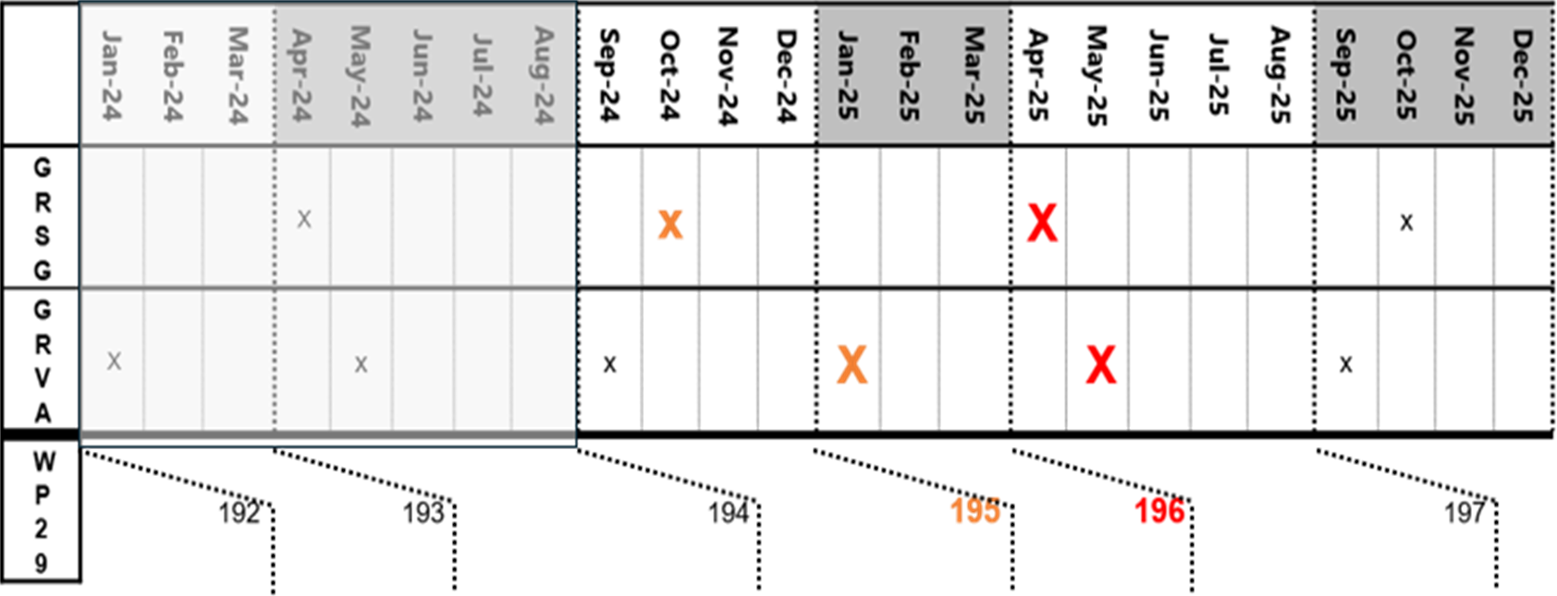
X: Informal document
X: Formal document
196
197
Copyright 08/11/24, Chairs of TF-AVC, all rights reserved. For reproduction permission and all other issues, please contact geena.rait@dft.gov.uk and thies.weinand@kba.de

