Slide 1
The Status of Korea’s School bus and relevant regulations
CLIV-3-xx
Submitted by Korea
The 3rd CLIV IWG,
20. June. 2024
Korea Automobile Testing and Research Institute

Slide 2
Definition of School bus in Korea
Road Traffic Act, Article 2 (Definition)
23. The term "school bus for children" means a motor vehicle used for transport, etc. of children to and from an establishment for education (excluding transport for occasional educational activities such as field experiential learning) of children (referring to persons under the age of 13; hereinafter the same shall apply) among the following establishments, and a motor vehicle for passenger transport business operated for children as its passengers after obtaining a restricted license for the passenger transport business
Kindergartens and early childhood education and development institutes provided for in the Early Childhood Education Act, elementary schools, special schools, alternate schools, and foreigners' schools provided for in the Elementary and Secondary Education Act;
(b) Childcare centers provided for in the Infant Care Act;
(c) Private teaching institutes and schools established pursuant to the Act on the Establishment and
Operation of Private Teaching Institutes and Extracurricular Lessons;
(d) Sports facilities established pursuant to the Installation and Utilization of Sports Facilities Act;
(e) Child welfare facilities defined in the Child Welfare Act (excluding specialized child protection agencies);

Slide 3
Definition of School bus in Korea
Road Traffic Act, Article 2 (Definition)
(f) Youth training facilities under the Youth Activity Promotion Act;
(g) Facilities for the welfare of persons with disabilities (excluding occupational rehabilitation facilities for
persons with disabilities) under the Act on Welfare of Persons with Disabilities;
(h) Public Libraries under the Libraries Act;
(i) City/Do institute for lifelong education and Si/Gun/Gu lifelong study halls under the Lifelong Education Act;
(j) Social welfare facilities, or social welfare centers under the Social Welfare Services Act;
Road Traffic Act, Article 52 (Reporting on School Buses for Children)
Each person who intends to operate a school bus for children (excluding motor vehicles for passenger transport
business operated for children as its passenger after obtaining a restricted license for passenger transport
business under Article 4 (3) of the Passenger Transport Service Act), shall pre-report such intention to the chief of
the competent police station, as prescribed by Ordinance of the Ministry of the Interior and Safety, and receive a c
certificate of reporting from him or her

Slide 4
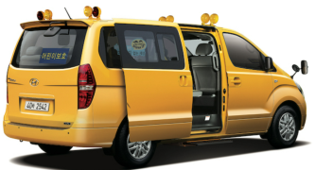
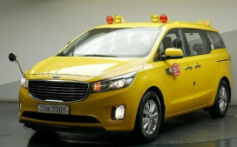
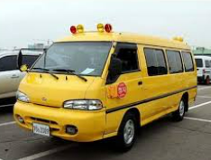
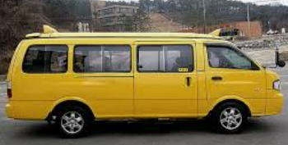
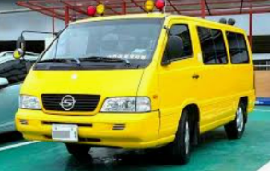
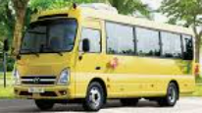
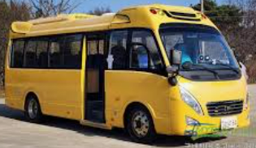
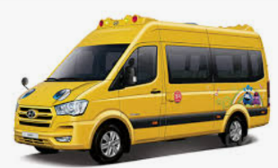
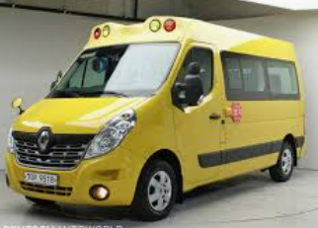
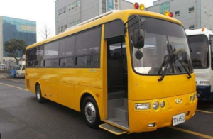
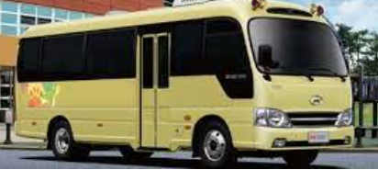
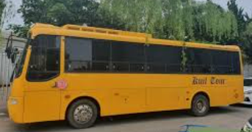
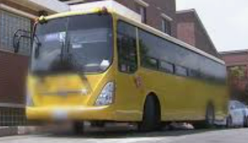
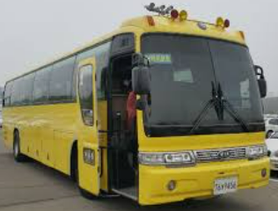
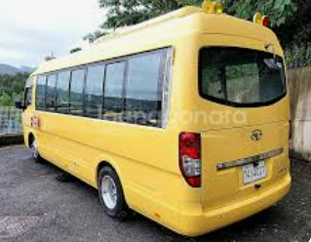
Status of operating school buses
Number of School buses : 83,090 units (official statistics, Sept. 2020)
Breakdown by size & model : 60,000 units (69%), 15 passengers or less
Seating capacity | Number of unit | Proportion | Vehicle models
15 or less | 56,960 | 69% | Strax : 49,717(87%) Canival : 3,659(6%) Grace: 940(2%) Bongo : 828(1%) Istana coach : 615(1%)
16~ 35 or less | 12,841 | 15% | County : 10,118(79%) Restar : 2,423(19%) Solaty : 62 (0%) Master : 58대(0%) Others : 180(1%)
36~ | 13,289 | 16% | County long : 6,624(50%) Aerotown : 1,800(14%) Aerocity : 1,183(9%) Grandbird : 829(6%)Resta : 766(6%)
Total | 83,090 | 100%

Slide 5
Status of operating school buses
Registration status by facility: 250,000 total facilities (official statistics, Sept. 2020)
Facility Name | Number of Facilities | Number of school buses | Proportion
Kindergarten | 8,837 | 16,258 | 11%
Child Daycare center | 37,371 | 37,727 | 26%
Private education institute | 80,937 | 38,584 | 27%
Elementary school | 6,087 | 8,714 | 6%
Special schools | 177 | 1,279 | 1%
Athletics/Other | 56,854 | 16,615 | 12%
Office of early childhood Education | 16 | - | -
Alternative schools | 243 | - | -
Foreign School | 41 | - | -
Private Classroom | 41,098 | - | -
Child welfare facilities | 4,000 | 4,000 | 3%
Youth retreat centers | 817 | 327 | 0.2%
Welfare Facility for the disabled | 775 | 298 | 0.2%
Public libraries | 775 | - | 0%
Institute of continuing education | 240 | - | 0%
Social services | 473 | 473 | 0.3%
Private physical education | 10,743 | 18,095 | 13%
Total | 249,484 | 142,370* | 100%
* The number is slightly different from the current umber of reported vehicles(83 thousands) due to the inclusion of scrapped vehicles

Slide 6
Accident Data in Korea
Statistics of accident and death by left in school buses
Year | 2011 | 2012 | 2013 | 2014 | 2015 | 2016 | 2017 | 2018 | Sum
Accident | 1 | 0 | 0 | 0 | 0 | 3 | 3 | 2 | 9
Death | 1 | 0 | 0 | 0 | 0 | 1 | 0 | 1 | 3
Accident details
When (Month, year) | Where | Age | Gender | Vehicle Type | Circumstance | Others
July, 2016 | Gwangju | 4 years | Male | School bus | Left by Kindergarten | Coma @ accident
July, 2018 | Dongducheon, Gyeonggi-do | 4 years | Female | School bus | Left by Nursery
- 6 -

Slide 7

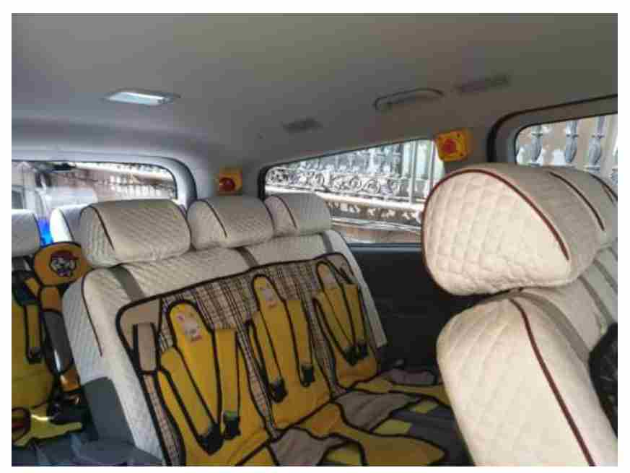
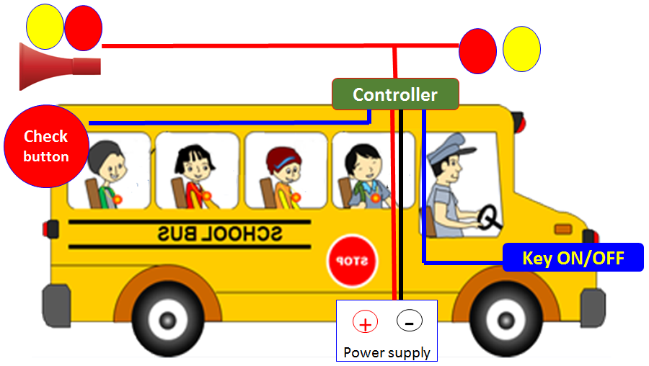
Regulation in KMVSS
Amended Vehicle Safety Regulation(KMVSS*)
* KMVSS : Korean Motor Vehicle Safety Standards
Article 53-4 (System for confirming children’s getting off)
Application: school bus
Regulation: After turning off the engine of school bus, if the device installed at the back of the bus is not pushed within 3 minutes, alarm and light will go off.
Enactment date: 21 March 2019
Enforcement date: 17 April 2019
Checking bell
Emergency button
Option
Regulation + emergency button
Regulation + motion sensor
- 7 -

Slide 8
Regulation in KMVSS
KMVSS Article 53-4
Article 53-4 (System for confirming Children's getting off) ① A bus carrying children shall have the system for confirming children's getting off, satisfying the following requirements, which ensure no child is left in the vehicle.
If the confirmation button (including near-field radio contact) installed near the seat in the rearmost row of the car is not pressed within three minutes after a vehicle stopped or the key of the starter is removed from the operating position, the warning sound generator and indicator lamp(referring to the Hazard warning signal under Article 45 or the indicator under Article 48 (4)) shall be operated.
2. If the warning sound generator and indicator lamp pursuant to subparagraph 1 are activated, press the
confirmation button (including near-field radio contact) or restart the motor of the vehicle
(excluding starting by auxiliary starting device under Article 13 (6)) to stop the engine.
3. The warning sound generator referred to in subparagraph 1 shall meet the following standards:
A. The warning sounds should be on and off repeatedly, and the sound of the same tone should be
generated at regular intervals.
B. The intensity of warning sound shall be greater than 60 decibels (A) when measured at a locations 2
meters from the front or rear end of the vehicle.
- 8 -

Slide 9
감사합니다.
Thank you for your attention.
hyoungu35@kotsa.or.kr

