Slide 1
TASK FORCE ON AUTOMATED VEHICLE CATEGORISATION (TF-AVC)
Submitted by the chairs of the AVC task force
Document ADS-05-22
5th ADS IWG session
9-13 December 2024
IWG-ADS: STATUS REPORT 1
Copyright 05/12/24, Chairs of TF-AVC, all rights reserved. For reproduction permission and all other issues, please contact geena.rait@dft.gov.uk and thies.weinand@kba.de

Slide 2
Latest Achievements
R.E.3 and S.R.1 amendment proposals are nearly finalised
Category X and Y definitions are unchanged from the last report to IWG-ADS
Positive feedback from GRSG regarding the amendment proposals for R.E.3 and S.R.1 (presented as informal documents at 128th session of GRSG, October 2024)
Q&A document to accompany the submission of the R.E.3 and S.R.1 amendment proposals
All relevant documents can be found on the TF-AVC UNECE Wikipage.
Copyright 05/12/24, Chairs of TF-AVC, all rights reserved. For reproduction permission and all other issues, please contact geena.rait@dft.gov.uk and thies.weinand@kba.de

Slide 3
TF-AVC future look
Monthly meetings continue, planned until July 2025
Next meeting: hybrid in Berlin - Germany (8th & 9th January 2025)
  Status report presentation to 5th session of IWG on ADS in December 2024
  Informal document to 21st session of GRVA in January 2025
  Formal document to 129th session of GRSG in April 2025
  Formal document to 22nd session to GRVA in May 2025
Phase 2 discussions to begin, Jan 2025 onwards:
  Bi-directional vehicle definition
  Small shuttles, with standees
Copyright 05/12/24, Chairs of TF-AVC, all rights reserved. For reproduction permission and all other issues, please contact geena.rait@dft.gov.uk and thies.weinand@kba.de

Slide 4
Items for Awareness
TF-AVC still seeking a sponsor country for the S.R.1 amendment
  Support the enforcement of the S.R.1 amendment
  Amendment proposal will be provided by TF-AVC
TF-AVC has proposed definitions to ensure consistency across the different GRs and their regulations, e.g. ADS feature type definitions
Copyright 05/12/24, Chairs of TF-AVC, all rights reserved. For reproduction permission and all other issues, please contact geena.rait@dft.gov.uk and thies.weinand@kba.de

Slide 5
Thank you, any questions?
Copyright 05/12/24, Chairs of TF-AVC, all rights reserved. For reproduction permission and all other issues, please contact geena.rait@dft.gov.uk and thies.weinand@kba.de

Slide 6

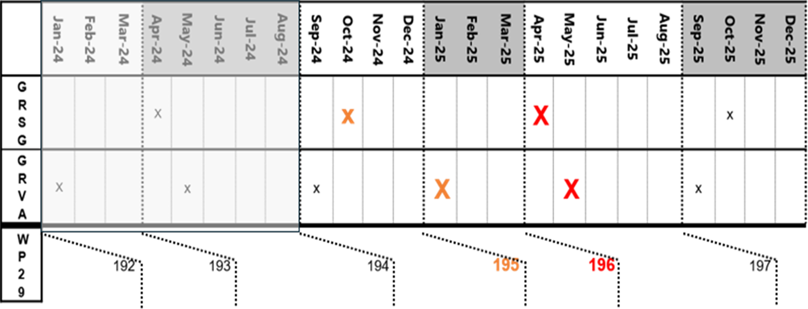
X: Informal document
X: Formal document
196
197
Copyright 05/12/24, Chairs of TF-AVC, all rights reserved. For reproduction permission and all other issues, please contact geena.rait@dft.gov.uk and thies.weinand@kba.de

Slide 7
Confirmed Meeting Schedule / Deliverables: Jan - June 2025
12th Meeting
8th & 9th January
(hybrid)
13th Meeting
10th February
(online)
14th Meeting
10th March
(online)
15th Meeting
1st & 2nd April
(online)
16th Meeting
12th &13th May
(online)
17th Meeting
3rd & 4th June
(online)
Jan 25
Feb 25
Mar 25
Apr 25
May 25
Informal document to
GRVA
(20th – 24th Jan)
Submit formal document to GRSG
Formal document to
GRVA
(14th Feb)
Informal document
WP.29 - 195
(4th-7th March)
Formal document
GRSG
(7th – 11th April)
Formal document
GRVA
(June)
Copyright 05/12/24, Chairs of TF-AVC, all rights reserved. For reproduction permission and all other issues, please contact geena.rait@dft.gov.uk and thies.weinand@kba.de

Slide 8
Category X and Y
New sections, aligned with text and format of R.E.3:
2.9. Category X
2.9.1. Definition.
Category X vehicles are vehicles of categories M, N, L and T meeting all of the following conditions:
(a) They are equipped with an ADS
(b) They are not capable of being driven manually at speeds exceeding 6 km/h
(c) They are designed to carry occupants
2.10. Category Y
2.10.1. Definition.
Category Y vehicles are vehicles of categories N, L and T meeting all of the following conditions:
(a) They are equipped with an ADS
(b) They are not capable of being driven manually at speeds exceeding 6 km/h.
(c) They are not designed to carry occupants at any time
Similar approach taken for S.R.1
Copyright 05/12/24, Chairs of TF-AVC, all rights reserved. For reproduction permission and all other issues, please contact geena.rait@dft.gov.uk and thies.weinand@kba.de

