Slide 1

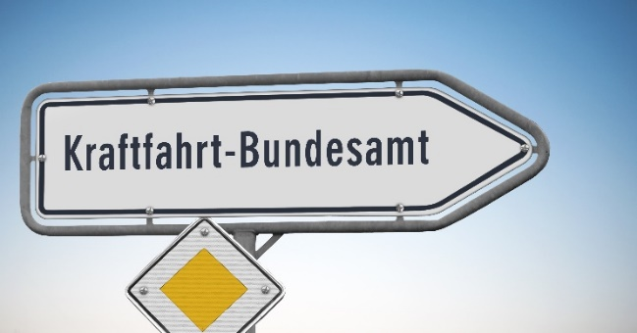
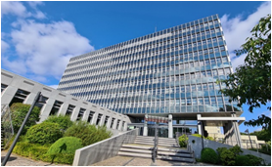


Assessment guide with requirements and assessment criteria for granting an approval of defined operating areas
Document ADS-05-23
5th ADS IWG session
9-13 December 2024

Slide 2
Content
Laws and regulations
Operating areas and their approval
Assessment guide

Slide 3

Laws and regulations - overview
Laws and regulations that apply for the type approval authority in Germany in the context of autonomous driving:
  National level:
    StVG → German Road Traffic Act
    AFGBV → Regulation on the approval and operation of motor vehicles with autonomous driving functions in defined operating areas
  EU level:
    Regulation (EU) 2018/858
    Regulation (EU) 2022/1426

Slide 4
Laws and regulations – process level 4
Vehicle approval (operating permit): The type approval authority issues an operating permit based on general requirements in the AFGBV or EU 2022/1426 and requirements specific to the vehicle’s operating design domain.
Step 1
Step 2
Approval of defined operating area: The operational area (limited to geographic area) is approved by a federal state authority.
Issuing of vehicle registration: Based on both approvals (and a third party motor insurance cover in accordance with the German Compulsory Insurance Act) the level 4 vehicle registration is issued by a federal state authority.
Step 3

Slide 5
Laws and regulations – process level 4
Requirements for approval Step 1:
Functional e.g. for save driving and emergency reactions
Technical e.g. for communication with infrastructure needed for operation
Operational e.g. for monitoring and owner/technical oversight (outside vehicle)
Inspection e.g. for regular inspections
Fulfillment is verified based on a multi pillar approach (Audit and Assessment, Simulation, Real world test drive)
1.
Vehicle approval
(operating permit) by the Federal Motor Transport Authority (Kraftfahrt-Bundesamt, KBA)

Slide 6
Laws and regulations – process level 4
2.
Operating areas and their approval
by the responsible federal state authority or the Autobahn GmbH
Requirements for approval Step 2:
Verification that the vehicle on the defined operating area is able to adapt fully to L4 driving
Requirements for approval Step 3:
Registration for level 4 vehicles in the same manner as normal vehicles – given requirements of step 1 and 2 are fulfilled; In this respect, the licensing authority only checks the completeness of the documents, no more substantive examination.
3.
Common registration procedure (allocation of reg. number, handover of vehicle documents);
Step 1 and 2 approvals must be presented

Slide 7
Step 2 - Operating areas and their approval
A operating area defined for a motor vehicle with autonomous driving function has to be approved by the responsible federal state authority / Autobahn GmbH in accordance with § 9 AFGBV.
  16 federal state authorities are responsible for granting operating areas approvals
  Autobahn GmbH is responsible for highway operating areas approvals
→ Conclusion: Harmonized process is necessary to establish standards, processes and forms
→ Also applies to vehicles with a type approval in accordance with Regulation (EU) 2018/858 in conjunction with VO(EU) 2022/1426

Slide 8
Assessment guide with requirements and assessment criteria for granting an approval of defined operating areas
Released by the Federal Ministry for digital and transport in Germany on behalf of the federal states
Describing the procedure how to approve the applied operating area by a federal state authority with support of a technical service
Compare the defined operating area with the ODD of the vehicle equipped with an ADS
In case of deviations between the ODD and the operation area the operation area will be restricted or the driving function has to be extended
Driving tests can be requested by the federal state authority to verify a neuralgic point
A driving catalog is annexed

Slide 9
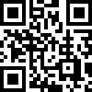
Legal notice
Publisher:
Kraftfahrt-Bundesamt
24932 Flensburg
Internet: www.kba.de
Special information and advice:
Phone: +49 461 316-0
Fax: +49 461 316-1650
E-mail: af@kba.de
Version: September 2022
Picture Source: KBA, Adobe Stock
All rights reserved. Reproduction and dissemination of this publication, including in parts or in digital form, is permitted provided the Kraftfahrt-Bundesamt is acknowledged as its source. This includes the dissemination of contents of this publication that have been obtained indirectly.
© Kraftfahrt-Bundesamt, Flensburg
/

