Slide 1
ADS-IWG Phase 2
Testing provisions
ADS-IWG 5th session
Seoul - 09-13/12/2024
Biagio Ciuffo, Rino Brouwer

Slide 2
Updates from the testing sub-group
5 meetings since ADS-IWG 4th meeting (London)
  Growing interest -> ca. 30 participants
Developed structure and agreed interactions with Assessment OPI
Developed first version of the testing provisions section mainly using GRVA-20-36e as basis

Slide 3
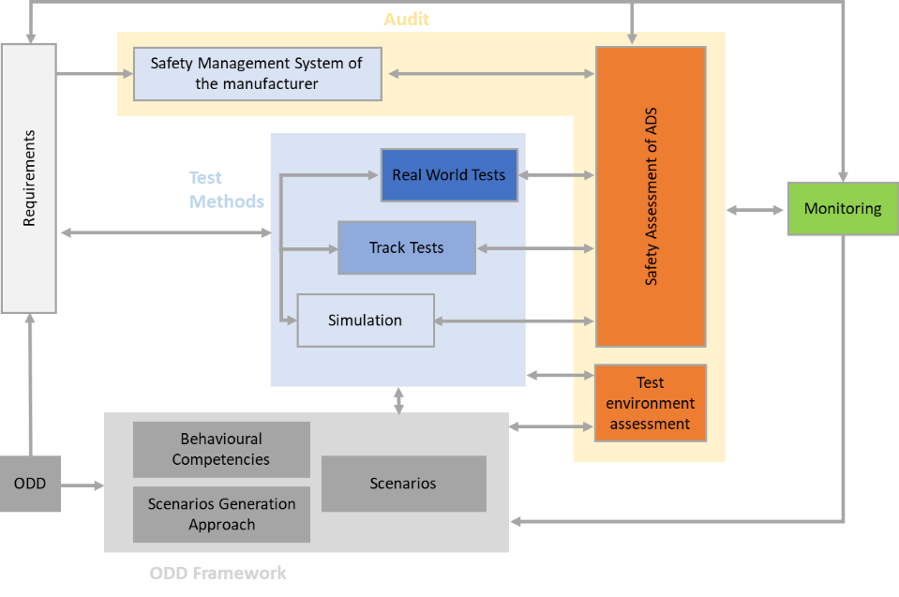
Multi-pillar approach (GRVA-20-36e)

Slide 4
Scope of Testing section (and related topic)

Slide 5
Structure of the document (ADS-05-16)

Slide 6
Legend
Notation used throughout the text
  Text in black -> (bold if different from GRVA-20-36e) text revised by the group but consensus not yet sought/achieved
  Highlighted green -> consensus text
  Highlighted yellow -> text for which references with other parts of the regulation need to be checked
  Text in red -> (bold if different from GRVA-20-36e) text proposed by OPI and not revised by the group
  Text in italic -> chapters for which no text proposal has been submitted by the OPI

Slide 7
Structure of the document (ADS-05-16) -> L1
Assessment by [authority/assessor]
  X -> Assessment of the safety case testing activities
  X+1 -> Confirmatory testing

Slide 8
Structure of the document (ADS-05-16) -> L2
Assessment by [authority/assessor]
  X -> Assessment of the safety case testing activities
    X.1 -> Assessment of the test environment
    X.2 -> Assessment of the scenarios and their management
    X.3 -> Assessment of the processes in place for testing
    X.4 -> Assessment of DDT testing evidence
    X.5 -> Assessment of ADS user testing evidence
  X+1 -> Confirmatory testing by [authority/assessor]
    X+1.1 -> Track tests
    X+1.2 -> Real-world tests

Slide 9
Structure of the document (ADS-05-16) -> L3
Assessment by [authority/assessor]
  X -> Assessment of the safety case testing activities
    X.1 -> Assessment of the test environment
      X.1.1 -> Appraisal of the physical test environment
      X.1.2 -> Appraisal of the credibility framework developed by the manufacturer for virtual testing
    X.2 -> Assessment of the scenarios and their management
      X.2.1 -> Assessment of the scenario generation process
      X.2.2 -> Assessment of scenario coverage and completeness
      X.2.3 -> Assessment of scenario representativeness (selection and characterization including behavioral competences)

Slide 10
Structure of the document (ADS-05-16) -> L3
Assessment by [authority/assessor]
  X -> Assessment of the safety case testing activities
    X.3 -> Assessment of the processes in place for testing
      X.3.1 -> Assessment of processes in place for DDT testing
      X.3.2 -> Assessment of processes for ADS user testing
    X.4 -> Assessment of DDT testing evidence
      X.4.1 -> General testing assessment
      X.4.2 -> Assessment of virtual tests
      X.4.3 -> Assessment track testing
      X.4.4 -> Assessment of real-worl testing

Slide 11
Structure of the document (ADS-05-16) -> L3
Assessment by [authority/assessor]
  X -> Assessment of the safety case testing activities
    X.5 -> Assessment of ADS user testing evidence
      X.5.1 -> Assessment of the research performed in the user centered design process.

Slide 12
Structure of the document (ADS-05-16) -> L3
Assessment by [authority/assessor]
  X+1 -> Confirmatory testing by [authority/assessor]
    X+1.1 -> Track tests
      X+1.1.1 -> Mandatory tests
      X+1.1.2 -> Repetition of tests carried out by the manufacturer
      X+1.1.3 -> Execution of additional tests with respect to those carried out by the manufacturer
    X+1.2 -> Real-world tests
      X+1.2.1 -> Minimum requirements for the real-world tests to be carried out by the authority

Slide 13
Next steps
Completion of first regulatory text draft up to Level 4/5 (December 2024)
Review and finalization of the text up to Level 4/5 (February 2025)
Open points
  Identification of missing parts
  Assessment of the need for more levels (i.e. higher level of details) in the regulatory text
  Establishment of the correct links with the other parts of the regulatory text
  …
The group is confident that finalization of the work by April is possible

Slide 14

Thank you
Notes:
Update/add/delete parts of the copy right notice where appropriate.
More information: https://myintracomm.ec.europa.eu/corp/intellectual-property/Documents/2019_Reuse-guidelines%28CC-BY%29.pdf

