Slide 1
ADS-IWG Phase 2
Simulation credibility
Requirements and assessment
ADS-IWG 5th session
Seoul - 09-13/12/2024
Biagio Ciuffo, Riccardo Donà

Slide 2
Summary
3 meetings since ADS-IWG 4th (London)
  Further round of review on Phase 1 text
  Brainstorming on assessment
Completed the review of the draft provisions from ID (GRVA-20-36e)
  Most of requirements are direct transposition from ID
  Some “NEW” requirements albeit inspired by ID
Started the draft of assessment provisions (high-level requirements)
Re-arranged in Table format with reference to ID (traceability)
Consolidated text since summer with only minor amendments

Slide 3
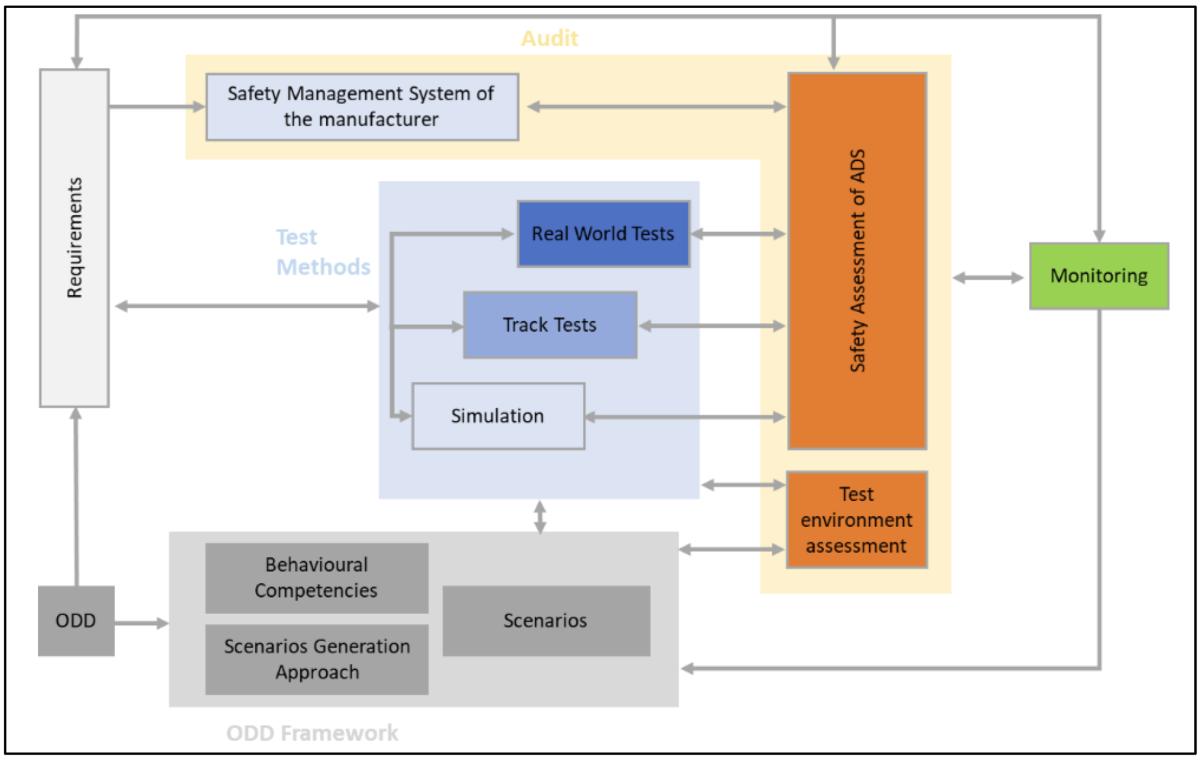
What is “credibility”
Qualify a testing toolchain (virtual/physical/mixed) to provide trustable results
Concept derived from NASA STD7009A/B as part of VMAD SG2
Other sectors/industries started to use similar approach
Main idea: move beyond validation (i.e. sim results match real data)
Adapted to fit multipillar approach
Notes:
Group participation not huge

Slide 4
Status of work
Assessor to ask for specific virtual tests to be carried out (link with testing)
Covered by current provisions
Assessor to review credibility framework

Slide 5
Text structure
Section 3: Definitions:
  4 entries: 2 unchanged since London, 1 modified, 1 new
Section 4: General requirements:
  3 entries: unchanged since London
Section 5: Manufacturer requirements:
  54 entries: minor changes since London
Section 6: Assessment requirements:
  3 entries: unchanged since London

Slide 6
Definitions
3.1.33. “Simulation” means the imitation of the operation of a real-world process or system over time. | 3.34. “Simulation” means the imitation of the operation of a real-world process or system over time utilizing a software implementation for some (or all) of the models, tools or test environment. | OPI: not changed from London
3.1.34. “Simulation toolchain” means a combination of simulation tools that are used to support the validation of an ADS. | 3.35. “Simulation toolchain” means a simulation tool or a combination of simulation tools that are used to generate evidence supporting the manufacturer’s safety case’s claims | OPI: not changed from London
3.1.44. “Virtual testing” means the process of testing a system using one or more simulation models. | 3.44. “Virtual testing” means a type of testing that uses a simulation toolchain(s) to assess the performance of the ADS generate evidence supporting the manufacturer’s safety case’s claims | OPI 7/11/2024: revised definition to avoid referring to “ADS’ performance” but to the “safety case’s claims”
NEW (Adapted from UN-R 155) | 3.XX. “Post-production phase” means the period in which an ADS vehicle is no longer produced until the end-of-life of all ADS vehicles of the same type. The phase ends when there are no longer any operational ADS vehicles of a specific ADS type. | OPI 21/11/2024: added definition to support 5.8.1.3.3.1. and avoid referring to “decommissioning”

Slide 7
General requirements
NEW | 4.6. The manufacturer shall demonstrate that the approach to testing is suitable for the demonstration of the safety case and the compliance with performance/functional requirements
NEW | 4.6.1. The manufacturer shall demonstrate that the physical testing (proving ground and/or public road) facilities and environment are suitable for the tests that are being conducted.
NEW | 4.6.2. The manufacturer shall demonstrate that the simulation toolchain(s) is suitable for conducting virtual tests. The requirements for the simulation toolchain(s) are listed in 5.8.1. | OPI: to check cross reference after structure is established
Consider to move these requirements in Safety Case section 5.4.1:
The manufacturer shall provide a safety case that includes:[…]
4) Demonstration of credibility and suitability of test tool used in generating evidence

Slide 8

Document overview
https://wiki.unece.org/download/attachments/254181423/ADS-05-07.docx?api=v2

Slide 9
Manufacturer requirements 1/1
Annex 5 – Appendix 1 – 8. The M&S lifecycle is a dynamic process with frequent releases that should be monitored and documented. As a result, it is recommended that management activities should be established to support the M&S through typical product management processes. Relevant information on the following aspects should be included in this section. | 5.8.1.3.3.1. The manufacturer shall manage and support the simulation toolchain(s) used for virtual testing throughout the lifecycle of the simulation toolchain(s). This management and support shall also continue until the end of the post-production phase of the ADS. | OPI 21/11/2024: revised definition following meeting. Avoid use of “decommissioning”. Avoid use of unclear pronoun “its”
Annex 5 – Appendix 1 – 43 (c). The ADS manufacturer should define the logical scenarios used for virtual testing toolchain validation. They should be able to cover, to the maximum possible extent, the ODD of virtual testing for ADS validation | 5.8.1.4.1.3.3. The manufacturer shall demonstrate that the test selection for simulation toolchain(s) validation is sufficient to justify the claim demonstrate that the simulation toolchain(s) it will perform effectively can be used within the defined scope. | OPI 21/11/2024: rephrased to avoid referring to the “validation” in scope section
Annex 5 – Appendix 1 – 30. The simulation models and the simulation tools used in the overall toolchain should be investigated in terms of their impact in case of a safety error in the final product. | 5.8.1.4.1.4.1. The manufacturer shall review the error estimates of the simulation toolchain(s) to assess their criticality of prediction errors and the effect these would have on the manufacturer's claims about their safety case. | OPI 7/11/2024: rephrased to avoid using unclear “prediction error” statement

Slide 10
Manufacturer requirements 2/2
Annex 5 – Appendix 1 – 41. The ADS manufacturer should demonstrate that robust calibration procedures have been adopted and that this has identified and calibrated the most critical parameters leading to an increase in the credibility of the developed toolchain. | 5.8.1.5.4.2. The manufacturer shall demonstrate that robust calibration procedures have been adopted for assigning appropriate value(s) to the most critical all the simulation parameters whilst ensuring that special attention is taken for the most critical parameters. This is to ensure that the simulation toolchain(s) imitates can be used to emulate the relevant real-world the physical system. | OPI 21/11/2024: rephrased to make sure there is no “unrobust” procedures but parameters might be treated differently depending on the sensitivity analysis outcome
Annex 5 – Appendix 1 – 43. The quantitative process of determining the degree to which a model or a simulation is an accurate representation of the real world from the perspective of the intended uses of the M&S. It is recommended that the following items be considered when assessing the validity of a model or simulation: | 5.8.1.6.1. The manufacturer shall perform a validation analysis to quantitatively determine the degree to which the simulation toolchain(s) is an accurate representation of the real-world system by means of a validation analysis. The validation analysis shall be based on quantitative metrics. | OPI 7/11/2024: rephrased following UK comment

Slide 11
Assessment requirements 1/2
Annex 5 – Appendix 1 – 4. […] The assessor should investigate the documentation and evidence supporting credibility during the audit phase. It is understood that the actual validation tests will take place once there is sufficient evidence that a simulation tool or toolchain produces credible results. | 6.4.1. The assessor shall review the manufacturer’s credibility framework to determine whether the simulation the toolchain(s) is suitable to undertake virtual testing.
NEW | 6.4.2. The assessor shall review the documentation and evidence supporting the manufacturer’s claims. A successful outcome of the assessment will be a confirmation that the claims of the manufacturer about the capability of the simulation toolchain(s), including its scope, are correct and that it can be used to perform the virtual testing as part of the ADS assessment. The simulation toolchain(s) can only be used to undertake virtual testing once the credibility of the same has been established.

Slide 12
Assessment requirements 2/2
Annex 5 – Appendix 1 – 43 (g). The assessor should audit the documentation provided by the manufacturer and may carry out tests of the complete integrated tool. If the output of the virtual tests does not sufficiently replicate the output of physical tests, the assessor may request that the virtual and/or physical tests to be repeated. The outcome of the tests will be reviewed and any deviation in the results should be reviewed with the manufacturer. Sufficient explanation is required to justify why the test configuration caused deviation in results. | 6.4.3. The assessor shall audit the information provided by the manufacturer and may request or carry out additional tests of the simulation toolchain(s) or physical tests. The outcome of the tests shall be reviewed and any concerns or discrepancies shall be raised and reviewed with the manufacturer. The manufacturer shall provide an explanation of the discrepancies in the results. If the results from the simulation toolchain(s) do not sufficiently replicate the output of physical test or does not have sufficient scope the assessor shall inform the manufacturer. The manufacturer shall conduct extra validation activity and resubmit their information for further assessment.

Slide 13
Open items
Link between Credibility & SMS (5.8.1.3.X Management activities)
Link between Credibility & Safety Case (4.6 General Requirements)
Level of detail in Assessment:
  Option 1: high-level requirements
  Option 2: middle-level requirements
  Option 3: low-level requirements (is it useful to double manufacturer requirement for the assessor?)
  Option 4: Alternate approach (Maturity Level)

Slide 14
Work ahead
To complete Assessment provisions (in collaboration with testing subgroup)
To provide provisions on “Documentation Structure” (a.k.a. simulation handbook, guidance from ID)

Slide 15

Thank you
Notes:
Update/add/delete parts of the copy right notice where appropriate.
More information: https://myintracomm.ec.europa.eu/corp/intellectual-property/Documents/2019_Reuse-guidelines%28CC-BY%29.pdf

