Slide 1
ADS-IWG
In-Service Monitoring and Reporting
Document ADS-05-34
5th ADS IWG session
9-13 December 2024
Espedito Rusciano, Riccardo Doná

Slide 2
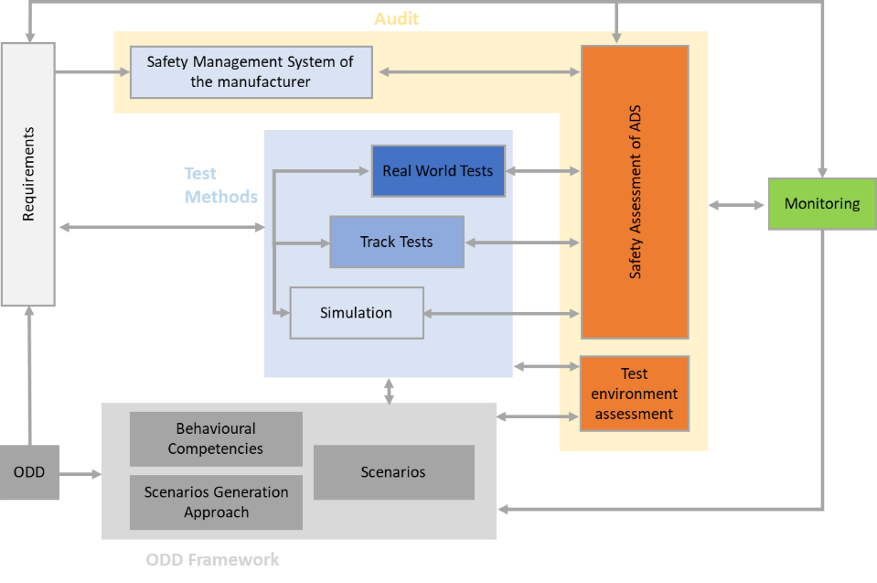
Background
The Monitoring is a post deployment validation pillar

Slide 3
Implementation of ISMR
PRE-DEPLOYMENT
POST-DEPLOYMENT
The SMS section includes processes for ISMR
The ISMR section provides detailed information on the ISMR
The Audit of the SMS shall evaluate the processes/tools/people for ISMR activities taken into account SMS and ISMR section
ISMR requires the management of the short term and periodic reporting in the frame of the post deployment activities of the SMS [Day by day evaluation of ADS operation]
SMS requirements
SMS audit
ISMR Requirements
ISMR Audit and Assessment
Safety case Assessment
Justification of the suitability of ISMR for the ADS under evaluation
Demonstration of compliance to specific requirements (e.g. metrics for monitoring)

Slide 4
Status of the Activities
Phase 1 - Requirements

Slide 5
ISMR Requirements
ISMR Requirements
There is general agreement on the text (ADS-05-05). However, the document will be checked:
To ensure consistency and alignment with EDR/DSSAD
To specify/indicate the relevant authority
To check for consistency with and to link with dedicated annexes (templates) and other sections (SMS, Safety case)
To check for consistency with new structure
General Requirements
Monitoring Requirements
Reporting Requirements

Slide 6
Status of ISMR Phase1
Under Discussion in the ISMR work stream
  Unknown scenarios encountered by the ADS
    To check possibility of moving into other part of the document to remove from occurrence list
  To check whether the reference to the applicable laws should be intended as:
    Laws applicable in the countries/jurisdiction of operation of the ADS
    Laws applicable in the countries/jurisdiction of the relevant authority
Topics to be discussed in Seoul
  UK proposal for reporting
  Thresholds for critical occurrence
  Alignment with DSSAD
Topics for Interpretation Document
  Occurrence and safety relevant events list requires further details/information (Example: operation outside the ODD, Should be always reported? Which metrics should be used??)

Slide 7
Proposals for new requirements
The following new requirements were submitted:
OPI: These requirements are without prejudice to applicable laws governing access to data, availability, privacy and data protection
  AGREED
UK: These requirements are without prejudice to applicable laws on provision of info to other authorities
  to be discussed in Seoul
FR: Emergency/complex manoeuvres to prevent a collision as safety relevant event to be reported
  Discussion moved to Phase 3
FR: The manufacturer shall provide relevant data to the ADS’s operator to fulfil its reporting obligations under applicable law
  Moved to SMS. Discussion in Seoul
ITU: The Manufacturer shall give authorization to the relevant authority to use ISMR information concerning new or revised scenarios for the purpose of developing generalized scenarios to make available for general use
  Discussion moved to Phase 3

Slide 8
Highlights and Open points
Phase 1

Slide 9
Topics for discussion
Definitions of Occurrences and Events
UK proposal for Requirement
Thresholds for critical occurrence
Alignment with DSSAD

Slide 10
Definitions of Events and Occurrences
Definition
“Event” means any situation happening in a given time and location.
“Safety-relevant event” means an event which is relevant for the evaluation of the safe operation of the ADS Vehicle. These events also include normal operation which are relevant to argument specific ADS design choices and/or the safety case. (e.g., fallback user unavailability, MRM)
“Occurrence” means a Safety-relevant event during which at least one of the following criteria is fulfilled: a)Collision involving the ADS vehicle b)ADS vehicle system/component failure c)ADS vehicle produces a noncompliance with respect to the requirements of this regulation d) Injury/fatality as a result of being in the ADS vehicle or being involved in the event.
“Non-critical Occurrence” means occurrences which are not “Critical Occurrences”
“Critical Occurrence” means an occurrence during which at least one of the following criteria is fulfilled: (a) at least one person suffers an injury that requires medical attention or dies as a result of being in the vehicle or being involved in the event. (b) the ADS vehicle, other vehicles or stationary objects sustain physical damage that exceeds a certain threshold. (c) any vehicle involved in the event experiences a deployment of any non reversible restraint systems
Event
Occurrence
Critical occurrence
Safety-relevant event

Slide 11
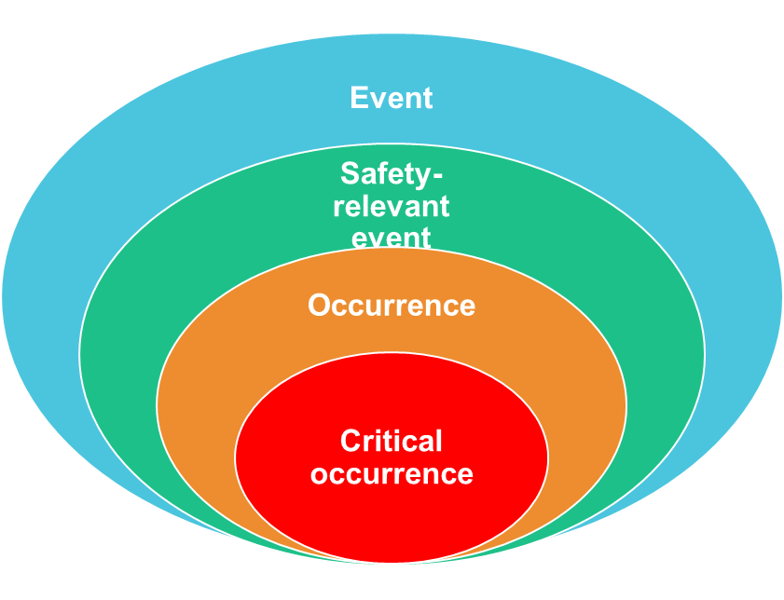

From Event to Critical Occurrences
ADS performs a Min. Risk Manoeuvre
ADS performs a Lane Change
Collision with Fatalities due MRM
ADS experiences a problem during MRM

Slide 12
Occurrence and Safety relevant event list

Slide 13
Critical occurrences status
“Critical Occurrence” means an occurrence during which at least one of the following criteria is fulfilled:
  At least one person suffers an injury that requires medical attention or dies as a result of being in the vehicle or being involved in the occurrence.
  The ADS vehicle, other vehicles or stationary objects sustain physical damage that exceeds a certain threshold.
  Any vehicle involved in the event experiences the deployment of any non-reversible deployable restraint system.

Slide 14

Issue #1 – what is an injury?
Different definitions for what is meant by ‘injury’
A widely used standardization (also as of SG3) is the Maximum Abbreviated Injury Scale (MAIS):
  “An anatomically-based, consensus-derived, global severity scoring system that classifies each injury by body region according to its relative importance on a 6-point ordinal scale”
  Severity score: 1 (minor) – 6 (maximal)
  Can deal with multiple types of injuries
  Codified description for a wide variety of possible road injuries

Slide 15
Issue #2 – how to establish thresholds?
Monetary threshold (e.g. special drawing rights SDR)
  Fictitious currency based on a basket of 5 international currencies (USD, EUR, CNY, JPY, GBP)
  Already used in refund practices to handle local currency dissimilarities
Police report (triggers) / insurance claim
Tow away
Important Damage (supported by example to avoid being subjective)

Slide 16
Issue #3 – rationale for ‘restraint system’?
Alignment with EDR/DSSAD
In a collision with a pedestrian an airbag may not deploy but active bonnet should
Different vehicle configurations covered here, they might not all feature airbags (e.g. shuttles, good delivery vehicles…)

Slide 17
Critical occurrence - Open questions
Thresholds (injury/monetary/damage) to be specified in Reg or Interpretation Document?
If Reg, where (main body/Annex)? when (Phase 3)?
Might be complex defining exact minimum thresholds given different vehicle types (masses, speeds, ODD…)
OPI: The activity will continue in the work stream. However, some direction is needed to decide where to include the thresholds. The Interpretation document seems the most appropriate document.

Slide 18
New requirement for phase 1
UK: The following requirement is proposed by UK:
  These requirements are without prejudice to applicable laws on provision of info to other authorities.
Rationale: Under national law, additional reporting requirements on ADS (e.g. for enforcement rather than a no blame safety culture) are still possible. Thus, the text aims to clarify that ISMR requirements cannot limit the power of the countries to introduce additional reporting requirements on ADS under national law
OPI: This is a new requirement so it should be addressed in phase3. However, it only clarifies that ISMR requirements cannot overrule National Law. This clarification is an important information to be included to avoid conflicts with national laws

Slide 19
Alignment with DSSAD
DSSAD is not mandated for ISMR. However, it is expected that DSSAD will support the ISMR implementation.
There are several topics which require alignment with EDR/DSSAD group:
  Definitions
  Occurrence/Events characterizations
  Data protection, Retention
  Data Recording (e.g. applicability of ISMR up to 30 seconds from the Deactivation).

Slide 20
Highlights and Open points
Phase 2

Slide 21
Assessment of ISMR
Assessment of In-Service Monitoring & Reporting
1) Pre-Deployment
    Suitability of the processes for the ADS
    Monitoring Capability
    Reporting Capability
    2) Post Deployment
    Reception of information
    Review of information
    Review of data processing
    Confidentiality
    Verification of information
    Recommendations
PRE-DEPLOYMENT
POST-DEPLOYMENT
The Audit of the SMS shall evaluate the processes/tools/people for ISMR activities taken into account SMS and ISMR section
ISMR requires the management of the short term and periodic reporting in the frame of the post deployment activities of the SMS [Day by day evaluation of ADS operation]
ISMR Audit and Assessment
Justification of the suitability of ISMR for the ADS under evaluation
Demonstration of compliance to specific requirements (e.g. metrics for monitoring)

Slide 22
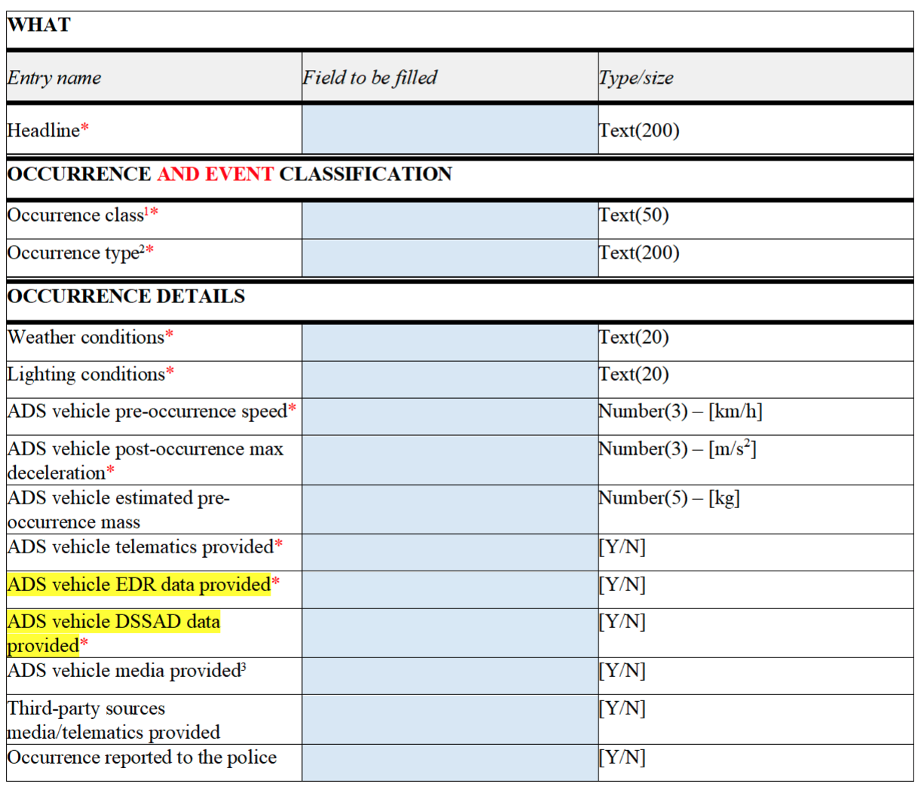
Status of activities Phase 2
  Several meetings dedicated to the assessment of ISMR
  Revised assessment document: ADS-05-18
    Focus on evaluation of the occurrences and safety relevant event management in the post deployment phase
  Revised template document: ADS-05-19
    Focus on mandatory and non mandatory elements based on manufacturer availability
    Focus on Confidentiality aspects based on IP/Sensitive information

Slide 23
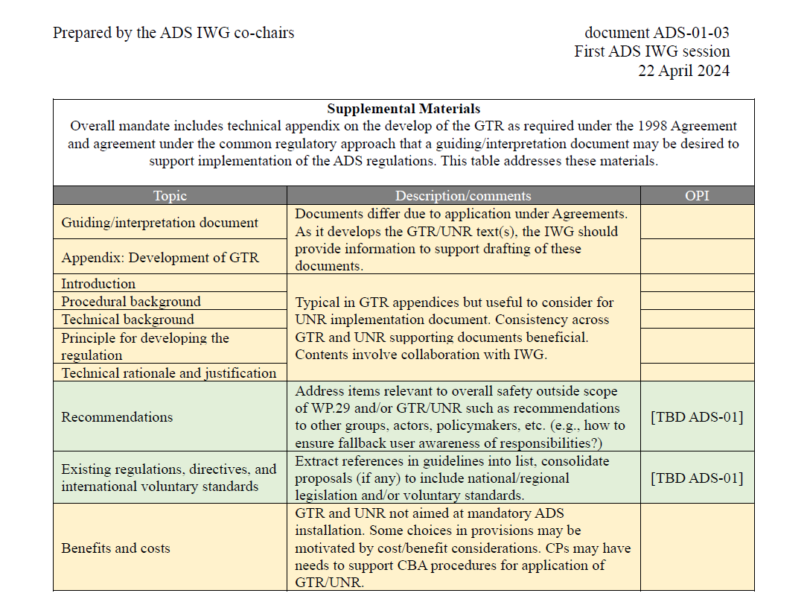
Phase 2 – Relevant Authority
Relevant Authority (Preliminary approach)
Assessment section
58 Agreement
  Assessor= Technical Service
  Relevant Authority=Type Approval Authority
98 Agreement
  We use always assessor/relevant authority
    Harmonization
      Occurrence/safety relevant events list (already covered)
      Critical Occurrences (covered in the phase1)
      Templates (under discussion)
    Recommendations for the Authority
      There is some text that falls outside the scope of the regulation. We could include this information in the recommendations section of the ADS regulation

Slide 24
Status of the Open Items
  Near misses (Closed)
  Data collection from other sources (Closed)
  Occurrence list (Closed)
  Relevant Authority (ongoing, preliminary agreement)
  ISMR templates (ongoing)
  Alignment with EDR/DSSAD (ongoing)
  New text proposals (phase 3)
  Alignment with SMS (phase 3)
  Elaboration of occurrences and Safety relevant events [e.g. metrics](Interpretation Document)
  ISMR scenarios development and use (?)

Slide 25

Thank you
© European Union 2020
Unless otherwise noted the reuse of this presentation is authorised under the CC BY 4.0 license. For any use or reproduction of elements that are not owned by the EU, permission may need to be sought directly from the respective right holders.
Slide xx: element concerned, source: e.g. Fotolia.com; Slide xx: element concerned, source: e.g. iStock.com
Notes:
Update/add/delete parts of the copy right notice where appropriate.
More information: https://myintracomm.ec.europa.eu/corp/intellectual-property/Documents/2019_Reuse-guidelines%28CC-BY%29.pdf

Slide 26








Keep in touch
ec.europa.eu/
europeancommission
europa.eu/
@EuropeanCommission
@EU_Commission
EUTube
@EuropeanCommission
EU Spotify
European Commission
Notes:
Delete/update as appropriate

