Slide 1
SIG on Thermal propagation
Discussion points
SIGTP-05-04r2
5th meeting, 27-28 August 2024
Prepared by Secretary

Slide 2
1. Objective and principles
REMINDER
Objective (of SIG-TP)
To provide robust procedures to assess thermal propagation performance that enable harmonized implementation
(among CP to the 58 Agreement and other nations interested)
Principles
Improve implementation of R100-03 Thermal propagation requirements
No intention to strengthen/reduce the stringency level from R100-03
Maintain framework of REESS type approval
To be reasonable, effective and practicable
Remain focusing on occupant protection

Slide 3
Timeline
July
August
September
October
November
December
(4) SIG#4 - Web
(27-28) SIG#5 - Web
(2) SIG-drafting – F2F(Tokyo)
(3-6) EVS#28 – F2F(Tokyo)
(9) D/L GRSP#76 working doc
(2-6) GRSP#76
For adoption at GRSP#76, need to submit working doc by 9 September
Obtain consensus on all technical issues by SIG#5 (3h x 2 days)
Further update of the working document may be introduced as informal document for GRSP#76
Once adopted at the GRSP#76, submission to March 2025 session of WP29 will be tried (D/L 10 December 2024)

Slide 4
Colour coding of comment sheet
(A)
(more or less) editorial, Quick confirmation
(B)
Need confirmation or some discussion
(C)
Need discussion at certain extent
(D)
Resolved
Expected outcome of SIG#5
To conclude all technical issues

Slide 5
2. Transitional provisions
Transitional provisions
2021
2022
2023
2024
2025
2026
2027
2028
2029
2030
2031
R100/03 (all M/N affected)
Entry into force (Jun/2021)
NT (Sep/2023)
AT (Sep/2025)
R100/04 (M2,M3,N2,N3 vehicles)
Entry into force (Jan/2025)
WP29
NT (Sep/2026)
(Expected timelines in current proposal)
AT (Sep/2027)
R100/05 (REESS with LiB)
GRSP#1
Entry into force (Jan/2026)
GRSP#2
→ If WP29/AC1 can adopt in March 25,
EIF will be advanced to Oct/2025
WP29
How long??
Will AT date needed? ← No stringency level change
→ Include AT date but certain exemption for smoke in 5min.
How long period is needed for NT date (test facility preparation, etc.)
REESS other than LiB (flammable electrolyte) are not affected

Slide 6
(Transitional provisions in guideline – amended by WP29/2024/76 [WP29/1044/Rev.4])
V.1. As from the official date of entry into force of the XX series of amendments, no Contracting Party applying this Regulation shall refuse to grant or refuse to accept type approvals under this Regulation as amended by the XX series of amendments.
V.2. As from 1 September Date (b), Contracting Parties applying this Regulation shall not be obliged to accept type approvals to any of the preceding series of amendments first issued after 1 September Date (b).
V.3. Until 1 September Date (c), Contracting Parties applying this Regulation shall accept type approvals to the XX-1 series of amendments first issued before 1 September Date (b).
V.4. As from 1 September Date (c), Contracting Parties applying this Regulation shall not be obliged to accept type approvals issued to any of the preceding series of amendments to this Regulation.
V.5. Notwithstanding the transitional provisions above, Contracting Parties who start to apply this Regulation after the date of entry into force of the most recent series of amendments are not obliged to accept type approvals which were granted in accordance with any of the preceding series of amendments to this Regulation / are only obliged to accept type approval granted in accordance with the XX series of amendments.
V.6. Notwithstanding paragraph V.4, Contracting Parties applying this Regulation shall continue to accept type approvals of the equipment/parts issued according to the XX-1 series of amendments to this Regulation.1,
(Note: V.6 is for special case 1-1 and comes in addition to V.4 when applicable)
V.7. Notwithstanding paragraph V.4, Contracting Parties applying this Regulation shall continue to accept type approvals issued according to the XX-1 series of amendments to this Regulation, for the vehicles/vehicle systems which are not affected by the changes introduced by the XX series of amendments.
(Note: V.7 is for special case 1-2 and comes in addition to V.4 when applicable.)
V.8. Contracting Parties applying this Regulation shall continue to accept type approvals issued according to the XX-1 series of amendments to this Regulation, first issued before Date (b).3,
(Note: V.8 is for special case 1-3 and would replace V.4 when applicable.)
V.9. Contracting Parties applying this Regulation may grant type approvals according to any of the preceding series of amendments to this Regulation.
V.9bis. Contracting Parties applying this Regulation shall continue to grant extensions of existing approvals to any of the preceding series of amendments to this Regulation.
See SIGTP-05-06 prepared by SEC
Add special provision for egress time
Need of adjustment for acceptance of 03 series in V.3 and V.7

Slide 7
3-1 Topic 10
Category O vehicles
Scope of R100 extended to category O
No occupants in category O vehicles in temporary parking mode.
The most of REESS requirements in R100 (except for 6.12 and 6.15) do not mention occupant protection
SIG#5
Direction suggested
- Not to apply thermal propagation requirements for category O vehicles for 05 series of amendments
- Consider the provisions for category O toward 06 series (likely prepared for ADS vehicles)
Justification need to be prepared for R100-05 proposal.

Slide 8
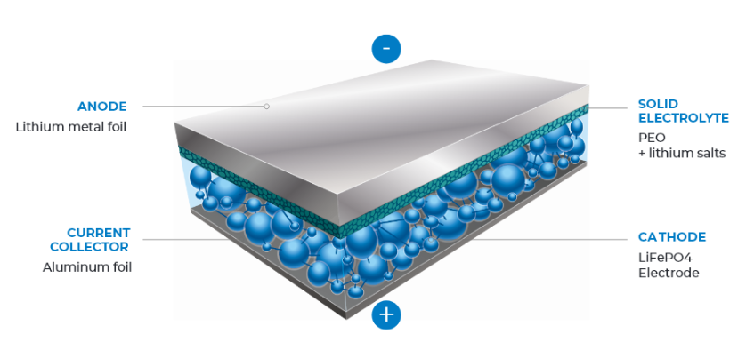
3-2 Topic 2
Application to LMP batteries
REESS containing “alkaline metal anode”
Will test procedures/requirements currently considered can be effectively applied to LMP batteries?
Any assessments on the REESS caused incidents?
See SIGTP-05-07
SIG#5
The need to apply TP requirement to LMP batteries was recognized, but the effectiveness should be confirmed.
Source: Blue Solutions - Battery technology (blue-solutions.com)

Slide 9
3-3 Topic 4
Cell temperature for test parameter
Maximum temperature safety limit + 100°C
(Maximum operating temp or maximum storage temp) + 200°C
“Maximum temperature safety limit” is not defined
“Maximum storage temperature” is not defined as well
“Maximum operating temperature” may be confirmed at over temperature test
SIG#4 Agreed to use
“at least 100 °C larger than maximum operating temperature”
for heater specification.
SIG#5
Annex 9K 5 (TR criteria): TBD (avoid faulty detection)
Annex 9K 6 (Adjacent cell temp): Use maximum operating temperature

Slide 10
3-4 Topic 3
Choice of testing or documentation
Mandate the test
vs
Keep as alternative
Availability of detection, prevention and mitigation measures
Harmonization with the US (FMVSS305a require documentation)
The feasibility of testing largely depends on the pre-installation (that may be applied at manufacturer’s discretion)
Documentation requirements have been improved to allow more harmonised implementation
SIG#5
EC want to maintain testing requirement as mandatory in principle.
At EVS-IWG, report SIG-TP proposal and seek for possibility of harmonisation
When can RIMA be accepted? → Manufacturer demonstrates that testing method is not feasible or suitable, and TS agrees.

Slide 11
3-5 Topic 5
Selection of trigger method
Specify default method
vs
Equally treat alternatives
What is the practical effect of having “default” method?
  Possibility to apply default method will always be required?
  If “default” method is applied and confirmed no TR initiated, can the verification be closed?
  How can TS assess if the trigger method is “suitable” or not?
SUG#5
Language of “default” will be revised, but a guidance should be given for the choice of the trigger method

Slide 12
3-6 Topic 6
Additional conditions for component-based test
Need of additional requirements to have venting system in REESS
Principle to keep REESS type approval has been confirmed
Validity of currently proposed provisions
SIG#5
Maintain current wording (6.15.3.3.(a))
Smoke released other than intended system → vehicle level test

Slide 13
3-7 Topic 7
Additional conditions for component-based test
REESS level behaviour
Vehicle level behaviour
Principle to keep REESS type approval has been confirmed
  REESS manufacturer shall be able to obtain the approval independently from the vehicle manufacturer
What will be critical difference (except for smoke ingress)?
SIG#5
Invite improved wording based on (Proposal A)to facilitate REESS type approval

Slide 14
3-8 Topic 9
Details of smoke ingress test
Current draft: Current draft was prepared rather instantaneously at SIG#3 and being improved
SIG#5
No discussion held

Slide 15
3-9 Topic 8
Alternative to smoke ingress test
Smoke ingress test for HDV ([and trailers])
Horizontal distance between cabin and REESS
Roof mounted REESS
SIG#5
No discussion held

Slide 16
3-10 Topic 1
Installation requirements for type-approved REESS
Revised proposal by the EC
Part I : Vehicle type approval on Electrical safety + REESS safety
Part II : Component type approval on REESS safety
Part III: Vehicle type approval on Electrical safety + REESS installation
Additional requirements in Part I
New Part III requires additional amendments in the scope and administrative provisions
SIG#5
OICA noted that the additional requirements are not related to TP and considered as redundant.
No discussion held.

