Slide 1
Status Report
GRE TF AVSR
Transmitted by the Chair of the GRE TF “Autonomous Vehicle Signalling Requirements” (AVSR) | Informal document GRE-91-xx 91st GRE, 21. –25 October 2024, agenda item 6 (a)
AVSR-19-02
Dr. K. Manz, DE – Chair
L. Schwenkschuster, GTB - Secretary

Slide 2
Fitness of UN-R48
After the last meeting of TF AVSR, a document was sent to GRE and published as
ECE/TRANS/WP.29/GRE/2023/9/Rev.3
However, several late but valid comments from France, need further discussion and thoughts!

Slide 3
Fitness of UN-R45
Only result of the Review of R 45:
Paragraph 6.5.4., amend to read:
“6.5.4. The control of the cleaning device shall may be operable from the driver's seat manual or automatic and may be coupled with the controls for other cleaning devices.
If a driver’s seat is fitted, the control of the cleaning device shall be operable from the driver's seat.
In addition, when the cleaning device is required to be fitted according to No. 48, and in the absence of any automatic activation of the cleaning device, it must operate through at least one cleaning period when, the headlamps being already switched on, the windscreen washers are operated.”

Slide 4
ADS Marker Lamps
Answers from CP’s about possible use cases
Input to the ADS marker lamp discussion
Discussion-paper on automated driving indication
Expected studies
WP.1 Documents
Question to the authorities
Statements of CP’s (annex I)
Most relevant studies (annex II)

Slide 5
Answers from CP’s about possible use cases
French response:
- Not well defined for the moment.
- Ideas about a substitution of existing lighting functions by the ADS marker lamp.
- Open question: How to identify the intended driving direction?
Japanese response:
- Japanese government has started a research to investigate the need and use cases for ADS marker lamps.
- Results will be available in estimated two years.

Slide 6
Input to the ADS marker lamp discussion
GTB input -Automated Driving Systems Marker Lamp (ADS ML)
See document GRE-90-06
Mercedes-Benz AG Concept presented at 89th GRE Session via TF AVSR
See document AVSR-18-02
Discussion-paper on automated driving indication
See document AVSR-18-03

Slide 7


Discussion-paper on automated driving indication
› How does the motivation influence the definition of the performance of an ADS marker lamp?
› The distance to a dedicated observer identifies the intensity of the ADS marker lamp
Question to
Intensities
Light distribution
etc.

Slide 8


Discussion-paper on automated driving indication
› The position and distance of a dedicated observer identifies the vertical angle of geometric visibility
Question to
Intensities
Light distribution
etc.
Traffic supervision camera

Slide 9
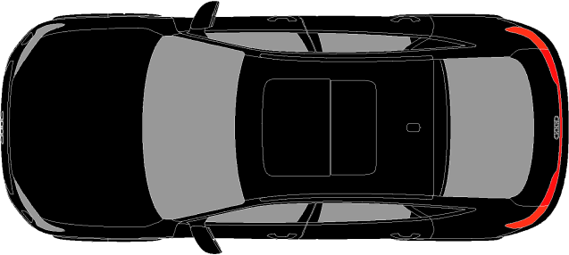
Discussion-paper on automated driving indication
› The position of dedicated observers identifies the position, number and geometric visibility of the ADS marker lamp

Slide 10

Discussion-paper on automated driving indication
› The relative position of dedicated observers influences the addressed vehicle classes
Front only: M and N
To be clarified
by the use cases
Front and rear: M, N and O

Slide 11
Discussion-paper on automated driving indication
› The motivation influences the importance of ADS indication in comparison to other lamps
ADS marker GRE feedback and former China GB draft 360°
Direction indicator 320°
Position lamp 320°
Fog rear 45°
To be clarified
by the use cases
ADS marker SAE 120°
Registration plate 60° (EU example)
Daytime running lamp 40°
Stop 60°

Slide 12


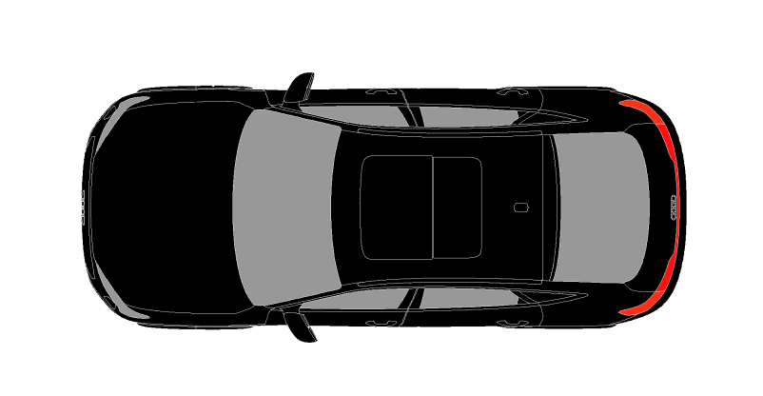
Discussion-paper on automated driving indication
› How important is the knowledge about the ADS status compared to the information about the presence or direction of travelling of the vehicle?
› ADS marker may substitute lamps that identify about the presence or width of a vehicle?
Solutions can be found in R48
e.g. daytime running lamps and direction indicators

Slide 13
Discussion-paper on automated driving indication
› Rear indication:
› A trailer will block the view on vehicle ADS marker lamps.
› To overcome this, automated vehicles must not carry trailers not equipped with ADS marker lamps?
› Alternatively, when trailers without ADS marker lamps are attached, the vehicle must not enter an automated mode?
Germany see no necessity on traillers

Slide 14
Expected studies/reviews
Japan has started a research project
Korea has started a research project
UK is providing a literature review

Slide 15
WP.1 Documents
Economic Commission for Europe
Inland Transport Committee
Global Forum for Road Traffic Safety
Eighty-third session
Geneva, 20-24 September
Item 3 (c) iii of the provisional agenda
Position statement on optical and/or audible signals in the context of driver assistance systems, advanced driver assistance systems and autonomous vehicles
Submitted by Germany
Informal document No. 2
30 August 2021
Following this discussion, Germany supports the following points of view:
- First and foremost, AVs should use the existing external signalization devices which are available in and used by current existing vehicles (direction indicators, brake lights, horn, etc.) without driver assistance systems. New and different solutions could cause confusion when road users have to interact with multiple vehicles, both conventional and automated.
- AVs should signal their status and communicate their next intended actions using visual or audible signals or a combination of both only in special cases.
- In such special cases, in general, they should make use of an optical signal (under normal traffic conditions and active autonomous driving).
- For an optical signal it must be defined, when and under which conditions this signal should be activated.
- In this context, e. g. interaction with police and other road users (pedestrians) shall be taken into account, depending on the extent of automation.
- An optical signal to indicate that a vehicle is being driven by an automated driving system can be useful as a temporary solution to address specific needs in specific situations, e.g. autonomous parking of the vehicle.
- We conclude that the traffic rules for automated vehicles must not be different from existing traffic rules.
- We would like to clarify that the aforementioned points shall not prevent us from discussing the topic further, particularly taking into account audible signals, which could support e.g. disabled persons in communicative scenarios.

Slide 16
WP.1 Documents
Economic Commission for Europe
Inland Transport Committee
Global Forum for Road Traffic Safety
Eighty-fifth session
Geneva, 19-23 September 2022
Item 3 (d) (ii) of the provisional agenda
ADS recognizability
Submitted by the Netherlands
Informal document No.11
13 September 2022
Goal
1. During the 85th meeting of WP.1, agenda item ‘Optical and/or audible signals in DAS and ADS vehicles’ will be discussed. The goal of this agenda item is to continue discussion on the topic of optical and/or audible signals in DAS and ADS vehicles to indicate their status and to communicate their intended actions on the roads.
….
Considerations
----
Responsibility
----
Remote operation of ADS vehicles
….
Exemption/permit/status of the system
…
Police street checks
…
Final note

Slide 17
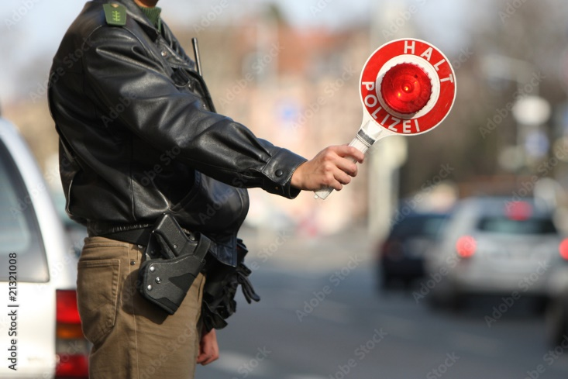
Question to the authorities
Question to Governments and to WP. 1
How can an ADS vehicle identify the legal request of any authority to stop?
source: Adobe Stock

Slide 18
GRE TF AVSR
Thank you for your attention!

Slide 19
Annex I – Statements of CP’s
France France is in favour of such a signal to clearly identify autonomous vehicles in autonomous state. No specific requirements ideas at this stage, open for discussion, has suggested the possibility to use the existing lamps to switch from normal conditions to autonomous conditions.
Japan Japan is in favour of having an external light signal and also of the policy proposed by GRVA. Japan believes that further discussion is needed on detailed regulatory requirements.
Japan now requires manufacturers to affix a sticker to automated vehicles. In addition, Japan has amended its Road Traffic Law to require autonomous vehicles without a driver to display the external signal.
UK UK is not in favour of such a signal and wants to come to a common understanding as expressed by GRVA. UK clearly wants to have a provision to ban such signals on their roads
Korea Korea is recently doing a study if and how to implement an ADS signal, however, no specifications available yet.

Slide 20
Annex I – Statements of CP’s
Australia Australia’s general view is that, in the initial stages of deployment and while there is a mixed fleet of ADS and Non-ADS vehicles, there may be benefit in communicating to Other Road Users (ORUs) that a vehicle’s ADS is operating.
Australia recommends that GRE continues to coordinate work with GRVA and conducts analysis of research and establishes high level principles related to light-signalling for ADS operational status which is in accordance with the outcomes from WP.29’s November 2022 session.
China China does allow such a signal; however, it is yet not required by GB-standards and defined inside the new, draft GB standard for light-signalling devices
SAE SAE has established a recommended practice (SAE J3134) about ADS marker lamps.

Slide 21
Annex II – Most relevant studies
European Commission, Directorate-General for Mobility and Transport, Montalvo, C., Willemsen, D., Hoedemaeker, M. (2020). Study on the effects of automation on road user behaviour and performance: final report, Publications Office. https://data.europa.eu/doi/10.2832/431870.
On page 82 of this document, it is stated under item 7.2.:
7.2. External HMI
The following issues concerning the interaction of the vehicle within its context of operation for e-HMI were identified: to make clear that no additional e-HMI for interaction with the environment is needed (thus, no new standards are required); the need to have a signal that the vehicle is under ADS control; and rural platooning for safe overtaking. The key stakeholders to lead the necessary actions outlined in Table 11 (further below) are the European Commission (DG Grow and DG R&I), OEMs, logistic companies and UNECE WP.29 Similar to external HMI, the actions required and outlined in the table can be completed within one to three years for Level 3 automation.

Slide 22

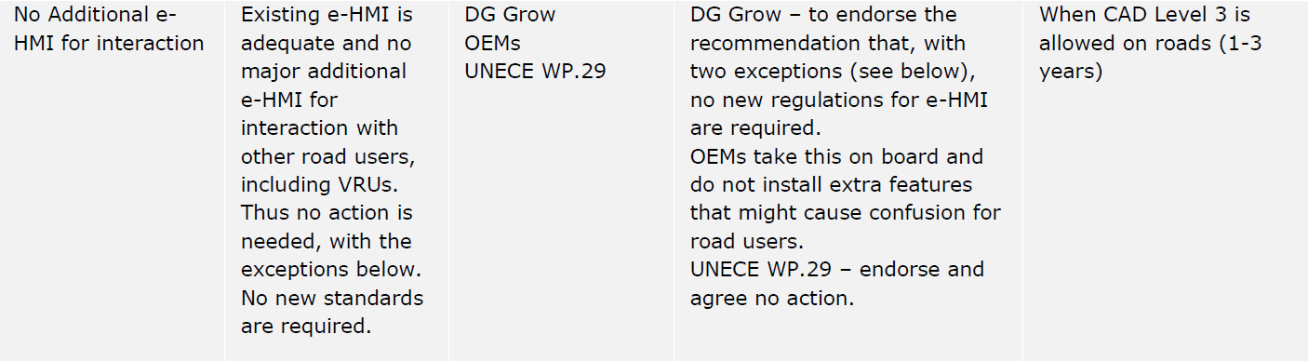
Annex II – Most relevant studies
European Commission, Directorate-General for Mobility and Transport, Montalvo, C., Willemsen, D., Hoedemaeker, M. (2020). Study on the effects of automation on road user behaviour and performance: final report, Publications Office. https://data.europa.eu/doi/10.2832/431870.
And in table 11 on page 83 of this document, as stated under item 7.2.:
But with two exceptions!

Slide 23
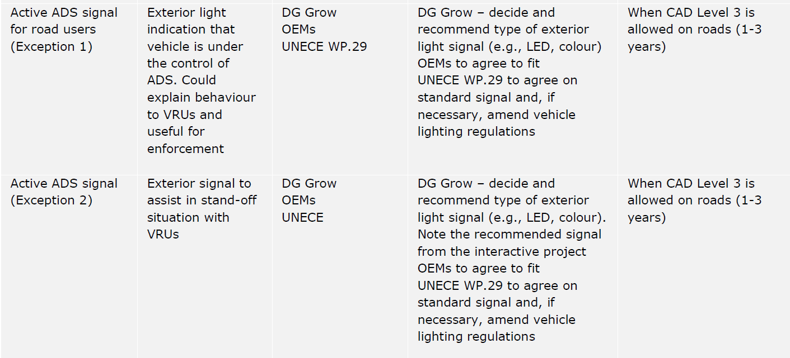
Annex II – Most relevant studies
European Commission, Directorate-General for Mobility and Transport, Montalvo, C., Willemsen, D., Hoedemaeker, M. (2020). Study on the effects of automation on road user behaviour and performance: final report, Publications Office. https://data.europa.eu/doi/10.2832/431870.
Those two exceptions are:

Slide 24
Annex II – Most relevant studies
WP.1-2021 - Informal document No.3
Brief Comments on Requiring Automated Vehicles to Communicate a Mode of Operation: The Importance of Avoiding Unintended Consequences
Bruce Mehler (bmehler@mit.edu) March 4, 2021
I should make it clear at the start of this brief comment that I am not firmly opposed to the idea of requiring an automated vehicle to signal in some manner it’s mode of operation. At first consideration, I expect that many people see this as a very reasonable and desirable proposal. However, as we look at research data, particularly considering pedestrian interactions with “automated” vehicles, there are both data and antidotal evidence that suggest that attempts to communicate the status of a vehicle and its “intended” behavior can cause confusion and may have unintended negative consequences when vehicles are in mixed traffic situations where both automated and manually controlled vehicles are present. ……
….
Again, this is, indeed, a complex topic as there may be good reasons for some knowability as to whether a vehicle is currently in automated or manual control. For example, this may be important when the police or other safety or management related officials need to understand the status of a vehicle. However, as outlined above, there can be unintended consequences and overall safety may be better served by proceeding very cautiously before requiring overt distinction between automated and manually driven vehicles. In particular, it will be important to carefully test specific signaling methods to ensure they do not increase confusion or have unacceptable levels of misinterpretation. Simply specifying that a visual and/or auditory method of signaling status be employed runs the risk of unintended, negative consequences.

Slide 25
Annex II – Most relevant studies
WP.1-2022 - Informal document No. 6
Convention on Road Traffic (1968):- Driving permits
Human factors and automated driving as key issues for future road traffic
Optical and/or audible signals in DAS and ADS vehicles
Submitted by the International Federation of Pedestrians (IFP)
1. The issue discussed in this paper was brought to the attention of WP1 by Germany and the GRE Task Force on “Automated Vehicle Signaling Requirements (AVSR)” in the informal document 13 of March 2020. …
2. Signals allowing automated vehicles (AV) to communicate their intended actions to other road users have often been tested with pedestrians. Different types of communication interfaces have been proposed and trialed. Such interfaces include: text messages displayed on the vehicle windscreen or projected on the roadway (e.g. “walk”, …)
7. In conclusion, the IFP is opposed to the introduction of signals (optical or audible) indicating AVs’ intended actions to pedestrians. The IFP is not opposed to signals indicating the status of the vehicle (whether the autonomous mode is on or not) as long as pedestrians are not expected to change their behavior in the presence of this signal.

