Slide 1
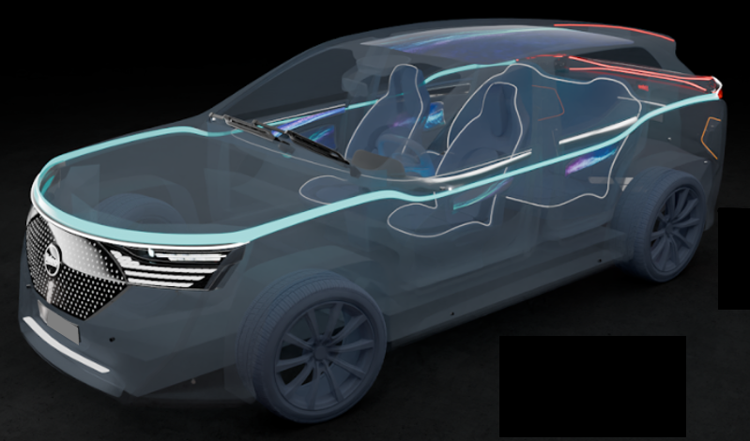
AVSR-19-03
Automated Driving Systems Marker Lamp
(ADS ML)
GTB WG Signal Lighting
GTBWGSL 655

Slide 2
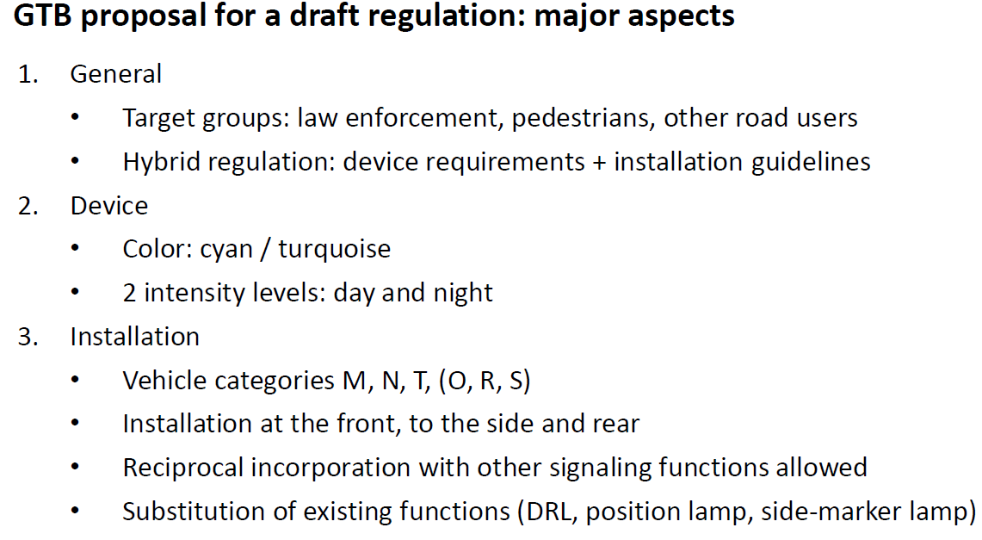
ADS Marker Lamp
Introduction
Extract of the document GRE-90-06 of April 2024
During this GRE 91st session TF AVSR/GTB is presenting further details for a proposal of a new hybrid regulation and a summary of proposed technical characteristics:
    see next pages in this document
GTB WG Signal Lighting
GTBWGSL 655

Slide 3
ADS Marker Lamp
Hybrid Regulation - description
General Structure:
    Part I: lamp requirements
    Part II: installation requirements
Definitions:
    Link to the definitions of R48 (R53, R74 and R86).
    New definitions related to ADS marker lamp added
General requirements of R48 added, when relevant for the ADS marker lamp function
Specific new requirements applicable to the ADS marker lamp added
Reference: adopted hybrid UN Regulation No. 165 considered as reference
GTB WG Signal Lighting
GTBWGSL 655

Slide 4
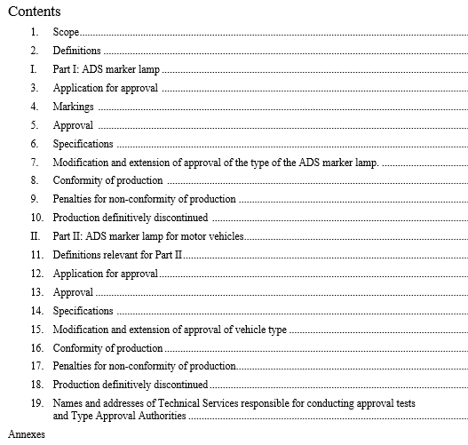
ADS Marker Lamp
Hybrid Regulation - contents
Scope: ADS marker lamps
Definitions:
- Link to R48 definitions
- New definitions related to the ADS marker lamps
Part I: Approval of ADS marker lamps
Part II: Approval of motor vehicles with regard to fitting of ADS marker lamps.
GTB WG Signal Lighting
GTBWGSL 655

Slide 5
ADS Marker Lamp
Draft Regulation: ADS marker lamp → Draft technical characteristics
 |  | DESIGNATED MARKING LAMPS FOR AUTOMATED VEHICLES
Number |  | 1 | 2
Photometry | Daytime (min/max) | Front: 50 / 300 cd Gral: Multipliers not needed as this function is information only – not required for road safety Rear: [20 / 120 cd] Non-impairment with Stop and rear turn signal US Side: 20 / 120 cd
 | Nighttime (min/max) | Front: 10 / 125 cd Gral: Multipliers not needed Rear: 4 / 42 cd Side: 4 / 25 cd
Geometric visibility | Vertical (up/down) | Front: 15° / 15° (5° down if lower than 750mm) (5° up 30° down if higher that 3000mm) Rear: 15° / 15° (5 down if lower than 750mm) (5° up 30° down if higher that 3000mm) Side: 10° / 10° (5 down if lower than 750mm) (5° up 30° down if higher that 3000mm)
 | Horizontal (outboard / inboard) | Front: [45° / 45°] Rear: [45° / 45°] Side: 45° / 45° | Front: [45° / 20°] Rear: [45° / 20°] Side front: 45° forwards / 30° rearwards Side rear: 45° rearwards / 30° forward
 | To be considered visible | Front, rear and side: 1 cd (day) / 0.05 cd (night)
Mounting (Location) | Height min/max | 250 mm / -
 | Width | Front and rear: Centerline of vehicle | Front and rear: evenly spaced about vertical longitudinal plane
 | Length | Side: < 3m from the front | Side front and side rear: < 3m from the front
 | Other requirements | Switched ON automatically only when the vehicle is in fully automated mode and human input is not expected/required. Switched OFF automatically when the vehicle is not in fully automated mode. Manual switching ON or OFF [or changing colors] - prohibited. Shall not mask or otherwise interfere optically, physically or operationally with any one of the required lighting or light signalling functions It should be possible to disable the automatic switching ON and OFF of ADS marking lamp (GPS/software switch) [It must not be easily accessible by the vehicle operator] [20mm] minimum separation to light functions emitting white light Reciprocal incorporation allowed with DRL, front position lamps, side marker lamps, direction indicators, rear position lamps (only partial incorporation, remaining part of the rear position lamp shall comply with the requirements). In the case of reciprocal incorporation with direction indicator, the ADS marker lamp should switch off when direction indicator is activated on the relevant side
Size | Min / max | - / -
Color |  | “blue-green” / “turquoise” x=0.012, y=0.495; x=0.200, y=0.400; x=0.200, y=0.320; x=0.040, y=0.320.
GTB WG Signal Lighting
GTBWGSL 655

Slide 6
ADS Marker Lamp
Draft Regulation: ADS marker lamp → Draft technical characteristics
 |  | USE OF LAMPS DESCRIBED ALREADY IN UN REGULATIONS – SUBSTITUTION
Lamps | May use | UNECE: DRL, front position lamps, side marker lamps, end outline marker lamp
Number |  | Per requirement of lamp used
Photometry | Daytime and Nighttime (min/max) | Per requirement of lamp used
Geometric visibility | Vertical (up/down) | Per requirement of lamp used
 | Horizontal (outboard / inboard) | Per requirement of lamp used
 | To be considered visible | Per requirement of lamp used
Mounting (Location) | Height min/max | Per requirement of lamp used
 | Width | Per requirement of lamp used
 | Distance to front | Per requirement of lamp used
 | Other requirements | Switched ON automatically only when the vehicle is in fully automated mode and human input is not expected/required. Switched OFF automatically when the vehicle is not in fully automated mode. Manual switching ON or OFF [or changing colors] - prohibited. It should be possible to disable the automatic switching ON and OFF of ADS marking lamp (GPS/software switch) [It must not be easily accessible by the vehicle operator] [20mm] minimum separation to light functions emitting white light
Size | Min / max | Per requirement of lamp used
GTB WG Signal Lighting
GTBWGSL 655

