Slide 1
Apparent Surface
SLR-69-12
SLR 69th session
Japan – 10-12 Sept. 2024

Slide 2
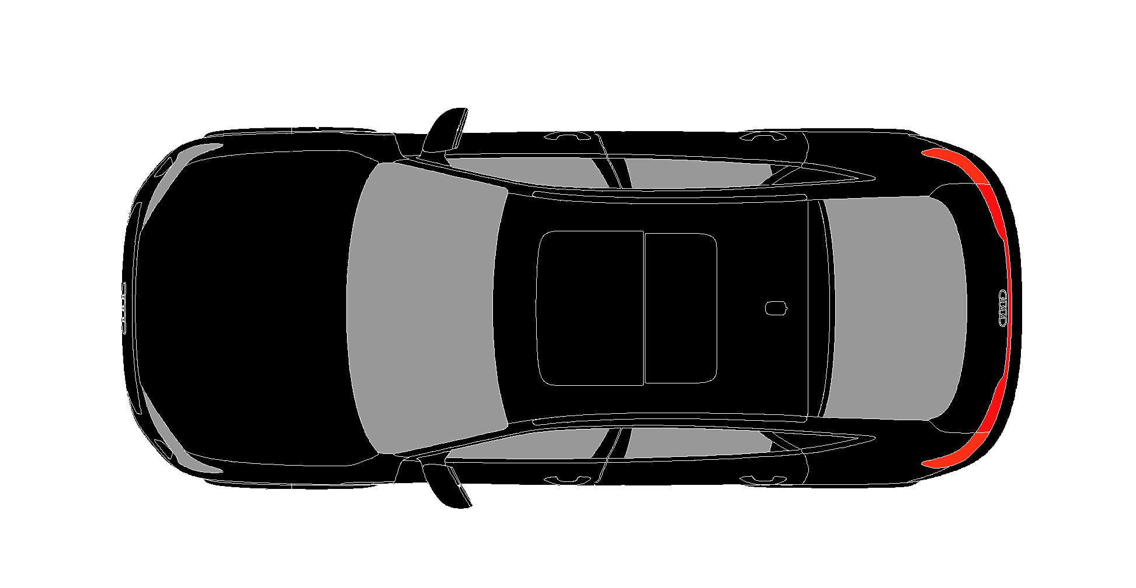
OICA has concerns about the practicality of using this measurement method on a vehicle.
We identified the following issues:
When light sources show a directed light pattern and do not distribute light homogeneously across a large angle, the test from another location of the luminance camera does not produce a correct result.
Low intensity by the central part of the device in the direction of a luminance camera positioned on the reference axis → projected area is not part of the apparent surface.
Camera on the reference axis
Camera
High intensity in the direction of the reference axis → projected area is part of the apparent surface for an observer

Slide 3
The result of a luminance measurement does not reflect the real-life condition of an observer in traffic relevant distances.
It does not reflect the current use case of an apparent surface to test the boundaries and surfaces based on an observer in a far distance to the lamp (orthogonal projection)
The camera shall measure this
It does measure this
Camera

Slide 4
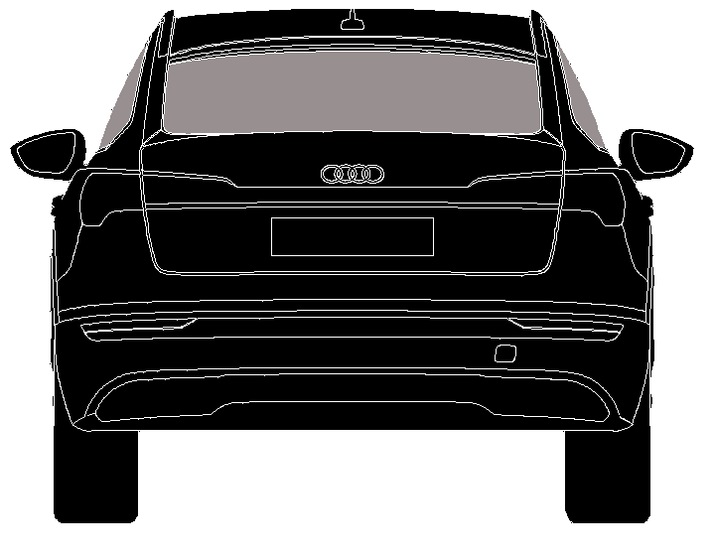
The result is, that the apparent surface is either smaller or bigger than the impression on an observer depending on the design of the lamp:
When the lamp is built of multiple small elements producing portions of narrow directed light, the intensity in the direction of the luminance camera does not exceed the threshold so they are outside of the apparent surface!
Camera
Apparent surface
Measured
Apparent surface
for an observer

Slide 5
The result is, that the apparent surface is either smaller or bigger than the impression on an observer depending on the design of the lamp:
When the lamp is built of multiple small elements directing light to the camera, the surface is large although an observer identifies differently.
Camera
Apparent surface
Measured
Apparent surface
for an observer

Slide 6
To get a correct result, the camera must “scan” the area of the lamp instead of a measurement on the reference axis.
Only then, the result of the camera matches the result of the orthogonal projection.
Camera
Camera
Camera
Camera
Apparent surface
Measured
Apparent surface
for an observer

Slide 7

Luminance measurement on a vehicle scale is not practicable.
How shall a test show repeatable results? The camera must be positioned very precisely but the position is fragile. In such height, a ladder, robot or lifter is needed but all have positioning tolerances.
15° up at 2.5m Distance → Height 4.65m
Camera
Optional lamp 4m height 2a
Who places this camera in all necessary locations around a vehicle to identify the size of the apparent surface by measurement of luminance?

Slide 8
What precision can we expect from a luminance camera in 2.5m distance that is held by hand or by a machine with position tolerances?
There will inevitably be differences between the measurement of luminance on a goniometer compared to the measurement on a vehicle.
Camera

Slide 9
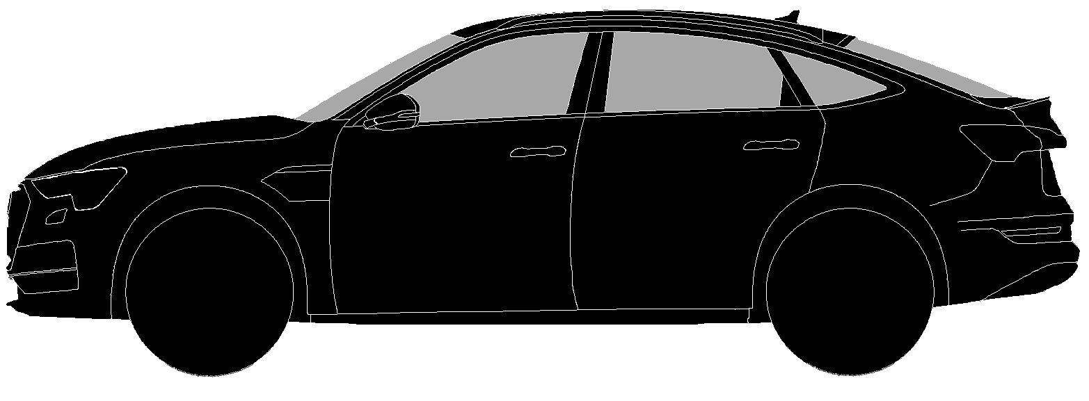
12.5 cm² is not a big area so small tolerances in the evaluation of a boundary have a huge influence on compliance evaluation.
Even a tolerance of 1 mm produces large level of uncertainty.
Example is a position lamp in the form of a band or stripe.
When viewed from an 80° outboard angle, it is a short line.
Such line 1 cm high must have a length of 12.5 to reach the required 12.5 cm².
An uncertainty of just 1mm on all boundaries means a result between 0,8 cm x 12.3 cm = 9.84 cm² (78.2%) and 1.2 cm x 12.7 cm = 15.24 cm² (123.2%).
A tolerance of more than 20% is not acceptable.

Slide 10
We must discuss the luminance threshold value that is defined by the formula.
Threshold is equal to K [1/m²] x I_{HV} [cd]
K = 5
A lamp must provide a minimum apparent surface area in all directions and must provide a minimum intensity in this direction.
When the apparent surface is defined by a minimum luminance with the new method and when the minimum area is defined by the regulation, the minimum intensity is defined by area and luminance.
With the current formula for a luminance threshold, the resultant intensity is higher than defined minimum intensity for a function.
Example front direction indicator: Intensity up to 1200cd on the reference axis
→ Luminance threshold 5/m²x1200cd = 6000cd/m² →6000cd/m² x 0,00125 m²= 7.5cd.
The minimum intensity of a front direction indicator in the angles of geometric visibility is 0.3cd. Thus, the new requirement introduces a factor of more than 24 times the intensity in the angles of geometric visibility on hight intensity front direction indicators!
To keep the existing requirements, the factor must be reduced by 24 times → instead of K=5 → K=0.2
Then the threshold is reduced from 6000cd to 250cd.

Slide 11
Other concerns:
The two described methods to identify the apparent surface do not have the same results. Is this acceptable?
The luminance of lamps during the development process cannot be accurately be simulated. This makes the result unpredictable.
We do not believe, that the new approach is a more simple solution compared with the current methods as discussed above so we would like to identify what is exactly the issue that is trying to be fixed?

