Slide 1
ETRTO additional inputs for IWG WGWT workplan 2024-2025
IWG WGWT 61st session 30 July 2024

Slide 2
CONTEXT & OBJECTIVES
RECALL OF THE AGREEMENTS AND OBJECTIVES OF THE IWG WGWT TEST CAMPAIGN 2024/2025
IWG WGWT Agreements in 60th session.
  2-stage approach
  KPI shall be the weighted standard deviation σ (per tyre category) (IWG WGWT discussed on how to fix the target level of weighted standard deviation σ).
Objectives for stage 1:
  to verify the effectiveness of the proposed change in wetted frictional properties, and its impact on candidate tires
  To provide sufficient test samples number for statistical analysis
  To test at 2 ‘extreme’ temperatures (with the expectation to have better results than in 2019-2021).
Objectives for stage 2: subject to the results and conclusions of stage 1.

Slide 3
ETRTO thoughts for stage 1
Considering the IWG WGWT agreements and the ETRTO + JASIC objectives, ETRTO further reflected on the co-chair document WT-60-2 and made the following proposal:
Establish the objective for the test precision improvement (KPI) in a quantified manner along with the relevant justifications.
ETRTO consideration | ETRTO proposal
It is not correct to use the same target as worn tyres are more sensitive to wet conditions than new tyres and higher variability is to be expected. Expected variation cannot be 0,065 and 0,060 for Normal and 3PMSF repectively. The JASIC proposed target has to be seen as a theoretical target but shall be verified considering the current testing technology. | ETRTO find the proposal of the 2-stage approach as appropriate. To fix the dispersion target now is too premature, as ETRTO proposal for stage 1 is to verify the test method precision improvement considering the proposed improvements (including JASIC requirements: extreme temperatures and sufficient test samples number for statistical analysis). After this stage 1, to evaluate the test method dispersion and then to refine the target to be reached (in a 2nd stage plan). This verification should be done comparing the Weighted Standard Deviation from 2024-2025 stage 1 test campaign versus previous 2019-2021 test campaign.

Slide 4
ETRTO thoughts for stage 1
Establish the current test precision following all the recent changes introduced / planned. Establish the remaining dispersion sources not solved yet.
If the improvement objective is not reached, which possible alternative approaches could be investigated?
ETRTO consideration | ETRTO proposal
Stage to verify/confirm the test method precision improvement | ETRTO is in favor for a 2-stage approach
ETRTO consideration | ETRTO proposal
Even if water depth is an influent parameter, the real dispersion source is the conjunction of [ track grip level + water depth ] (50/50), not only water depth. The correction by the LTD SRTT takes well into account this overall influent parameter and it has been already demonstrated as not statistically significant | JASIC calculation methodology for number of tyres to be tested (N) can be considered as correct when considering 5 coefficients. However, for ETRTO the stage 1 shall be based on the verification of the test method precision improvement and so consider the current correction formula with 4 coefficients. Considering 4 coefficients will lead to a N = 24 as proposed in ETRTO workplan for step 1 for a margin of error of 5%.(see appendix) ETRTO workplan is considering 3 repetitions considering different temperatures. ETRTO agree with JASIC proposal to test at low and high temperature ranges.

Slide 5
ETRTO thoughts for stage 1
Water depth introduction in the correction formula, restriction of the test watering systems.
ETRTO consideration | ETRTO proposal
To review the correction formula takes time and testing capacity way too long than required to arrive in 2026 with definite results. ETRTO's proposal has a higher feasibility, and results can be provided in time, keeping considering water depth influence within BFC and µpeak factors. An improvement of the factors has been proposed | For ETRTO, the stage 1 cannot consider the modification of the correction formula for the following reasons: 1. trailer and vehicle method to be considered in the same timeframe (vehicle method not considered by JASIC) It is not correct to penalize CP's using vehicle method. 2. test sample proposed by JASIC is not statistically relevant to modify the formula. 3. There is no unique method to master and measure the water depth seen by the tyre during testing. For ETRTO any modification to the correction formula is only possible, if deemed valuable and necessary, based on a targeted stage 2 test campaign (timeline and scope to be defined) On the proposal on restriction of the test method, this could penalize some Contracting Parties as tests need to be executable (accessible, affordable, repeatable, reproducible)

Slide 6
ETRTO thoughts for stage 1
Importance of improvement of certification test precision
Workplan cost and resources
ETRTO consideration | ETRTO proposal
yes | How to consider the eligibility of the STD reduction considering that it is needed for type approval test?
ETRTO consideration | ETRTO proposal
JASIC'S Test plan is unbalanced amongst Technical Centers and it doesn't take in consideration all possible testing modes (trailer with self watering system, trailer with external watering system, vehicle). ETRTO proposal, is considering well the balance between testing capacity and relevant dataset for stage 1 considering the limitations of the timeframe we have to work in. | All Technical Centers involved in the testing plan should not to penalize anyone, to maximize results array and split costs

Slide 7
Conclusions
ETRTO workplan complies with the IWG WGWT stage 1 requirements
Following ETRTO calculations, the ETRTO proposed plan (see appendix )
is in line with JASIC approach
Stage 1 will allow to confirm the effectiveness of the proposed change in wetted frictional properties, and its impact on candidate tires by considering a statistical relevant sample and assessing low and high temperature ranges.

Slide 8
ETRTO vision for Stage 2
Stage 2 subject to the results and conclusions of stage 1.
Stage 2 to be eventually performed:
  on a selected UN 1958 agreement market sample with the necessary statistical relevance;
  considering all test methods and watering systems.

Slide 9
Appendix

Slide 10
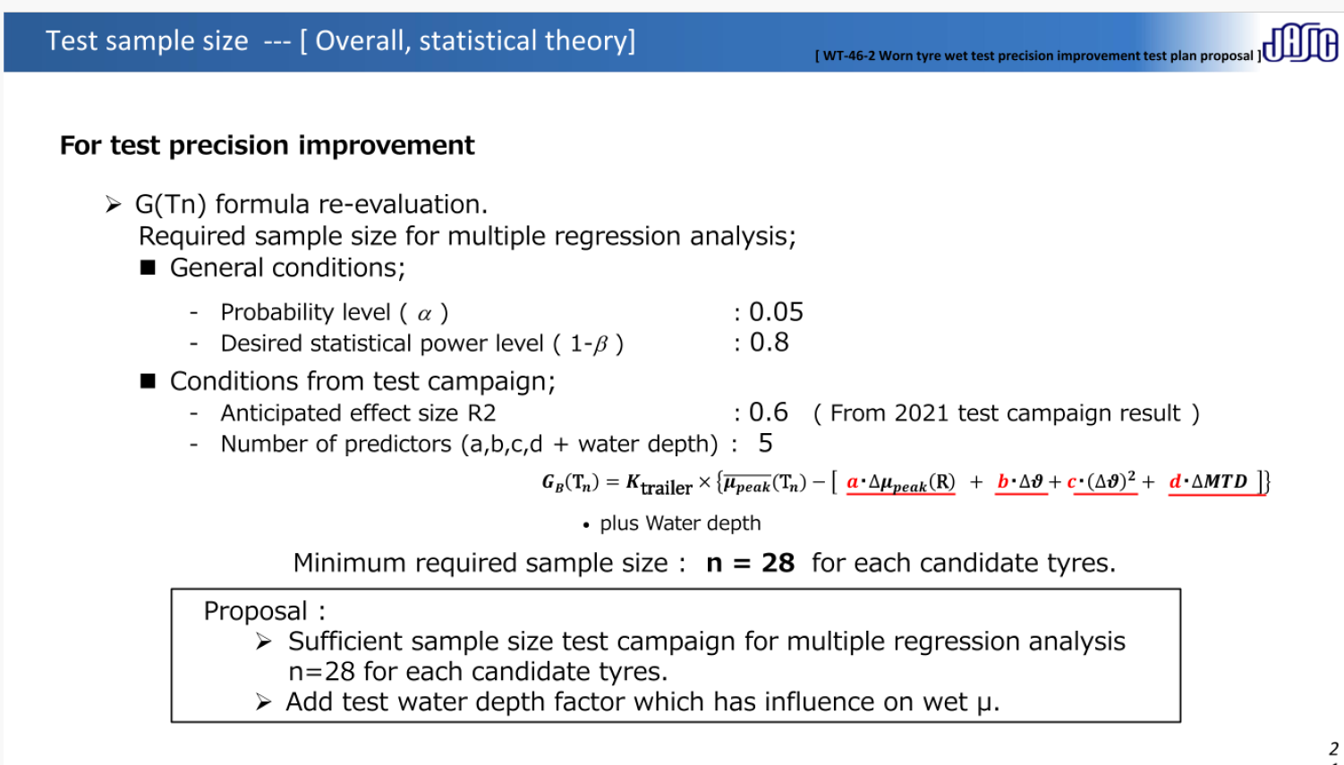
HOW TO DESIGN STAGE 1 TEST CAMPAIGN
Standard conditions → OK
Questionable
Hypothesis / assumption that WD will be the 5th correction factor
Used methodology : “Statistical Power and Sample Size for Multiple Regression”

Slide 11
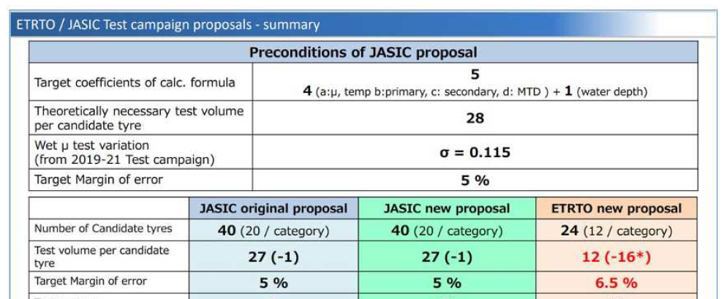
WT-60-6 JASIC revised proposal to the worn tyre wet test precision improvement activities to Co chair proposal
Scenario | General conditions & Test campaign conditions | Variable ?
JASIC proposal | α = 0.05, target Power level = 0.8, R² = 0.6 Number of predictors = 5 (a, b, c, d + water depth) | min number of tests/tyre = 27
 | α = 0.05, R² = 0.6 Number of predictors = 5 (a, b, c, d + water depth), 27 tests/tyre | Power level = 0.79 (OK vs target = 0.8)
ETRTO proposal | α = 0.05, R² = 0.68 Number of predictors = 4, 12 tests/tyre | Power level = 0.84 (OK vs target = 0.8)

Slide 12
ETRTO proposal
24 SKU’s, 15 test centers, each test center testing 8 SKU’s, 3 repetitions, each SKU tested in 5 test centers:
Still considering the agreed test sequence “SRTT16 worn – Candidates – SRTT16 worn”, two levels low/high of wet surface temperatures and two levels of water height (e.g. 0.7 / 1.3 mm) for capable test centers

Slide 13
Thank you

