Slide 1
12th A-LCA IWG SG2 MTG
2024.Jul.25
Isao Tabushi / JASIC (Japan)

Slide 2
Overall schedule plan
 | 2023 |  |  |  |  |  | 2024 |  |  |  |  |  | 2025
 | Jun | Aug | Sep | Oct | Nov | Dec | Jan | Feb | Mar | 2Q | 3Q | 4Q | -
IWG MTG
Objective ,usage method, applicable product setting
Automotive material list/classification setting
System boundary setting - Material flow/hotspot - manufacturing SG3 - waste/recycling SG5
a level concept setting
Cutoff/Data requirement/
Setting of each material carbon intensity
Data collecting and setting
Info.exchange for verification
Material classification concept for Batteries
Secondary Data Sets discussion

Slide 3
Meeting minutes (Summary of 11th meeting)
1. Dataset criteria
Tabushi proposed some criteria for dataset selection, such as update date, availability, usage history, data source, and external review.
Ramsdell suggested adding accessibility and cost as additional criteria.
Benedetta suggested adding ILCD entry level and detailed documentation as additional criteria.
Tabushi explained that ILCD entry level is common for European datasets but not for other countries.
Maruno shared OICA's comments, proposing the need for free datasets, the use of GLAD platform, and the criteria for comparability of datasets.
Hofer shared the reference information for GLAD platform and expressed support for the UN initiative.
Benedetta pointed out some caveats about the quality and cost of datasets on GLAD platform.
Tabushi summarized the opinions and said he would discuss them in an informal working group.
2. Material classification concept for other materials
Furusawa presented a list of materials used for steel, aluminium, copper alloys, and batteries, and explained the proposed steps for setting the carbon intensity values for each material.
Furusawa showed some examples of system boundaries and process flows for different materials, such as platinum, epoxy, rubber, glass, and lead acid battery, based on various databases and sources.
Benedetta suggested adding leather as a material for the seat, and offered to help with the data.
Lama pointed out that some tyre materials, such as carbon black and silica, were missing from the list, and recommended to use the tyre PCR as a reference.
Hofer proposed to have a decision tree for data selection, based on the level of detail and the availability of sector-specific data, and agreed to provide a slide for the next meeting.

Slide 4
Follow-up Tasks
Data Set Criteria: Add accessibility or cost as a criterion for data set selection (Tabushi)
Data Set Documentation: Include documentation availability as a criterion for data set selection (Tabushi)
Free Data Set for LCA: Explore the use of the GLAD platform for free data set accessibility (Tabushi)
Data Set Quality: Ensure criteria for data set quality and comparability are established (Tabushi)
Material List Addition: Add leather to the material list for consideration (Furusawa)
Tyre Material Categories: Share the tyre PCR to inform material categorization for tyres (Lama)
Data Selection Process: Visualize a decision tree for data selection process based on data availability and quality (Dietmar)

Slide 5
Agenda
Dataset
  Discussion - dataset criteria
Material classification
  Follow up task
    Leather (Furusawa)
    Tyre material (Lama)
    Data selection process (Dietmar)
Preparation for drafting

Slide 6
1.Dataset

Slide 7
Remind of IWG presentation from SG2

Slide 8
Executive summary
Remind
GHG emissions
[kg-CO2e]
Activity Data
[kg]
Intensity Data
[kg-CO2e/kg]
※For material acquisition
Both Activity Data & Intensity Data can be Primary Data or Secondary Data.
It is nearly impossible to get the all data by Primary Data.
Therefore, Secondary Data discussion is needed.
SG2 has discussed Material Classifications, these materials need to set Secondary Data for Intensity Data.
To harmonize Secondary Data as one specific Data Set, has difficulty of consensus.
SG2 propose to nominate the list of several Data Sets as preference.
Primary Data : product specific data
Secondary Data : industrial average data

Slide 9
Secondary Data Sets discussion

Slide 10
Target of Secondary Data Sets discussion
Remind
Harmonized Level | Description | Difficulty of consensus | Fairness for all user | Target
Level 4 | Develop New Deliciated DB for A-LCA | High | High
Level 3 | Select one common DB from existing DB for A-LCA
Level 2 | Nominate several common DB from existing DB for A-LCA |  |  | ← Proposal
Level 1 | No decision making of DB selection for A-LCA | Low | Low
Need to be discussed Harmonized Level of Secondary Data Sets

Slide 11
Data set proposal list (summary of 8th Meeting)
Remind
Data set name | Recommender
GREET | JASIC, OICA, VECC
IDEA | JASIC, OICA
LCIDB | OICA
CALCD | OICA
Ecoinvent | OICA, VECC
GaBi Databases | OICA, VECC
EF compliant dataset | OICA
Each industry association dataset | JASIC, European Aluminum

Slide 12
Adoption of UUID to Material Classifications
Remind
Material | No | Upstream | Process name | ID | No | Downstream | Process name | ID
Steel | 1 | Blast furnace | Crude steel, convert furnace method | 221115201pJPN | 1 | Cast iron | Pig iron castings for machinery | 225111000pJPN
 | 2 | Methane DRI | Pig steel_Methane_DRI_1 | AIST_JAMA_001 | 2 | Cast steel | Ordinary steel castings (cast steel) (including cast steel pipes) | 225311000pJPN
 |  |  | Crude steel_Methane DRI_2 | AIST_JAMA_001A | 3 | Hot-rolled steel sheet | Ordinary steel medium and thin plates (less than 6 mm thick, including low-mo plates and electric steel plates) , converter method | 222118201pJPN
 | ３ | Hydrogen DRI | Hydrogen,SMR (Gray) | AIST_JAMA_021 | 4 | Cold-rolled steel sheet | Cold-rolled ordinary steel sheet (including cold-rolled low-mo steel sheet and recycled finished steel sheet) , converter method | 222212201pJPN
 |  |  | Hydrogen,SMR +CCS (Green) | AIST_JAMA_022 | 5 | Electromagnetic steel sheet | Cold-rolled electric steel strip, converter method | 222213201pJPN
 |  |  | Hydrogen,Renew Electrolysis (Blue) | AIST_JAMA_026 | 6 | Hot-rolled hot-dip galvanized steel sheet | Hot rolled hot dip galvanized steel sheet, converter method | AIST_JAMA_000A
 | 4 | Electric furnace | Crude steel, electric furnace method | 221115202pJPN | 7 | Hot-rolled electrogalvanized steel sheet | Hot rolled electrogalvanized steel sheet, converter method | AIST_JAMA_000B
 |  |  |  |  | 8 | Cold-rolled hot-dip galvanized steel sheet | Hot dip galvanized steel sheet, converter process | 224111211pJPN
 |  |  |  |  | 9 | Cold-rolled electrogalvanized steel sheet | Electrogalvanized steel sheet, converter process | 224111221pJPN
 |  |  |  |  | 10 | Carbon steel bar/wire rod | Ordinary steel wire rod and bar in coil, converter process | 222116201pJPN
SG2 has discussed adoption of UUID to each materials. But gave up…
⇒ Finally, SG2 decide just to nominate the Data sets List.

Slide 13
Discussion – dataset criteria
Remind
In IWG, there were many comment to make a criteria for the dataset.
Now we assume below points could be discussion point as criteria.
<Proposal of dataset criteria>
  Declaration of defined criteria
  Dataset updated date
  Dataset suitability for A-LCA (Suitable for our material classification list)
  Usage history (How many user was using the dataset)
  Data source (Original creation dataset (e.g., average value of industry) or Citations from other literature)
  External reviewer

Slide 14
3. Drafting

Slide 15
SG2 drafting concept
Content of material production stage
System boundary of material production stage
  Processes included in the scope of data collection
  Data collection categories
    Primary data collection categories
    Secondary data collection categories
  Scenario
Material classification
Boundary and flow definition of each material
  Steel
  Aluminium
  Copper
  Plastic
  X. Other materials...
Today’s discussion focus
What we discussed so far

Slide 16
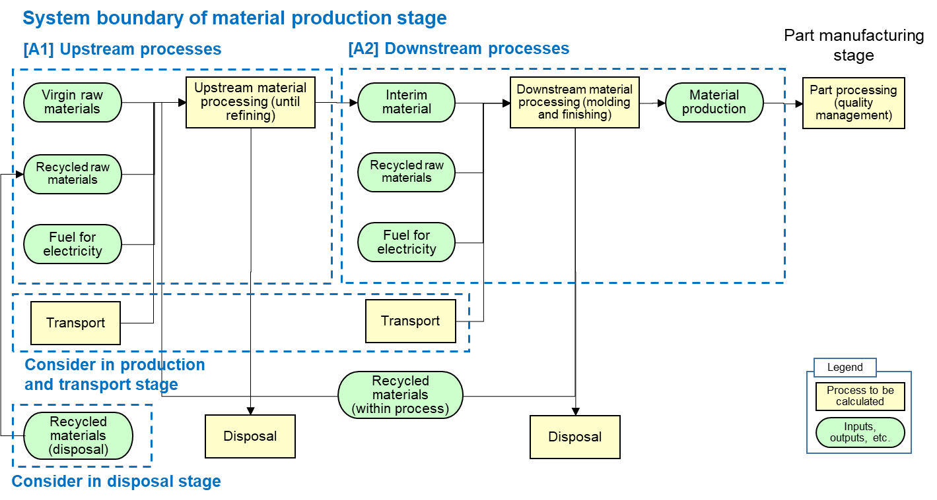
1.System boundary of material production stage
Boundary with production and EoL need to be confirmed

Slide 17
1.1 Processes included in the scope of data collection
Definition of upstream and down stream
Upstream process : material mining, refining, and impurity removal
Downstream process : Processes related to material production
Additionally, each material has own boundary of upstream and down stream.

Slide 18
1.2 Data collection categories
What data need to be collected in material stage
Blue : Primary data required
Green : Secondary data required
Red : Both primary / secondary allowed
Upstream process
  Types of processes
  Material input weight and blending ratio (usage rate of recycled materials and bio-derived materials) *Secondary data can be used if based on specific scenario model.
  Country of origin, country/region of processing, amount of fuel used for electricity, and rate of renewable energy
  GHG emission factors related to upstream processes
Downstream process
  Products being used as well as the types of processes related to their production
  Material input weight and blending ratio (usage rate of recycled materials and bio-derived materials) *Secondary data can be used if based on specific scenario model.
  Country/region of processing, amount of fuel used for electricity, and rate of renewable energy
  GHG emission factors related to downstream processes

Slide 19
1.2.1 Primary data collection categories
What primary data source allowed?
  IMDS data
  Design data?
  Actual mass measurement data? (As for material mass)
  Material inspection data? (As for material name / ingredient)
  CASS No.? (As for material name / ingredient)

Slide 20
2.3 Scenario
Assumption need to be defined for calculation
Material classification shall be selected from material list.
Selected material classification shall be most similar material of used material.
Which secondary data is used shall be described. (UUID, Dataset name, etc) * Need to be discussed with IWG
For secondary data of key materials, the upstream and downstream processes should be consistent with “3. Boundary and flow definition of each material”.
Electricity locality and usage ratio of recycled materials depend on the user, companies can conduct their own modeling calculations.
The yield rate during material production is set as being included in material intensity. When calculating CO2 during material acquisition, calculation is carried out by multiplying the material intensity by the product weight for each material and the yield rate during part processing. Therefore, instead of the yield rate during material production, the yield rate during part processing should be used for the yield rate of the material acquisition stage.

