Slide 1
Administrative Communication
SG6 leaders

Slide 2
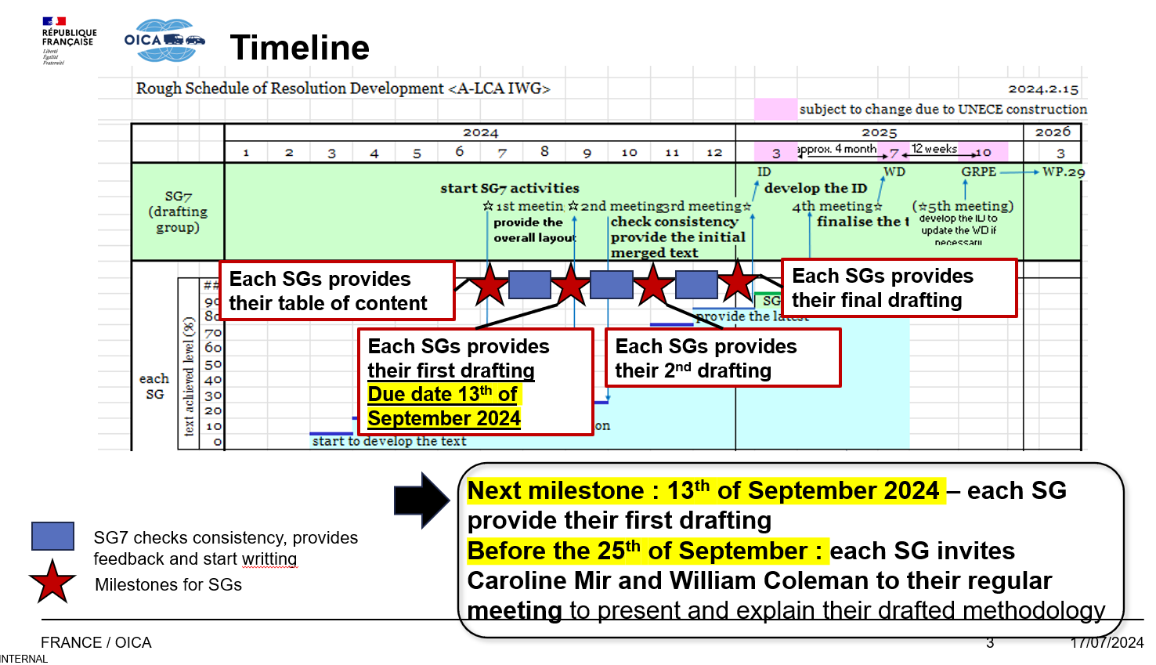
Schedule
Shared information from SG7

Slide 3
SG6 Meetings
18th (or 9th) September 13:00-14:30 CEST
We need to invite Caroline Mir and William Coleman (SG7) to explain our draft methodology.
Before 13th September: TBD

Slide 4
IWG meetings
According to the advanced notice…
September 10th 12:30 to 15:30 in CEST via Webex
17th Meeting : September 26th 9:30 to 27th 16:45 in CEST @ EC building* in Brussels (web session is also available)
* 26th is not confirmed yet
18th Meeting : October 18th 9:30 to 17:00 in CEST @ Palais des Nations/Geneva (in conjunction with 91st GRPE, web session is also available)

