Slide 1
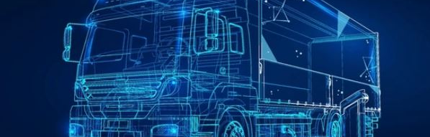
24 July 2024
IWG - EV
Explosives Subgroup Update

Slide 2
Explosives Subgroup Meetings (15 May & 17 July 2024)
Presentations:
Battery Master Switch and Permanently Energized Circuits (Kees de Putter)
Battery Electric Vehicles and Hydrogen Fuelled Vehicles (Kees de Putter)
Battery Technology and Hazards – Current State (Neeraj Sharma)
Subgroup Remit:
Review R100 and identify any issues of concern re EV/EX vehicles.
Consider the need for battery master switches
Consider Hydrogen Vehicles – Review of R-134
Priority for Group:
  Review of R100 considering transport of explosives and explosive precursors
Reporting through IWG EV; Explosives WG to be kept informed
Working towards a proposal for ADR 2027 (Nov. 2025)
Planned informal paper to EWG UN Meeting (July 2025)
Notes:
Meetins on a 2 month schedule

Slide 3
Explosives Working Group – Questions EV powered vehicles
Explosives are currently classified based on hydrocarbon or wood fires. How differently might explosives behave in a lithium batteries fire? More specifically, what are the properties of a lithium batteries fire that may be different from a hydrocarbon or wood fire?
Cells and other ejecta may be projected from a battery pack in some adverse circumstances, thus projecting heat and reactive chemicals and electricity into the explosives. How might this be controlled.
Preferably avoid placing batteries under the load.
Is it necessary to require tyre or running gear monitoring systems on vehicles? (Tyres and running gear present problems already for all vehicles, however the presence of lithium batteries will compound the problems.)
Electric detonators are still widely used. What might be the impact of a massive discharge from the battery.
Could there be a bigger hazard from electro-static discharge if the vehicle is battery powered?
What might be the impact on explosives in metal packagings?
Is it possible to monitor the buildup of lithium in the battery?
Notes:
26 June 2024
Questions 5-7 should be answered by the EWG members

Slide 4
Explosives Subgroup Members
Barbara Lehner Anna Martinez
Jon Wood Jonathan Buston
Bob Woolley Soedesh Mahesh
Roman Vala King Wei Siew
Christopher Proctor Richard Bilman
Ken Price Josh Hofmann
Neeraj Sharma Daniel Brocklebank
David Piper Travis Hillaby
Johann Zank

Slide 5
UNECE Working Party on the Transport of Dangerous Goods (WP.15)
Developing provisions for the electrified carriage of dangerous goods for road. These provisions will be included in ADR (Agreement concerning the International Carriage of Dangerous Goods by Road).
Explosives Subgroup to support WP15 with development of requirements for the powering of EX-vehicles (carriage of Explosives and Explosive Precursors) on batteries, hydrogen, and hydrogen fuel cells.
Given specific knowledge and experience with Class 1 within CIE/IGUS-EPP and involvement in the Working Group on Explosives of the UN SCE TDG, we would like to invite you to participate in the Explosives Subgroup.
Please contact Soedesh Mahesh (soedesh.mahesh@rivm.nl) or Johann Zank (johann.zank@orica.com) if interested.

