Slide 1
Method of Stating Energy Consumption
Updated
2015

Slide 2
Part 1: Literature review
Many papers are related to the assessment of energy saving and GHG emission reductions of EV in different countries or districts.
Upstream stage of power supply should be covered for EV assessment.
The data of electricity mix and upstream emissions factor of different power supplying can be collected in most of countries.
A standardized method for calculating and stating energy consumption and the associated GHG emissions for electrified vehicles is therefore recommended for consideration.

Slide 3
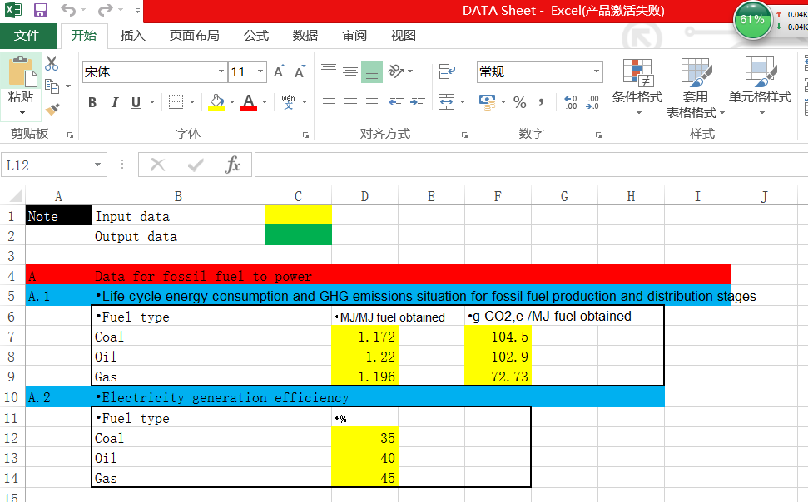
Part 2: Calculation methods suggested
The methods are suggested to use EXCEL tools to get Life cycle analysis results.

Slide 4
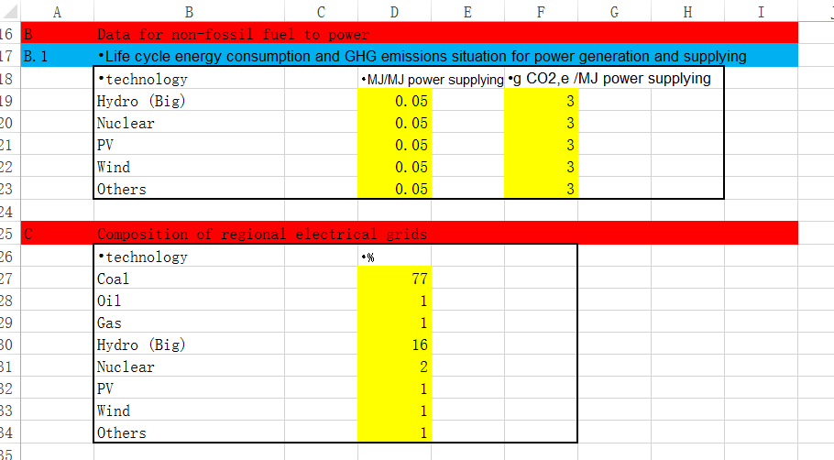
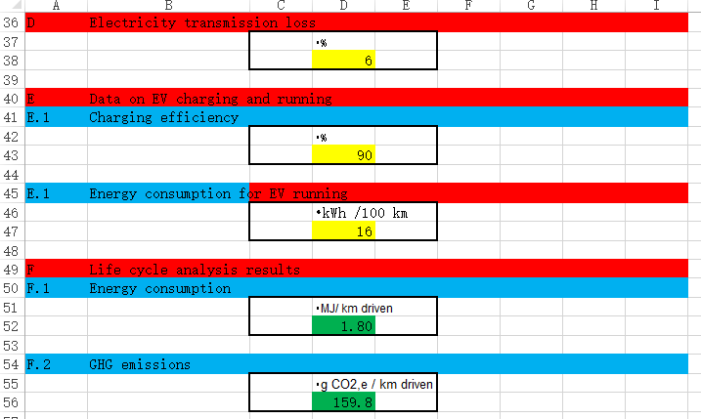

Slide 5
Part 3: Stating Methods suggested
the life cycle energy consumption per unit distance driven by EV can be calculated based on some data collected for the specific region

Slide 6
Based on the data input in to the input cell (the Yellow Cell), the results will be showed in the output cell (the Green Cell) with the formula in Cell D52 and Cell D56:
  Energy consumption
    D52=3.6*D47/D43/(1-D38/100)*(D27/100/(D12/100)*D7+D28/100/(D13/100)*D8+D29/100/(D14/100)*D9+D30/100*D19+D31/100*D20+D32/100*D21+D33/100*D22*+D34/100*D23)
  GHG emissions
    D56=3.6*D47/D43/(1-D38/100)*(D27/100/(D12/100)*F7+D28/100/(D13/100)*F8+D29/100/(D14/100)*F9+D30/100*F19+D31/100*F20+D32/100*F21+D33/100*F22*+D34/100*F23)

Slide 7
Part 4: DATA to collect
The following data were encouraged to submit for the calculation mentioned above,
Data on electricity chains
  Life cycle energy consumption and GHG emissions situation for fossil fuel production and distribution stages of power generation
    MJ/MJ fuel obtained
    g CO2,e /MJ fuel obtained
  Electricity generation efficiency (%, by type)
  Life cycle energy consumption and GHG emissions situation for non fossil fuel power generation and supplying
    MJ/MJ power supplying
    g CO2,e /MJ power supplying
  Composition of regional electrical grids (%)(Coal, Oil, Gas, Hydro, Nuclear, PV, Wind and others)
  Electricity transmission loss (%)
Data on EV charging and running
  Charging efficiency (%)
  Energy consumption for EV running (kWh /100 km)

Slide 8
Part 5: Stating Methods Suggested
About the stating methods, some rules are suggested.
Labelling together
  ** kWh /100 km
  ** Liter (gasoline equivalent)/ 100 km
Considering energy consumption by upstream and operation stages
  Upstream (percentile)
  Operation (percentile)
Comparing GHG emissions to conventional gasoline vehicle
  Total
  By stages

Slide 9
Part 6: Supports are welcomed from contracting parties
The data listed in Part 4 should be collected with clear sources such as statistical book or formal report;
The data format please see the EXCEL Sheet;
Modifications suggestion for our suggested methods, with the presentation about the experiences of current calculation and labelling methods in EU, US and other specific regions.

