Slide 1

WLTP-12-08-rev1e
BMW, Christoph Lueginger
23.09.2015
WLTP, result calculation, v6
measured result is corrected by RCB, Ki, 14° test and interpolation.

Slide 2
WLTP Result Postprocessing Proposal
Dear Reader,
please provide your feedback on that questions in Tokyo or in advance:
After options are selected and agreement is achieved, implementation and drafting will be done by the taskforce until GTR deadline.
Question | EU | Japan | India | Korea | NGOs | autho-rities | received tendency up to now
Do you prefer to clarify that issue and provide a transparent process by the GTR (a) or do you want to leave it up to OEM and authority to solve that at the stage of the type approval (b)? |  |  |  |  |  |  | a
Do you prefer to simplify the final GTR text (which puts more effort in drafting until the deadline in 2 weeks) (a) or should we do an "endoscopic surgery" (b)? |  |  |  |  |  |  | a
Should HEV and CS be aligned as much as possible with ICE or do we accept a deviation. Option 1 or 2? |  |  |  |  |  |  | 2
Do you agree to leave out CD and OVC-HEVs (a) or should that be solved within phase 1b as well (b)? |  |  |  |  |  |  | a
Do you agree to that priority in the current proposal: 1. criteria emissions and CO2, 2. fuel consumption; (yes/no)? |  |  |  |  |  |  | yes
WLTP Postprocessing, Result Calculation, BMW, 23.09.2015

Slide 3
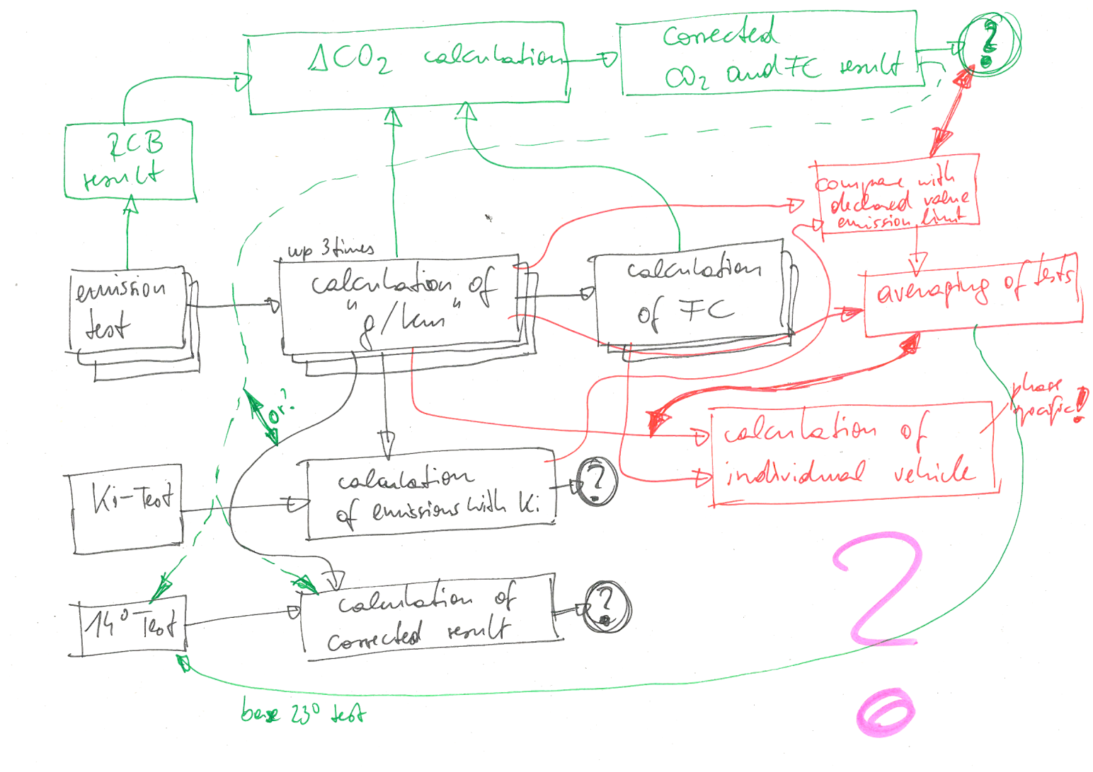
WLTP Result Postprocessing Proposal
Current situation
➔ All GTR post-calculations have been developed regardless of other parts and issues.
➔ Some references are wrong, some results come to nothing, some results are bypassed.
➔ Also Calculation of EV issues is unclear, especially at which stage and where tests are averaged and how that is aligned with a declared value.
WLTP Postprocessing, Result Calculation, BMW, 23.09.2015

Slide 4
WLTP Result Postprocessing Proposal
How values are connected (1)
CO₂ phase values
CO₂ combined
FC phase values
Ki and regional corrections (e.g. 14° test)
averaging of tests
FC combined value
declared value
criteria emissions
WLTP Postprocessing, Result Calculation, BMW, 23.09.2015

Slide 5
WLTP Result Postprocessing Proposal
How values are connected (2)
CO₂ phase values
CO₂ combined
FC phase values
Ki and regional corrections (e.g. 14° test)
averaging of tests
FC combined value
declared value
criteria emissions
WLTP Postprocessing, Result Calculation, BMW, 23.09.2015

Slide 6
WLTP Result Postprocessing Proposal
How values are connected (3)
CO₂ phase values
CO₂ combined
FC phase values
Ki and regional corrections (e.g. 14° test)
averaging of tests
FC combined value
declared value
criteria emissions
WLTP Postprocessing, Result Calculation, BMW, 23.09.2015

Slide 7
WLTP Result Postprocessing Proposal
Challenges and open tasks
phase specific values
influence of criteria
emissions on FC
?
additive corrections
(step exchange will deliver
different results)
declaration (alignment of
values like FC and phases
towards the declared value)
averaging of tests
solution
regional options
vehicle type | prior to IWG | IWG Tokyo, TARGET | until mid of October | TF-meeting | Final text | Phase II
conventional vehicle | proposal for order of steps, first drafting | agreement on steps | drafting of references and additional formulas | TBA | 18th of October | -
NOVC-HEVs, CS of OVC-HEVs, fuel cell | identification of steps and proposal for order | agreement on principle and steps | drafting of references and if necessary adaptions to Annex 8 | TBA | 18th of October | -
CD and combined values of OVC-HEVs |  | decide, if actions are needed | - | - | - | deal with that issue, if necessary
PEVs | not necessary
WLTP Postprocessing, Result Calculation, BMW, 23.09.2015

Slide 8
WLTP Postprocessing, V6: conventional
1
test
measurement, calculation of mass emissions [Annex 7, 3.]
phase
CO₂
phase
emiss.
comb.
emiss.
2
comb.
combined value (3-/4-phases, weighted by distance) [open → in new draft]
phase
CO₂
comb.
CO₂
phase
emiss.
comb.
emiss.
3
RCB
RCB correction [Annex 6, App. 2]
phase
CO₂
comb.
CO₂
inter-
mediate
comb. FC
comb.
emiss.
4
Ki
K_{i} correction [Annex 6, App. 1]
phase
CO₂
comb.
CO₂
comb.
emiss.
(
5
regional
Regional corrections (EU: ATCT 14°C test, DF) [e.g. EU Sub-Annex 6a]
phase
CO₂
comb.
CO₂
comb.
emiss.
)
6
AVG
averaging of tests, declared value (regional?) [Annex 6, Japanese proposal]
phase
CO₂
comb.
CO₂
comb.
emiss.
7
align
alignment of phase values [Annex 6, Japanese text proposal]
phase
CO₂
comb.
CO₂
comb.
emiss.
8
FC
calculation of fuel consumption values [Annex 7, 6.]
phase
CO₂
comb.
CO₂
phase
FC
comb.
FC
comb.
emiss.
9
approval
averaging of emissions L and H (?), final interpolation line [open → in new draft]
phase
CO₂
comb.
CO₂
phase
FC
comb.
FC
comb.
emiss.
10
vehicle
interpolation method, rounding. (Europe → "CoC") [Annex 7, 3.2.3.]
phase
CO₂
comb.
CO₂
phase
FC
comb.
FC
comb.
emiss.
WLTP Postprocessing, Result Calculation, BMW, 23.09.2015

Slide 9
WLTP Postprocessing, V6: NOVC-HEV/CS OVC-HEV option 1
1
test
measurement, calculation of mass emissions
[Annex 7, 3.]
phase
CO₂
phase
emiss.
comb.
emiss.
GTR rules the development of fuel consumption and CO₂ correction coefficients. Hence, the fuel consumption has to be calculated in parallel, but…
1.) … no procedure defined to calculate K_{i} for NOVC-HEVs and OVC-HEVs.
2.) … no FC correction factor from the 14ºC test.
First an agreement is necessary how to proceed:
First option: Try to get the CS test in line with conventional vehicles. This needs time for agreements and amendments in Annex 8.
Second option: Separate postprocessing procedure.
Additionally we need a postprocessing procedure for:
1.) CD test for OVC-HEVs
2.) weighted values
3.) For ranges of OVC-HEVs and PEVs
4.) OVC-FCHVs?
Construction work:
Averaging and declared value
2
comb.
combined value (3-/4-phases, weighted by distance)
[open → in new draft]
phase
CO₂
comb.
CO₂
phase
emiss.
comb.
emiss.
3
RCB
RCB correction [Annex 8, App. 2]
phase
CO₂
comb.
CO₂
comb.
emiss.
4
Ki
K_{i} correction [no procedure for
NOVC/OVC-HEV defined → skip for HEVs]
phase
CO₂
!
comb.
CO₂
comb.
emiss.
(
5
regional
Regional corrections (EU: 14°C test, DF)
[e.g. EU Sub-Annex 6a]
phase
CO₂
comb.
CO₂
comb.
emiss.
)
6
AVG
averaging of tests, declared value (regional?)
[Annex 6, Japanese proposal]
phase
CO₂
comb.
CO₂
comb.
emiss.
7
declare
alignment of phase values
[Annex 6, Japanese text proposal, works for HEV?]
phase
CO₂
comb.
CO₂
comb.
emiss.
8
FC
calculation of fuel consumption values
[Annex 7, 6.]
phase
CO₂
comb.
CO₂
phase
FC
comb.
FC
comb.
emiss.
9
approval
averaging of emissions L and H (?), final interpolation line
[open → in new draft]
phase
CO₂
comb.
CO₂
phase
FC
comb.
FC
comb.
emiss.
10
vehicle
interpolation method, rounding. (Europe → "CoC")
[Annex 7, 3.2.3.]
phase
CO₂
comb.
CO₂
phase
FC
comb.
FC
comb.
emiss.
For fuel cells whole process is done with fuel consumption instead of CO₂.
WLTP Postprocessing, Result Calculation, BMW, 23.09.2015

Slide 10
WLTP Postprocessing, V6: NOVC-HEV/CS OVC-HEV option 2
1
test
measurement, calculation of mass emissions
[Annex 7, 3.]
phase
CO₂
phase
emiss.
GTR rules the development of fuel consumption and CO₂ correction coefficients. Hence, the fuel consumption has to be calculated in parallel, but…
1.) … no procedure defined to calculate K_{i} for NOVC-HEVs and OVC-HEVs.
2.) … no FC correction factor from the 14ºC test.
First an agreement is necessary how to proceed:
First option: Try to get the CS test in line with conventional vehicles. This needs time for agreements and amendments in Annex 8.
Second option: Separate postprocessing procedure.
Additionally we need a postprocessing procedure for:
1.) CD test for OVC-HEVs
2.) weighted values
3.) For ranges of OVC-HEVs and PEVs
4.) OVC-FCHVs?
Construction work:
Averaging and declared value
2
FC
calculation of fuel consumption values
[Annex 7, 6.]
phase
CO₂
phase
FC
phase
emiss.
3
comb.
combined value (3-/4-phases, weighted by distance)
[open → in new draft]
phase
CO₂
comb.
CO₂
phase
FC
comb.
FC
phase
emiss.
comb.
emiss.
4
RCB
RCB correction [Annex 8, App. 2]
phase
CO₂
comb.
CO₂
phase
FC
comb.
FC
comb.
emiss.
5
Ki
K_{i} correction [no procedure for
NOVC/OVC-HEV defined → skip for HEVs]
phase
CO₂
comb.
CO₂
phase
FC
!
comb.
FC
comb.
emiss.
(
6
regional
Regional corrections (EU: 14°C test, DF)
[e.g. EU Sub-Annex 6a]
phase
CO₂
comb.
CO₂
phase
FC
!
comb.
FC
comb.
emiss.
)
7
AVG
averaging of tests, declared value (regional?)
[Annex 6, Japanese proposal]
phase
CO₂
comb.
CO₂
phase
FC
comb.
FC
comb.
emiss.
8
declare
alignment of phase values
[Annex 6, Japanese text proposal, works for HEV?]
phase
CO₂
comb.
CO₂
phase
FC
comb.
FC
comb.
emiss.
9
approval
averaging of emissions L and H (?), final interpolation line
[open → in new draft]
phase
CO₂
comb.
CO₂
phase
FC
comb.
FC
comb.
emiss.
10
vehicle
interpolation method, rounding. (Europe → "CoC")
[Annex 7, 3.2.3.]
phase
CO₂
comb.
CO₂
phase
FC
comb.
FC
comb.
emiss.
For fuel cells whole process is done with fuel consumption instead of CO₂.
WLTP Postprocessing, Result Calculation, BMW, 23.09.2015

Slide 11
WLTP Result Postprocessing Proposal
TODO-List
item | situation | task | status
1 | No agreed postprocessing procedure for ICE. | To be agreed / adopted. | proposal available
2 | No agreed postprocessing procedure for HEVs and CS. | To be agreed / adopted. | two options and proposal available
3 | Also table needed for PM PN? Annex 7, 3.3. Mass of particulate matter emissions Annex 7, 4. Determination of PN | To be clarified. | open
4 | If additive K_{i} is used for CO₂, an alignment (→ as for declared value issue) is necessary. | Draft formulas to Annex 6. | open
5 | RCB corrections provides FC correction as well. | Delete requirement, as FC is based on corrected CO2. | open
6 | References and formulas to be adapted to final proposal | Go through any of the paragraphs which are used for post calculation and: 1) change input reference 2) add formulas, if necessary (e.g. combined value instead of phases only) 3) change output reference | open
7 | declared value, alignment and distinction between fuel cell and HEV in that context | Check current draft and apply changes, if necessary. Use Japanese Annex 6 draft as far as possible. | open
WLTP Postprocessing, Result Calculation, BMW, 23.09.2015

