Slide 1

WLTP-12-08e
BMW, Christoph Lueginger
31.08.2015
WLTP, result calculation, v4
measured result is corrected by RCB, Ki, 14° test and interpolation.

Slide 2
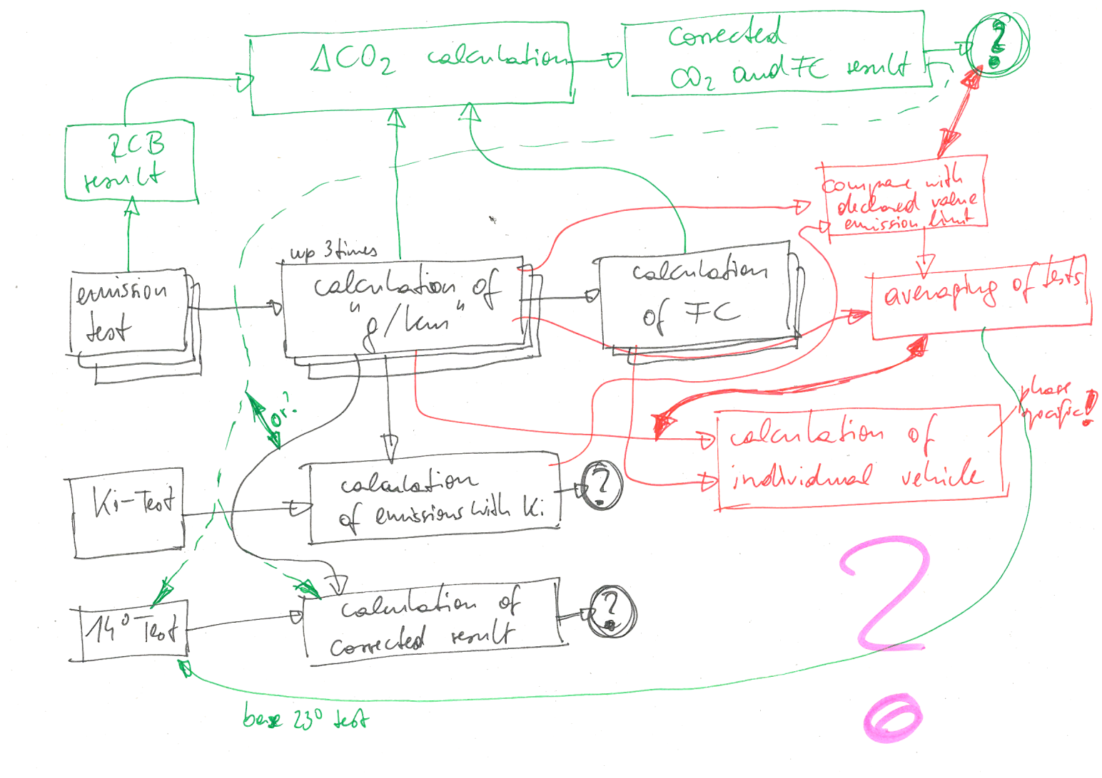
WLTP Result Postprocessing Proposal
Current situation
➔ All GTR post-calculations have been developed regardless of other parts and issues.
➔ Some references are wrong, some results come to nothing, some results are bypassed.
WLTP Postprocessing, Result Calculation, BMW, 20.08.2015

Slide 3
WLTP Result Postprocessing Proposal
1
test
measurement, calculation of mass emissions [Annex 7, 3.]
phase
CO₂
phase
emiss.
comb.
emiss.
2
RCB
RCB correction [Annex 6, App. 2]
phase
CO₂
inter-
mediate
comb. FC
comb.
emiss.
3
Ki
Ki correction [Annex 6, App. 1]
phase
CO₂
comb.
emiss.
(
4
regional
Regional corrections (EU: 14° test, DF) [e.g. EU Sub-Annex 6a]
phase
CO₂
comb.
emiss.
)
5
FC
calculation of fuel consumption values [Annex 7, 6.]
phase
CO₂
phase
FC
comb.
emiss.
6
comb.
combined value (3-/4-phases, weighted by distance) [unclear]
phase
CO₂
comb.
CO₂
phase
FC
comb.
FC
comb.
emiss.
A
AVG
averaging of test results, alignment of phase values [Annex 6, Japanese proposal]
phase
CO₂
comb.
CO₂
phase
FC
comb.
FC
comb.
emiss.
B
declare
declared value, regional differences [Annex 6, Japanese text proposal]
phase
CO₂
comb.
CO₂
phase
FC
comb.
FC
comb.
emiss.
C
approval
averaging of emissions L and H, final interpolation line [open]
phase
CO₂
comb.
CO₂
phase
FC
comb.
FC
comb.
emiss.
vehicle
interpolation method, rounding. (Europe → "CoC") [Annex 7, 3.2.3.]
phase
CO₂
comb.
CO₂
phase
FC
comb.
FC
comb.
emiss.
WLTP Postprocessing, Result Calculation, BMW, 20.08.2015

Slide 4
WLTP Result Postprocessing Proposal
Challenges and open tasks
phase specific values
influence of criteria
emissions on FC
?
additive corrections
(step exchange will deliver
different results)
declaration (alignment of
values like FC and phases
towards the declared value)
averaging of tests
solution
regional options
steps | task | situation
1 | agreement on importance, agreement being a GTR issue, installation of TF | the need was already identified in the last drafting-TF-meeting
2 | identify all calculation steps | done for ICE and EV
3 | decide their order, decide which errors can be accepted, clarify overlapping issues ICE-EV | proposal for ICE available
4 | drafting of main structure | proposal for ICE available
5 | drafting within each calculation step | open
6 | check by stakeholders and testing (via a tool?) | open
today's task
WLTP Postprocessing, Result Calculation, BMW, 31.08.2015

