Slide 1
Progress report of
Sub Group EV
(WLTP-12-19e)
1. Proposals for adoption
2. Discussion points
3. Issues for phase 2

Slide 2
1. Proposals for adoption

Slide 3
OIL# 56 : Interpolation approach
OIL # 55 : Phase specific calculation & OIL #2 Family definition
Overview:
In this approach, parameters, such as FC, could be calculated by the Interpolation which is based on energy demand.
Family definitions and special treatments for electrified vehicles have been discussed to ensure the interpolation line to have good linearity.
EV SG’s conclusion:
EV SG proposes to use this approach in order to obtain all parameters (excluding Rcda) of Electrified Vehicles.
Special conditions for EVs are applied.
*CO2 mass emission criteria between H & L vehicle
*linearity observation with M vehicle
*allowable difference in Rcdc between H & L vehicle
See draft proposal
Note: Interpolation approach for Rcda is not prepared in phase 1b.

Slide 4
The current GTR definition of Rcda
Rcda: "Charge-depleting actual range" means the distance travelled in a series of WLTCs in charge-depleting operation condition until the rechargeable electric energy storage system (REESS) is depleted.
100
80
charge-depleting
60
SOC (%)
40
charge-sustaining
20
0
Rcda
The distance of a trip
With this Rcda, the things in the next page could happen.

Slide 5


Complexity of what Rcda indicates
 | AER type | BLENDED type
Vehicle
+
0
Rcda
0
Rcda
AER type vehicle could be converted into BLENDED type by changing its control strategy without changing its hardware. As the consequent, Rcda could be extended easily.

Slide 6
Problem with Rcda(for cycle and phase)
What Rcda indicates is too complex to users.
⇒ This is a common problem between cycle and each phase.
EV SG concluded that the group halts the development on the interpolation method for Rcda in phase 1b.

Slide 7
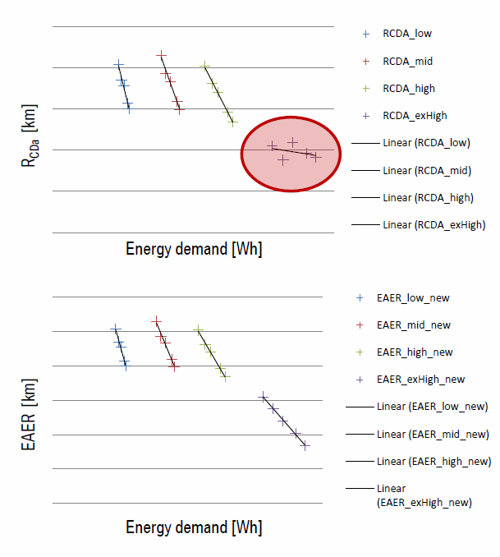
Appendix
Comparison between Rcda and EAER on the interpolation approach
Vehicle L was driven with no engine-on in CD
Vehicle H was driven with engine-on in CD
Vehicle L
Vehicle H
The linearity of interpolation line for Rcda is insufficient in case that the additional family criteria is not included.
Under the same condition, the linearity of interpolation line for EAER is sufficient.
(Reference : WLTP-SG-EV-08-05-rev1)

Slide 8
OIL# 56 : Interpolation approach
OIL # 55 : Phase specific calculation & OIL #2 Family definition
The interpolation approach shall be used if the difference in M(CO2,CS) between test vehicles L and H is between a minimum of 5 and a maximum of 20 g/km or 20 per cent of M(CO2,CS).
If vehicle M is tested, the maximum absolute boundary of 20 g/km difference between vehicle L and vehicle H or 20 per cent of the M(CO2,CS) for vehicle H, whichever is smaller, may be extended by 10 g/km.
Vehicle M is a vehicle whose cycle energy demand is within ± 10 per cent of the center value between vehicles L and H.
The linearity of vehicle M should be checked to have smaller deviation than 3 percent or 3 g/km, whichever is smaller, with allowed minimum tolerance for the linearity of 1 g/km from the interpolation line. If the linearity criterion is not fulfilled, the interpolation family shall be split in two sub-families.
Rcdc difference between vehicle L and H shall be up to one.
CO2
Interpolation line
energy demand
Vehicle_L
Vehicle_M
Vehicle_H
SOC
Vehicle_L
Vehicle_H
Rcdc(Vehicle_H)
length
Rcdc(Vehicle_L)

Slide 9
OIL# 58: PEV shorten test procedure
Overview:
This procedure is based on range calculation. This enables to reduce the test burden keeping good accuracy.
EV SG’s conclusion:
EV SG proposes Shorten test procedure for PEV to obtain Range and EC.

Slide 10
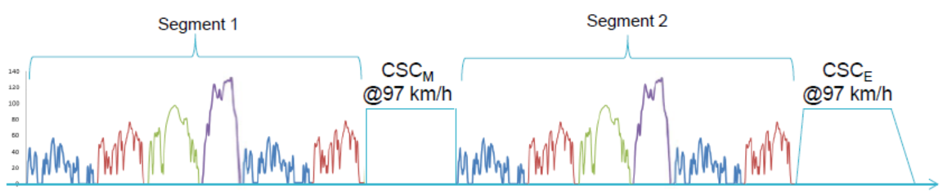

Method of PEV shorten test
${AER}_{WLTC}=\frac{{UBE}_{STP}}{{EC}_{DC,WLTC}}$ (29)
${EC}_{DC,WLTC}=\sum_{j=1}^{2}{{EC}_{DC,WLTC,j}×K_{WLTC,j}}$ (31)

Slide 11
Conditions for Shorten Test Procedure
 | Proposals (tentative)
Boundary for STP use | Test method Test vehicle’s range | Consecutive cycle test | Shorten test
 | Range < 70km (L ~ exH ) < 60km (L ~ H ) | Mandatory | Prohibit
 | Range ≧ 70km (L ~ exH ) ≧60km (L ~ H ) | Prohibit | Mandatory
Constant Speed Cycle (minimum speed) | L ~ exH : 100km/h , L ~ H : 80km/h
Constant Speed Cycle duration | The duration is set to preserve the 10% electric energy of UBE at the CSCE (= the final CSC of the test schedule)
WLTP IWG is requested to adopt these issue.

Slide 12
OIL# 52: End of PEV test criteria
Overview:
This issue is to consider special treatments for PEVs which are not able to follow the prescribed cycle due to their limited speed or power.
EV SG’s conclusion:
EV SG agreed on Downscale for ex-H of PEV.
EV SG agreed on Cap speed of EV as a regional option.
EV SG proposes a new cycle modification* for Cap speed.
*: This will be explained in “discussion point” session.

Slide 13
OIL# 52: End of PEV test criteria
Summary of implementation of downscale and
cap speed + special cycle modification(distance compensation)
vehicle type | downscale | cap speed + distance compensation
NOVC-HEV | NG | Regional option OK : EU NG : JPN(L&M only)
OVC-HEV | NG | Regional option OK : EU NG : JPN(L&M only)
PEV | OK But it is only for ex-H | Regional option OK : EU NG : JPN(L&M only)
ICE V | OK | Regional option OK : EU NG : JPN(the acceleration shall be fully activated)

Slide 14
OIL# 51: Mode selectable switch
Overview:
When several modes are available, the method to select a mode for testing needs to be defined. The EV SG has constracted the decision flow for the selection considering the ability to follow the cycle.
EV SG’s conclusion:
The SG agreed on the following decision flow.

Slide 15
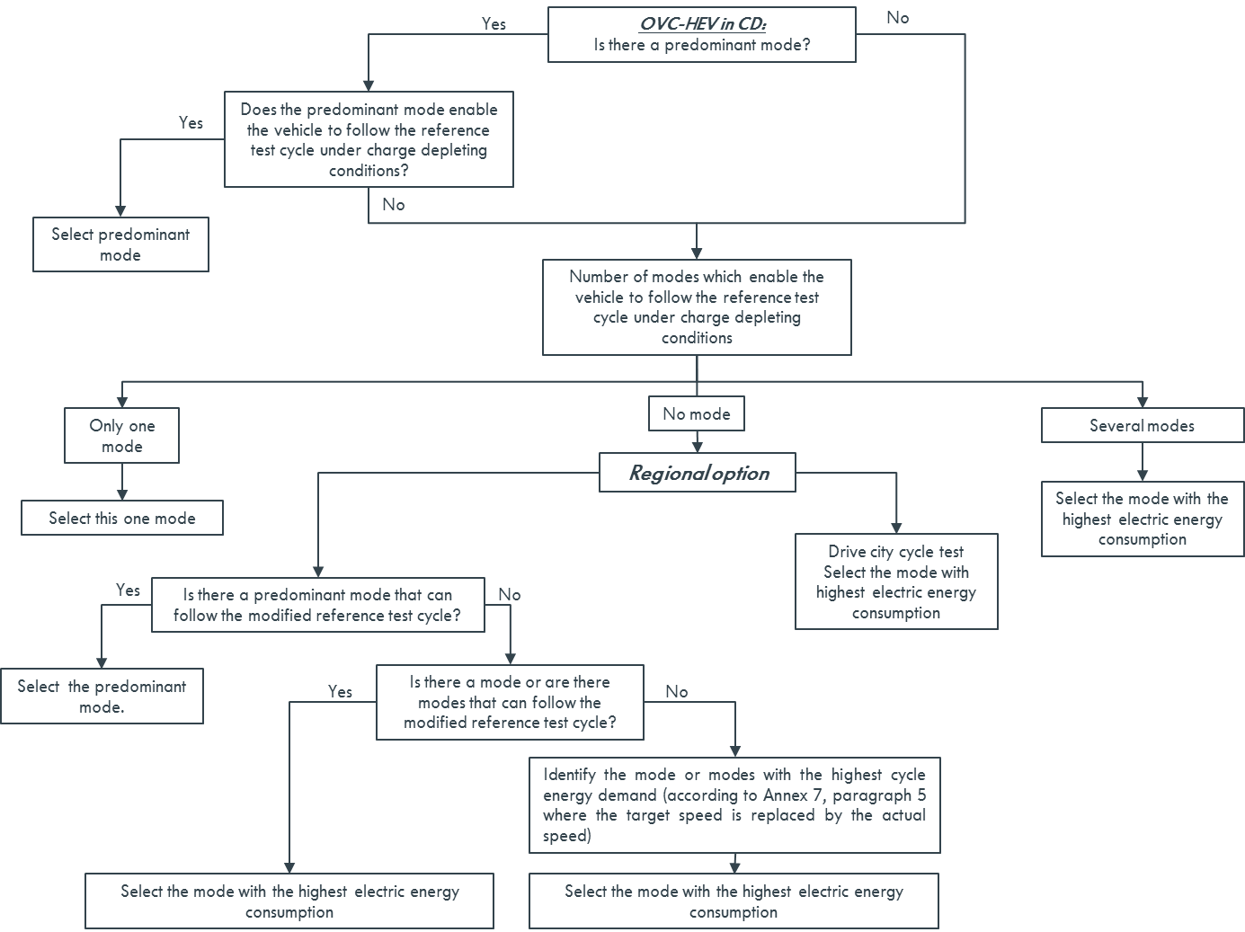
For OVC-HEV in CD

Slide 16
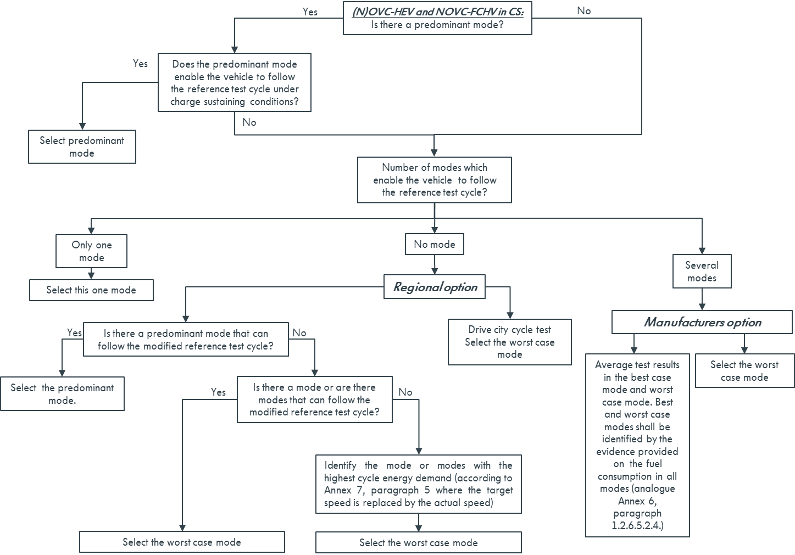
For NOVC-HEV, NOVC-FCHV and OVC-HEV in CS (draft version)

Slide 17
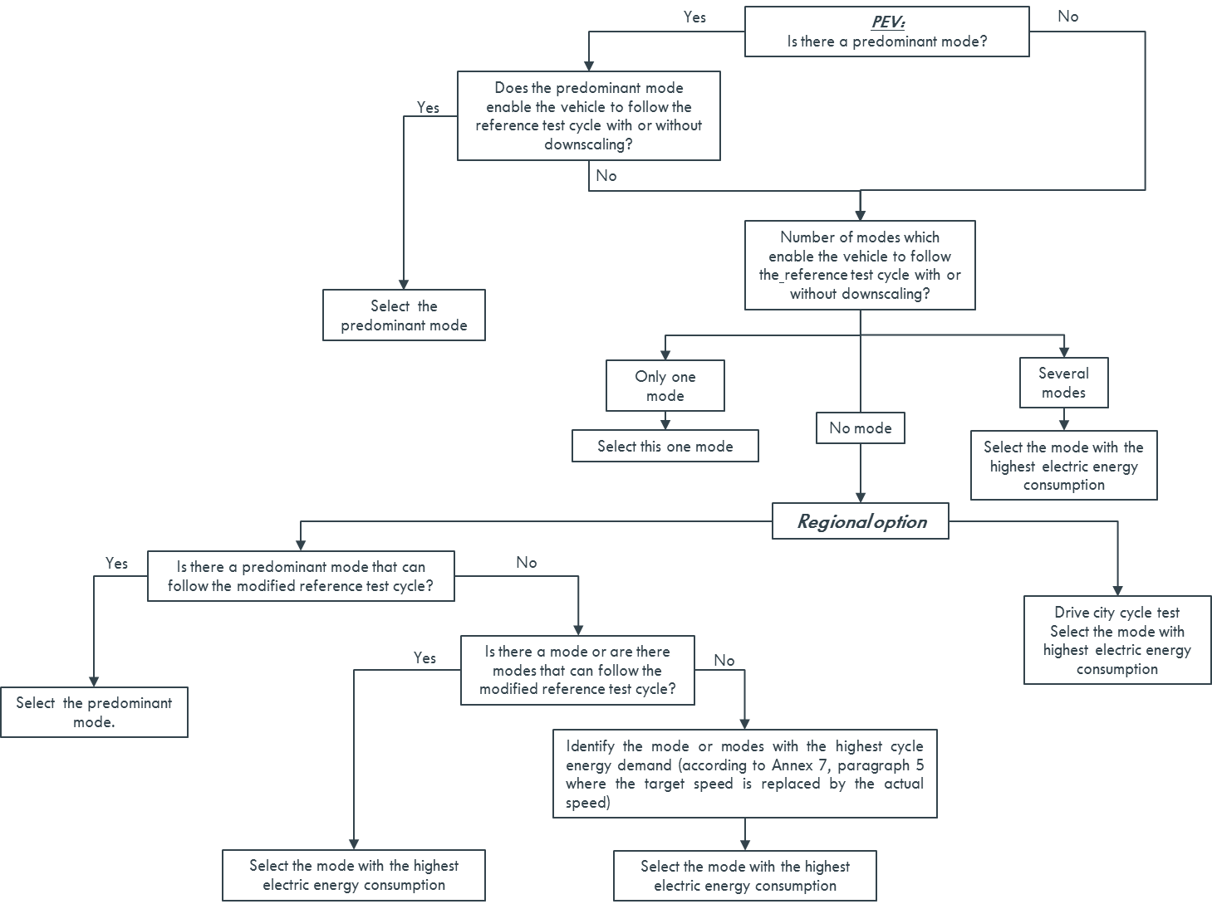
For PEV (draft version)

Slide 18
2. Discussion points

Slide 19
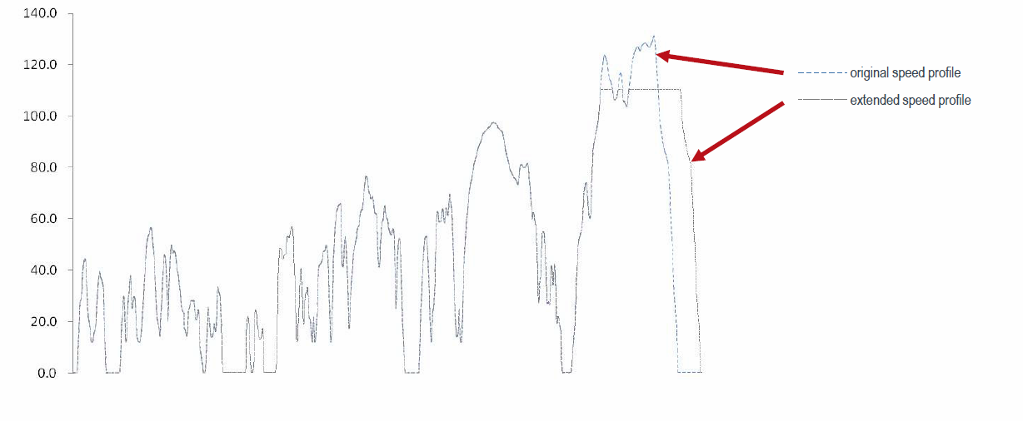
Capped speed is now available for all type of vehicles.
The EV SG developed the special modification method for capped cycle to have the same length of the original cycle with a compensation.
The idea of the compensation is following.
The final trip is extended in order to compensate the length.

Slide 20
The EV SG’s recommendation
The WLTP IWG is requested to discuss the implementation of this compensation method for all type of vehicles as a CP’s option. In this case, this part should be put in the annex 1.
The draft proposal of the distance compensation was already provided by Mr. Heinz Steven.

Slide 21
3. Issues for phase 2

Slide 22
Classification of EVs
Power determination is required and EVE IWG will working on it.
EV SG is requested to provide a guidance considering the adoption of EVE’s output to WLTP GTR.
Interpolation method for Rcda
Interpolation method for FCHVs
AOB

Slide 23
Schedule
 | 6 | 7 | 8 | 9 | 10
IWG Meeting | #11 |  |  | #12
Drafting Meeting | #3 |  |  |  | #4 18, Oct
E-Lab. Meeting | #9 |  |  | #10(28)
Euro. EV drafting
@Brussels(11,12)
gtr drafting in advance
is necessary
EV drafting
@web(20)
Deadline of gtr submission
EV drafting
@web(4)
EV drafting
@web(11)
EV drafting
@web(18)
EV drafting
@web(25)

