Slide 1
19th SG6 meeting
9th of October 2024 online
Meeting info
Date | October 9th 2024
Time | 13:00pm until 14:30pm CEST
Link | Online: https://meet.google.com/jzm-dtzo-mkt
Time |  | Agenda Item | Lead | Working Paper | Purpose or Target
13:00 ~ | 1 | Welcome and introduction | Chair | NA | Introduction
~ 13:05 | 2 | Adoption of the agenda | Chair | A-LCA-SG6-19-01 | Agreement
~ 13:10 | 3 | Report from the last A-LCA meeting: Emissions related to infrastructure Leveling concept | Chair | A-LCA-SG6-19-02 | Notification
~ 13:20 | 4 | Energy modelling draft | Chair | A-LCA-SG6-19-02 | Discussion
~ 14:10 | 5 | Open issue | Chair | NA | Agreement
~ 14:20 | 6 | Any other business & next meeting | Participants | NA | Notification
~ 14:30 | 7 | Closing | Chair | NA | Closing

Slide 2
Report from 17th IWG
+ new task
SG6 co-leaders

Slide 3
What were discussed in the IWG
Infrastructure
- Include or exclude the emission from the construction of infrastructure
- Chair requested SG6 to consider the draft document about infrastructure and to present the document at the next IWGs
Leveling concept

Slide 4
Infrastructure

Slide 5
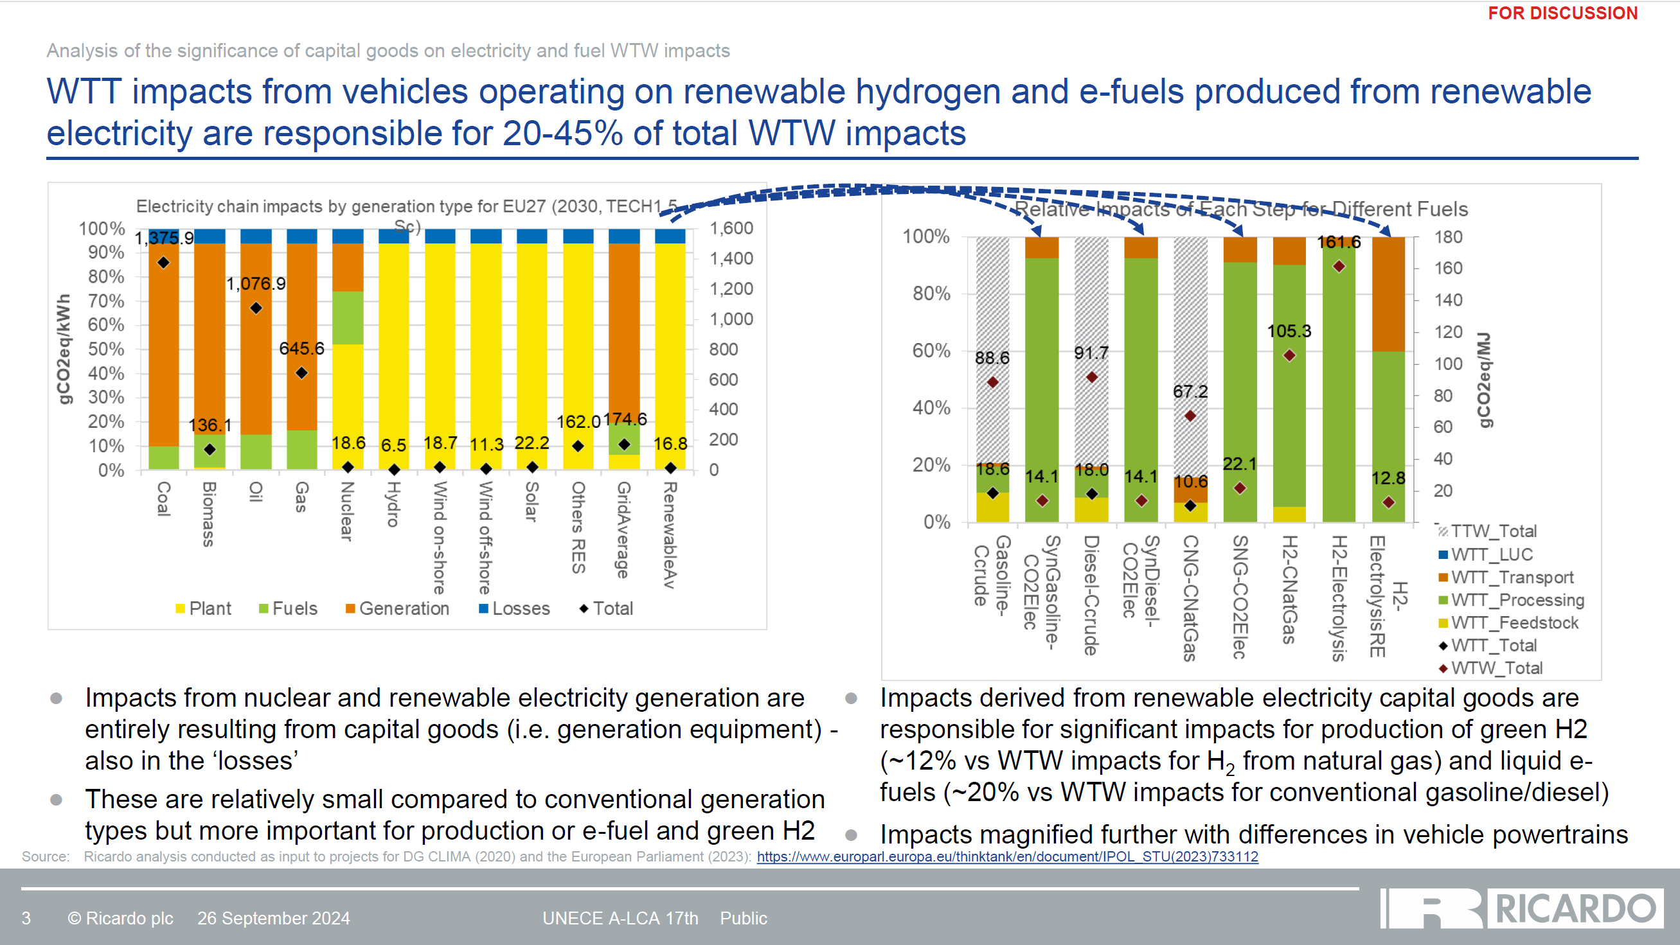
IWG #17 Ricardo

Slide 6
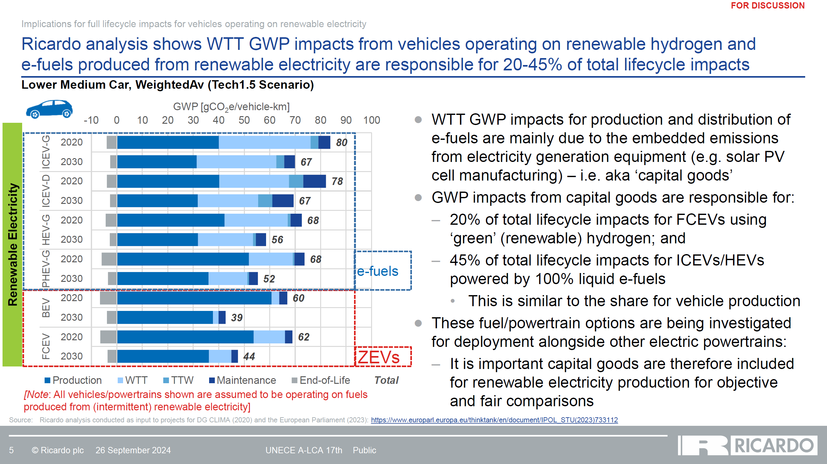
IWG #17 Ricardo

Slide 7
Emission from Infrastructure
Basically excluded
Exception: Construction of Power generation plant
- Reason for the consideration
  Emission factor may differ drastically for Green energies power plants
  Example：Solar 22.2 gCO2eq/kWh → 3 gCO2eq/kWh from the slide above.

Slide 8
Draft for Infrastructure
Infrastructure and capital goods
This section provides rules for modeling infrastructure and capital goods, which are defined here as products used in the studied product system that are not consumed and retains their function for a certain period of time. Examples include the building in which the product or upstream materials or components are produced, machinery used in the manufacturing of the product or its materials or components, or vehicles used for transportation in the product system.
In general, the production and end-of-life processes of infrastructure and capital goods used in the product system shall not be included in the system boundaries unless there is evidence from previous studies that they are relevant. However, there are some exceptions to this rule, as follows:
- Construction of power plants and production of power generation equipment shall be included. Other infrastructure involved in the generation and distribution of electricity may also be included.
- Infrastructure/capital goods may be included if a generic LCI dataset includes infrastructure/capital goods, and it is not possible, within reasonable effort, to subtract the data on infrastructure/capital goods from this dataset.
We appreciate your feedback for the document !

Slide 9
Secondary dataset
As far as I know...
IDEA: include Construction of Power generation plant
EcoInvent: include Construction of Power generation plant
Any others?

Slide 10
Leveling concept

Slide 11
Leveling Concept
SG1: Possible to say “Leveling concept is not applicable to SG6”
SG6 member+ : Level of Emission factor related to energy will be decided by LCA practitioner because it is up to the data they choose. We recommend the condition of emission factors should fit to their calculating condition i.e. location- or market- base, regional or world wide average etc...

Slide 12
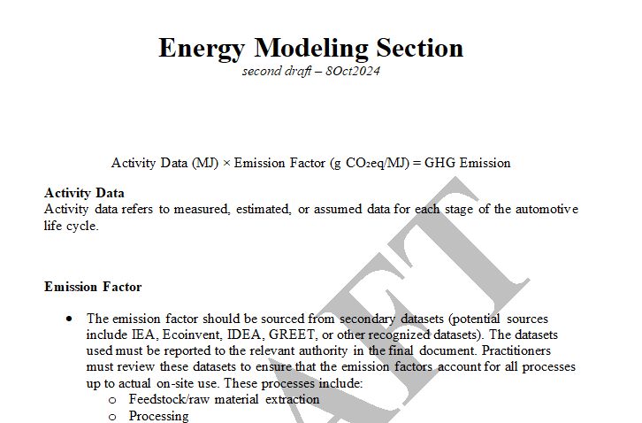
Drafting
New version is available

Slide 13
Open issue
✓[Leveling concept] to be considered
✓ Specific energy modeling for each SGs
ILUC – any comments or suggestions?
Marginal emissions - postponed
H2 - postponed

Slide 14
AOB & next meetings
!!! SG6 Draft deadline – 16 October 2024 18h CET !!!
Submiting draft deadline – 21 October
Next meeting – submitting final draft 21 Octber 13 CET?
Next Next meeting – November 18th ⟶⟶

Slide 15
THANK YOU!
Leading Team:
Noritsune Kawaharada no-kawa@ntsel.go.jp
Banita Fidyova banita@avere.org

