Slide 1
< discussion starter > Level concept during USE phase
Since the methodology during USE phase is quite clear, SG4 does NOT expect the multiple approaches in any levels. Level concept during USE phase may be considered the mass size of primary data of Activity data and Maintenance parts (intensity data is a part of SG6 responsibilities)
 | Definition by SG3 |  |  |  | <one of ideas> Definition by SG4
 | Purpose | Degree of freedom | Vehicle model | Supply chain model | Purpose | Degree of freedom | Vehicle model | Supply chain model → Mass size of primary data (please see next slide)
Level 1 | Strategy(research and strategic public policy making) | multiple approaches possible | generic | generic | strategy (region/CP level) | up to each region/CP or each OEM | Sales mix per regional/CP or each OEM | Per region/CP or each OEM
Level 2 | Strategy (OEM’s internal assessment and strategic planning) | multiple approaches possible | BOM & MDS | generic | strategy (OEM level)
Level 3 | Reporting (OEM’s official reporting) | single fixed approach | BOM & MDS | partially specific | reporting | single fixed approach (Region/CP/OEM’s official reporting) | depend on the parameter | accept more wider mass size or other region/CP data
Level 4 | Reporting (OEM’s and supplier’s official reporting) | single fixed approach | BOM & MDS | mainly specific | reporting |  |  | best effort minimum or appropriate mass size of each primary data

Slide 2
mass size of primary data
A : each region/CP
B : each PC/Commercial
C : each powertrain
D : each vehicle classification
E : each vehicle
configuration

Slide 3
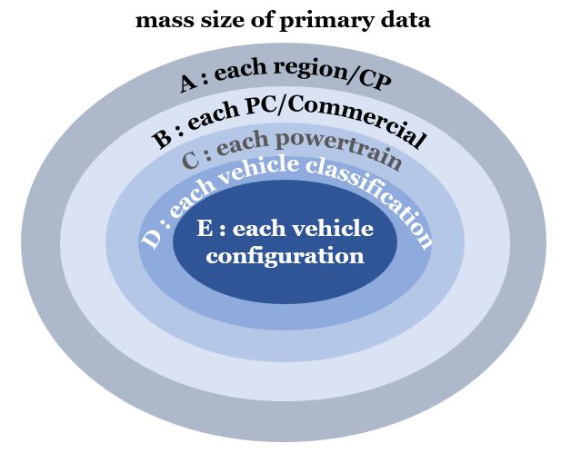


<sample, not proposal>
Timing_1 : homologation phase (default timing) per vehicle configuration
 |  | Mass size of primary data
 | SG4 concept | Fuel consumption Electric consumption | Discrepancy Factor | Deterioration Factor | Utility Factor | Vehicle service life (in km) | Vehicle service life (in years) | Fluorocarbons Evaporation | Maintenance and Consumables Production | Maintenance and Consumables Transportation | Driving in secondary countries | GHG emission factor
Level 1 | strategy (region/CP level) |  |  |  |  |  |  |  |  |  |  | Up to the level defined by SG6
Level 2 | strategy (OEM level)
Level 3 | reporting | E | A* or A*’ | C* | A | A | A | C** | A | A | (A)
Level 4 | reporting | E | C* | E | A | A or B | A or B | E** | D** | D** | (A or B)
* : need the determination methodology
** : need to define the representative vehicle
Timing_2 : end of FY (FY record) per OEM ? CP?
Idea_A
FY
X
Σ
(Z $×$sales mix)
Y
x
Idea_B
Σ
Z
y
(x $×$sales mix + y $×$sales mix + z $×$sales mix )
z

