Slide 1
Rolling Circumference
Task Force on R39 covering mileage values: 23 September 2024

Slide 2
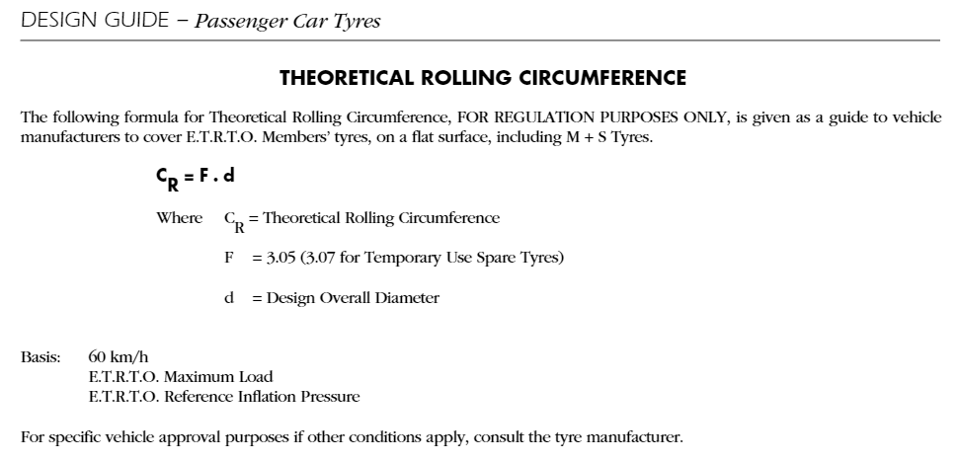
Definition of Theoretical Rolling Circumference
EDI 2024, PC.8

Slide 3
ETRTO Statements
The rolling circumference is not directly related to the overall diameter. It is not straightforward to estimate the variations between different products, even within the same tyre size.
Establishing reliable data on the tolerances of the rolling circumference would be a major exercise.
Reducing the tolerances on the odometer from the current state could severely affect the interchangeability of tyres.
The effect of changing the tyre size on the vehicle is not even considered in the estimation.

Slide 4
Thank you

