Slide 1



7th session of ADS IWG
Petten,17^{th-} 21st March 2025
Organized by JRC RDW and Ministry of IenW
E. Rusciano, R. Brouwer, P. Striekwold
February 18th ,2025

Slide 2
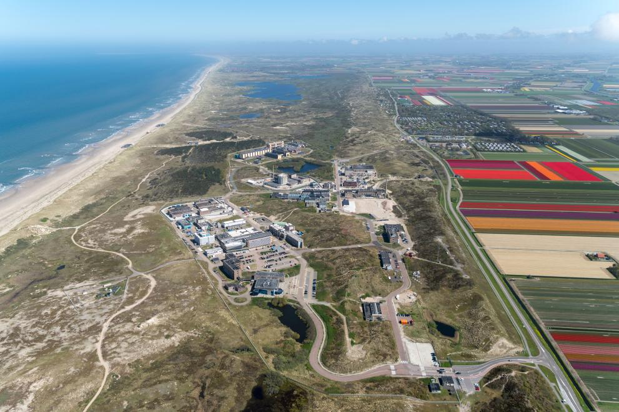
Meeting venue
The JRC in Petten (Netherlands)
  Petten Auditorium, capacity 200 people theatre layout
  Additional rooms booked for side meetings
Keep in mind: This is our address,
  European Commission – Joint Research Centre, Westerduinweg 3, NL-1755 LE Petten
Participants need to be registered to enter in the JRC and they will get a temporary badge for the entire week.
The JRC site in Petten is situated in the heart of the Netherlands, 1 km from the Dutch coast.
© European Union

Slide 3
How to reach Petten
From Schiphol Airport: 1 hour by car
From Amsterdam Central station: 1 hour by car or by JRC bus
From Alkmaar central station: 25minutes by car or 35 minutes by JRC buses

Slide 4
Transportation
Special JRC Bus for ADS IWG participants
  Departure time on March 17, 18, 19 & 21 from K+R Wognumsebuurt (back of Alkmaar station) at 08:30.
    Stop at the Amrath Hotel in Alkmaar (approximately at 08:40)
  Departure time on March 20 from K+R Wognumsebuurt (back of Alkmaar station) at 08:00
    Stop at the Amrath Hotel in Alkmaar (approximately at 08:10)
  Departure time from Petten at 18:00 on March 17th - 20th and at 13:00 on March 21st
JRC shuttles for employees which can be used by ADS IWG participants
  https://wiki.unece.org/display/trans/ADS+7th+session

Slide 5
People coming by Car
Please provide the Licence plate as soon as it is available
If you want to reach the meeting venue by car, the security will ask you to check the inside of the car. Otherwise, you can park at the entrance
We do advice you to arrive 1 hour earlier for security reasons (especially the first day)

Slide 6
Lunch, Social Dinner and Labs
The Lunch and the coffee breaks are offered by the Dutch Ministry
Note: Participants can also use the Canteen/Restaurant on their expenses
The Social Dinner in Alkmaar (at https://www.heerenvansonoy.nl/) on the 19th March from 7-10pm is offered by RDW.
A visit to JRC labs is organized on the 20th from 8:45 until 10

Slide 7
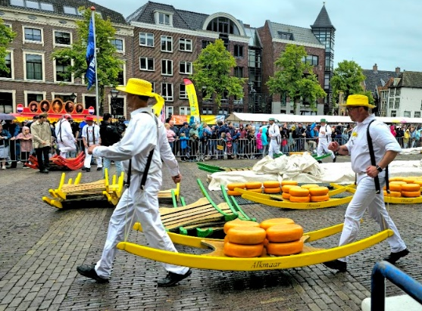
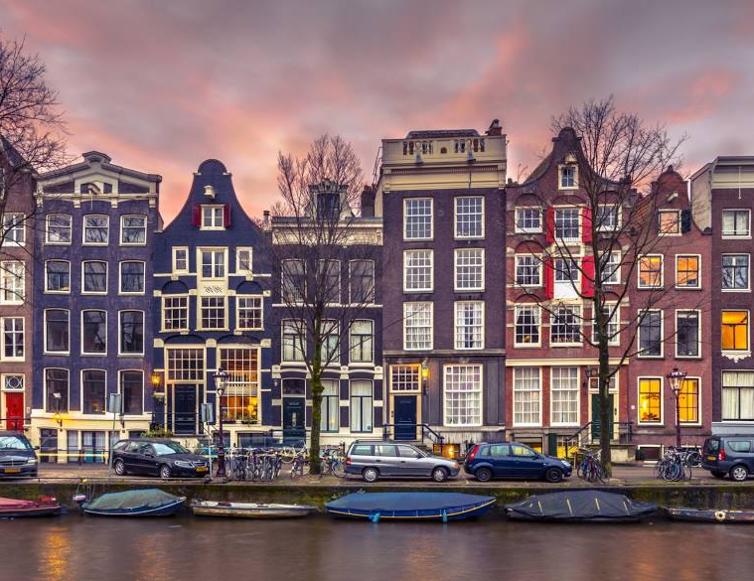
Hotels
Hotel validated by JRC in Alkmaar and Amsterdam
Alkmaar: The Fallon Hotel, Amrath Hotel*, Grand hotel Alkmaar, Golden Tulip, Stad en Land
*We have special rates for the Amrath hotel: in case the market price is higher, we will get our fixed price. We have a special link for the Amrath hotel to be used in case people opt for Amrath. The prices are breakfast included. ROOMTYPE SINGLE USE DOUBLE USE Deluxe room € 113.85 € 142.35 Deluxe room with balcony € 138.85 € 157.90
Amsterdam: Eden Hotel NH, Carlton Art Hotel, Crowne Plaza
All the hotels must be booked by the participants.

Slide 8
Useful links
To book you slot for the airport security control:
https://www.schiphol.nl/en/my-travel-day/today
To check available public transportation available:
https://www.overal.nl/nl/ or https://9292.nl/en/

Slide 9

Thank you
© European Union 2025
Unless otherwise noted the reuse of this presentation is authorised under the CC BY 4.0 license. For any use or reproduction of elements that are not owned by the EU, permission may need to be sought directly from the respective right holders.

