Slide 1
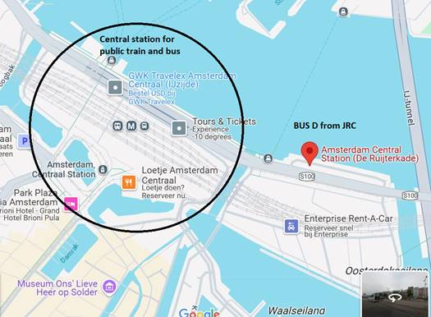
JRC Bus Pickup @ 07:30 am
Company: Jan de Wit
Address: De Ruijterkade
Oost Amsterdam

