Slide 1
ADS-IWG Phase 2
Credibility and Testing provisions
ADS-IWG 7th session
Petten - 17-21/03/2025
R. Brouwer, B. Ciuffo, R. Donà, E. Rusciano

Slide 2
Updates from the credibility and testing sub-groups
Credibility of the test environment
  Work to define manufacturers’ requirements completed
  Work to define assessment principles transferred to testing sub-group after Seoul
Testing provisions
  3 meetings since ADS-IWG 6th and 8 meetings since ADS-IWG 5th meeting (Seoul)
  Revised structure and content

Slide 3
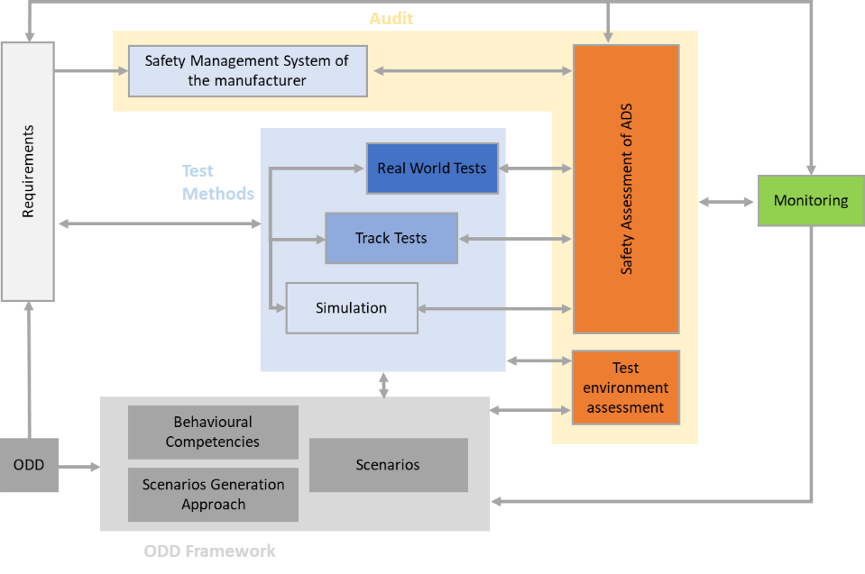
Multi-pillar approach (GRVA-20-36e)

Slide 4
Scope of Testing section (and related topic)

Slide 5
Suggested changes to the structure to include the work after ADS-IWG#5

Slide 6
Suggested changes to the structure to include the work after ADS-IWG#5
Suggest to move to general requirements section
Suggest to remove this sections being a duplication of aspects dealt with in testing section
Suggest to keep only this and the equivalent for physical testing into 7.2 and move the rest to 7.3 as part of the safety case assessment. 7.2 is indeed a prerequisite for the other parts

Slide 7
Suggested changes to the structure to include the work after ADS-IWG#5

Slide 8
Outstanding issues – Confirmatory tests
Are confirmatory tests mandatory or left to the judgement of the assessor/authority?
  7.3.3.2.1. The assessor [shall/may] use track testing to confirm the performance of the ADS in a number of selected relevant nominal, critical, and failure scenarios.
  7.3.3.3.1. The assessor [shall/may] conduct real world testing of the ADS in nominal scenarios […]

Slide 9
Outstanding issues – Annexes
In the text there are several references to information available in annexes
  E.g. The methodology in the Annex [X] is one suitable process against which to review the process adopted by the manufacturer.
The group suggested to have more general discussion on the role of these annexes. Are the information included binding or not?

Slide 10
Next steps
Review and finalization of the text
  Identification of missing parts (if any)
  Assessment of the need for higher level of details in the regulatory text (if possible)
  Development of the referenced annexes (if possible)
  Establishment of the correct links with the other parts of the regulatory text
  Ensuring consistency between requirements and assessment provisions
The group is confident that finalization of the work by April is possible

Slide 11

Thank you
Notes:
Update/add/delete parts of the copy right notice where appropriate.
More information: https://myintracomm.ec.europa.eu/corp/intellectual-property/Documents/2019_Reuse-guidelines%28CC-BY%29.pdf

