Slide 1
ADS-IWG
In-Service Monitoring and Reporting
Status and open Items
19/03/2025
Espedito Rusciano, Riccardo Doná

Slide 2
Status of activities
Definitions
  Changes in definition of Occurrences and deletion of events/safety relevant events
Requirements Section
  General statements
    The requirements listed in the 6.1.5 are without prejudice to applicable laws governing access to data, availability, and privacy and data protection] – general agreement on the intention but we need to find a proper location
    The requirements of this section are without prejudice to applicable laws on provision of info to other authorities- general agreement on the intention but we need to find a proper location
  Occurrence list
    Unknown scenarios encountered by ADS – to discuss today
    France proposal to introduce a new occurrence – to discuss today
    ITU proposal to introduce a new requirement – to discuss today/tomorrow
    Comments from SAE – to discuss today

Slide 3
Definitions
Definition
“Event” means any situation happening in a given time and location.
“Safety-relevant event” means an event which is relevant for the evaluation of the safe operation of the ADS Vehicle. These events also include normal operation which are relevant to argument specific ADS design choices and/or the safety case. (e.g., fallback user unavailability, MRM)
“Occurrence” means a Safety-relevant event during which at least one of the following criteria is fulfilled: a)Collision involving the ADS vehicle b)ADS vehicle system/component failure c)ADS vehicle produces a noncompliance with respect to the requirements of this regulation d) Injury/fatality as a result of being in the ADS vehicle or being involved in the event. e) normal operations which are relevant to argument specific ADS design choices and/or the safety case.
“Significant Occurrence” means occurrences which are not “Critical Occurrences” but require to be reported on short term basis due to their relevance on safety
“Critical Occurrence” means an occurrence during which at least one of the following criteria is fulfilled: (a) at least one person suffering an injury that requires medical attention or dying as a result of being in the vehicle or being involved in the occurrence; (b) the ADS vehicle, other vehicles road users or stationary objects sustaining physical damage that exceeds a certain threshold; (c) any vehicle involved in the event experiencing the deployment of any non-reversible occupant deployable restraint system, vulnerable road user secondary safety system or the delta-V thresholds to be met, whichever occurs first.
Occurrence categories
Critical Occurrences,
Non-Critical Significant Occurrence,
Occurrence
Safety Relevant Event,
Event
Critical occurrence
Significant Occurrence
Occurrence

Slide 4
Definitions: Occurrence
3.16. “Occurrence” means a safety-relevant event during which at least one of the following criteria is fulfilled:
  a) Collision involving the ADS vehicle
  b) ADS vehicle system/component failure
  c) ADS vehicle produces a noncompliance with respect to the requirements of this regulation
  d) Injury/fatality as a result of being in the ADS vehicle or being involved in the event
  e) Normal operations which are relevant to argument specific ADS design choices and/or the safety case.

Slide 5
Definitions: Significant Occurrence
3.16.1. “Significant Occurrence” means occurrences which are not “Critical Occurrences”, but require to be reported on short term basis due to their relevance on safety

Slide 6
Definitions: Significant Occurrence
3.16.2. “Critical Occurrence” means an occurrence during which at least one of the following criteria is fulfilled:
(a) At least one person suffers an injury that requires medical attention or dies as a result of being in the vehicle or being involved in the event.
(b) The ADS vehicle, other vehicles [road users] or stationary objects sustain physical damage that exceeds a certain threshold.
(c) Any vehicle involved in the event experiences a deployment of any non-reversible occupant restraint system, vulnerable road user secondary safety system or the delta-V thresholds to be met, whichever occurs first.

Slide 7
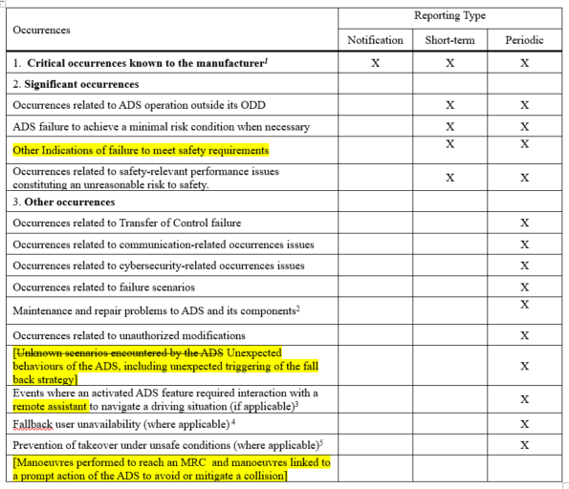
Occurrence List

Slide 8
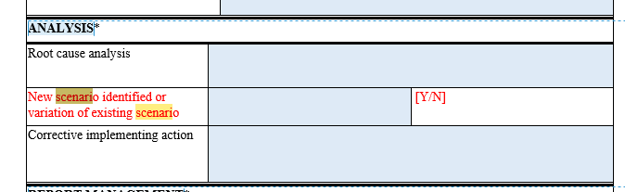
Occurrence list: scenarios
Unknown scenarios encountered by the ADS
  This occurrence is currently included in the Occurrence list. However, the Industry considers that Unknown scenarios are not really an occurrence rather they can be considered as the outcome of an occurrence. In this regard, the Industry proposes to remove “Unknown scenarios encountered by the ADS’” from the occurrence and safety relevant list
  OPI new text proposal: Unknown scenarios encountered by the ADS [Unexpected behaviors of the ADS, including unexpected triggering of the fall back strategy response]
  In addition, the following box will be added in the template: :
Note: Unexpected behaviors are identified/judged by the manufacturer in reference to its safety case

Slide 9
Occurrence list: Emergency/complex manoeuvres
FR: The table with “Occurrence and safety-relevant event” should include this safety-related event: “Emergency/complex maneuvers to prevent a collision”.
Rationale: Reporting this event is a way to confirm to the authorities that the system is indeed working as designed for as far as emergency maneuvers are concerned and to confirm the level of safety of the system. It was one of the examples that were given in the GRVA integration document's definition of non-critical occurrences (in the foot note)
Feedback from ISMR group: The intention of this proposal is agreed among the participants because these reports provide information useful to evaluate the safety of the system including the safety benefit from the use od ADS. The only problem relates to the definition of emergency or complex maneuver.
OPI proposal: Emergency/complex
  1) Maneuvers performed to reach MRC
  2) Maneuvers linked to a prompt action of the ADS to avoid or mitigate a collision.

Slide 10
New requirements for phase 1
ITU: The Manufacturer shall [give authorization to/support] the relevant authority to use ISMR information concerning new or revised scenarios for the purpose of developing generalized scenarios to make available for general use.
Rationale: One goal of the ISMR is to develop generalized scenarios to make available for general use. This activity will be done by a “Relevant Authority” (national or supranational) or by an entity acting on behalf of the authority. However, such activity cannot be done without the involvement of the Manufacturer
Feedback from ISMR group: This proposal only requires the manufacturer support a relevant authority in developing generalized scenarios and give authorization to use data for such purpose. The requirement is not mandating the authority to perform this activity. Therefore, there is general support on this new requirements even thought there are some open points to be solved such as data needed to characterize a scenarios. Industry is not in favor due to the uncertainty related to these open points (data, Relevant authority, etc.)

Slide 11
Status of activities
  Assessment Section
    The Assessment of the ISMR is divided in pre-deployment assessment (included in the audit of SMS, 7.1) and post deployment section (included in post deployment safety, 7.4)
    General agreement, with following open points
      7.1.4.6.(d), documentation review for the pre-deployment
      7.4.1., confirmatory evidence during the post deployment
      7.4.6., Authority enforcement action
  Annexes,
    Two annexes (Short term & periodic template Annex and Critical Occurrence Annex)
    General agreement, with following open point
      3.5.2.(a), critical occurrence in case of ADS features not in a safe state to continue the journey in ADS mode
      Status: To discuss today

Slide 12
Assessment Section
7.1.4.6. The documentation review shall provide evidence that, at least:
…….
(c) ADS safety performance will be verified in reference to the safety performance indicators and safety performance targets as indicated in the Safety Case.
(d) [the risk assessment, including residual risks, will be evaluated regularly through the information coming from the monitoring activities.]
(e) the monitoring takes into account feedback and reports information received from sources other than the ADS vehicle data

Slide 13
Assessment Section
7.4.1. (UNR) The Type Approval Authority or its Technical Service shall receive and review confirmatory evidence produced by that the information provided by the manufacturer during the ADS during its operations (e.g. Notification, short term and periodic reports) is in compliance with and assess that it is in accordance with capabilities described in the manufacturer’s SMS [ref. 7.4.1.7-7.4.1.10].
New proposal: (UNR) The Type Approval Authority or its Technical Service shall receive information provided by the manufacturer and assess that it is in accordance with the manufacturer’s SMS [ref. 7.4.1.7-7.4.1.10].

Slide 14
Assessment: Authority actions
7.4.6. (UNR) If an serious unreasonable safety risk is identified, the Type Approval Authority may inform the Contracting Party on the need of recommend temporary safety measures, including immediately restricting or suspending the relevant operations via remote termination, and on the need to require actions to restore an acceptable level of safety as per the applicable laws.
Alternative for UNR
If an serious unreasonable safety risk is identified, the Contracting Party may recommend temporary safety measures, including immediately restricting or suspending the relevant operations via remote termination, and may require to take actions to restore an acceptable level of safety as per the applicable laws
(GTR) If a serious unreasonable safety risk is identified, the Contracting Party may recommend temporary safety measures, including immediately restricting or suspending the relevant operations via remote termination, and may require to take actions to restore an acceptable level of safety as per the applicable laws.
Alternative proposal UNR/GTR
[If an unreasonable risk to safety is identified, the Contracting Party may carry out its enforcement authorities to the maximum extent under applicable law. Depending on national law, options could include ordering remedies, suspending relevant operations, and recommending or requiring actions to remedy the safety risk]

Slide 15
Other Topics
Recommendations beyond the scope of the Regulation
Implementation of ISMR
  What happens to 'non confidential' information
  What, if any, information is made public
  What authority to share to
  What information sharing happens between authorities
  Scenario work, what info is shared
  Possibility from other TAAs to have access to reports
  What happens after reporting? Recall, TAA’s role/possibility
  The EC/JRC will propose a workshop to discuss on the above topics which goes beyond the scope of the ADS regulation

Slide 16

Thank you
© European Union 2025
Unless otherwise noted the reuse of this presentation is authorised under the CC BY 4.0 license. For any use or reproduction of elements that are not owned by the EU, permission may need to be sought directly from the respective right holders.
Notes:
Update/add/delete parts of the copy right notice where appropriate.
More information: https://myintracomm.ec.europa.eu/corp/intellectual-property/Documents/2019_Reuse-guidelines%28CC-BY%29.pdf

Slide 17








Keep in touch
ec.europa.eu/
europeancommission
europa.eu/
@EuropeanCommission
@EU_Commission
EUTube
@EuropeanCommission
EU Spotify
European Commission
Notes:
Delete/update as appropriate

Slide 18
Assessment of ISMR
Generic management of the safety, including ISMR
SMS Audit
Safety case Ass.
Post deployment Ass.
ISMR is
operating & effective
and
ADS safety is confirmed is safe
ISMR is
present &
“suitable”
ISMR is
suitable
ISMR Pre-deployment Assessment
For the first SMS certificate/approval, the SMS and ISMR are linked/coupled to a specific ADS

