Slide 1
ADS-IWG
In-Service Monitoring and Reporting
Annexes
ADS-IWG 7th session
Petten - 17-21/03/2025
Espedito Rusciano, Riccardo Donà

Slide 2
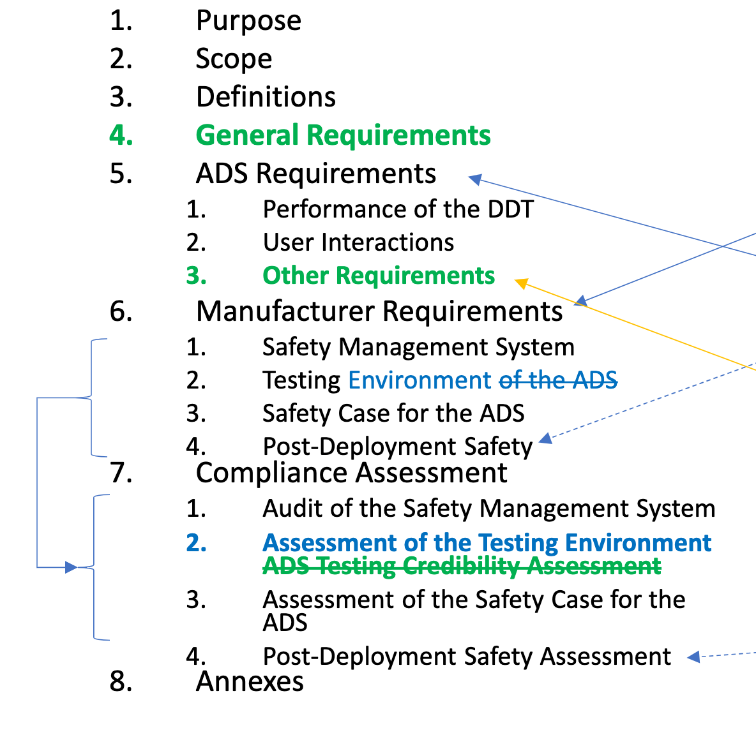
Summary
Two Annexes developed for ISMR:
  Templates for short-term reporting and periodic reporting
  NEW Critical Occurrence metrics for notification support

Slide 3
Occurrence table
Annex II
Critical occurrence characterization
Annex I
Templates
Occurrences | Reporting Type
 | Notification | Short-term | Periodic
1. Critical occurrences known to the manufacturer | X | X | X
2. Significant occurrences
Occurrences related to ADS operation outside its ODD |  | X | X
ADS failure to achieve a minimal risk condition when necessary |  | X | X
Other Indications of failure to meet safety requirements |  | X | X
Occurrences related to safety-relevant performance issues constituting an unreasonable risk to safety. |  | X | X
3. Other occurrences
Occurrences related to Transfer of Control failure |  |  | X
Occurrences related to communication-related occurrences issues |  |  | X
Occurrences related to cybersecurity-related occurrences issues |  |  | X
Occurrences related to failure scenarios |  |  | X
Maintenance and repair problems to ADS and its components² |  |  | X
Occurrences related to unauthorized modifications |  |  | X
[Unexpected behaviours of the ADS, including unexpected triggering of the fall-back strategy] |  |  | X
Events where an activated ADS feature required interaction with a remote assistant to navigate a driving situation (if applicable) |  |  | X
Fallback user unavailability (where applicable) |  |  | X
Prevention of takeover under unsafe conditions (where applicable) |  |  | X
[Manoeuvres performed to reach an MRC and manoeuvres linked to a prompt action of the ADS to avoid or mitigate a collision]

Slide 4
Reporting Templates
Annex I – Agenda Item 6.4

Slide 5
Background
Templates originally developed within ISMR for VMAD-SG3
  Short-term first presented on 19/12/2022
  Periodic first presented on 30/01/2023
Aimed at harmonization for maximum effectiveness
Extensive discussions to strike a balance between the amount of reported information and the practicalities of the retrieval process
Templates evolved with ISMR text main body

Slide 6
Reporting template – structure
Short-term
What
Occurrence Classification
Occurrence Details
When
Where
Damage
Injury
Vehicle
Narrative
Analysis
Report Management
Periodic
ADS identification
ADS operation information
Occurrence and Safety Relevant Events Assessment
Occurrences Safety Outcome
Occurrences Aggregate Description
ADS Safety Gap
Report Management

Slide 7
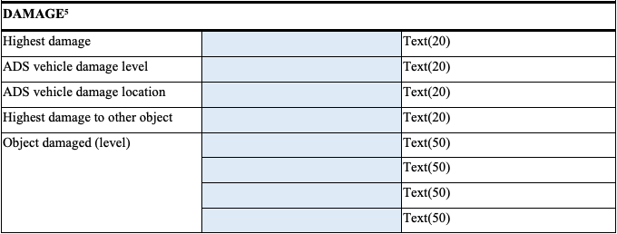
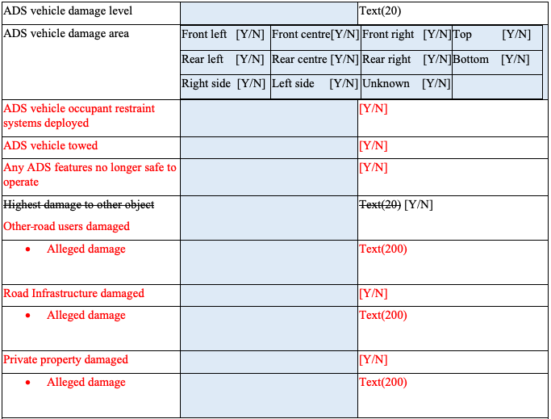
Template revision – 1st discussion
General
  Re-structuring to match Regulation formatting
Short-term
  Damage Section simplified and aligned with NHTSA SGO & Critical Occurrence Annex
  Wording alignment: crash => collision
v5.3
v5.4

Slide 8
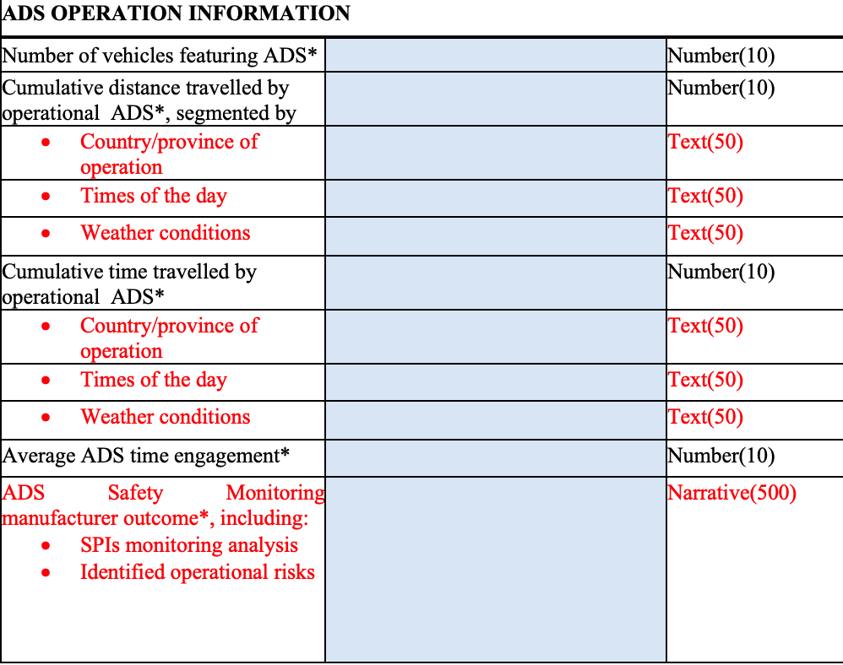
Template revision – 1st discussion
Periodic
  (Optional) additional exposure granularity
  Placeholder for a description of the Safety Monitoring analysis
Give context to reported evidence

Slide 9
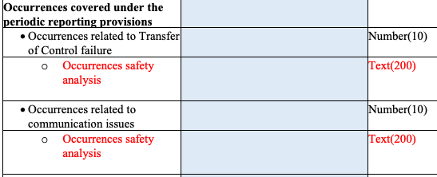

Template Revision following 2nd discussion
General
  Alignment with the wording modification to the main body (Event, Safety-relevant event, business confidential)
  Link between injury and MAIS, ‘severe injury’ => MAIS 3+, ‘minor injury’ => MAIS 1/2
Short-term
  'New identified scenario’ as an entry for the Analysis section
  New Scenario occurrence is an Open Item
Periodic
  Added ‘Safety analysis’ entry under periodic-only report occurrences
  to allow extra flexibility and granularity on top of the simple counting
MAIS: Maximum Abbreviated Injury Scale

Slide 10
Critical occurrence
Annex II – Agenda Item 6.5

Slide 11
Background
ISMR sub-group during 5th IWG-ADS was tasked to define concrete metrics for critical occurrences definition:
“Critical Occurrence” means an occurrence during which at least one of the following criteria is fulfilled:
  At least one person suffers an injury that requires medical attention or dies as a result of being in the vehicle or being involved in the occurrence.
  The ADS vehicle, other [vehicles/road users] or stationary objects sustain physical damage that exceeds a certain threshold.
  Any vehicle involved in the event experiences the deployment of any non-reversible occupant deployable restraint system vulnerable road user secondary safety system or the delta-V thresholds to be met, whichever occurs first.

Slide 12
Sub-group – task allocation
Small sub-group within ISMR sub-group was created:
  Injury thresholds EC-JRC, UK, RDW/NL
  physical damage EC-JRC, OICA, FR, UK
  restraint system EC-JRC, RDW/NL
Approach pursued of directly measurable criteria by the ADS and/or the manufacturer in favour of a prompt notification

Slide 13
Gap #1 – setting the injury threshold
New Section 2, no MAIS in favour of more easily measurable criteria:
2.1. The injury level threshold for critical occurrence aims at promoting the reporting of collisions resulting in a fatality or any person requiring medical attention due to the injury, regardless of whether the person killed or injured was an occupant of the subject vehicle.
2.2. The threshold is triggered by the presence in the area of the collision of an ambulance.
2.3. The manufacturer shall classify the occurrence as critical if they reasonably believe that there may be an injury requiring medical attention to any person even if an ambulance has not been detected.
2.4 The manufacturer is expected to fulfil these criteria through one of the following approaches: :
  ADS strategies in place to appropriately detect such situations provided that the ADS vehicle is still capable of performing [audio/visual sensing capabilities], following the collision ;
  Processes to receive and analyse information from other sources;
  Combination of a) and b).
Notes:
OICA: welcome change; ‘situation’ wording debated; what is expected from ADS itself? 2.2. might not be achievable after critical occurrence.
NL: requirement seems achievable; 2.2. might not be achievable after critical occurrence.
UK: we are looking for industry to provide us with explanation of how accident identification capabilities are embedded into the design of the ADS.
OICA: we will have to find a way to comply with that through robust monitoring processes; we will have dependencies from 3rd parties which might be difficult to fulfil; experience will tell us.

Slide 14
Gap #2 – setting the damage threshold
Thresholds options for “Physical Damage” whichever occurs:
  Tow-away, e.g., damage that restricts/prevents regular operation of a vehicle involved in the collision as part of the reported occurrence;
  Importance-based, e.g., a damage that affects the safe state of the ADS, critical road infrastructure asset and other vehicles/road users;
  Monetary, e.g., monetary damage resulting from a crash involving the ADS

Slide 15
Gap #2 – importance damage
Monetary damage does not capture the relevance of the object/road-user involved (e.g., ambulance, connected traffic light for other ADS…)
The importance-based threshold shall be deemed exceeded when one of the following conditions occurs:
  [Collision making any of the ADS features not in a safe state to continue the journey in ADS mode];
  Collision with priority vehicles;
  Collision rendering traffic lights and/or other safety-relevant road signage no longer operational/visible;
  Collision affecting infrastructure communication/connectivity support system
  Collision damaging or rendering impassable a roadway segment;
  Collision producing a vehicle or other road user fire;
  Any other collision which requires the attendance of road safety agent.

Slide 16
Gap #3 –‘restraint system’
Requirement revised to match EDR formulation, aim of the Annex is to provide same triggering criteria for consistency:
  4.1. The restraint system triggering condition for critical occurrence aims at promoting the reporting of events in case of deployment of any non-reversible deployable occupant restraint systems or vulnerable road user secondary safety system such as airbags, pretensions, and active bonnet systems. Deployment of such non-reversible restrain systems shall be classified as a critical occurrence.
  4.2. In absence of non-reversible restrain systems the Delta-V Thresholds shall be considered for classification of critical occurrence
    4.2.1 Change in longitudinal vehicle velocity more than 8 km/h within a 150 ms or less interval.
    4.2.2 Change in lateral vehicle velocity more than 8 km/h within a 150 ms or less interval

Slide 17

Thank you

