Slide 1

Topic
Children Left in Vehicles (CLIV)
An Australian bus perspective and solution
October 2024

Slide 2
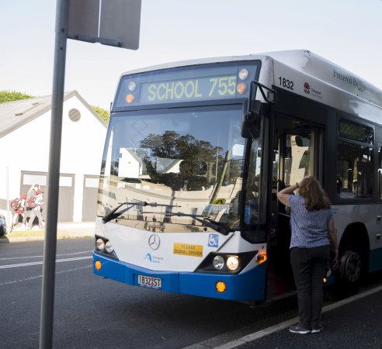
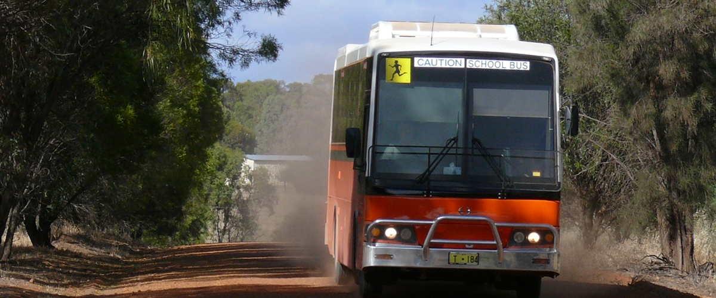
Agenda
Background
Jurisdictional Action
System Function
Advantages
Questions
Bus Industry Confederation (Australia) – October 2024 Children Left in Vehicles : Australian Perspective and solutions

Slide 3







Australian Background
1.3 Million
Children travel by
bus each day
5-18yrs
Average Age range
Up to 120kms
Per trip one way
+60^{C}
-10^{C}
45 minutes
Average trip time
68 Children
left on a bus, last 5yrs
Temperature
Inside an unattended bus
Heatstroke possible 10 minutes
Bus Industry Confederation (Australia) – October 2024 Children Left in Vehicles : Australian Perspective and solutions

Slide 4
Jurisdictional Action
A ‘child check system’ was Mandated for School Buses (not other services)
Mandated
Optional or recommended
2013
2022
Bus Industry Confederation (Australia) – October 2024 Children Left in Vehicles : Australian Perspective and solutions

Slide 5
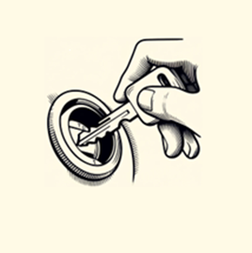
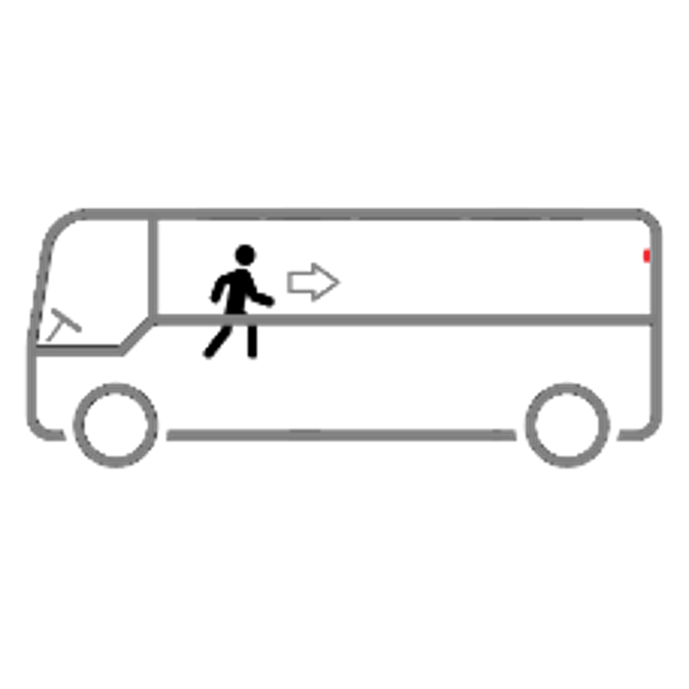
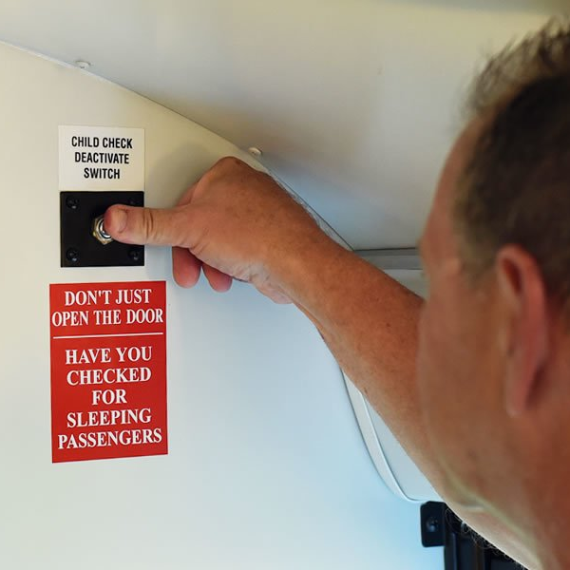
System Function
1. System Enabled
2. Check Timer Armed
3. Physical Driver Check
Automatically with Ignition on or School bus lights
4. Check Confirmation
A 30 second timer Automatically starts when ignition key is turned off.
**5. Alarm**
In the 30-seconds, driver walks to rear of bus checking each seat and under each seat.
Driver presses button at rear of bus to acknowledge bus checked.
This turns system off.
**If driver fails to presses button this activates a 95dB alarm.
It sounds until button is pressed
Bus Industry Confederation (Australia) – October 2024 Children Left in Vehicles : Australian Perspective and solutions

Slide 6
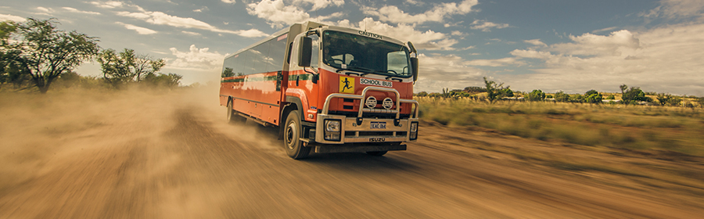
Advantages / Consideration
Fitment: Can be easily fitted & Retrofitted.
Cost: $900 - $2000 AUD, (€550 - €1200 or CNY4200 – CNY9500)
Technology: Robust, simple, low maintenance, Readily available, Not Unique
Application: Fitment to all buses?
Bus Industry Confederation (Australia) – October 2024 Children Left in Vehicles : Australian Perspective and solutions
Notes:
Avoids multiple systems on different age vehiucles

Slide 7

Thank you
Bus Industry Confederation (Australia) – October 2024 Children Left in Vehicles : Australian Perspective and solutions

Slide 8
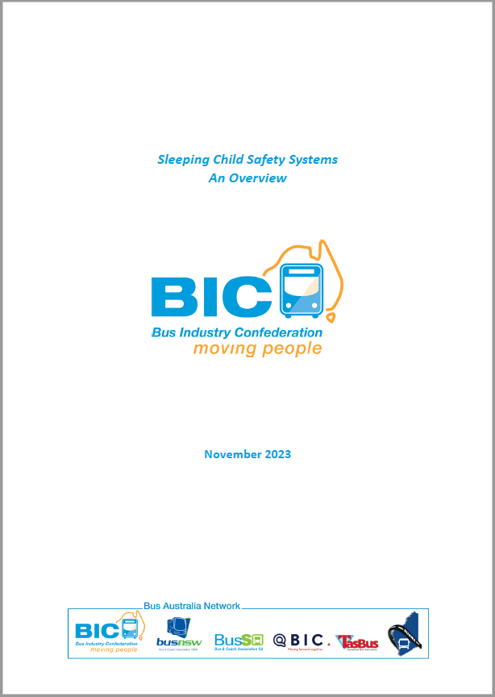
Annex A – Supportive Information
BIC Paper Sleeping Child Safety Systems
Bus Industry Confederation (Australia) – October 2024 Children Left in Vehicles : Australian Perspective and solutions

