Slide 1
Countermeasures for Buses Carrying Children
IWG-CLIV (2024.10)
JINSEOP PARK, Chief Researcher
Korea Automobile Testing & Research Institute(KATRI)
* This is based on the study of the R&D project ‘Technology development to improve the safety of Korean children’s school buses’ [RS-2022-00143581]

Slide 2
Institutional Countermeasures
Regulation
- Republic of Korea, KMVSS Article 53-4 (National level)
· applies to a bus intended to carry children
· requires an unloading child confirmation alert device
- USA California, Cal. Code Regs. Tit.13, §1294 (State level)
· applies to a school bus, a school pupil activity bus
, a youth bus, a child care vehicle
· requires a child safety alert system
Guideline
- Japan’s guideline applies to a nursery school bus
- requires check-on-disembarkation type device
/ automatic detection type device

Slide 3
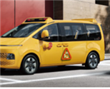
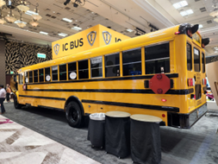
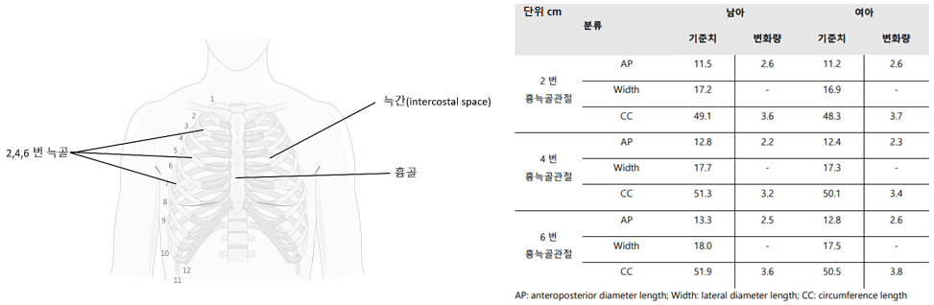
Technical Countermeasures
Basis
Vehicle types to carry children
- small passenger vehicles
and vans
- buses and coaches
Vital signs
- respiration, heartbeat/pulse, body temperature, blood pressure, body movement, etc.
Detection parameters
- movement, sound, temperature, weight, bioelectricity, gas concentration, device/system, etc.
[Van type school bus]
*source: Korea R&D report [RS-2022-00143581]
[Coach type school bus]
*source: taken by KATRI at 2022 STN EXPO Reno
[Respiration movement displacement of 3 year children in Korea]
(source: 1st phase report of Korea R&D project [RS-2022-00143581])

Slide 4
Technical countermeasures
Categorization
Have the drivers physically check there is no children left on buses
- unloading child confirmation alert device, reporting system, reminder
Indirect detection of left children on buses
- active: Ingress & Egress monitoring system
- non-active: door opening & closing, seat-occupancy
Direct detection of left children on buses
- radar sensor, ultrasonic sensor, camera

Slide 5
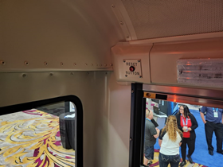
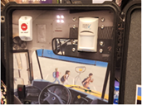
Have drivers physically check there is no children left on buses
Unloading child confirmation alert device
- a device located at the
compartment rear of a bus
- requires the driver to push a
button of the device within a
certain time after the end of the
journey (turning off the vehicle)
- the driver may tag or scan the
device or use other ways to
activate the device after
checking no children left on
buses
[Child Safety Alert System example]
*source: taken by KATRI at 2022 STN EXPO Reno
[Child Safety Alert System sample]
*source: Korea R&D report [RS-2022-00143581]
※ All figures/illustrations other than captioned pictures are made by KATRI

Slide 6
Have drivers physically check there is no children left on buses
Reporting system
- requires the driver to report no children left on the bus after the end of the journey (to someone in charge of the operation, the driver, or database, etc.)
Reminder (indication)
- message to the driver after the end of a journey
- encourages the driver to check no children left on the bus
Did you check no children left on the bus?
YES
NO
Check no children left on the van !
* from the report “The trend of regulations and technologies of school buses (2022, in Korean)” of R&D project ‘Technology development to improve the safety of Korean children’s school buses’ [RS-2022-00143581]

Slide 7
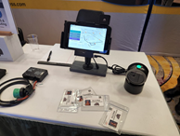
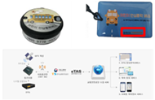
Indirect detection of left children on buses
Active systems
- Ingress & Egress monitoring system
- Child occupants scan a QR code card, a RFID card, etc. in getting on or off the bus
- the monitoring system detects tag-less beacons / personal mobile devices with child occupants getting on or off the bus
- visual/audible warning or texting a person responsible for operating the bus if the system finds unloading child occupants
- the monitoring system may share the locations of child occupants in real time
Ingress/Egress monitoring system
QR code scan
RFID card
Tag-less beacon
Personal mobile devices
(e.g. smart phone application)
Etc.
[QR code monitoring]
*source: Korea R&D report [RS-2022-00143581]
[Tag-less beacon]
*source: Korea R&D report [RS-2022-00143581]

Slide 8
Indirect detection of left children on buses
Non-active systems
- usually for a small passenger vehicle or van
- by assumption of child presence based on door opening and closing
· low accuracy
· door opening & closing
≠ passengers getting on & off
- by assumption of child presence based on seat-occupancy
· low accuracy
· objects on seats may be recognizable by the occupancy sensor (e.g. pressure type sensor)
Door opening & closing signal
Occupancy sensor signal
(e.g. pressure sensor)

Slide 9
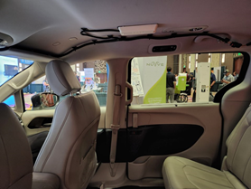
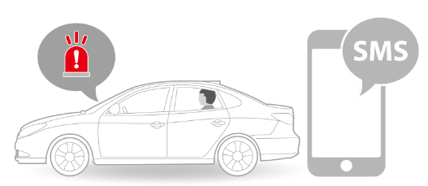
Direct detection of no children left on buses
Movement detection
- radar sensor
· high accuracy
· high cost
- ultrasonic sensor
· lower cost (c.t. radar sensor)
· affected by the environment
- camera
· in line with future tech trends
(in-cabin monitoring)
· blind spot
(behind seat backs
/ if covered by a blanket)
ROA
[Rear Occupant Alert]
* source: Hyundai Motors manual
[Radar sensor on the roof inside]
*source: Korea R&D report [RS-2022-00143581]

Slide 10
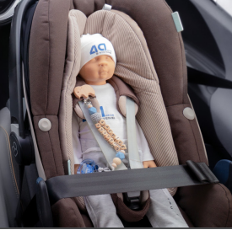
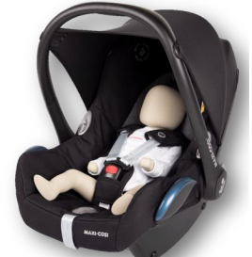
Direct detection of left children on buses
Test tool for the direct detection performance → necessary
- test tool: ATD(anthropometric test device)
Test tool status in the market
- no standard (e.g. ISO) yet
- two ATD manufacturers
- ATD types: TBD (0y(newborn), 1y, 3y, 6y)
Test tool specifications
- must be included in UNECE WP.29 M.R.1 (like other ATDs)
after a sufficient review and discussion of
· anthropometric specs. (dimension, weight, etc.)
· movement specs. (respiration, extremities, etc.)
· other specs. simulating human child body characteristics
[4a systems (newborn)]
[MESSRING (newborn)]
* Picture sources) 4a systems & Messering websites (brochures)

Slide 11
Discussion & Conclusion
Potentially mandatory countermeasures should be decided for the international regulation establishment after reviewing all countermeasures with stakeholders
- have the driver physically check no children left on buses
- indirect detection of the left children on buses
- direct detection of the left children on buses
Depending on the decided countermeasures, specific requirements and procedures of the regulation should be discussed
- requirements (general and performance)
- test procedures
- CLIV ATD specifications (if needed), etc.

Slide 12
Discussion & Conclusion
IWG should reviews conflict with other regulations (e.g. hazard light, horn), and should revise the other regulations if necessary
Further specific discussions (next phase)
- warning only or including intervention
- warning types
· visual: tell-tale(to a driver), hazard light
· audible: horn
· mobile: text or application
- warning requirements: sound volume & duration
- durability
- deactivation
- potential field complaints, etc.

Slide 13
고맙습니다.
Thank you for your attention
jspark@kotsa.or.kr

