Slide 1

The 5th IWG on CLIV
Investigation CPD countermeasures and application
in passenger car
Submitted by experts from China
16-10-2024

Slide 2
CONTENT
CONTENT
1. Background
2. CPD countermeasures and investigation
3. Summary

Slide 3
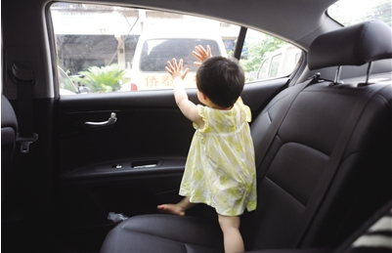
1
Background
Accidents are either 0% or 100%, so NEVER, ever leave a child alone in a car.
To raise awareness.
Establishment of standard.
Increase CPD tech. application rate.
Picture sources from public internet

Slide 4
2
CPD countermeasures and investigation
Q: How does your company conduct tests or refer to relevant information regarding the bioretention detection system? -- Multiple choices
Tech. Reference Proportion
Reference Test Protocol | Quantity
Reference- CNCAP+ENCAP | 12
Reference- ENCAP | 4
Reference- CNCAP | 3
Other | 1
sources from Geely Survey @ 2024

Slide 5
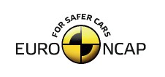



2
CPD countermeasures and investigation
Scenarios 1 & 2 (forgotten and short time left behind)
  Infant in a rearward-facing CRS: sleeping under blanket/sun shield
  1YO child in a rearward-facing CRS: sleeping under blanket, awake under blanket
  3YO in forward-facing CRS: sleeping under blanket, awake under blanket
  6YO on booster cushion installed with car belt: sleeping & awake
  Cover all likely child positions (seat positions in all rows)
Scenario 3 (child enters unlocked vehicle)
  Parked vehicle with unlocked doors
  Any door is opened, 3-6YO child enters vehicle and door is closed with child lock activated
  Cover all seating positions incl. driver seat and other hiding areas e.g. footwells
Initial warning: within 10s
Escalation warning: within 90s after initial warning
Intervention: within 10min of vehicle locked or 5min after escalation warning
Euro NCAP scoring / points:
Scenario | Response | All Seats | Rear seats only
1, 2 | Warnings | 2 | 1
 | Warnings & Intervention | 3 | 1.5
1, 2, 3 | Warnings | 3 | 1.5
 | Warnings & Intervention | 4 | 2
Sources from Euro NCAP

Slide 6
2
CPD countermeasures and investigation
Relevant Scenarios
  Scenario 1: Child forgotten in vehicle
  Scenario 2: Child short time left in vehicle
  Scenario 3: Child gains access to unlocked vehicle
Age vs. Scenario vs. Capability
  Up to 1YO: Scenario 1 & 2 – helpless
  1YO to 3YO: Scenario 1 & 2 (& 3) – likely helpless
  3YO to 6YO: Scenario 1 & 2 & 3 – somewhat capable
Technology aspects
  Consider technology limits when discussing a scenario
  Consider sensor coverage / number of sensors
  Consider other OMS functions – avoid “one sensor per function”
Key points
  Consider statistics to assess scenario frequency
  Regulation will improve current situation in any case
    No sensing → cover important scenarios → cover all scenarios

Slide 7
2
CPD countermeasures and investigation
Pressure Sensor
Temperature Sensor
Motion Sensor
Indirect Detection
Weight Sensor
Sound Monitoring System
CO2 Concentration detection
CPD Detection
Visible Light Camera
Infrared Night Vision Camera
Direct Detection
Ultrasonic Radar
Millimeter-Wave Radar
UWB Radar

Slide 8
2
CPD countermeasures and investigation
Direct Detection example : 3D cameras
Safety Perspective
  ADAS systems rely on 2D cameras and Radar
  Self-driving cars add accurate range: Stereovision or Lidar
  Why? Cannot afford mistakes in complex scenarios
Interior Safety Applications
  Complex occupant behavior
  Restraints require fast and precise information
Solution: Measure, not infer or estimate
3D for HMI Applications
  Accurate and low-latency head position for
  3D displays and augmented reality
  Eye gaze control & Gestures

Slide 9
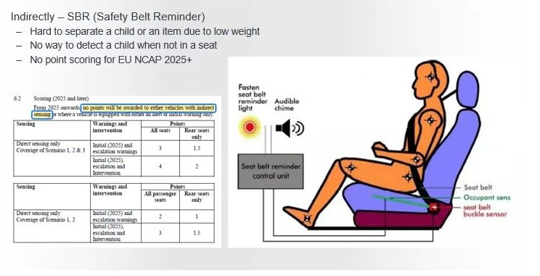
2
CPD countermeasures and investigation
Indirect Detection example : SBR
figure from www.yoojia.com/article/962381566197415.html

Slide 10
3
Summary
Summary
Current situation
Both Global OEM and China OEM are attach great importance to the development of CPD technology.
Most of the technical are developed according to the requirements of Euro NCAP and C-NCAP etc.
Direct and indirect solutions coexist in the market.
  Direct solution：Based on various sensors to track heartbeat, breathing, movement, or any other signs of life. This includes visible light cameras, infrared night vision cameras, ultrasonic radars, millimeter-wave radars, and UWB radars.
  Indirect solution: Based on pressure or capacitive sensing to infer the possible presence of objects inside the vehicle, but cannot identify whether they are living beings. This includes pressure sensors, temperature sensors, motion sensors, weight sensors, and sound monitoring systems.
Look forward for future
It is recommended to establishment global technical standard, which do not conflict with NCAPs.
It is suggested that technical countermeasures should be considered, including direct and indirect technical solution, technical requirements, test procedures and other related content, to guide technical development.

Slide 11
Thanks for your attention!

