Slide 1
Countermeasures for Light Vehicles
IWG-CLIV (2024.10)
JINSEOP PARK, Chief Researcher
Korea Transporation Safety Authority
Korea Automobile Testing & Research Institute(KATRI)
* This is based on the study of KNCAP R&D project and Korea’s R&D project for enhancing safety of school buses [RS-2022-00143581]

Slide 2

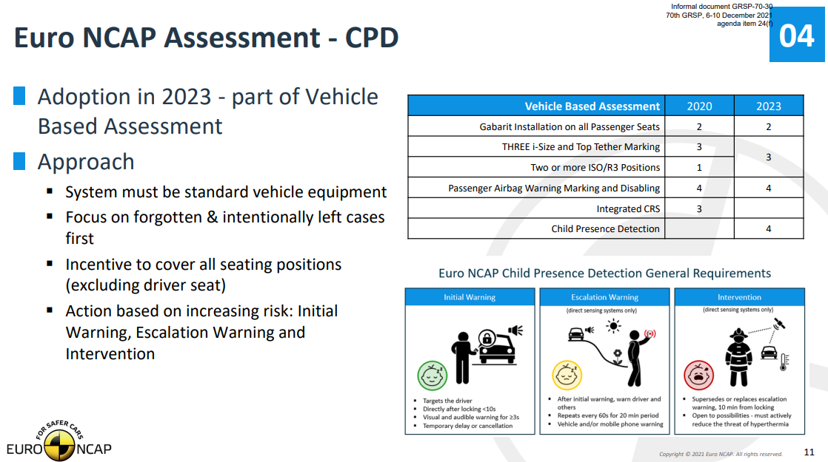
Institutional Countermeasures
Voluntary obligation
- USA (2019)
· “leading automakers’ commitment to
implement rear seat reminder system”
· DOT NHTSA X 22 OEMs
Consumer testing
- Euro NCAP/ANCAP
· introduced CPD(Child Presence Detection)
assessment in 2023
· scores are awarded to a car based on the
performance
- Others (KNCAP, CNCAP, JNCAP)
· to include the similar assessment*
(or possibly introduced)
[USA automakers’ commitment]
(source: provided by Hyundai Motors Group)
[Euro NCAP CPD presentation]
(source: GRSP-70-30)
*based on 2023 Global NCAP meeting presentations

Slide 3
Technical countermeasures
Categorization
Encourage the drivers to check there is no children left in vehicles
- reminder (to the driver)
Indirect detection of left children in vehicles
- door opening & closing, seat-occupancy
Direct detection of left children in vehicles
- radar sensor, ultrasonic sensor, camera

Slide 4
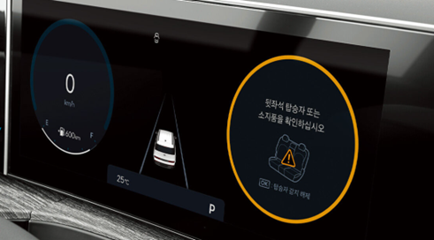
Encourage the drivers to check no children left
Reminder
- message to the driver after
the end of a journey
- audible/visual signal may be
provided
- may be incorporated with the
indirect detection of left
children in vehicles
(e.g. door opening & closing)
- encourages the driver to
check no children left in the
vehicle
[message to a driver]
* source: Hyundai Motors Blue Link manual
Check no children left on the van !
※ All figures/illustrations other than captioned pictures are made by KATRI

Slide 5
Indirect detection of left children in vehicles
by assumption of child presence based on door opening & closing
- low accuracy
- door opening & closing
≠ passengers getting on & off
by assumption of child presence based on seat-occupancy
- low accuracy
- objects on seats may be recognizable
as a child occupant by the seat-
occupancy sensor (e.g. pressure type
sensor)
Door opening & closing signal
Occupancy sensor signal
(e.g. pressure sensor)

Slide 6
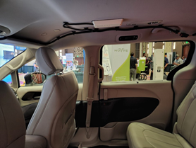
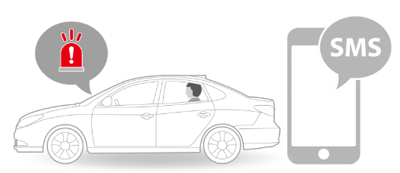
Direct detection of no children left in vehicles
Movement detection
- radar sensor
· high accuracy
· high cost
- ultrasonic sensor
· lower cost (c.t. radar sensor)
· affected by the environment
- camera
· in line with future tech trends
(in-cabin monitoring)
· blind spot
(behind seat backs
/ if covered by a blanket)
ROA
[Rear Occupant Alert]
* source: Hyundai Motors manual
[Radar sensor on the roof inside]
*source: Korea R&D report [RS-2022-00143581]

Slide 7
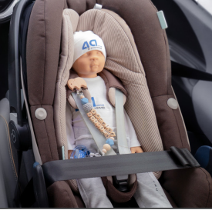
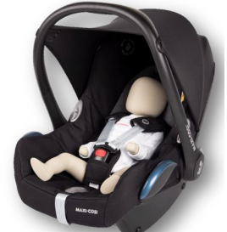
Direct detection of left children in vehicles
Test tool for the direct detection performance → necessary
- test tool: ATD(anthropometric test device)
Test tool status in the market
- no standard (e.g. ISO) yet
- two ATD manufacturers
- ATD types: TBD (0y(newborn), 1y, 3y, 6y)
Test tool specifications
- must be included in UNECE WP.29 M.R.1 (like other ATDs)
after a sufficient review and discussion of
· anthropometric specs. (dimension, weight, etc.)
· movement specs. (respiration, extremities, etc.)
· other specs. simulating human child body characteristics
[4a systems (newborn)]
[MESSRING (newborn)]
* Picture sources) 4a systems & Messering websites (brochures)

Slide 8
Discussion & Conclusion
Potentially mandatory countermeasures should be decided for the international regulation establishment after reviewing all countermeasures with stakeholders
- encourage the drivers to check no children left in vehicles
- indirect detection of the left children on buses
- direct detection of the left children on buses
Depending on the decided countermeasures, specific requirements and procedures of the regulation should be discussed
- requirements (general and performance)
- test procedures
- CLIV ATD specifications (if needed), etc.

Slide 9
Discussion & Conclusion
IWG should reviews conflict with other regulations (e.g. hazard light, horn), and should revise the other regulations if necessary
Further specific discussions (next phase)
- warning only or including intervention
- warning types
· visual: tell-tale(to a driver), hazard light
· audible: horn
· mobile: text or application
- warning requirements: sound volume & duration
- durability
- deactivation
- potential field complaints, etc.

Slide 10
Attachment - Idea suggestion
Visual warning to the outside
- direction indicators alternately flash diagonally
· simple, noticeable, distinct
· education/campaign friendly
Vertical Parking
Parallel Parking

Slide 11
고맙습니다.
Thank you for your attention
jspark@kotsa.or.kr

