Slide 1

Submitted by the expert from China
The 5th IWG on CLIV
Factors driving and leading to PVH
research and investigation from China
Submitted by experts from China
15-10-2024

Slide 2
00
Content
CONTENT
1 Research on PVH
2 Investigation on PVH
3 Answers to Q1 to Q4 of IWG

Slide 3
01
Research on PVH
Some organizations in China have studied on the influencing factors of Paediatric Vehicular Heatstroke (PVH)^{[1]}. A research project studies on the influence of different factors on PVH as: ambient temperatures, whether the vehicle windows are opened or not, different combinations of body colors and different interior colors of the same vehicle.
^{[1]}Source: Zhu Hang, Ma Zhixiong, Dong Liping, Wu Xiuying, research on the Children Occupant Hyperthermia in Enclosed Vehicle [J]. Journal of Jiamusi University ( Natural Science Edition), 2014, 32 (2), 246-248

Slide 4
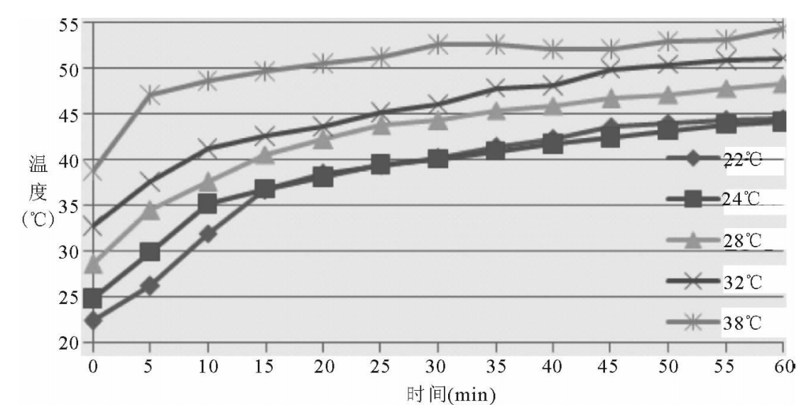
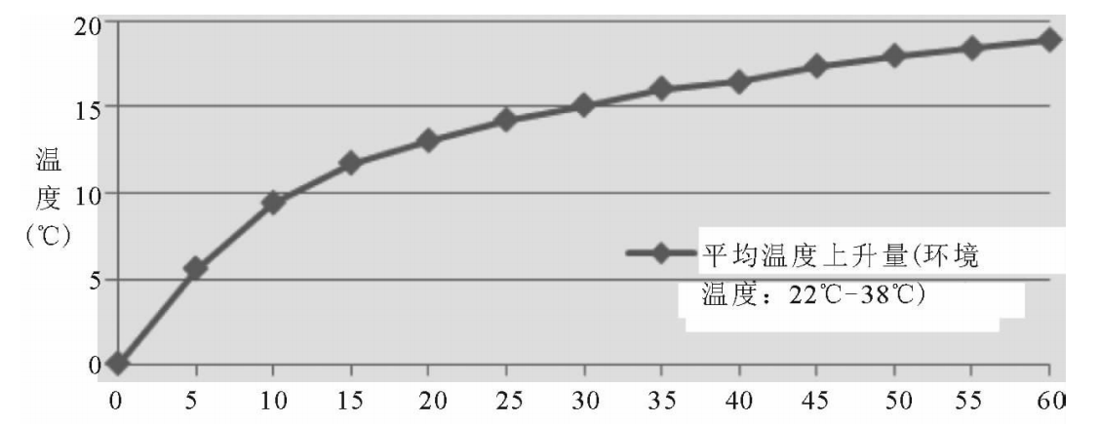
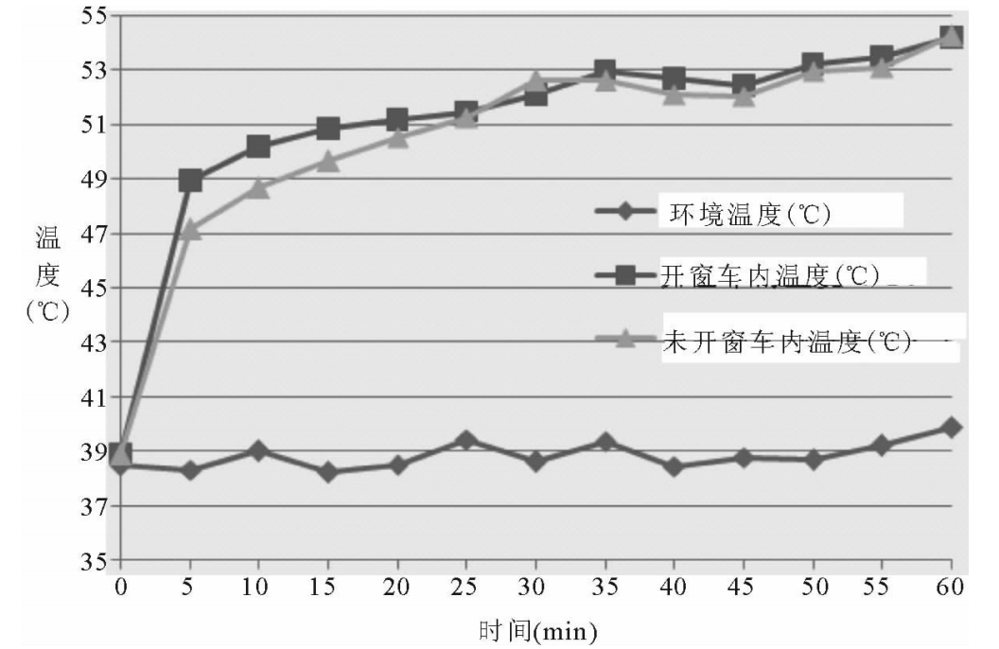
01
Research on PVH
time (min)
time (min)
Figure 1: the temperature rising in the vehicle over time at different ambient temperatures
Figure 2: average temperature in the car at different ambient temperatures.
ambient temperature
temperature with window opening
temperature without window opening
time (min)
Figure 3 : temperature in the car with time when opening the window and not opening the window
Source: Zhu Hang, Ma Zhixiong, Dong Liping, Wu Xiuying, research on the Children Occupant Hyperthermia in Enclosed Vehicle [J]. Journal of Jiamusi University ( Natural Science Edition), 2014, 32 (2), 246-248
Notes:
希望法规的内容与NCAP不产生冲突；
希望建立法规；

Slide 5
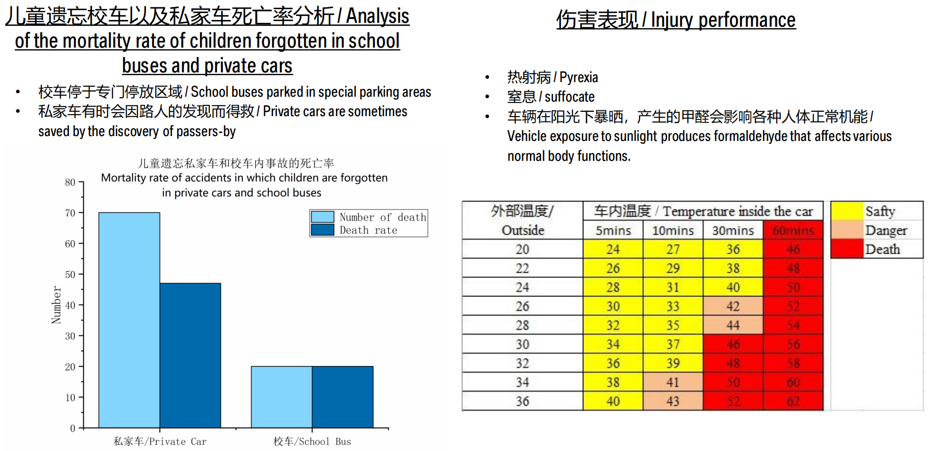
01
Research on PVH
The research gives the following conclusions:
  Even when the ambient temperature is 22℃, it is comfortable for human body, but the temperature in the car will rise to more than 40℃ within 1h, indicating that it is still dangerous to stay in the car.
  Opening window can not reduce the temperature in the car significantly.
Source: Zhu Hang, Ma Zhixiong, Dong Liping, Wu Xiuying, search on the Children Occupant Hyperthermia in Enclosed Vehicle [J]. Journal of Jiamusi University ( Natural Science Edition), 2014, 32 (2), 246-248
Source: Project by BMW brilliance automotive: Investigation and study of incidents of children being left in car.

Slide 6
Background
02
Investigation on PVH
It is relatively early that cars in china installed biological detection system, some car makers started to carry out relevant exploration and application around 2020, began to install in-cabin biological detection system from 2021.
According to incomplete statistics, 41 car models in China have been equipped with the biological detection system [2], and there are no public accurate statistics. However, as people pay more attention to the safety in car, more and more cars are to be equipped with the system.
^{[2]}* Source: public media investigation

Slide 7
Data analysis
02
Investigation on PVH
^{[3]}Source: Public available reported cases(2007-2024).

Slide 8
Data analysis
02
Investigation on PVH
^{[3]}Source: Public available reported cases(2007-2024).

Slide 9
Data analysis
02
Investigation on PVH
^{[3]}Source: Public available reported cases(2007-2024).

Slide 10
Data analysis
02
Investigation on PVH
No statistic data for other cases
^{[3]}Source: Public available reported cases(2007-2024).

Slide 11
02
Investigation on PVH
Conclusion
1. From 2021, the number of PVH deaths has decreased significantly, which is related to the installation of biological detection systems in vehicles;
2. PVH cases are mainly aged between 0 and 6 years;
3. PVH deaths are mainly concentrated in southern provinces in China, and the ambient temperatures are generally high; and PVH deaths are also concentrated in April-September.

Slide 12
03
Response to Q1 to Q4
Q1 What are the factors driving and leading to the 3 typically known scenarios where Paediatric Vehicular Heatstroke (PVH) is observed in field events globally?
The most probable factors are the followings:
Temperature outside vehicle, a 22-degree temperature rise after an hour would put the children in the car in extreme danger, PVH is particularly likely to occur in tropical and temperate countries and regions around the world.
Negligence and unknowingly of the child's guardian. People can not avoid negligence and unknowingly, technical measures are necessary to prevent negligence and unknowingly and to avoid the occurrence of tragedies.
knowingly left. In this scenario, the child's guardians are not awareness of the danger of children left in vehicle in sunshine or hot weather, or they just think they will be come back soon but they can’t or are not in fact.
Notes:
y9SS#78FKLkPmF1

Slide 13
03
Response to Q1 to Q4
Q2 In what type of vehicles is PVH occurring in field events globally?
  More than half of the cases of PVH in China occurred in private cars, and the school buses follows.
Q3 Under what environmental and vehicle conditions are global field events observed in which PVH occurs?
  Relatively high ambient temperature ( equal or greater than 22 degrees Celsius);
  Dark body color and dark interior color is a factor of high temperature in vehicle;
  Generally in summer, plus spring and autumn for areas close to the south (the equator) ;
  Private cars accounted for the highest proportion of PVH, the school bus takes the second;
Q4 What age groups does PVH affect and how are the victims seated/oriented in the vehicle?
  PVH usually occurs in the age group of 0-6 years, which has little relationship with sitting orientation. There is no relevant data in China.

Slide 14
Thank for your attention!
Notes:
That is all, Thanks for your attention!

