Slide 1
CLIV workshop
Brisbane | 15 -17 October 2024
Ronald Vroman

Slide 2
Legal requirements in Italy
(GRSP 69-16)
Mandatory from 7 November 2019, to have a Child Reminder System when a child under 4 years old is transported
Fiscal incentives are issued for a quick implementation
An awareness campaign is carried out.

Slide 3
Legal requirements in Italy
(GRSP 69-16)
System originally integrated in vehicles
System originally integrated in child restraint systems itself
Separate system
Various retrofit systems entered the market following the introduction of mandatory CPD equipment in Italy.
Consumer groups reviewed some of them in 2019
General concept: add-on on CRS plus smartphone app, alarming when smartphone gets out of reach (‘noise’ , dialling pre-programmed numbers

Slide 4

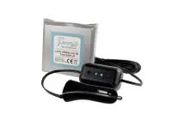

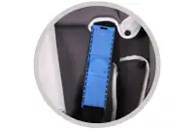
General Description and Pre-requisites
Sensor options
Weight sensor: determines by loading that a child is seated
Chest clip with sensor: clamping harness shoulder pads together
Shoulder pad sensor: detects when harness is tightened
Pre-requisites Smartphone
Battery sufficiently loaded
Connected to network
Be with caretaker
Active Bluetooth connection

Slide 5
Observations and Concerns
Connecting to multiple phones can cause problems.
Sensor mat in car seat may affect safety performances
App requiring a lot of personal data – purpose unclear
Some apps only for iPhone or only for Android device.
12V plug (de)connection not working in all vehilces
OBD connected systems not suitable for every vehicle
Electronic connections sometimes vulnarable
Some more robust solution than others – none perfect
All require conscious actions to install /use / maintain

