Slide 1
Including the development of the electricity mix during a vehicle’s lifetime
Georg Bieker
UNECE-GRPE, Informal Working Group on Automotive LCA
Subgroup 6 meeting, November 5, 2024

Slide 2
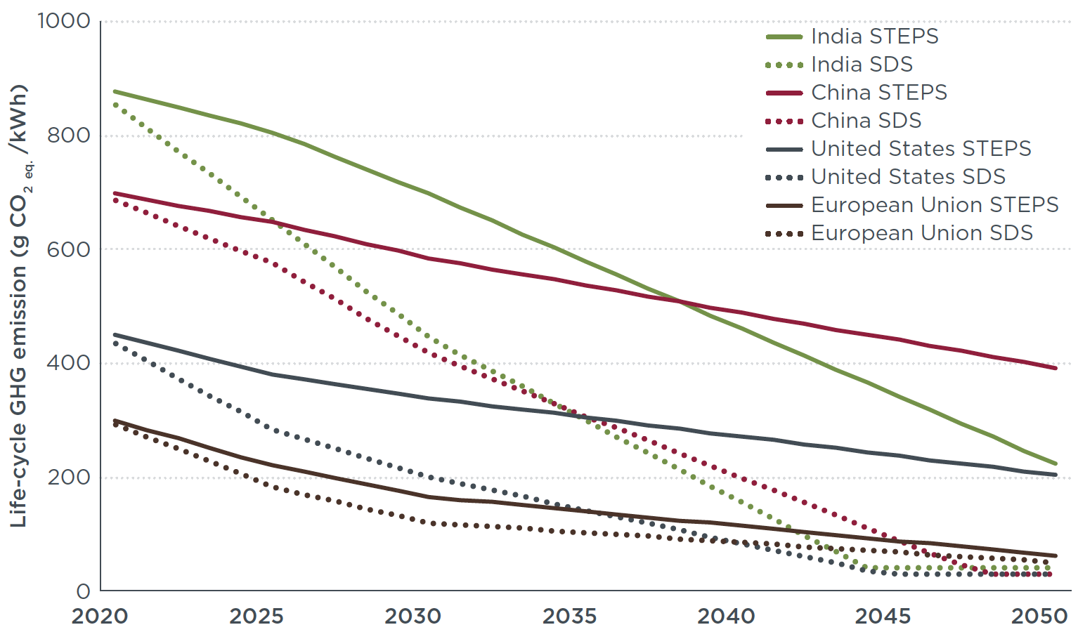
The electricity mix emission intensity changes largely during the lifetime of a vehicle
Life-cycle GHG emissions of electricity consumption
Calculation in ICCT studies:
IEA scenarios on the average electricity mix:
  “Worst case” future mix based on current policies (solid lines)
  “Best case” sensitivity: Paris-
  aligned development (dotted)
  Multiplied with IPCC emission factors of electricity generation technologies
  Corrected by transmission and distribution losses in the grid
  Weighted with decreasing annual mileage over the vehicle lifetime
18-year lifetime of 2021 cars
India
China
USA
EU
Bieker (2021). A global comparison of the life-cycle GHG emissions of combustion engine and electric passenger cars. https://theicct.org/publication/a-global-comparison-of-the-life-cycle-greenhouse-gas-emissions-of-combustion-engine-and-electric-passenger-cars/

Slide 3
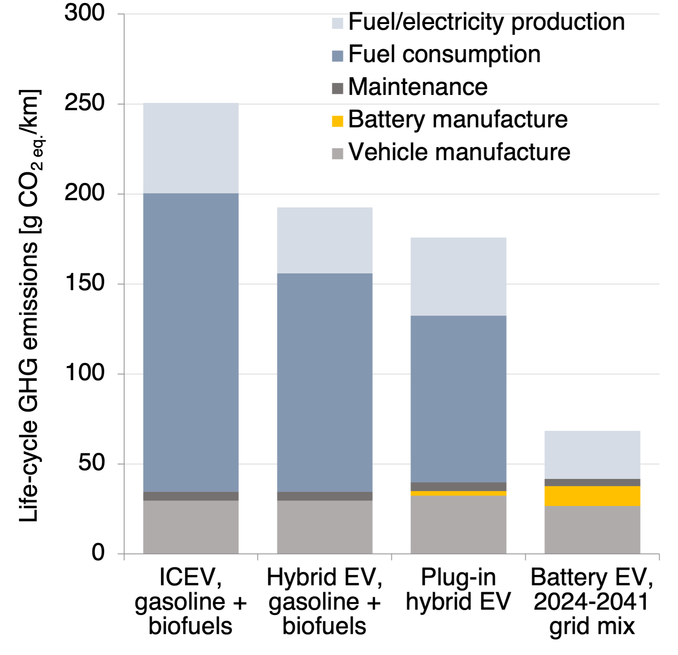
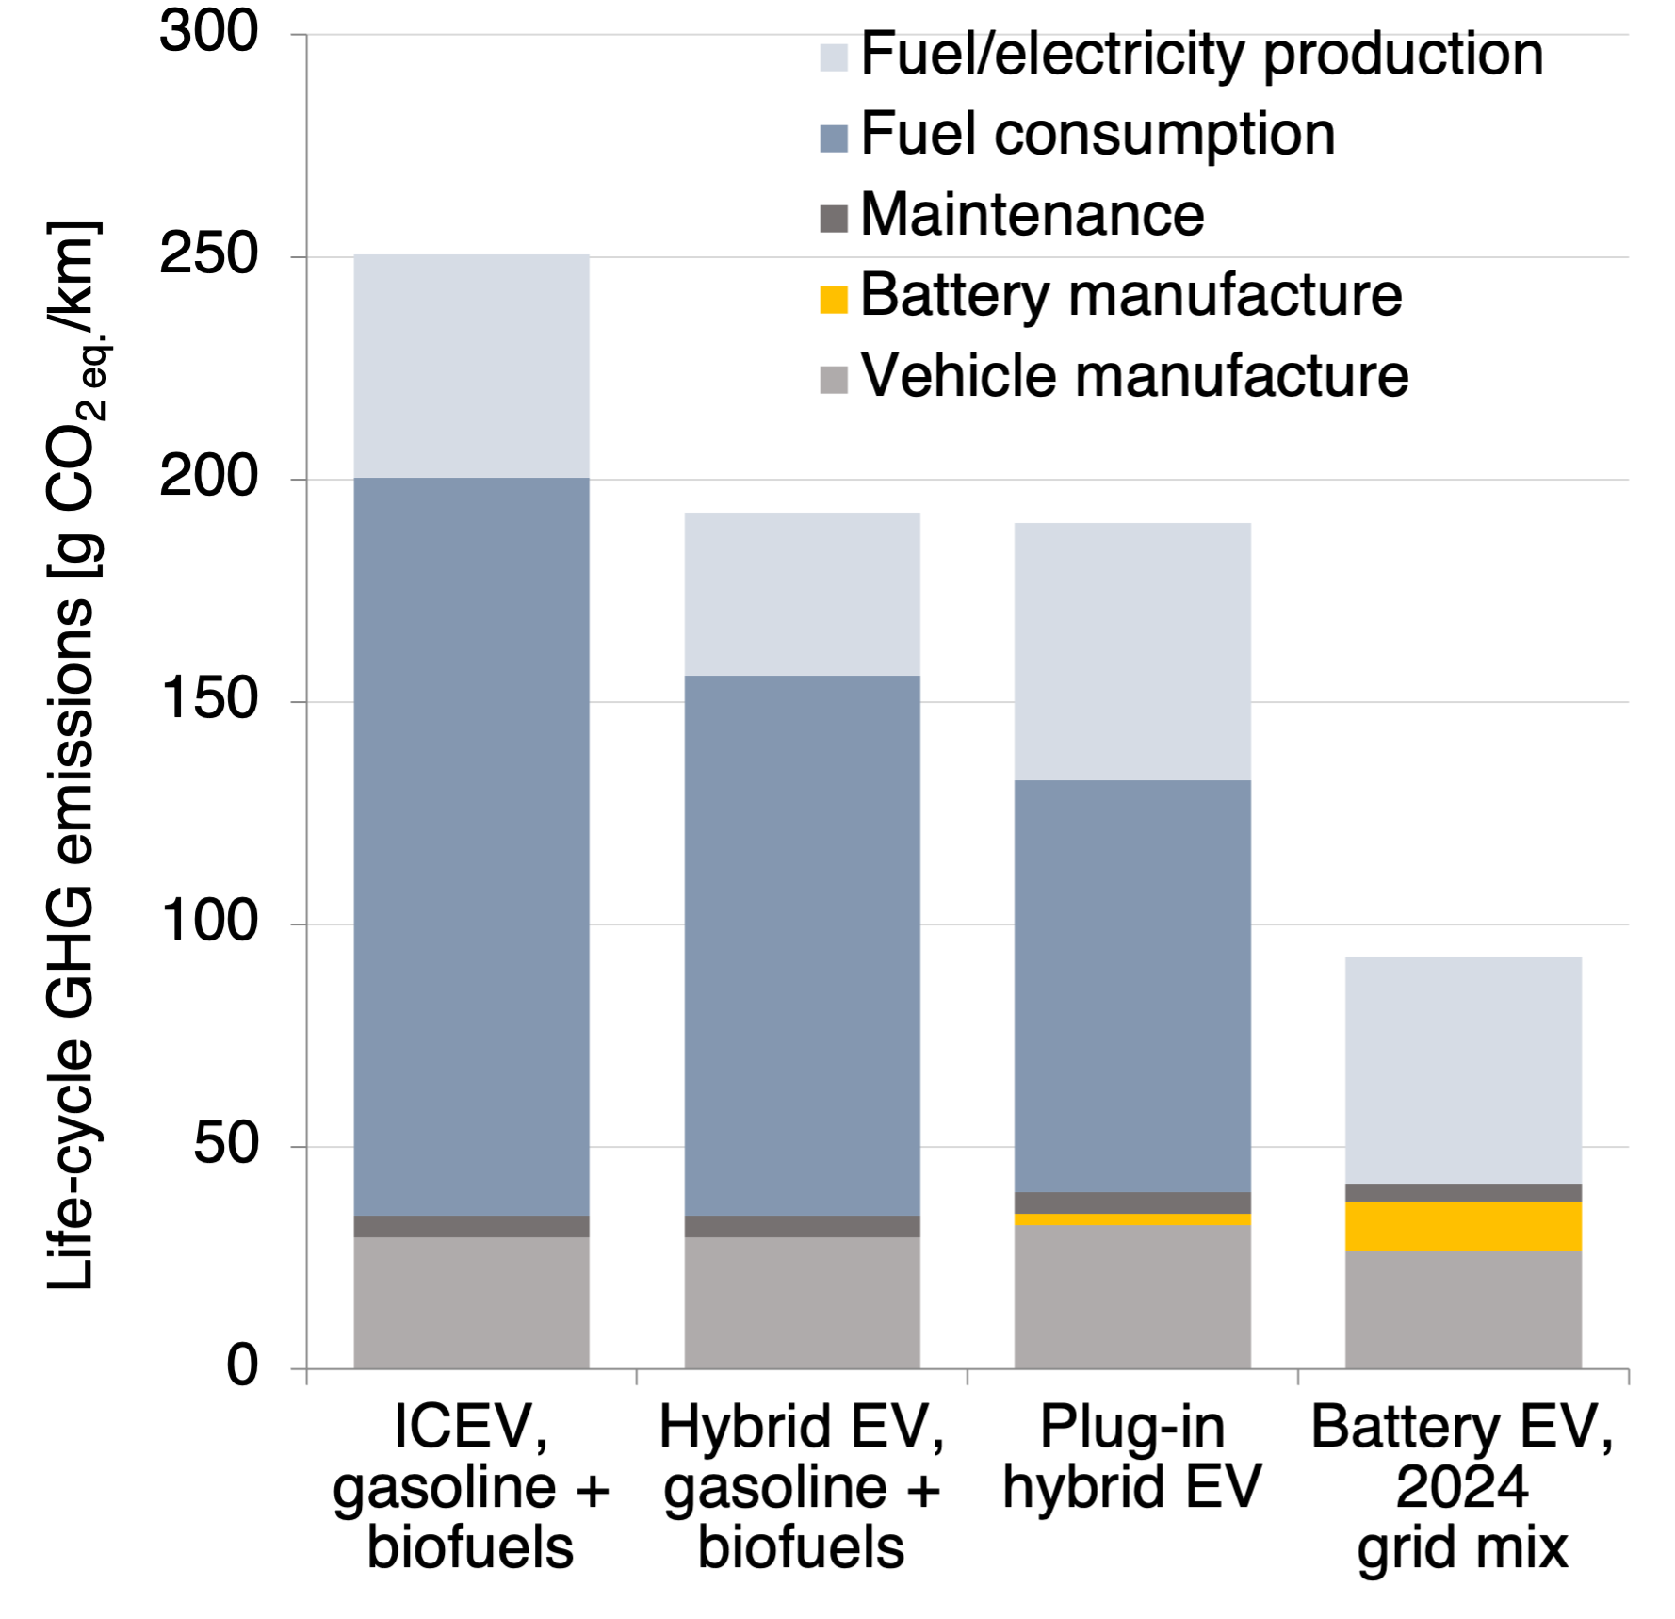
Not including the change of the electricity mix largely overestimated the life-cycle emissions of battery EVs
Case 1: projection for 2024-2041
(IEA World Energy Outlook 2023)
Case 2: no future change
The electricity mix is becoming cleaner, while the fuel mix is improving only marginally.
Assuming no change in the electricity mix largely overestimated the GHG emissions of BEVs.
+ 0%
+ 0%
+ 8%
+ 37%
Based on EU medium segment cars in: Bieker (2021). A global comparison of the life-cycle GHG emissions of combustion engine and electric passenger cars. https://theicct.org/publication/a-global-comparison-of-the-life-cycle-greenhouse-gas-emissions-of-combustion-engine-and-electric-passenger-cars/

Slide 4
Suggested methodology

Slide 5
Summary and recommendations
The mix of electricity generation technologies in the average electricity mix of a region, and to a lesser extend also the blend of fossil fuels with biofuels, varies by region and changes over time. The emissions factor of the electricity and fuel mixes should therefore be specific to the region and year of the electricity/fuel consumption.
For the usage phase, the average emission factor of the electricity and fuel mix during the lifetime of the vehicle (as defined by SG4) needs to be considered.
The emission factor of the average electricity and fuel mixes in a given region and year should therefore be based on the emission factors of individual electricity generation technologies (e.g., coal power, photovoltaics) and fuel pathways (e.g., fossil gasoline, corn-based ethanol, sugarcane-based ethanol) weighted by their (projected) share in the consumption mix in that year.

Slide 6
Summary and recommendations
A conservative scenario for the expected evolution of the mix of electricity generation technologies and fuel pathways can be based on a recent, official published scenario [based on currently implemented policies] specifically for the country or region of interest. The Stated Policies Scenario from the most recent International Energy Agency’s World Energy Outlook report provides a fallback option. If none of these options are available for the country or region of interest, the most recent fuel or electricity mix can be assumed to remain constant for future years.
The emission factors of individual electricity generation technologies and fuel pathways that are considered in the average mixes should be sourced from secondary datasets (potential sources include IEA, Ecoinvent, IDEA, GREET, or other recognized datasets).
…

Slide 7

Thank you!
g.bieker@theicct.org

