Slide 1

Submitted by the expert from China
The introduction of the DAMS（Driver Attention Monitoring System） standard in China
Zhang Lu, Wang Botong, Zhang Guangxiu
2024.11.19

Slide 2
Driver Attention Monitoring System in China
Name of the standard：Performance requirements and test methods for driver attention monitoring system（GB/T 41797─2022）
Type：Recommended National Standard
Release date：2022.10.12
Implementation date：2023.5.1
Scope：This document specifies the general requirements, performance requirements and test methods of the driver attention monitoring system. This document applies to Class M and N vehicles equipped with driver attention monitoring systems based on image recognition technology. Others have the system with the same function can be executed as a reference.
Driver distraction：When driving a vehicle, the driver is unable to concentrate on the driving task due to fatigue driving, interference from the external environment, or actions unrelated to driving.

Slide 3
Technical Requirements
General Requirements
Basic requirement of function
The system should have the ability to monitor the driver's status in real time and send a warning when the corresponding conditions are met
System warning
The driver actively turns off the function
The driver is distracted
System failure
System state transitions
When the vehicle is started, the system automatically turns on and standby, with a manual switch

Slide 4
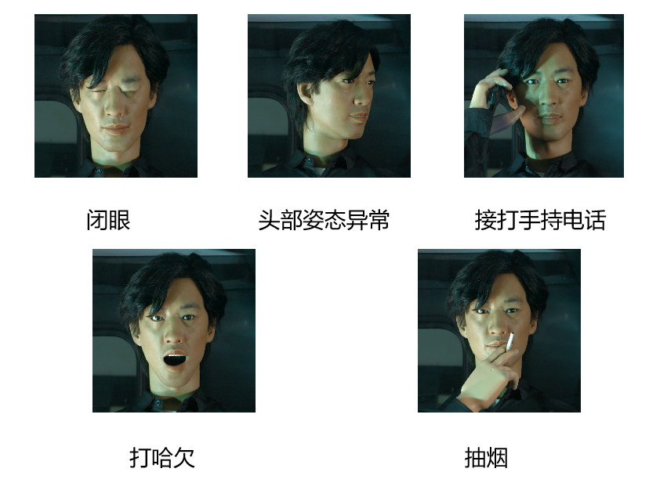
Technical Requirements
Performance requirements
The behavior of the system monitoring
System recognition capability requirements（Real driver test）
The number of correct identification is not less than 2/3
Each behavior was identified at least once in a single trial
Detection rate and accuracy requirements
（Bionic robot test）
The system should send a warning within 1.5s, and the detection rate and accuracy should be greater than or equal to 95%
Close Eyes
Abnormal Head Posture
Use Phone
Yawn
Smoking

Slide 5
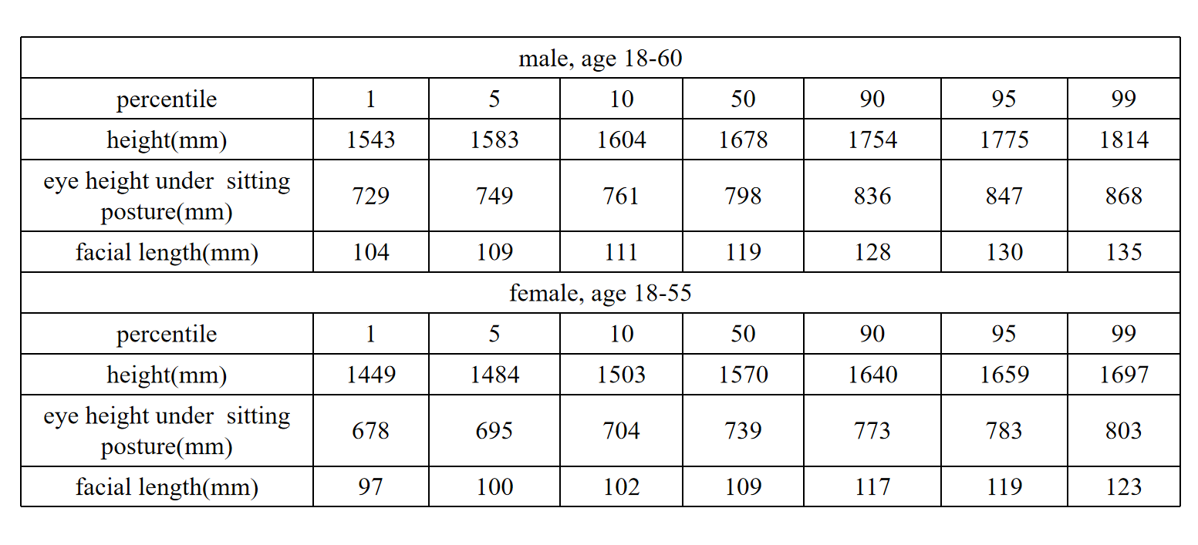
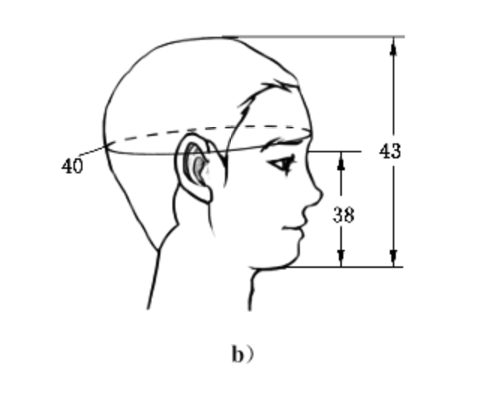
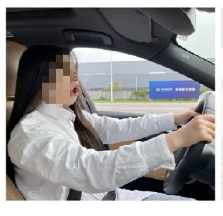
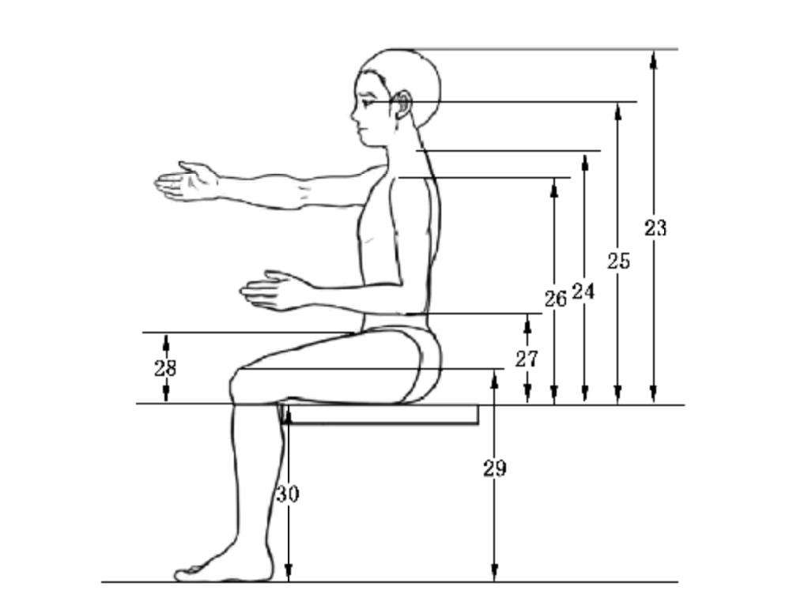
Test Methods
Real driver test
The experimental objective is to have at least 3 adults who have meet the height,eye height under sitting posture , facial length requirements of the 18-60 age group in GB/T 10000 Human dimensions of Chinese adults.
Subject | Specific Actions | Number of Tests | Pass Requirements
Close Eyes | Fully closed eyes for a duration of 2 seconds or more | At least 3 drivers, each driver tested for 6 times, for a total of 18 times | Only one failed subject is allowed, and at least one of the six unidentified experiments can be identified
Yawn | The aspect ratio of the mouth opening is greater than 0.6, and the duration is greater than or equal to 3 seconds | At least 3 drivers, each driver tested for 6 times, for a total of 18 times | Only one failed subject is allowed, and at least one of the six unidentified experiments can be identified

Slide 6
Test Methods
Real driver test
The experimental objective is to have at least 3 adults who have meet the height,eye height under sitting posture , facial length requirements of the 18-60 age group in GB/T 10000 Human dimensions of Chinese adults.
Subject | Specific Actions | Number of Tests | Pass Requirements
Turn head left | Head left turn ≥ 45 degrees, duration ≥ 3s | At least 3 drivers, each driver tested for 6 times, for a total of 18 times | Only one failed subject is allowed, and at least one of the six unidentified experiments can be identified
Turn head right | Head right turn ≥ 45 degrees, duration ≥ 3s
Head upward | Head up ≥ 30 degrees, duration ≥ 3s
Head downward | Head down ≥ 30 degrees, duration ≥ 3s
Use Phone | The distance between any point on the phone and the face is ＜ 5cm, duration ≥ 3s
Smoke | The minimum distance between cigarettes and lis is ≤ 2cm, and the duration is ≥ 2s

Slide 7
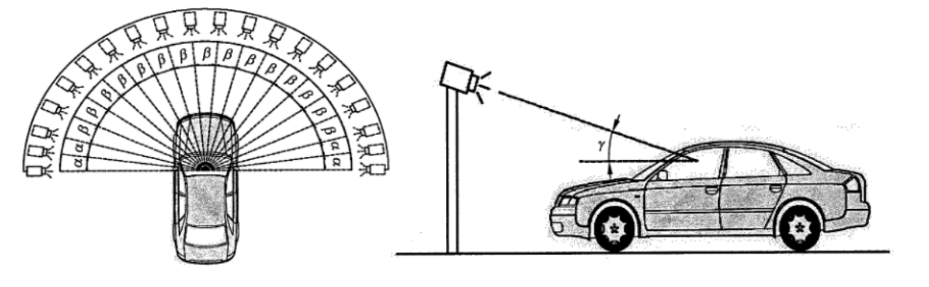
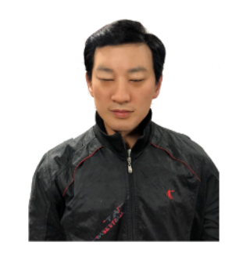
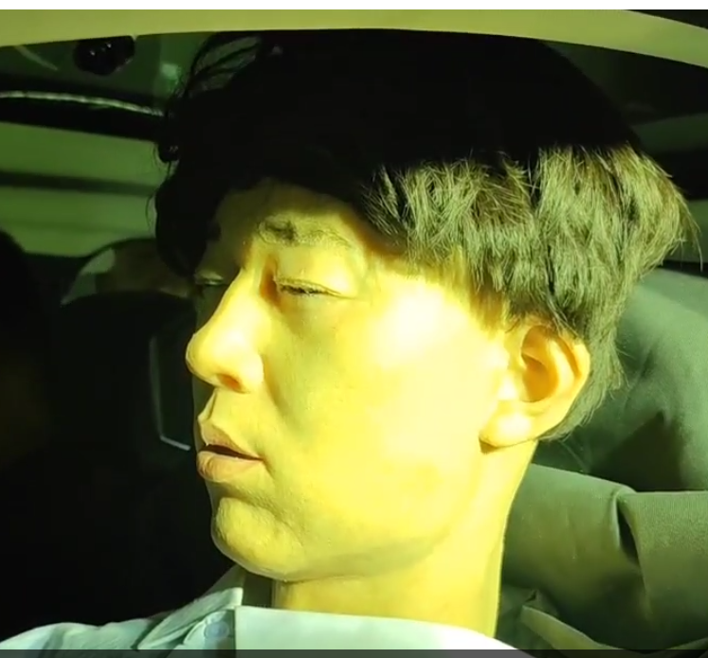
Test Methods
Bionic robot test
The experimental objective is to develop Bionic robot that meets the requirements of size and motion accuracy. The light source is centered around the center of the first row of seats in the vehicle and moves according to the position shown in the figure below, where α is 7.5 degrees, β is 10 degrees, and the incident angle of the light source γ is 30 °~45 °.
Subject | Specific Actions | Naked Eye | Wear Glasses | Wear Sunglasses | Pass Requirements
Close Eyes | Fully closed eyes for a duration of 2 seconds | Daytime: 20 times Evening: 20 times | Daytime: 20 times Evening: 20 times | Evening: 20 times | If a fatigue alarm is issued within 1.5 seconds after the action is completed, it is considered a positive inspection.The detection rate and accuracy rate should be greater than 95%.
Yawn | The aspect ratio of the mouth opening is greater than 0.6, and the duration is 3 seconds | Daytime: 20 times Evening: 20 times | Daytime: 20 times Evening: 20 times | Evening: 20 times | If a fatigue alarm is issued within 1.5 seconds after the action is completed, it is considered a positive inspection.The detection rate and accuracy rate should be greater than 95%.

Slide 8


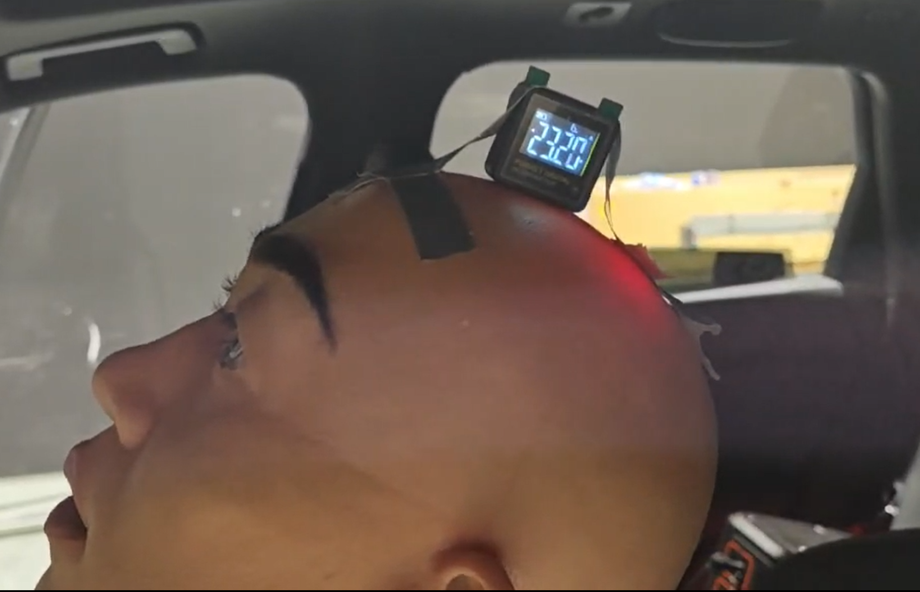
Test Methods
Bionic robot test
Subject | Specific Actions | Naked Eye | Wear Glasses | Wear Sunglasses | Pass Requirements
Abnormal Head Posture | Turn the head to the left 45° to 50°, hold for 3 seconds, and then return to the 0° position. | Daytime: 20 times Evening: 20 times | Daytime: 20 times Evening: 20 times | Evening: 20 times | If a distraction alarm is issued within 1.5 seconds after the action is completed, it is considered a positive inspection.The detection rate and accuracy rate should be greater than 95%.
 | Turn the head to the right 45° to 50°, hold for 3 seconds, and then return to the 0° position. | Daytime: 20 times Evening: 20 times | Daytime: 20 times Evening: 20 times | Evening: 20 times | If a distraction alarm is issued within 1.5 seconds after the action is completed, it is considered a positive inspection.The detection rate and accuracy rate should be greater than 95%.
 | Head up 30° to 35°, hold for 3 seconds, then return to the 0° position | Daytime: 20 times Evening: 20 times | Daytime: 20 times Evening: 20 times | Evening: 20 times | If a distraction alarm is issued within 1.5 seconds after the action is completed, it is considered a positive inspection.The detection rate and accuracy rate should be greater than 95%.
 | Head down 30° to 35°, hold for 3 seconds, and then return to the 0° position | Daytime: 20 times Evening: 20 times | Daytime: 20 times Evening: 20 times | Evening: 20 times | If a distraction alarm is issued within 1.5 seconds after the action is completed, it is considered a positive inspection.The detection rate and accuracy rate should be greater than 95%.

Slide 9
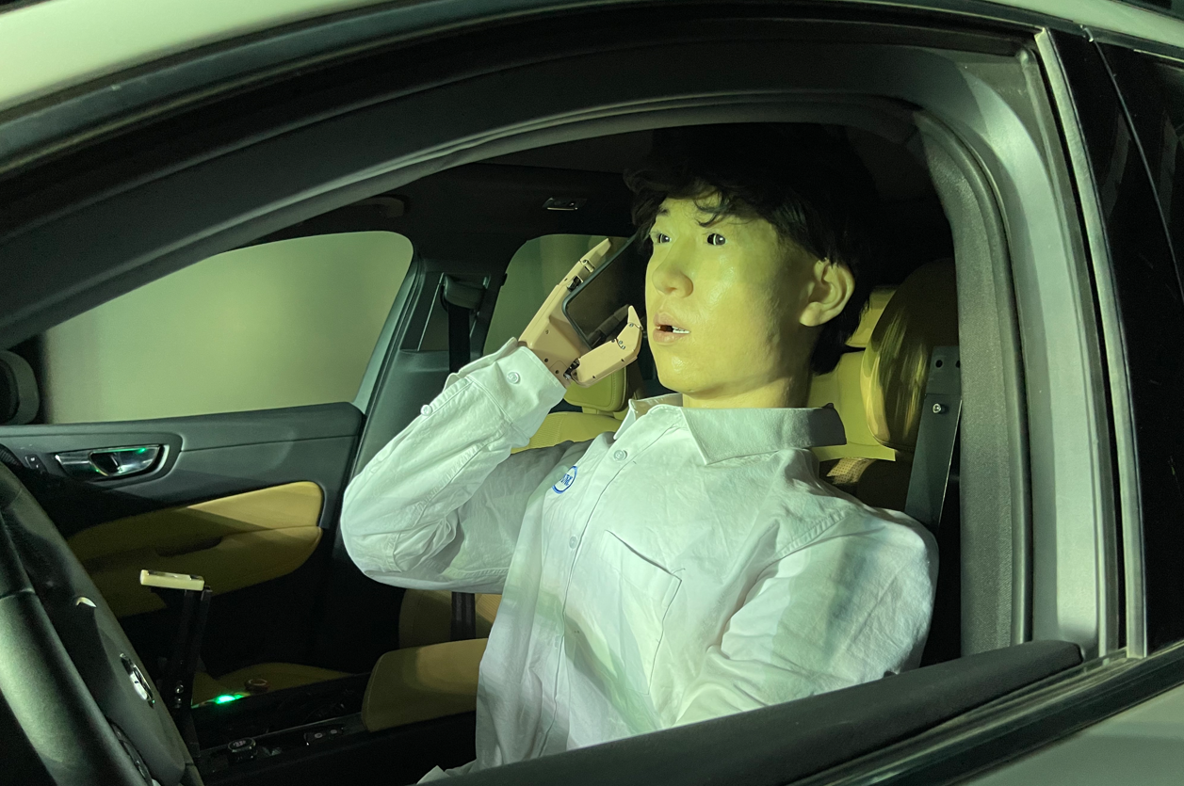
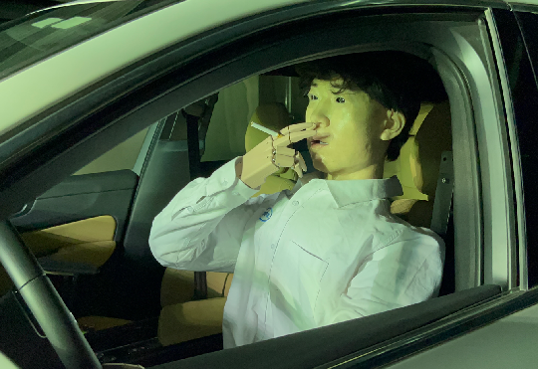
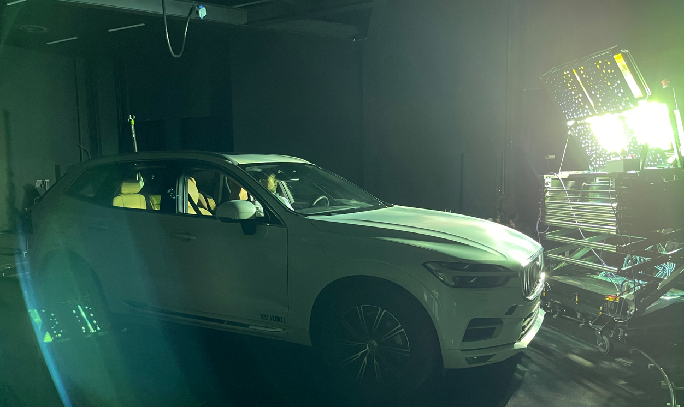
Test Methods
Bionic robot test
Subject | Specific Actions | Naked Eye | Wear Glasses | Wear Sunglasses | Pass Requirements
Use Phone | Place the handheld phone close to the head for 3 seconds and then put it down | Daytime: 20 times Evening: 20 times | —— | —— | If a distraction alarm is issued within 1.5 seconds after the action is completed, it is considered a positive inspection.The detection rate and accuracy rate should be greater than 95%.
Smoking | Pinch the cigarette within 2cm of the face and hold it for 2 seconds before putting it down | Daytime: 20 times Evening: 20 times | —— | —— | If a distraction alarm is issued within 1.5 seconds after the action is completed, it is considered a positive inspection.The detection rate and accuracy rate should be greater than 95%.

Slide 10
Thinking on DDADW
There are many factors that affect system performance, such as lighting and driver wearing conditions. It should be tested through a combination of subjective and objective methods. The dummy test is an important reference for objective testing.In addition, system false responses should also be considered as part of the system performance evaluation.
For the automated vehicles, the driver's attention warning is required in ECE R157 ALKS and ECE R171 DCAS , so this regulation does not require repeated requirements.
10

Slide 11
Thanks for attention!

