Slide 1


Submission from Australia for Step 2 of EDR for heavy vehicles – UN R169 – IWG EDR/DSSAD meeting 42
Document xxxxx-xx-xx
IWG-EDR/DSSAD Mtg 42, 21 November 2024
Agenda Item XXX
X November 2024 / Australia /
Unless otherwise noted, copyright (and any other intellectual property rights, if any) in this publication is owned by the Commonwealth of Australia. All other rights are reserved.
For reproduction permission and all other issues, please contact Kris Slattery, standards@infrastructure.gov.au

Slide 2
Background
The Bus Industry Confederation (BIC) is a national peak body representing the interests of the bus and coach industry in Australia, inclusive of both manufacturers and operators.
BIC work with the Australian federal government (DITRDCA) to advocate for and support initiatives that improve the overall safety performance of the bus industry and reduce accidents involving buses or coaches.
BIC provided a submission to DITRDCA in relation to the draft version of UN R169 that was adopted by GRSG and sent to WP.29 for consideration at the November 2023 session.
BIC have made recommendations on additional data elements for inclusion in Annex 4 (Data Elements and Format) of UN R169.

Slide 3
Overview of data element requests
BIC have indicated:
  general support for the existing scope of Annex 4 of UN R169, but also that;
  some important general vehicle data is notably absent; and
  they believe there are several critical data elements not included which are specific to bus vehicle types; and that
  those bus data elements are not unique to Australia but rather apply at a global level, especially in Europe.

Slide 4
General lighting data (R169 & R160)
Data elements for lights and light-signaling devices appear limited.
This assessment was made with consideration to the potential importance of lighting data for accident investigation purposes; e.g.
  were the headlamps on in the case of a night time incident,
  were the position lamps on and/or hazard lamps activated,
  was the indicator on for the turning vehicle involved.

Slide 5
Bus passenger door position
To provide the status of the door/s at the time of an incident.
Although systems to mitigate issues involving passenger doors are used, there are circumstances where door position could be an issue, including but not limited to;
  a passenger forcing a door open while the bus is driving,
  a vehicle driven away from rest with a door open,
  a bus rollaway/runaway incident.

Slide 6
Bus door brake status
Also referred to as a ‘stop brake’ or ‘halt brake’.
Designed to automatically apply service brakes when a passenger door is open, to either prevent the bus from moving or bring it to a stop if a door is opened while moving.
A critical system, mandated in Australia by most government based operators and many private operators of commercial vehicles.
Many investigations of bus incidents look to understand the status of the door brake.

Slide 7
Articulated bus turntable angle
Yaw rate and lateral acceleration are typically direct measurements for only the front section of an articulated vehicle, as this is where the sensors are typically located.
In this situation, a more complete picture of the vehicle can be obtained by knowing the turntable angle and thereby the position of the rear section relative to the front section.
Turntable is a rotating element of the coupling between vehicle sections, with similar importance to steering wheel angle (see next).

Slide 8
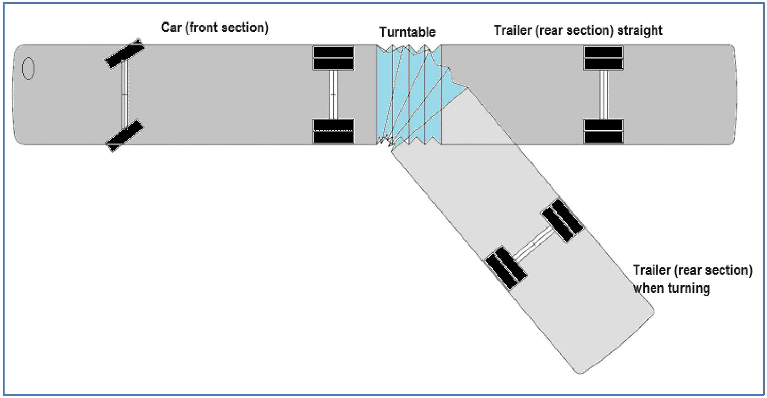
Articulated bus turntable angle (cont’d)

Slide 9
Bus fire suppression status
In Australia, fire suppression is mandated by the vast majority of government jurisdictions and private (commercial) operators on both internal combustion engine (ICE) and zero emission buses.
Similarly, fire suppression is mandated on all ICE buses in Europe.
Data relating to the activation of a fire suppression system is very important when investigating accidents including thermal incidents.
Data helps to understand performance of both the system and the driver (e.g. activation by driver, automatic activation, false activation).

Slide 10
Bus duress alarm status
A bus-specific function to enable the driver to signal an emergency, such as an incident on board the vehicle or an accident.
A communication system that will alert the depot / home base.
Mandated by most government jurisdictions and private (commercial) operators to improve overall vehicle safety.
BIC have suggested that if a separate EDR input is not provisioned for a bus duress alarm, consideration be made for the AECS input to be alternatively used for this purpose where AECS does not apply.

Slide 11
Suggestions on data element formatting
Some suggestions from the BIC include that:
  All new data elements are recorded for all 5.3.1 triggers.
  All new data elements have a recording interval/time of -20 to +10 sec, except for duress alarm (event).
  Bus passenger door position can be; open, closed, fault. Recording rate of 1 sample/sec. Mandatory requirement.
  Door brake status can be; activated, not activated, fault. Recording rate of 1 sample/sec. Mandatory requirement.

Slide 12
Suggestions on data element formatting
  Turntable angle requires a range of 100 deg, 1 deg resolution, and recording rate of 2 samples/sec. Mandatory for articulated vehicles only.
  Fire suppression status can be; activated, not activated, fault. Recording rate of 1 sample/sec. Mandatory where fitted.
  Duress alarm status can be; activated, not activated. Mandatory where fitted.
  Australia (DITRDCA) would support higher data recording rates, and understand this may be under consideration for all elements.

Slide 13
thank you
Department of Infrastructure, Transport,
Regional Development, Communications and the Arts

