Slide 1
What is EPLLA?
SLR-70-04
Effective Projected Luminous Lens Area, or in the absence of a lens involved in the optical design, it could be the Effective Projected Luminous Lamp Area

Slide 2
What is EPLLA?
Richard L. Van Iderstine
Chairman, SAE Measuring Luminous Area Task Force
Scottsdale, AZ, Spring 2008

Slide 3
NHTSA published the final rule for the visibility of lamps as installed on motor vehicles over 3-1/2 years ago.
Federal Register: August 11, 2004 (Volume 69, Number 154), Pages 48805-48817
[Docket No. NHTSA-2004-18794]

Slide 4
EPLLA is defined in that final rule:
Effective projected luminous lens area means the area of the orthogonal projection of that portion of a lamp that directs light to the photometric test pattern, and does not include transparent lenses, mounting hole bosses, reflex reflector area, beads or rims that may glow or produce small areas of increased intensity as a result of uncontrolled light from an area of 1/2 degree radius around a test point of a lamp on a plane perpendicular to a defined direction relative to the axis of reference.

Slide 5
You have probably seen the following sketches of various representations of EPLLA that were provided by Larry Rice and Monty Foust

Slide 6
Reflector Optics
Unobstructed
Effective Projected Luminous Lens Area
Orthogonally projected in the defined direction
Effective Light-emitting surface

Slide 7
Reflector Optics
Unobstructed
Effective Projected Luminous Lens Area
Orthogonally projected in the defined direction
Maybe if far wall directs light to the phometric test pattern.
Maybe if far wall is not reflective.
Effective Light-emitting surface

Slide 8
Inner Lens Optics
Unobstructed
Effective Projected Luminous Lens Area
Orthogonally projected in the defined direction
Effective Light-emitting surface
Lit edge of reflector projected parallel to the
axis of the parabola

Slide 9
Inner Lens Optics
Unobstructed
Effective Projected Luminous Lens Area
Orthogonally projected in the defined direction
Effective Light-emitting surface
Lit edge of reflector projected down the
axis of the parabola
Maybe if far wall directs light to the phometric test pattern.
Maybe if far wall is not reflective.

Slide 10
Outer Lens Optics
Orthogonally projected in the defined direction
Unobstructed
Effective Projected Luminous Lens Area
Effective Light-emitting surface
Lit edge of reflector projected parallel to the
axis of the parabola

Slide 11
Outer Lens Optics
Unobstructed
Effective Projected Luminous Lens Area
Orthogonally projected in the defined direction
Effective Light-emitting surface
Maybe if far wall directs light to the phometric test pattern.
Maybe if far wall is not reflective.
Lit edge of reflector projected parallel to the
axis of the parabola

Slide 12
The Key to unlock this seems simple: determine how to scientifically measure the luminous part of the lamp that is seen by an observer when stationed at the requisite angles.

Slide 13
Is it really that straight-forward?
Can’t we just take a photo and measure the luminous area?
What about the equipment used, doesn’t that affect the measurement?
What is the minimum intensity that should be used to count a valid area?
Also, if they are luminous, why must we discount beads, bosses, reflex reflectors, and such?
How can I do this in the lamp design stage, before I have built the first lamp?

Slide 14
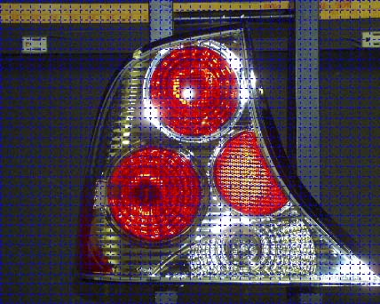
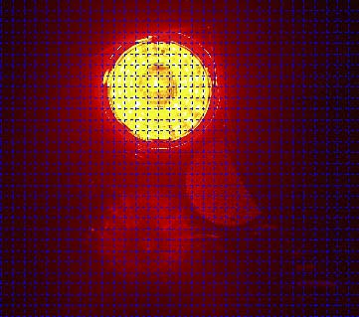
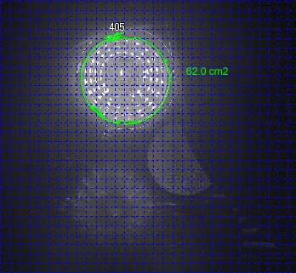
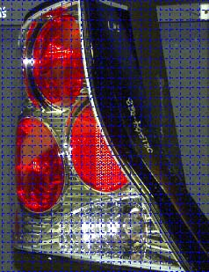
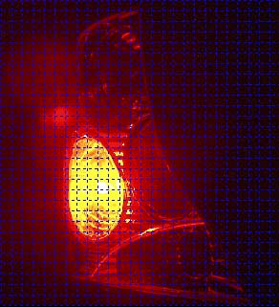
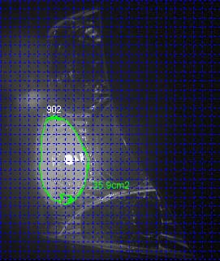
Here is some work on EPLLA, courtesy of CalCoast ITL and Mark Evans using a digital camera instead of a 1:1 measurement method:

Slide 15
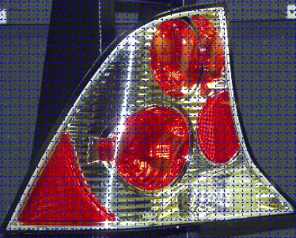
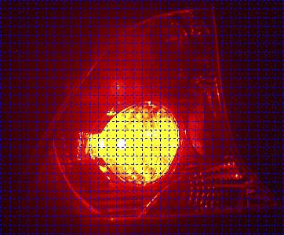
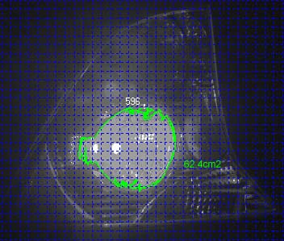
And…
Lens area was determined using a digital camera and image analysis software. First, a high resolution digital picture was taken of a grid pattern of 1.0cm² squares and loaded into the software program. The grid was placed on a reference line a distance of 48" and perpendicular to the camera. The software then overlaid a digital grid onto the image and calibrated so that each digital square was recognized as 1.0cm². Next, the physical grid was replaced by the sample lamp placing the function cavity's focal point (filament) on the reference line and high resolution digital pictures were taken of the lamp and its illuminated cavity at viewing angles of 0°(HV) and 45° left and right. The photos were then loaded into the software and a blob pattern analysis was performed to determine the area of the illuminated function by calculating the total area above an arbitrary threshold value.

Slide 16
Mark, was it really that easy?
Dave Post, you have looked at it from the designer’s side. Is it really that easy?

Slide 17
Please don’t answer, I will.
No, it is surely not that easy!

Slide 18
David and I volunteered to generate new text for J575 on EPLLA.
Since the last meeting David and Mark have been independently studying the issue and are learning that there are pertinent challenges to the development of a requirement and test procedure.
There is much work to be done and to be presented for your consideration.
We will continue to work and hope to conduct a discussion at the next meeting in Ottawa.

