Slide 1
Apparent Surface Workshop SLR Dec 2024
SLR-70-06
(R)Evolution idea
What is the apparent surface?
What we currently treat with regulations
→ Necessary for device regulations
What we see on the vehicle
→ Required for Installation

Slide 2
Apparent Surface Workshop SLR Dec 2024
Question: What is the target of the request to work on this topic?
1) Clarification and simplification → simple reproducable approach based on what the observer perceives?
OR
2) Is there a different intent? If yes, which one?

Slide 3
Apparent Surface Workshop SLR Dec 2024
Method assessment
Where are the differences in apparent surface size coming from?
- Diffuse definition of the „Illuminating Surface“ in 2.10.3.2
- Outer lens may be considered or not (no matter if textured or clear) for light emitting surface definition
Target
→ define one or more methods, which are defining an apparent surface
- close to the visual impression
- with comparable result for all criteria
- easy to assess during desing phase (CAD basis)
- reproducible, comprehensible results

Slide 4
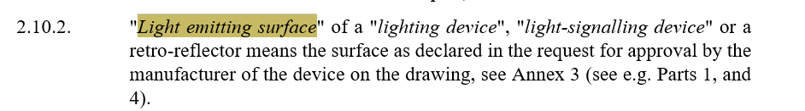
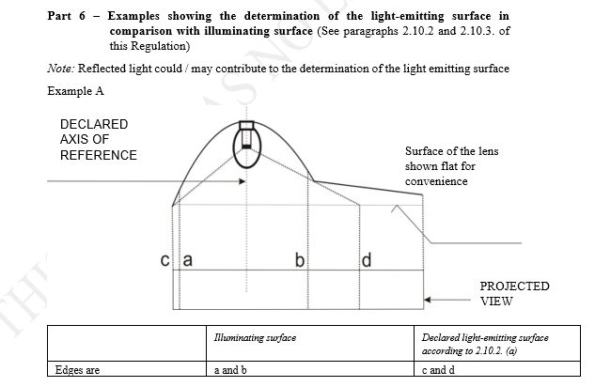
Simplification Apparent Surface
Apparent surface / DePLA
Light emitting surface
textured
outer lens
Clear outer lens
Apparent surface = blue line
Direction of observation
Partly textured outer lens directing reflected or direct light
Partly textured outer lens in the direction of observation
Partly textured outer lens in the irrelevant direction (e.g. visibility 80° if direction of observation = direction of reference axis)

Slide 5
How do we define the Apparent Surface of a function?
As a concept / framework for a light function mounted on one side of the vehicle?
→ Describe installation limits refering to the lowest, highest, most outboard, most inboard point of all distinct parts consituting the Apparent Surface of a function
b) As a rectangle around all distinct parts
→ Describe installation limits refering to the lowest, highest, most outboard, most inboard point of the Apparent Surface of a function.
This clarification should be included in the definition of the „apparent surface“
Use reference to the distinct parts of the apparent surface to define:
Distance to other function
Single lamp requirements
Incorporation
Size
Attention: for the distance between two distinct parts the reference to the extreme outer points may produce a different result than using tangents

Slide 6
BACKUP

Slide 7
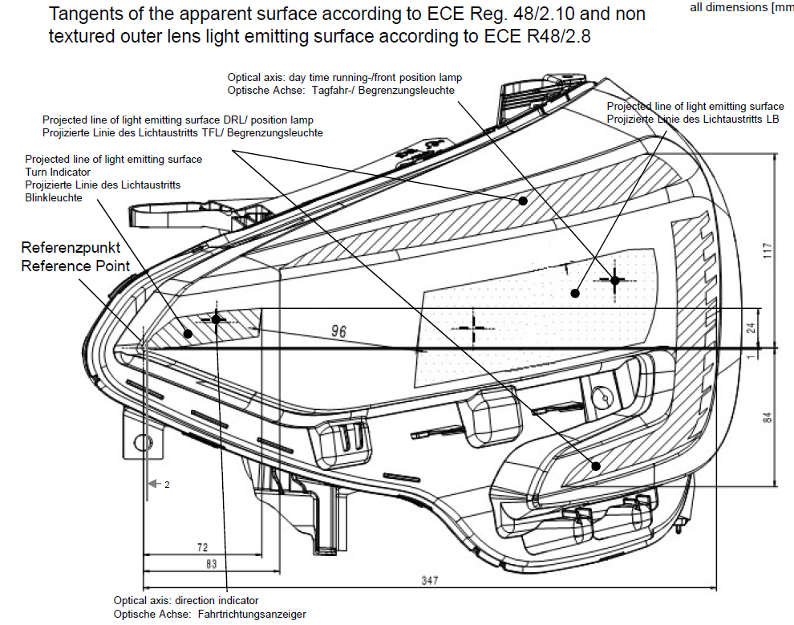
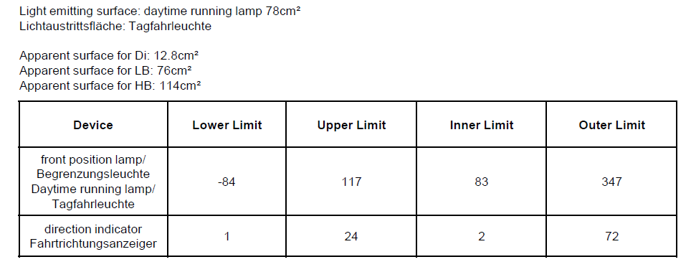
Apparent Surface Workshop SLR Dec 2024
Current content for type approval with light emitting surface
= light emitting surfaces projected in the direction of reference / observation, i.e. the apparent surface

Slide 8

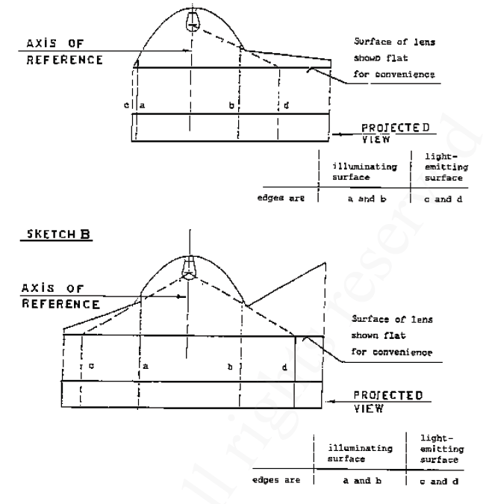
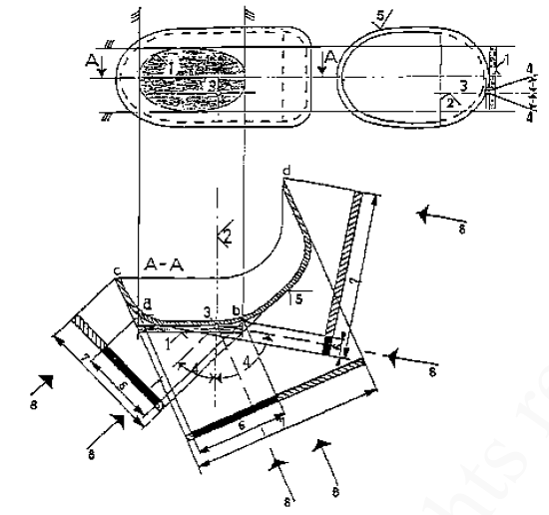
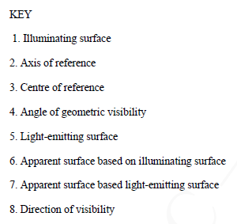
Apparent Surface Workshop SLR Dec 2024
Small history
R48-00
1982
R48-01 C4 from 1995:
2.8. "Light-emitting surface" of a "lighting device", "light-signalling device" or a retro-reflector means all or part of the exterior surface of the transparent material as declared in the request for approval by the manufacturer of the device on the drawing, see Annex 3;
→ Difference of apparent surface depending on

Slide 9
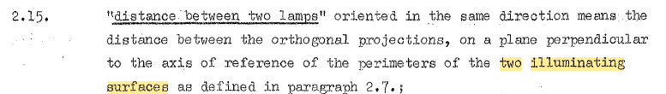

Apparent Surface workshop
Small history 1982
Light-emitting surface used for:
- single lamp definition
- geometric visibility assessment
Illuminating surface used for:
- installation
- distance between lamps
- reciprocal incorporation
→ Dedicated function of illuminating and light-emitting surface
→ This idea got lost with the introduction of „apparent surface“. Today you have to decide which option to chose for all criteria!

