Slide 1
OICA Input to SLR-70
Topic: “Prohibited if not allowed”
SLR-70-11
12-13 December 2024

Slide 2
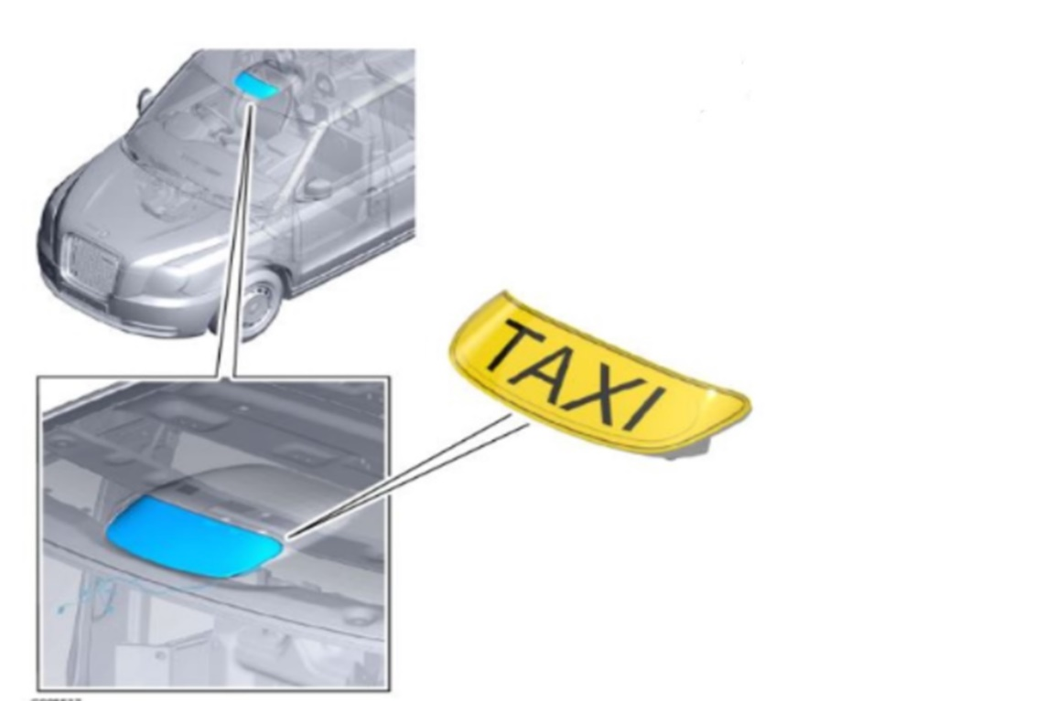
Problem
The SLR group has a proposal to add new requirements under paragraph 5. ‘General specifications’ which will require “multi-stage” production of some vehicles.
The situation with option A is not 100% clear. How could this be determined?
If option C is implemented, these lamps could not be fitted on the production line.
Option A:
Notwithstanding those lamps which may be installed at national and regional level, the fitting of any lamps other than those mentioned in paragraph 6 is prohibited for the purposes of granting a [UN] type-approval according to this Regulation.
Option C:
The fitting of any lighting and light-signalling devices other than those mentioned in paragraph 6 is prohibited for the purposes of granting a [UN] type-approval according to this Regulation. [National regulations are not considered as part of the type-approval.]
Image: Copyright free. Supplied with permission from LEVC.

Slide 3

Alternative Proposal (not finalised)
Modify Option A, to add the requirement to list lamps that are installed according to national legislation in the Communication form.
Option A2:
Notwithstanding those lamps which may be installed at national and regional level, the fitting of any lamps other than those mentioned in paragraph 6 is prohibited for the purposes of granting a [UN] type-approval according to this Regulation. Any lamps installed according to national or regional laws shall be listed in the Communication form.
Photo: Copyright free, photo taken by Mark Grainger, OICA.

Slide 4
Conclusion
Proposal to use the wording in Option A would permit:
  UN R48 approvals without the need to physically removing these nationally allowed lamps.
  EUWVTA requires Emission testing road load aerodynamic testing to UN R83 and external projections to UN R26 with lamps present.
  COP testing of a ‘fully manufactured’ vehicle (without the need for post-registration installation).
  An approval to UN R48 means the vehicle meets the requirement of UN R48. Any additional national approval is the responsibility of the vehicle manufacturer or operator, This is not the jurisdiction of UN R48 type approval.
  If additional lamps are fitted during the vehicle production, a more integrated solution can be implemented. We do not see the advantage of forcing post-registration installation of additional lighting equipment.

Slide 5
Backup Information

Slide 6

Original OICA Proposal
Using Option B, vehicle manufacturers are allowed to install lamps that are permitted under national approvals during type approval and onto production vehicles (in line with CoP).
Option B:
In accordance with this Regulation, the type-approval only applies to the lamps specified in paragraphs 5 and 6 in accordance with the template from Annex 1. Other lamps installed according to national or regional Regulations are not considered as part of approval and do not compromise compliance evaluation to this Regulation.
Photo: Copyright free, photo taken by Mark Grainger, OICA.

