Slide 1
Transmitted by the Republic of Korea
PSG-02-XX
Overall Review of CPA
(CPA : Ceramic Printed Area)
29. Sep. 2015

Slide 2
Contents
Table of Contents
1. Status of consumer defect complaints & media reports
2. Status of CPA application in Korea
3. Strength Characteristics of CPA in Toughened glass
4. Conclusions
-2-
Notes:
2

Slide 3
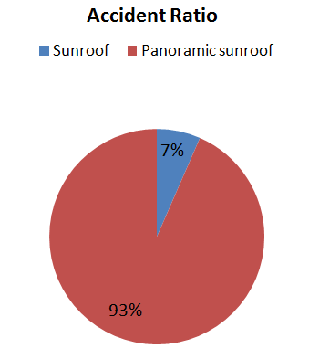
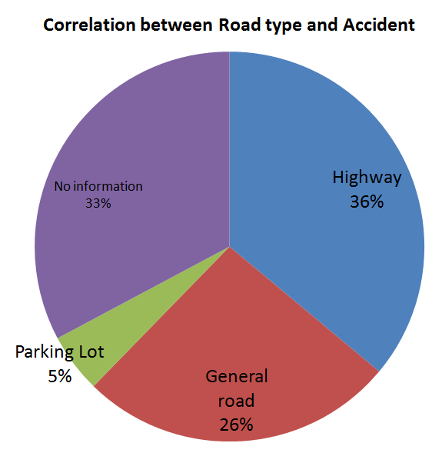
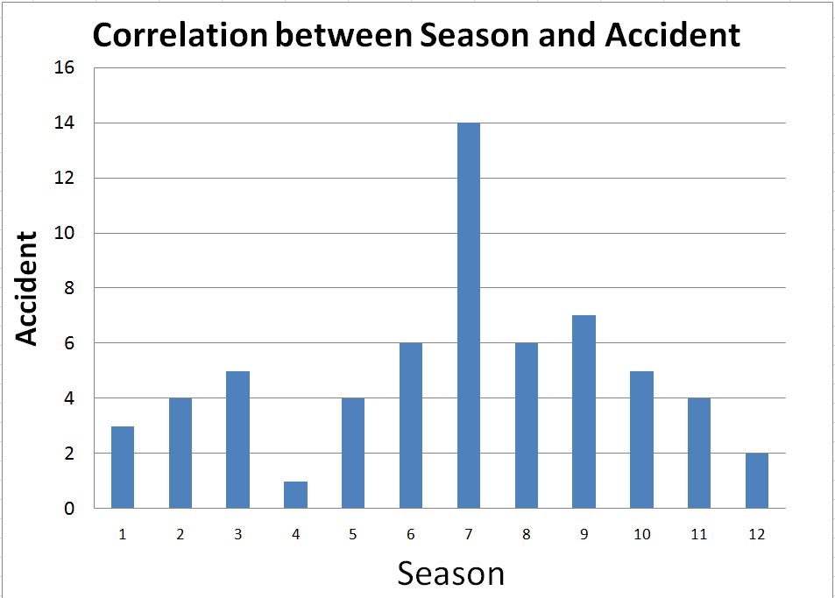
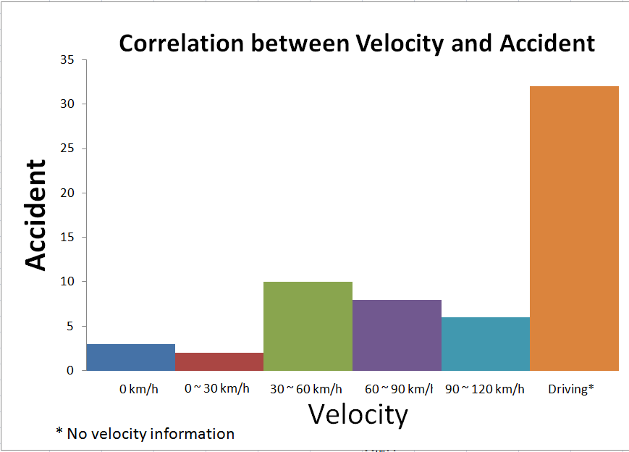
1. Status of consumer defect complaints & media reports
Status of Consumer defect complaints in Korea
- The number of consumer defect complaints : 61 (2010~2015. 7)
High Accident Rate
Most defect complaints due to glass breakage seem to be placed on panoramic sunroof of a large glass size.
In terms of season, the glass breakage rate is high from June to September, of which temperature is high..
-3-
Notes:
3

Slide 4
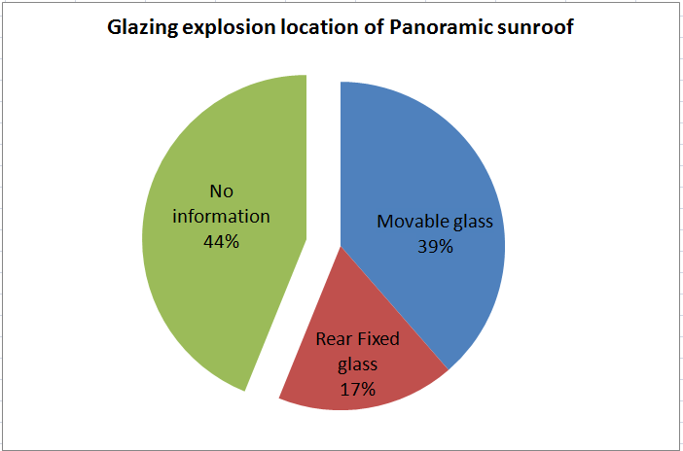
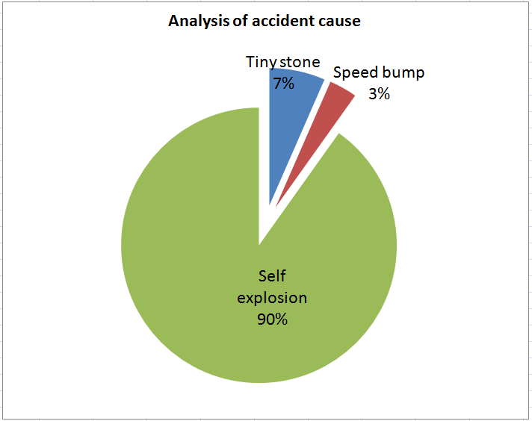
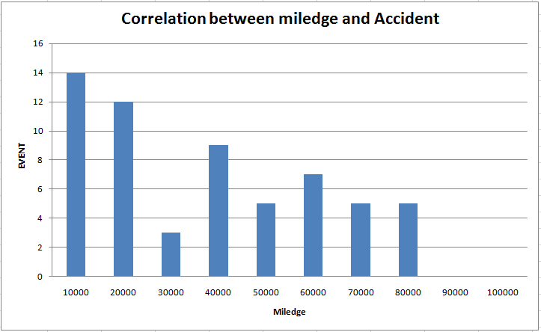
1. Status of consumer defect complaints & media reports
Status of Consumer defect complaints in Korea
- Analysis of Consumer defect complaints
High Accident Rate
-4-
Notes:
4

Slide 5
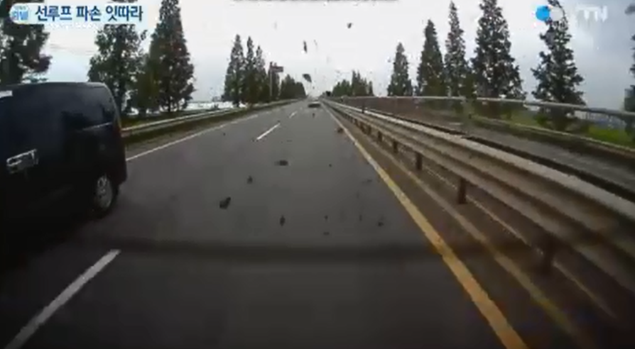
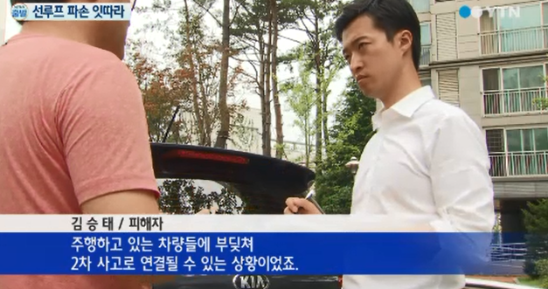
1. Status of consumer defect complaints & media reports
Media Reports in Korea
- Report about breakage of PSG (YTN, 14 July 2014)
- Response of the driver
* The driver was shocked because he suddenly heard explosions like gunshots and then was not
able to focus on driving for a while.
* If there were other vehicles around his vehicle, that could lead to secondary accidents by
hitting other vehicles.
-5-
Notes:
5

Slide 6

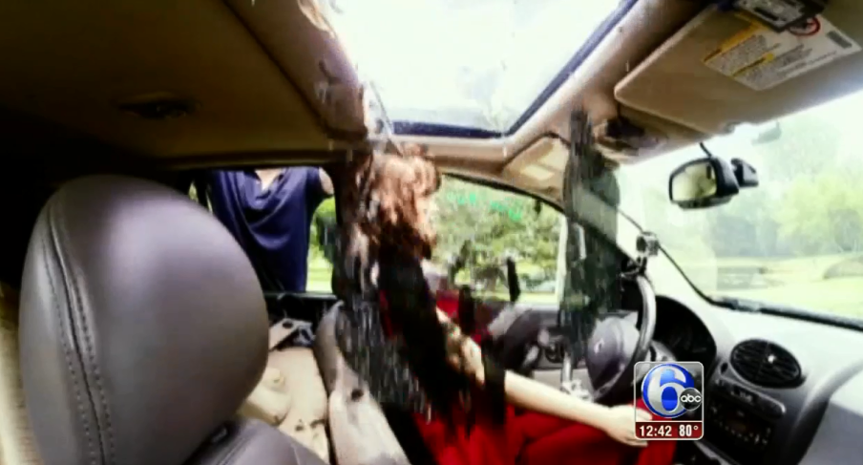
1. Status of Consumer defect Complaints & Media Reports
Media Reports in USA
- Report about breakage of PSG
<NBC_6 Aug 2015> <ABC_7 Aug 2015>
- Response of the driver
* The driver felt very surprised because he suddenly heard explosions like gunfight
* The driver was not able to see for a moment because glass pieces fell into
vehicle like rain. There were even the case of eye injuries of driver.
-6-
Notes:
6

Slide 7
1. Status of Consumer defect Complaints & Media Reports
Summary
- The main features of glazing breakage accidents are as follows
· Accident rate is high during summer (July-August), in which sunshine is strong.
· Accident rate is high when mileage (>20,000 km) is short.
· Most of the complainants claimed self-explosion by unknown cause,
some were hit by tiny stone and passing a speed-bump.
- The glazing breakages of sunroofs and Panoramic sunroof were worried
about occupant injury risks and probability of secondary accidents by hitting
other vehicles
-7-
Notes:
7

Slide 8
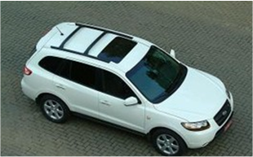
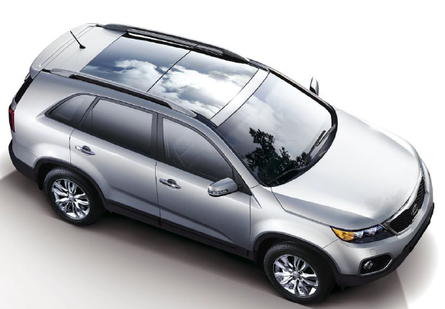
2. Status of CPA application in Korea
Survey of sunroof and Panoramic sunroof
- Toughened glass of sunroof (including panoramic sunroof) mounting
on the vehicles sold in 2015 Korea market from the Korea vehicle
manufacturer
: Sunroof : 20 models, Panoramic sunroof : 21 models
Panoramic sunroof of Top-loading type is placed on about 95% of panoramic sunroof models mounting on vehicles and about 99% of sales volume in Korea
-8-
Notes:
8

Slide 9
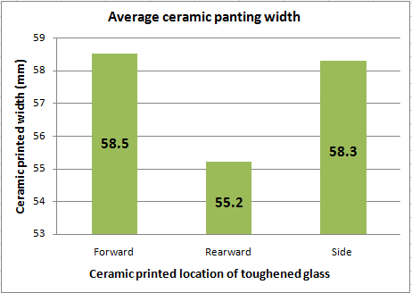
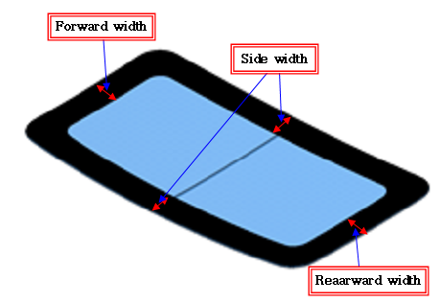
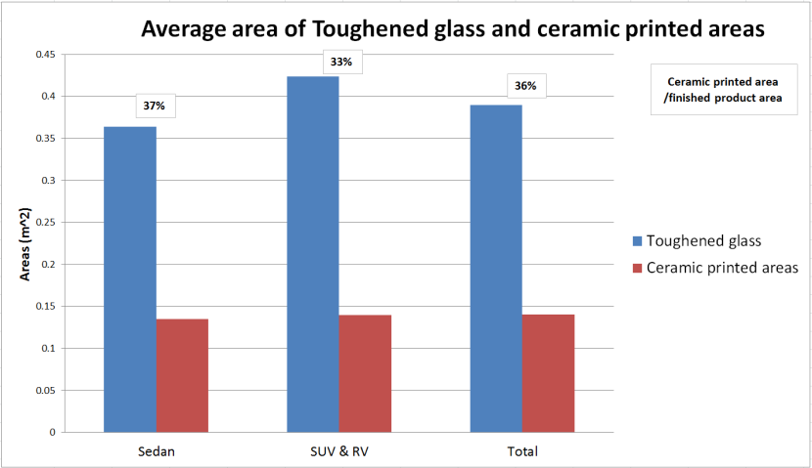
2. Status of CPA application in Korea
Survey of Ceramic Printed Area(CPA) in Sunroof
- Average width of CPA at each location in sunroof glazing (20 models)
- Size and proportion of CPA sunroof glazing depending on vehicle type
-9-
Notes:
9

Slide 10
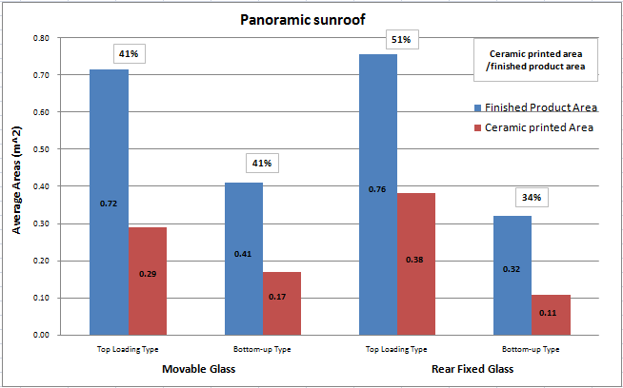
2. Status of CPA application in Korea
Survey of Ceramic Printed Area(CPA) in PSG
- Proportion of CPA as a type of PSG (21 models)
The top-loading type seems larger toughened glass sizes and ceramic printed applicable areas
compared to bottom-up type.
In particular, unlike bottom-up type, top-loading type has wider area of rear fixed glass and
ceramic print applicable area
-10-
Notes:
10

Slide 11
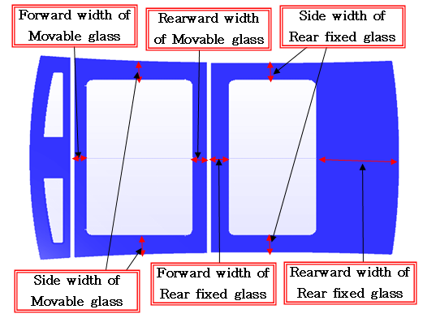
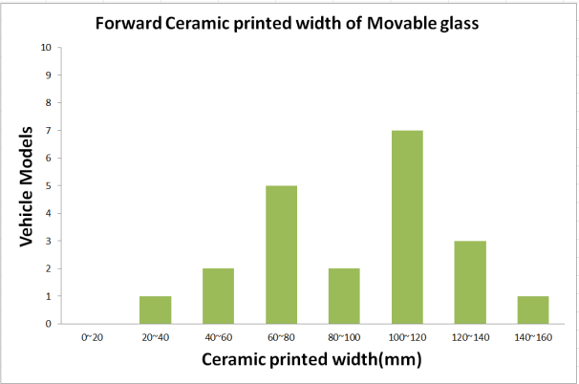
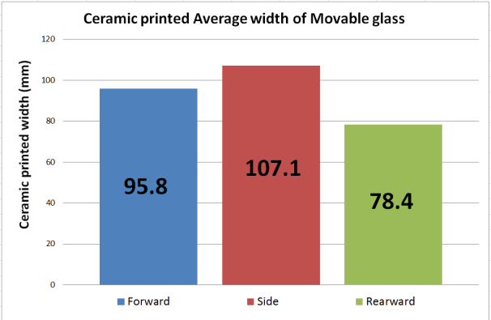
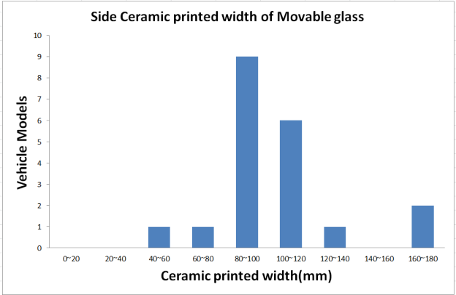
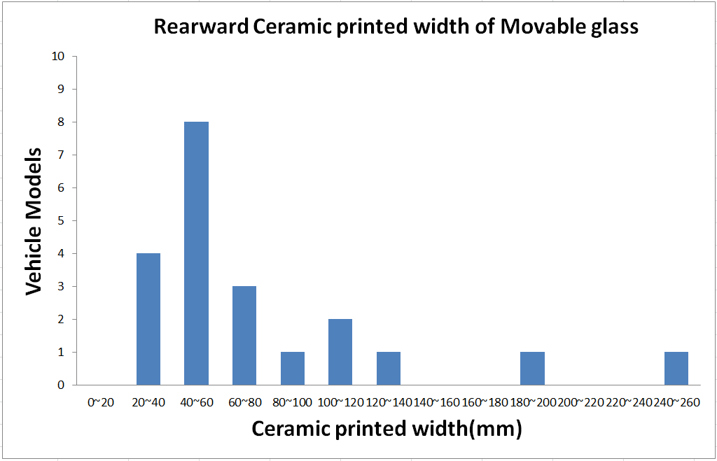
2. Status of CPA application in Korea
Survey of Ceramic Printed Area(CPA) in PSG
- Width of CPA at each location in movable glass of PSG
Excessive use
-11-
Notes:
11

Slide 12
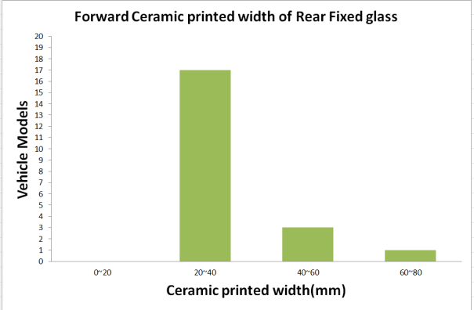
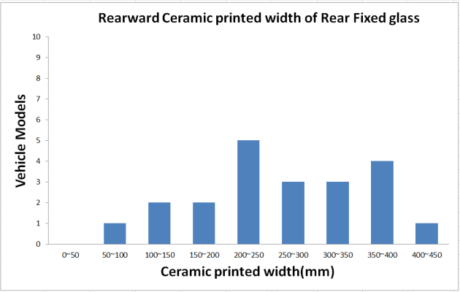
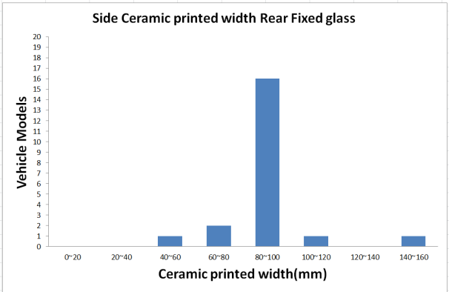
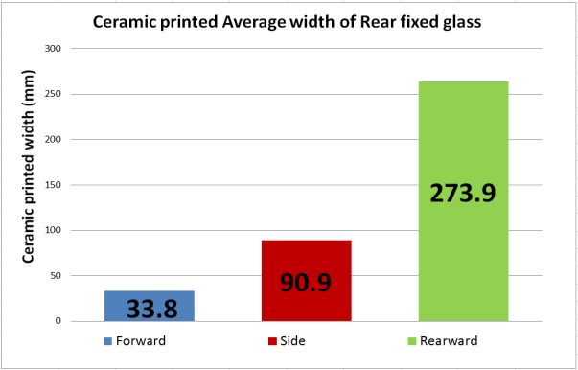
2. Status of CPA application in Korea
Survey of Ceramic Printed Area(CPA) in PSG
- Width of CPA at each location in Rear fixed glass of PSG
Excessive ceramic
printed width
-12-
Notes:
12

Slide 13
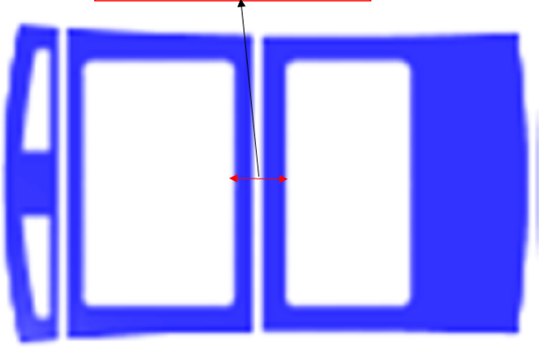
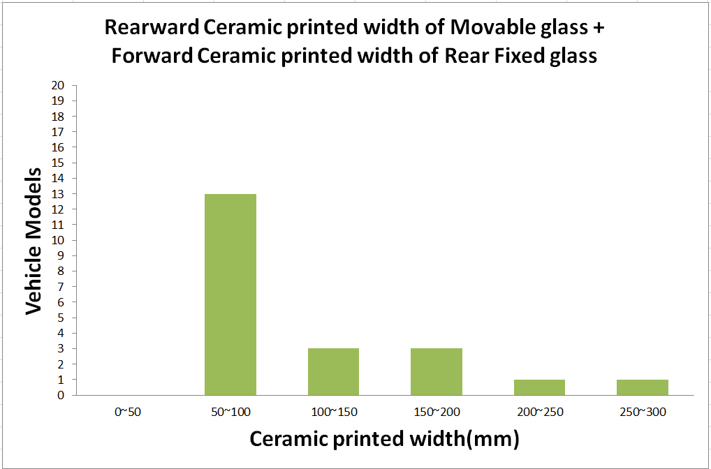
2. Status of CPA application in Korea
Survey of Ceramic Printed Area(CPA) in PSG
- Width of CPA at the center position in PSG
The location where two sheets of toughened glass adjoins becomes the center of a panoramic sunroof owing to the structural characteristics of a panoramic sunroof. Therefore, the width of ceramic printed area of that location shall be considered
Center position width
Excessive use
-13-
Notes:
13

Slide 14
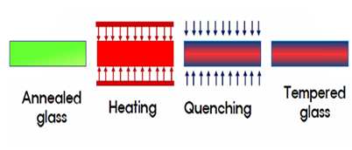
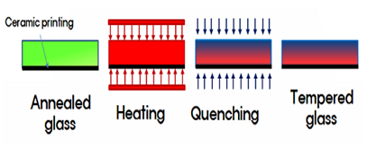
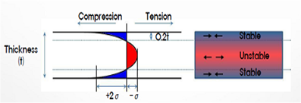
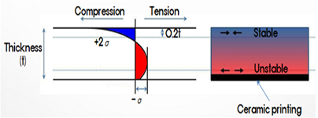
3. Strength Characteristics of CPA in Toughened glass
Manufacturing Process & Stress Distribution
 | Toughened Glass | Toughened Glass With CPA
Process
Stress Distribution
1/ The toughened glass becomes to have unstable stress distribution, because ceramic prevents
compression by adhering to toughened glass surfaces during tempering process
☞ Becomes vulnerable in terms of the mechanical strength
-14-
Notes:
14

Slide 15

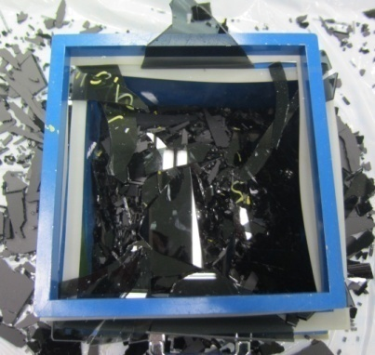
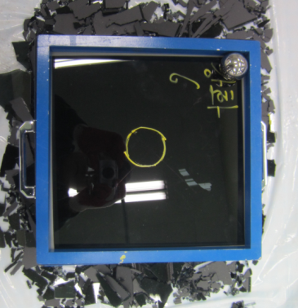
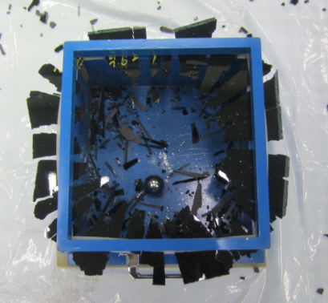
3. Strength Characteristics of CPA in Toughened glass
227g ball drop test
(in accordance with GTR No.6)
- Test Results
Glass Type | Annealed Glass | Toughened Glass | Ceramic Printed Toughened Glass
Fracture Drop Height (m) | 3.0 m | More than 10m | 1.4m
The mechanical strength of ceramic printed toughened glass is weaker
than that of annealed glass
-15-
Notes:
15

Slide 16
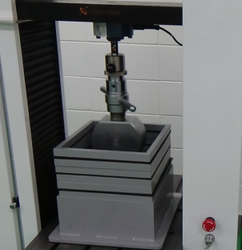
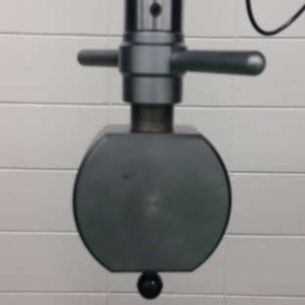
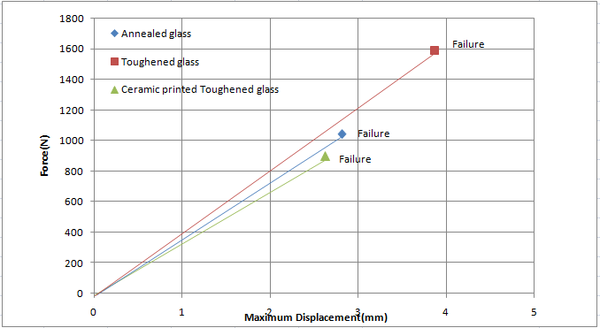
3. Strength Characteristics of CPA in Toughened glass
Static Compressive Bending Test
- Test Method
• Samples : Annealed, Toughened, Ceramic printed Toughened Glass
- Sample size : 300 x 300 mm
- Sample thickness : 4mm
• Test Vel. : 10mm/min
- Indenter : Plastic ball(Ø30mm)
- Test Results
<Apparatus>
• Max. Displacement & Fracture Strength
Glass Type | Annealed Glass | Toughened Glass | Ceramic Printed Toughened Glass
Max. Displacement(mm) | 2.81 | 3.87 | 2.63
Fracture Strength (N/m²) | 11,577 | 17,666 | 9,977
• Strength of Ceramic printed toughened glass is 43% lower than that of toughened glass
-16-
Notes:
16

Slide 17
4. Conclusions
Toughened glass with ceramic printed area is more likely to be fractured
because of its unstable stress distribution and low fracture strength
A Sudden shattering of toughened glass at the roof of vehicle put drivers at risk
and can cause secondary traffic accident while driving
Need to minimize the usage of ceramic printed area of
Toughened glass or find out other solutions
-17-
Notes:
17

Slide 18
Thank you for your attention !
Notes:
18

