Slide 1
Near Miss/Proximity conflict
UK Department for Transport – Transport Research laboratory
16/01/2024
EDR/DSSAD-IWG-26

Slide 2
What is the objective?
Investigating the performance of an ADS after a collision is dealing with the issue after the fact. We ideally need to be identifying dangerous driving behaviours before they result in a collision.
To do this, we need to identify triggers and develop appropriate threshold(s) for a near miss/proximity conflict which, if breached, records a time-stamp and triggers recording of time-series data to tell us more about the incident
These could be based on different dynamics such as time, distance, speed etc, used either on their own or in combination with one another
These triggers and thresholds could be used across different manufacturers to ensure consistency and comparability between different systems.

Slide 3
Initial scoping
A literature review and previous work done by the department identified different scenarios types from naturalistic driving studies and the 3 most relevant to ‘near misses’ were taken forward:
Different scenarios, and combinations thereof, were also identified from the literature, which were evaluated and assigned to relevant scenario types to give a wide range of events to analyse.
Eight possible metric types (Time, Distance, Velocity, Acceleration, Jerk, Index, Probability, Potential) were identified from a paper on Criticality Metrics for Automated Driving. This paper listed different metrics (i.e. time to collision) within these metric types, which could be used to help develop thresholds to identify when a scenario has occurred.
Scenario types
1. Near collision
2. Safety-critical event
3. Proximity conflict
Scenarios
Unawareness of object
Path planning fault
Change in path from other road users
Examples of events to analyse*
Near collision with path planning fault
Safety-critical event with change in path from other users
Proximity conflict with unawareness of object
*Not an exhaustive list, near collision with change in path from other road users could be another example

Slide 4
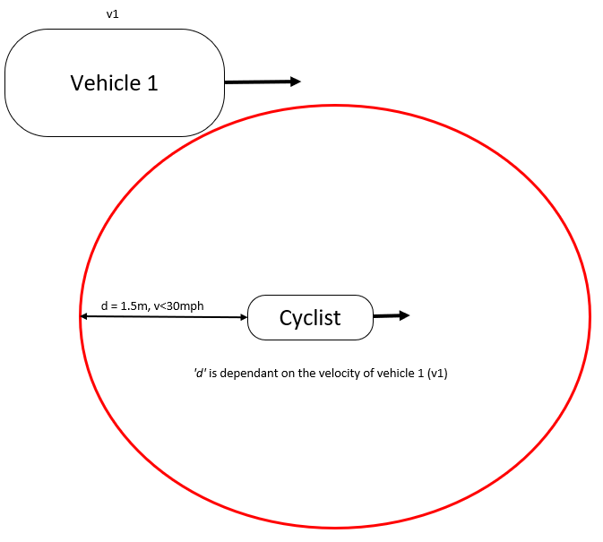
Initial scoping
The concept of a conflict area was also identified and needs developing to support the use of certain metrics. We have currently defined it as:
The area around a road user which if an AV was to enter would increase the risk of damage to a person or property above an acceptable level.
The concept has only been roughly defined, but an example would be the area around a cyclist which a vehicle must avoid in order to overtake safely.
.

Slide 5
1. Scenario and their types
2. Metric and their types
3. Metric vs scenarios

Slide 6


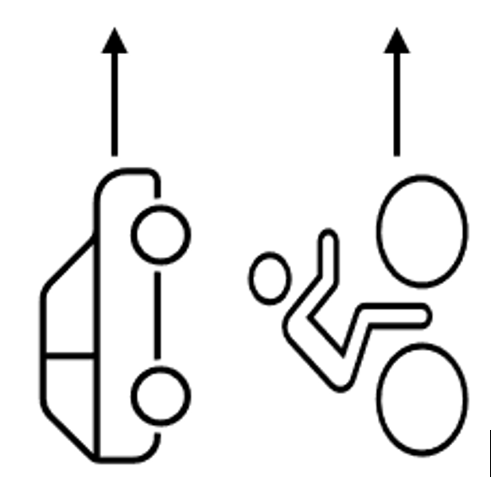
Scenario types
An outline of the three different scenario types:
Near collision (Evasive longitudinal input)
Harsh application of brakes to avoid collision with another road user.
Safety critical event (Evasive lateral input)
Steering input to avoid a road user that is more severe than normal driving conditions but less severe than an emergency manoeuvre.
Proximity conflict (No evasive input)
Incident where the ego vehicle enters the conflict area of another road user
The different scenarios identified (unawareness of object, path planning fault and change in path from other road users) were applied to each of the scenario types above

Slide 7
Metric types

Slide 8
Metric types
The literature review carried out identified 8 different metric types below. The literature also identified different metrics which were assigned to relevant metric types.
Metric types | Metrics (not exhaustive) | Description
1. Time | Post encroachment time Time to closest encounter | Measures factors such as the time between two vehicles colliding if they continue on the same course
2. Distance | Distance of closest encounter Accepted gap size | Looks at minimum distances between two vehicles which can be considered unsafe driving, which is dependent on the speed of the vehicles
3.Velocity | Delta V Conflict severity | Looks at differences in speed between two vehicles to assess whether driving was unsafe – more useful for post-event analysis
4. Acceleration | Required lateral acceleration Required longitudinal acceleration | Measures the rate acceleration, if it crosses a certain threshold this would indicate an emergency manoeuvre
5. Jerk | Lateral Jerk Longitudinal Jerk | Rate of change in acceleration and quantifies over the abruptness of a maneuver. Used to determine driving styles.
6. Index | Predictive metric – unsuitable
7. Probability | Predictive metric – unsuitable
8. Potential | Predictive metric – unsuitable
Notes:
Index – (brake threat number) Required longitudinal acceleration imposed on actor A1 by actor A2 at time t, divided by the longitudinal acceleration that is at most available to A1. BTN>=1 a collision will occur.
Collision is done via various statistical models such as Monte Carlo, Scoring multiple hypotheses and Stochastic reachable sets
Potential function as superposition of scoring functions
Lit review: https://link.springer.com/article/10.1007/s11831-022-09788-7 and https://criticality-metrics.readthedocs.io/en/latest/time-scale/PET.html

Slide 9
Metrics vs scenarios

Slide 10
Metrics vs Scenarios
These metrics identified were applied to the different scenarios and given a possibility of 4 different ratings (low, medium, high and contributory) for their contribution as a trigger and if they would be useful in post-event analysis for a scenario (yes/no).
Examples of outputs from this process for each of the 3 scenario types (Near collision, Safety-critical event and proximity conflict) are shown on the next few slides

Slide 11
Metrics vs scenarios summary
Important to remember these are not all the metrics identified
Metric types
Time
Distance
Velocity
Acceleration
Jerk
Post encroachment time
Distance to closest encounter
Delta V
Required lateral acceleration
Lateral jerk
Metrics
Time to closest encounter
Accepted Gap size
Conflict severity
Required longitudinal acceleration
Longitudinal jerk
…
…
…
…
…
Near collision
Unawareness of object
Trigger ratings
Post event analysis
Scenario Types
Safety critical event
Path planning fault
Scenarios
Low
Medium
Yes
Proximity conflict
Change in path from other road users
High
Contributory
No

Slide 12
Metrics vs scenario types
Each of the metrics were assessed against the 3 different scenario types for their use as a trigger rating and in post event analysis
Near collision scenario type: Ego vehicle rapidly decelerates to avoid another road user
Near collision
Scenario
Post encroachment time
Distance to closest encounter
Delta V
Required longitudinal acceleration
Longitudinal jerk
Metric
Low
Contributory
Low
High
Low
Trigger rating
No
Yes
Yes
Yes
No
Post event analysis
Notes:
In the near collision the two most relevant metrics were Distance to closest encounter and required longitudinal acceleration

Slide 13
Metrics vs scenarios
Each of the metrics within the metric types were assessed against the 3 different scenarios for their use as a trigger rating and in post event analysis
Safety critical conflict scenario type: Ego vehicle rapidly swerves around another road user to avoid a collision.
High
Safety critical event
Required lateral acceleration
Scenario
Yes
Post encroachment time
Distance to closest encounter
Delta V
Required longitudinal acceleration
Longitudinal jerk
Metric
Medium
Contributory
Low
Low
Low
Trigger rating
Yes
Yes
Yes
No
No
Post event analysis
Notes:
In the safety critical conflict the three most relevant metrics were Post encroachment time, Distance to closest encounter and required lateral acceleration

Slide 14
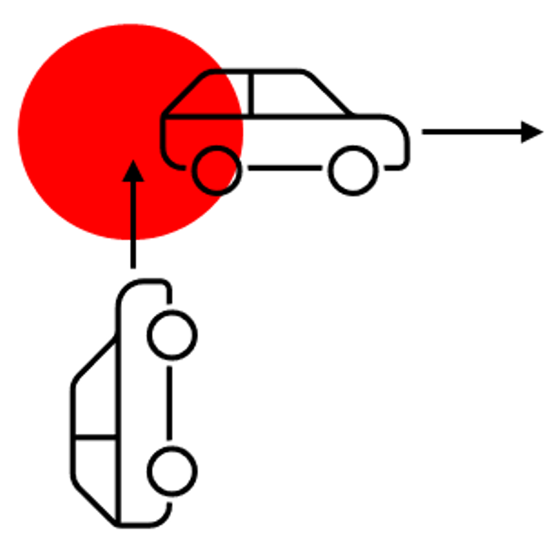
Metrics vs scenarios
Each of the metrics within the metric types were assessed against the 3 different scenarios for their use as a trigger rating and in post event analysis
Proximity conflict scenario type : Ego vehicle narrowly misses road user travelling perpendicular to ego vehicle, entering the conflict area highlighted in red
Proximity conflict
Scenario
Post encroachment time
Distance to closest encounter
Delta V
Required longitudinal acceleration
Longitudinal jerk
Metric
High
Contributory
Low
Low
Low
Trigger rating
Yes
Yes
Yes
No
No
Post event analysis
Notes:
In the proximity conflict the two most relevant metrics were Post encroachment time and Distance to closest encounter

Slide 15
Summary of output
Near collision
Safety critical event
Required longitudinal acceleration
Distance to closest encounter
Post encroachment time
Distance to closest encounter
Required lateral acceleration
All the identified metrics were evaluated in each of the 3 scenarios for their use as a trigger rating and in post event analysis, the ones with the most relevance will be taken forward
This is one output but there are more based on the different scenarios and metrics
Proximity conflict
Post encroachment time
Distance to closest encounter

Slide 16
Future development
The next stage in creating a proposal for this data element will be rationalising and developing the thresholds for the metrics that are considered of most important for each of the scenarios
Open to discussion and potential collaboration with other stakeholders.
Notes:
It is necessary but still requires significant work and should be in guidelines but need time to develop it into something more. If anybody is interested in collaborating please let us know.

