Slide 1



DSSAD Data Elements

Slide 2
Outline
1 | Definition – purpose of the DSSAD
2 | DSSAD data overview
3 | Method
4 | Key findings from literature review
5 | Key findings from expert workshop
6 | Exemplar real-world incidents
7 | Recommended DSSAD data elements
8 | Recommended DSSAD data analysis framework

Slide 3
1. Definition
Purpose of DSSAD (Data Storage System for Automated Driving)
DSSAD refers to a capability of a vehicle to monitor the performance of its Automated Driving System (ADS). This document provides recommendations to enable evaluations of ADS performance. (Source: SG-DSSAD-25-08 Guidance Document)
  It is assumed that DSSAD datasets will be interpreted in line with the competent and careful driver baseline defined in UN R157
The intention of DSSAD is to give regulators an initial understanding of safety-critical incidents including collisions, near misses, and emergency manoeuvres
  An understanding of whether there are potential concerns regarding the performance of the ADS that would necessitate a follow-up investigation or discussion with the manufacturer
DSSAD time series data will include (limited) information to help understand ‘what happened’ and ‘what did the ADS do’

Slide 4
2. DSSAD Data Overview
DSSAD will have 2 types of data
Time stamp data
  General data events
  Data elements including time, location, data event type
Time series data
  Triggered by a sub-set of the time-stamped data events
  Safety-critical event detailed log
  To provide information of ‘what happened’ and ‘what did ADS do’
  Data elements including parameters around vehicle behaviour and dynamics

Slide 5
3. Method
Approach to identifying recommended data elements
Building on VMAD's work to define and prioritise relevant occurrences, the overall task was to define the data elements (including their respective recording interval, sample rate, range, accuracy, and resolution) that should be recorded to provisionally investigate an occurrence and determine what the vehicle did during this occurrence
Build on TRL's experience in heavy vehicle EDR triggering and extensive experience of investigating collisions involving conventional vehicles, as well as investigation of non-collision incidents involving automated vehicles from the real-world trials TRL have been involved in
Literature Review:
  A rapid review of international proposals, national legislation, and relevant technical standards to collate a list of data elements and the approaches that are recommended by these sources
  This task mapped those data elements with the recommended data format, range and resolution by reviewing available information.
Expert workshop:
  Develop a recommended minimum dataset for DSSAD by utilising the findings from literature review and our insights from in-depth collision investigations for expert witness, collision data collection programme (Road Accident In-Depth Studies – RAIDS) and TRL's understanding of data used by automated vehicles to perform the dynamic driving task
  TRL’s Collision Investigation and AV Regulation experts reviewed, refined and updated the draft list of data elements

Slide 6
4. Key Findings from Literature Review
Key purpose of the DSSAD Time series data is to flag the issue for incident investigation
Key categories of data elements for DSSAD time series data to include are:
  Event based: Time, Location
    Timestamp is needed to associate time series data with a specific time stamped data event
    The time series data may be combined for a chain of continuous triggering events, e.g. Near miss -> MRM -> Collision. How time series data are linked to time stamp data required further consideration.
  Perception: 'What were in the field of the view', 'What did ADS perceive'
  Action: 'What did ADS do'
  Outcome: 'What was the observed driving behaviour’
It is important to include both pre-event and post-event data to help with understanding the normal driving behaviour and the influence of the event

Slide 7
5. Key Findings from Expert Workshop
Recommended essential data elements
What happened – for understanding the scenario
  Location – horizontal and vertical
  Heading
  Visual representation – raw camera footage, or annotated image
What did the ADS do - for understanding ADS’s response to the scenario
  ADS requested control – gear, breaking, indicated status (exterior lights, turn signals, hazard flasher), audible warning system
  Vehicle dynamics
For details, please see Excel spreadsheet

Slide 8
6. Exemplar real-world incidents
Case summaries
Simplified incident or collision scenarios
  Based on real cases investigated by TRL collision investigation experts
Each case demonstrates need for different time-series data elements
  Particular attention to object detection and identification, and duration of data required

Slide 9
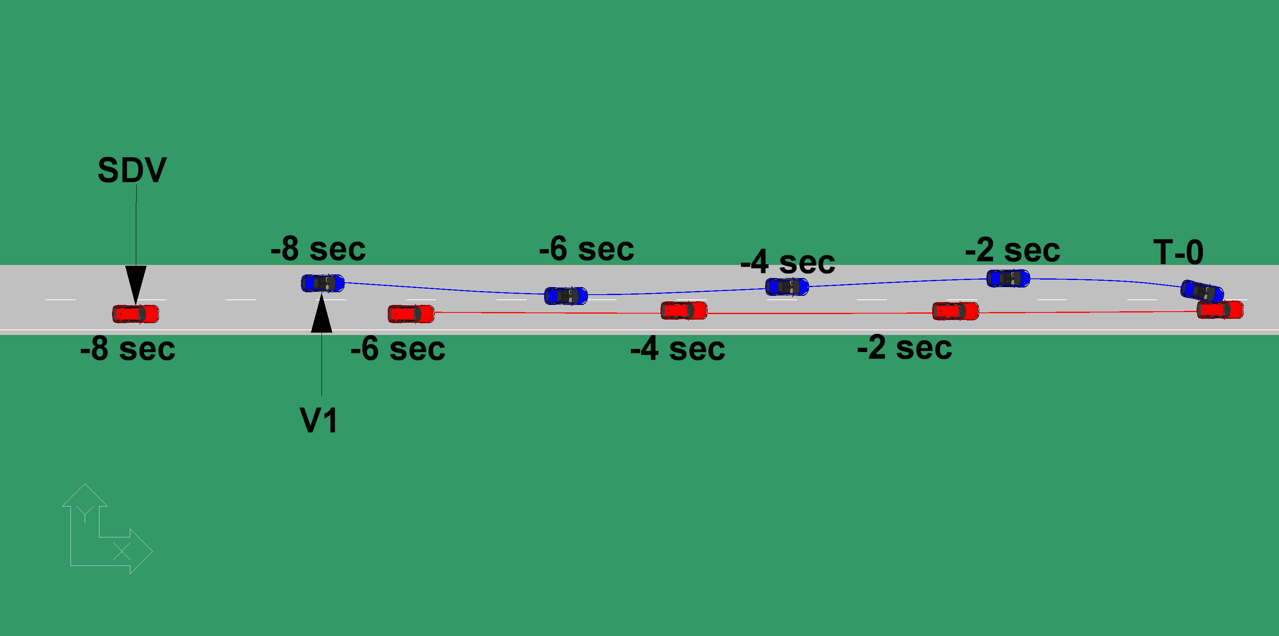
6. Exemplar real-world incidents
Medical impairment event
Scenario
  2-lane high-speed road
  Self-Driving Vehicle (SDV) encounters a general vehicle driven by a fatigued or medically impaired driver, leading to erratic driving patterns over time
  Car (V1) (in Lane 1) exhibits erratic behaviour – drifting in and out of lane over an extended time period
  SDV driving faster than V1 – catching up and intending to overtake in Lane 2
  As SDV passes V1, V1 makes a sudden lane-change manoeuvre and crashes into SDV, causing a high-speed run-off-road event for both vehicles

Slide 10
6. Exemplar real-world incidents
Medical impairment event
SDV had an opportunity to observe the erratic behaviour and decide not to attempt to overtake
  This would be a ‘careful’ approach from a ‘competent’ driver
  If SDV takes the ‘careful’ approach, no data will be recorded
    Data only recorded if the observable hazard is not acted upon AND this results in a collision, near miss or emergency manoeuvre
Why extended data is needed
  Detection of objects supports assessment of observable hazard
  Longer period of data recording shows that the hazard was observable for long enough to support a more cautious decision

Slide 11
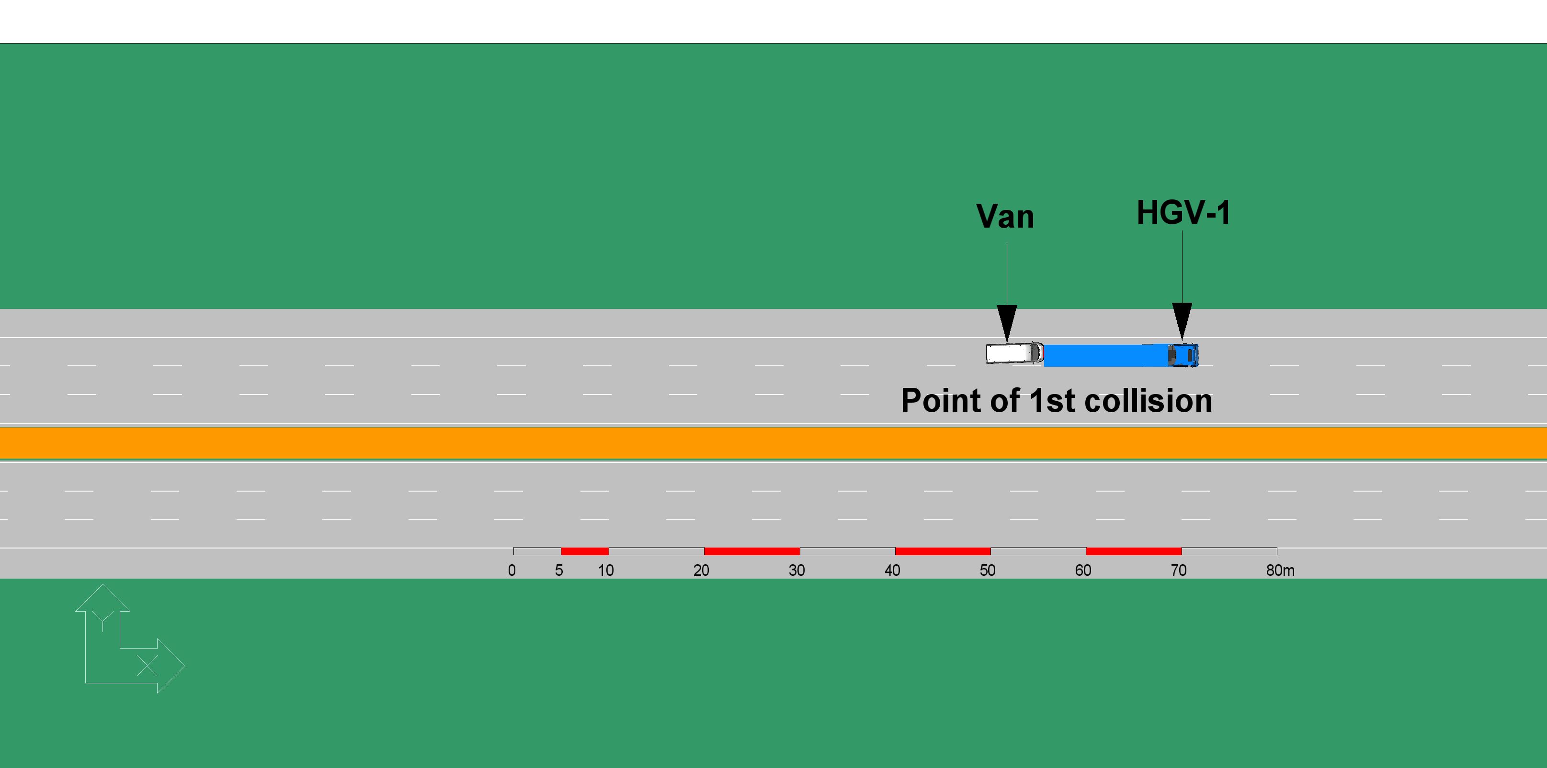
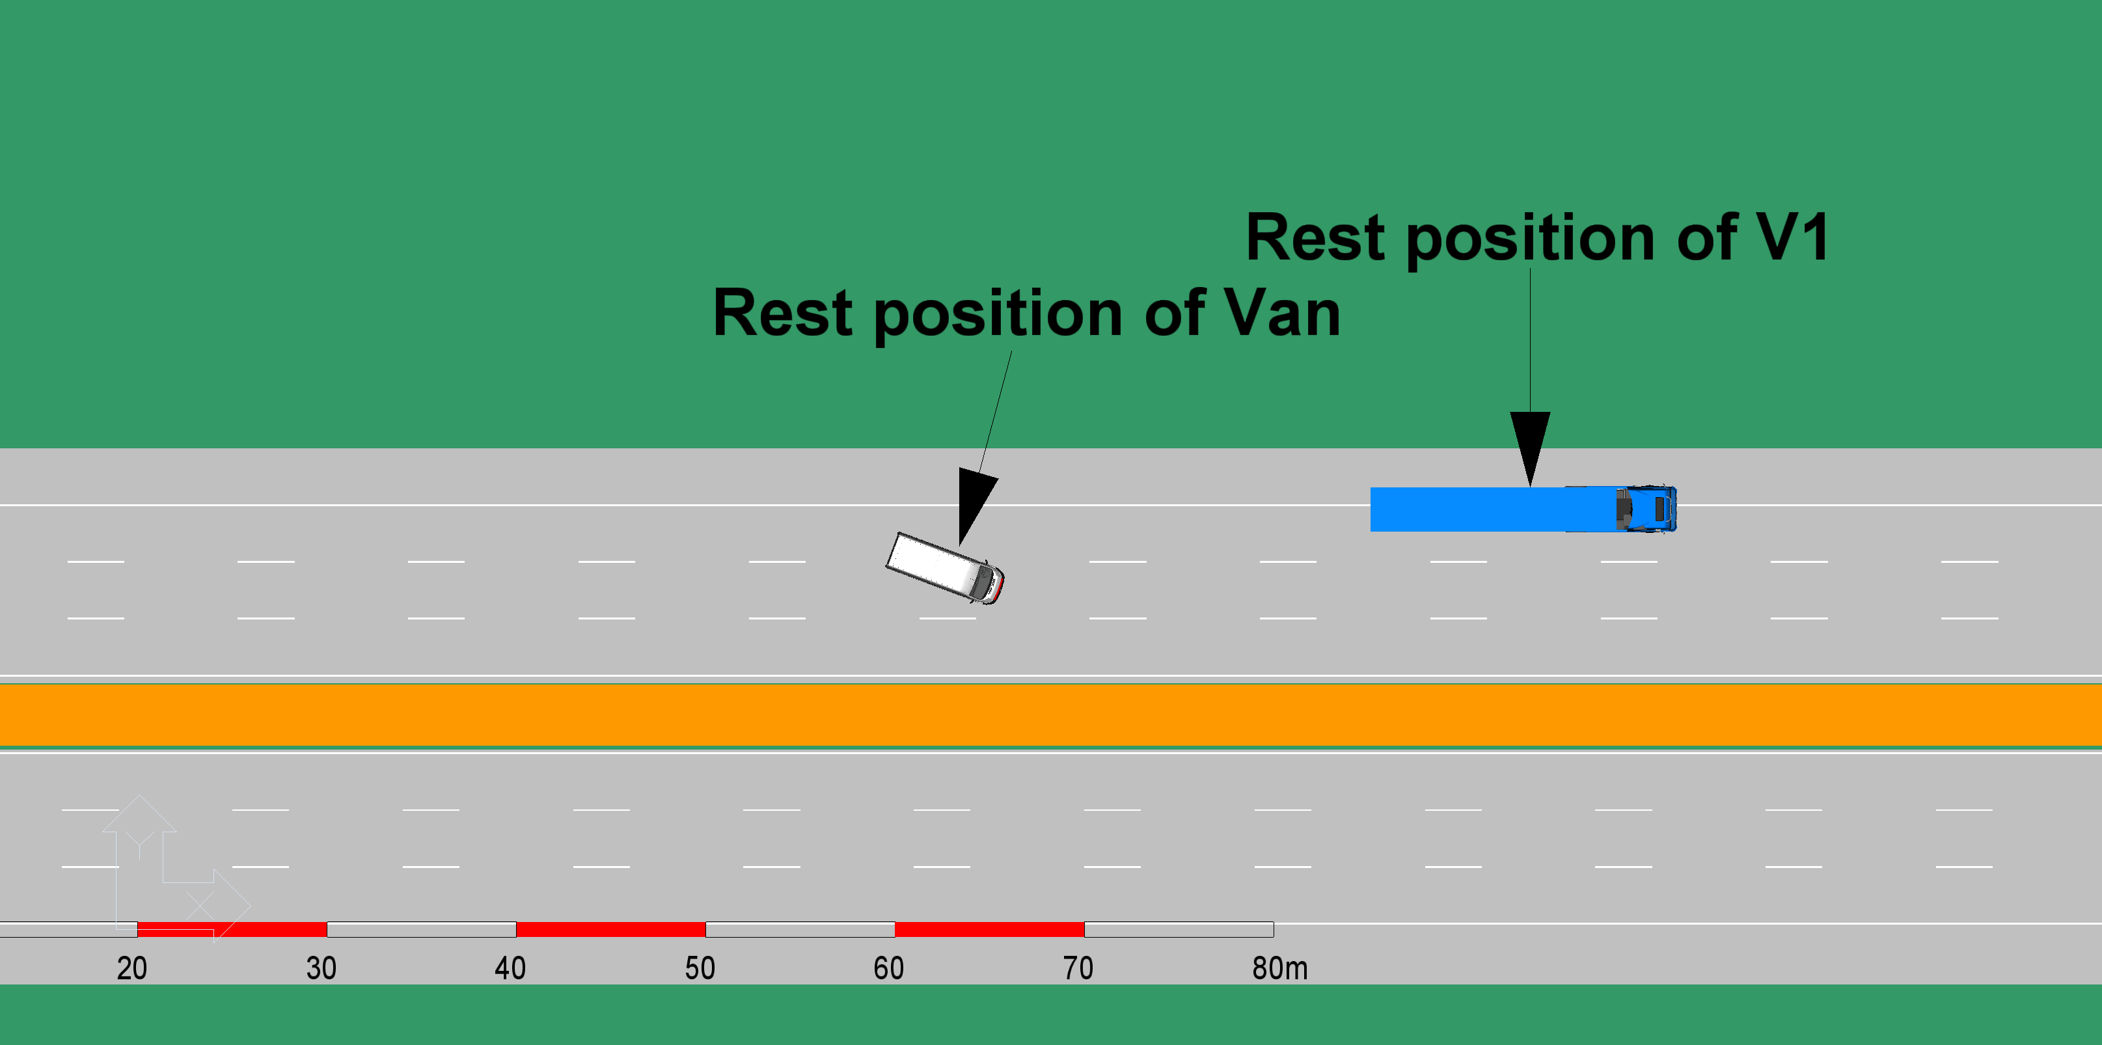
6. Exemplar real-world incidents
Reaction to a previous collision
Scenario
  3-lane motorway at night, no streetlamps
  Incident 1 – A Van rear-ends an HGV (HGV-1) travelling in Lane 1 resulting in
    Van heavily damaged and stationary in Lane 2
    HGV-1 slightly damaged and parked partially on the hard shoulder, partially in Lane 1

Slide 12
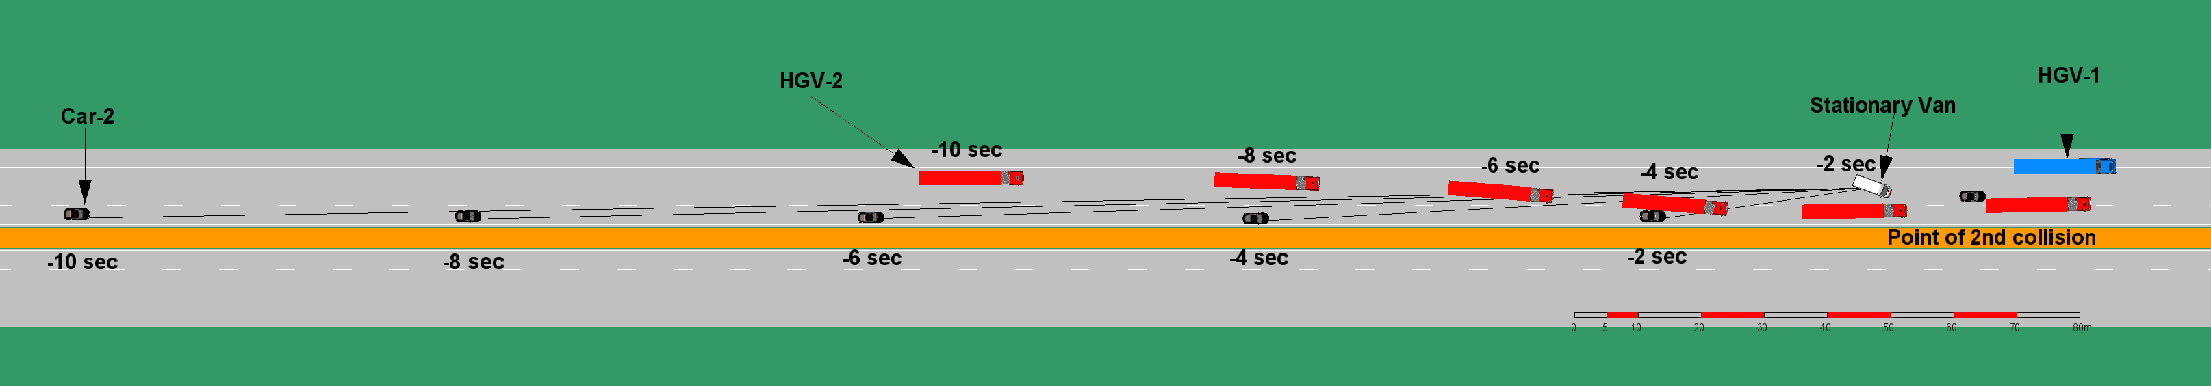
6. Exemplar real-world incidents
Reaction to a previous collision
Scenario (continued)
  Incident 2 – One minute later, a following HGV (HGV-2) approaches the collision scene from Incident 1
    HGV-2 is travelling at 85 km/h in Lane 1
      Realising that Lane 1 is partially blocked by HGV-1, driver of HGV-2 indicates and moves over to Lane 2
      Realising that Lane 2 is blocked by Van, driver of HGV-2 indicates and moves over to Lane 3
    SDV is travelling at 110 km/h in Lane 2 and approaching HGV-2 as it moves from Lane 1 to Lane 2
      SDV moves to Lane 3
      Typical SDV sensor range and enables identification of stationary vehicle (HGV-1) partially in Lane 1 and stationary vehicle (Van) in Lane 2 at 6-7 seconds
      Clear sight lines to HGV-1 and Van are available at multiple time points from 8 seconds before the location

Slide 13
6. Exemplar real-world incidents
Reaction to a previous collision
SDV likely can identify the potential hazard earlier than a human driver (dark road)
  SDV should expect HGV-2 to continue to move across to Lane 3 and reduce speed early and appropriately
  Having identified the potential hazard, a ‘careful’ approach can be chosen
  If SDV takes the ‘careful’ approach, no data will be recorded
    Data only recorded if the observable hazard is not acted upon AND this results in a collision, near miss or emergency manoeuvre
Why extended data is needed
  Detection of objects supports assessment of observable hazard
  Longer period of data recording shows that the hazard was observable for long enough to support a more cautious decision

Slide 14
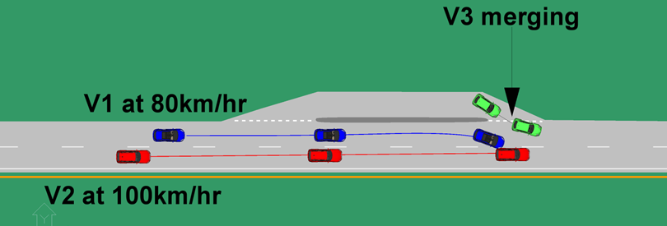
6. Exemplar real-world incidents
Vehicle exiting a lay-by
Scenario
  2-lane road, daylight, clear visibility, 110 km/h speed limit
  Vehicle 1 (V1) stops at give-way lines at the exit from a lay-by
  Vehicle 2 (V2) approaching lay-by at 80 km/h in Lane 1
  SDV approaching V2 at 100 km/h in Lane 2
  V1 makes a very late, poor decision to pull out from the lay-by, directly into the path of V2
  Unaware that SDV is about to pass, V2 makes a sudden manoeuvre to Lane 2 to avoid rear-ending V1 at high delta-v – and collides with the SDV

Slide 15
6. Exemplar real-world incidents
Vehicle exiting a lay-by
SDV had an opportunity to observe the hazard
  Potential for V1 to exit the lay-by inappropriately
  If that happens, V2 will perform an emergency manoeuvre, possibly including moving to Lane 2
  Having identified the potential hazard, a ‘careful’ approach can be chosen
  A ‘careful’ approach for the SDV might be to match speeds with V2 several seconds behind V2
    Allows time and space for possible V2 reactions
    Allows time and space for a successful collision avoidance manoeuvre if needed
  If SDV takes the ‘careful’ approach, no data will be recorded
    Data only recorded if the observable hazard is not acted upon AND this results in a collision, near miss or emergency manoeuvre
Why extended data is needed
  Detection of objects supports assessment of observable hazard
  Longer period of data recording shows that the hazard was observable for long enough to support a more cautious decision

Slide 16
7. Recommended DSSAD data elements
Summary of data element implications from literature review and exemplar cases
Data collection pre-event
  Incident sequence and event build-up (scenario)
  General driving behaviour (e.g. lane changing, following distance, acceleration/deceleration)
  Operation status and condition (e.g. operator, system status)
  Interaction between operators (onboard driver, remote assistant or driver, and automated driving system) and vehicle
  Vehicle operation information (e.g. speed, control inputs, impact)
  Compliance with traffic rules (e.g. demonstrating that appropriate, early signalling of and intended manoeuvre was provided to other road users)
  Environmental factors (e.g. traffic conditions, road geometry, lighting)
  Mitigation efforts before the crash and timing of the response
Data collection post-event
  Incident sequence, including impact and vehicle resting state
  Operational actions of the vehicle operator(s) after the crash
  Contributions of other stakeholders to the event and injuries
Recommend up to 10 seconds to record pre-event build-up described in the scenarios above
Recommend up to 10 seconds to record post-event to record the minimum risk manoeuvre in most scenarios that could be envisaged

Slide 17
8. Recommended DSSAD data analysis framework
The general architecture of an Automated Driving System (ADS) typically consists of modules for perception, planning, and action.
As the DSSAD (Data Storage System for Automated Driving) time-series data is designed to provide information for understanding "what happened" and "what the ADS did," TRL recommends that DSSAD time-series data capture elements relevant to perception and action, while excluding the planning module. Additionally, incorporating vehicle dynamics data is essential to analyze the observed driving behavior.
The primary purpose of DSSAD is to evaluate the safety performance of the ADS. The benchmark for this evaluation is based on the assumption that the ADS should meet the standards of a competent and careful driver. Safety arguments and safety cases serve as key references for this assessment.
The following slides outline a review framework for assessing the relevance of DSSAD data elements. The framework also identifies potential sources of inconsistencies, which can support the determination of whether further investigation is required.

Slide 18
8. Recommended DSSAD data analysis framework
Dataset vs. Safety Expectations
DSSAD
Time
Series
Data
Perception
Action
Outcome
Visual Representation
Object Detection
ADS Requested Actions
Vehicle Dynamics
* Visual-based info only
What was in the field of view?
What did ADS observe?
What did the ADS decide to do?
What was the observed driving behaviour?
What ADS recognise as relevant to the operation?
Planning
External factors
e.g. road surface
Event recognition
Context-aware planning
What ADS was expected to (visually) observe?
What happened?
What would be appropriate responses?
What would be expected execution outcome?
What are relevant to the operation?
Expectations
Standard: ‘A Careful and Competent Driver’
Reference: Safety Arguments + Safety Cases

Slide 19
8. Recommended DSSAD data analysis framework
In what circumstances would the regulator initiate further investigation
Triggering Events
Collision
Near-misses
Emergency Manoeuvre
Indicators from Time Series Data for Further Investigation
Single incident
  Inconsistency between intended action and observed behaviour
  Inconsistency between expected action and ADS requested action
  Inconsistency between expected outcome and observed outcome
Across instances of the same incident type or the same scenario
  Inconsistency of ADS behaviour

Slide 20
8. Recommended DSSAD data analysis framework
DSSAD
Time
Series
Data
Perception
Action
Failed Execution
Outcome
Visual Representation
Object Detection
ADS Requested Actions
Vehicle Dynamics
* Visual-based info only
What was in the field of view?
What did ADS observe?
What did the ADS decide to do?
What was the observed driving behaviour?
What ADS recognise as relevant to the operation?
Planning
External factors
Event recognition
Context-aware planning
What happened?
What ADS was expected to (visually) observe?
What would be appropriate responses?
What would be expected execution outcome?
What are relevant to the operation?
Expectations
Standard: ‘A Careful and Competent Driver’
Reference: Safety Arguments + Safety Cases

Slide 21
8. Recommended DSSAD data analysis framework
DSSAD
Time
Series
Data
Perception
Action
Outcome
Visual Representation
Object Detection
ADS Requested Actions
Vehicle Dynamics
* Visual-based info only
What was in the field of view?
What did ADS observe?
What did the ADS decide to do?
What was the observed driving behaviour?
What ADS recognise as relevant to the operation?
Planning
External factors
Event recognition
Context-aware planning
What happened?
Inadequate Control – Response and timing
What ADS was expected to (visually) observe?
What would be appropriate responses?
What would be expected execution outcome?
What are relevant to the operation?
Expectations
Standard: ‘A Careful and Competent Driver’
Reference: Safety Arguments + Safety Cases

Slide 22
Dataset vs. Safety Expectations
Expectations
Reference: Safety Arguments + Safety Cases
Standard: ‘A Careful and Competent Driver’
Major difference
Unstable control
DSSAD
Time
Series
Data
Perception
Action
Outcome
Visual Representation
Object Detection
ADS Requested Actions
Vehicle Dynamics
* Visual-based info only
What was in the field of view?
What did ADS observe?
What did the ADS decide to do?
What was the observed driving behaviour?
What ADS recognise as relevant to the operation?
Planning
External factors
Event recognition
Context-aware planning
What happened?

Slide 23
Dataset vs. Safety Expectations
Expectations
Reference: Safety Arguments + Safety Cases
Standard: ‘A Careful and Competent Driver’
Same situation, same actions
Same action, same outcomes
Inconsistent response and timing
DSSAD
Time
Series
Data
Perception
Action
Outcome
Visual Representation
Object Detection
ADS Requested Actions
Vehicle Dynamics
* Visual-based info only
What was in the field of view?
What did ADS observe?
What did the ADS decide to do?
What was the observed driving behaviour?
What ADS recognise as relevant to the operation?
Planning
External factors
Event recognition
Context-aware planning
What happened?

