Slide 1

IWG DDADWS #3
(driver drowsiness and distraction warning system)
Industry Feedback
24/12/10

Slide 2


Topic Overview
Vehicle type definition
DDAW system definition
Link to R155/R10
PTI
Privacy and Data protection
Extension of scope (multiple means, exemption for M/N)
Monitoring driver drowsiness (indirect/direct)
Deactivation
Vehicle master control switch
Wording primary/secondary metrics and measurements
Common space definition
Environmental conditions
Regulation scope - 1 or 2 regulations

Slide 3
2.10. Vehicle type
  Industry proposal:
  2.10. Vehicle type with regard to its DDAW system” means a category of vehicles which do not differ in such essential respects such as:
      (a) the manufacturer’s trade name or mark;
      (b) the type and design of the DDAW system, including but not limited to:
        (i) the method(s) used in detection of a drowsy driver;
        (ii) the specifications for the sensor(s) used in the detection system;
        (iii) the warning system methods, strategy and characteristics;
      (c) the other vehicle systems which integrate with the DDAW system for the purpose of it performing its safety function; and
      (d) the vehicle features which significantly influence the performance of the DDAW system as mentioned in the documentation.
  Rational for proposal:
    Deleting of (c): DDAW is the system that provides the data (output) and cannot regulate the systems that use the data as an input.
    In (d) referring to the described/used DDAW system

Slide 4
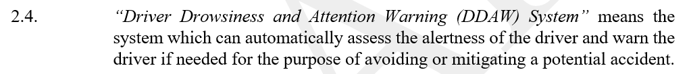
2.4. DDAW System Definition
Current text (DDADWS-02-03):
  Industry proposal:
  2.4. “Driver Drowsiness and Attention Warning (DDAW) System” means a system that assesses the driver’s alertness through vehicle systems analysis and warns the driver if needed via the vehicle’s human- machine interface.
  Rational for proposal:
  Do not add new definitions on system level but keep used/established definitions
  If system definition is changed regulation/concept in whole needs to be adapted which is contradicting the goal of 00 series and is not doable on the agreed timeline in ToR
  Cross out the mentioned “mean” as it is limiting the assessment
DDAW introduction:

Slide 5
Link to R155
Industry proposal & rational:
no reference to UN-R155 in DDADWS
if cybersecurity is relevant to DDAW system then the respective regulation is applicable anyhow, hence no link in DDADWS needed
Way forward:
  If cybersecurity is important to CPs, industry suggest to address it to the experts of the GRVA IWG on Cyber Security and OTA issues (TF CS/OT) directly to include DDADWS
  If CPs have not adopted UN-R 155 for whatever reasons, implementing such UN-R regulation via the provisions of this regulation is not scope of this IWG. CPs may adopt the UN-R155/10. If further concerns are raised, this shall be discussed with the respective CP in WP.29 Forum

Slide 6
Link to R10
Industry position:
Industry does not see the need to add this link to R10, but we can accommodate with the extra documentation effort.
Note: If EMC is proven on vehicle level, there is no need for doubling requirements.
Industry proposal – as suggested by AUS:
The effectiveness of the system shall not be adversely affected by magnetic or electrical fields. This shall be demonstrated by fulfilling the technical requirements and respecting the transitional provisions of the 06 or later series of amendments to UN Regulation No. 10.

Slide 7
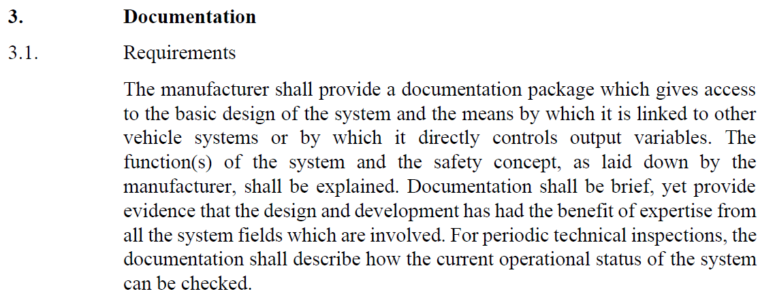
5.8. Provisions for the PTI
Current text (DDADWS-02-03):
5.8. Provisions for the Periodic Technical Inspection
5.8.1. At a Periodic Technical Inspection, it shall be possible to verify the following features of the DDAW system:
Its correct operational status, by visible observation of the failure warning signal status following the activation of the vehicle master control switch and any bulb check. Where the failure warning signal is displayed in a common space, it must be checked first that the common space is functional prior to the failure warning signal status check;
Its correct functionality and the software integrity, by the use of an electronic vehicle interface.
5.8.1.1. Manufacturers shall ensure to make available the technical information for the use of the electronic vehicle interface.
5.8.2 At the time of type-approval, the means to protect against simple unauthorised modification of the operation of the failure warning signal chosen by the manufacturer shall be confidentially outlined. Alternatively, this protection requirement is fulfilled when a secondary means of checking the correct operational status of the DDAW system is available.
UN-R 171 Reference – as in documentation package
UN-R151 BSIS
5.7. Provisions for inspection
5.7.1. It shall be possible to confirm the correct operational status of the BSIS by a visible observation of the failure warning signal status.
UN-R159 MOIS
5.9. Provisions for Periodic Technical Inspection
5.9.1. At a Periodic Technical Inspection, it shall be possible to confirm the correct operational status of the MOIS by a
visible observation of the failure warning signal status.
In case of the failure warning signal being in a common space, the common space must be observed to be functional
prior to the failure warning signal status check.
Rational for proposal:
PTI requirements shall be kept aligned with minimal requirements and provisions of other regulations. DDADWS has not the mandate to regulate PTI but of course request needed information for PTI. Analog to R159 we suggest to request the following below:
Industry proposal:
5.8. Provisions for the Periodic Technical Inspection
5.8.1. At a Periodic Technical Inspection, it shall be possible to confirm the correct operational status of the DDAW by a visible observation of the failure warning signal status. In case of the failure warning signal being in a common space, the common space must be observed to be functional prior to the failure warning signal status check.

Slide 8
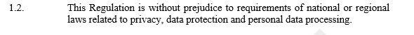
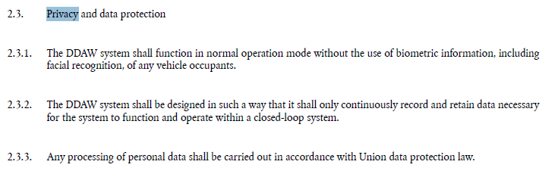
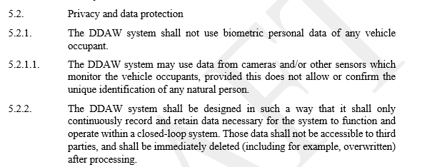
5.2. Privacy and Data Protection
Current text (DDADWS-02-03):
DDAW today:
Industry proposal:
Delete 5.2. and keep scope 1.2. for privacy and data protection target.
Rational for proposal:
  Privacy and data protection is and should be handled nationally
  1.2. keeps the topic open to future technologies (e.g. better impaired assessment by using historical data of a driver)
  Identification should be allowed, and it is – after driver acceptance (e.g. following GDPR in EU) – already used (e.g. comfort features, DCAS driver manual recognition)

Slide 9
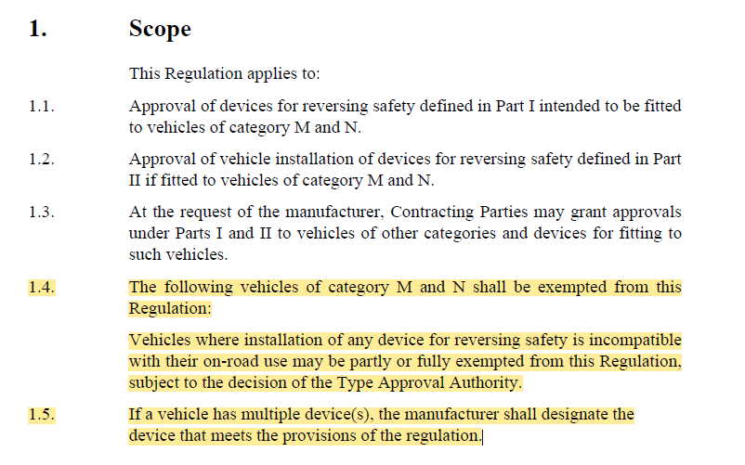
1. Scope
Industry proposal:
Add additional provision in scope:
1.3. If vehicle has multiple means (direct/indirect), the manufacturer shall designate the means that meets the provisions of the regulation.
Rational for proposal:
If there are multiple means available in the car, the OEM may decide which one/ones shall meet the regulation (see example UN-R 158).
See UN-R 158:

Slide 10
1. Scope
Industry proposal:
Add additional provision in scope:
1.4. The following vehicles of category M and N shall be exempted from this Regulation:
Vehicles where the use of DDADWS and/or installation of any device for DDADWS is incompatible with their on-road use may be partly or fully exempted from this Regulation, subject to the decision of the Type Approval Authority.
Rational for proposal:
Off-road vehicles where the environment that vehicle operates in may lead to high number of false positive → misinterpretation of movements as drowsiness (same for mining vehicles)
Emergency vehicles where driver's interaction and communication with in-vehicle systems may be interpreted as distraction. It is the same for detection of drowsiness.
Military vehicles where tactical manoeuvres can be misinterpreted as distraction or drowsiness. In these cases, triggering DDADWS warnings can be irrelevant or considered as false positive. There are also conditions like blackout mode where absolutely safety-critical warnings shall be only prioritized and displayed.
Regarding installation of any device for DDADWS, this could often pose challenges in special purpose vehicles regardless of interior or exterior installation placement of the devices as both can be modified depending on the vehicle’s purpose and usage.
See UN-R 158:

Slide 11
5.5. Monitoring driver drowsiness
Rational for proposal:
Historically (respecting market situation back then) DDAW was write by focusing on indirect means and having some technology specific requirements (e.g. vehicle based metrics). Today systems based on direct means with equal or even better performance are available as well.
Industry proposal:
Replace 5.5.2. drowsiness detection by a technology neutral wording:
The DDAW system shall detect driver drowsiness by indirect and/or direct means as declared by the manufacturer.
Define the terms direct and indirect means in 2.:
  2.11. “Indirect means” is a method for observing the vehicle behavior and/or vehicle parameters to assess drowsiness.
  2.12. “Direct means” is a method for observing the driver directly to assess drowsiness.
Rearrange 5.5.1. and 5.5.2. as follows:
5.5.1. Warning based on KSS
5.5.2. Analyze other vehicle systems
5.5.1.
The DDAW system shall detect driver drowsiness
by indirect and/or direct means as declared by the manufacturer.
5.5.2.
Warning based on KSS
5.5.2.1. Recommendation for lane position/steering input
5.5.2.2. Alternative manners allowed
5.5.2.3. More than one alternative manners allowed

Slide 12
5.5. Monitoring driver drowsiness
Updated provision:
5.5. Monitoring driver drowsiness
5.5.1. The DDAW system shall detect driver drowsiness by indirect and/or direct means as declared by the manufacturer.
5.5.2. The DDAW system shall provide a warning to the driver at a level of drowsiness which is equivalent to or above 8 on the reference sleepiness scale defined in paragraph 2.7. of this Regulation (the Karolinska Sleepiness Scale, hereinafter referred to as the ‘KSS’).
5.5.2.1. The DDAW system may provide a warning to the driver at a level of drowsiness which is equivalent to level 7 on the KSS.
5.5.2.2. In addition, the manufacturer may implement an information strategy on the HMI prior to the warning.
5.5.2.3. The manufacturer shall carry out validation testing in accordance with Annex 4 – Appendix 1, to ensure that DDAW systems are able to monitor driver drowsiness in a manner which is accurate, robust, and scientifically valid.
0.3. A Driver Drowsiness and Attention Warning (DDAW) System can be used to monitor the driver’s physical state through indirect and/or direct means (e.g. by such as system analysis and recognition of driving or steering patterns or using driver monitoring cameras). The system will be able to provide a warning if the driver is identified as drowsy.
Annex 3 – documentation package
(d) evidence on the relationship between a drowsy driver, drowsy driving and/or steering vehicle behaviour and the chosen trigger behaviour;
Update Scope according to adapted 5.5.2.

Slide 13
Deactivation
Current text (DDADWS-02-03):
5.3. DDAW system control
5.3.1. It shall not be possible for the driver to manually deactivate the DDAW system.
5.3.1.1. It may however be possible for the driver to manually deactivate the DDAW system HMI warnings.
5.3.1.2. Following manual deactivation of the DDAW system HMI warnings, it shall be possible for the driver to re-activate the system HMI warnings by taking no more than the same number of actions as were required to deactivate it.
5.3.2. The DDAW system may be automatically deactivated in the situations pre-defined by the manufacturer. Such situations include, for instance, the deactivation of the warnings by the driver defined in paragraph 5.3.1. above.
Industry proposal:
5.3.1. It shall be possible for the driver to manually deactivate either the ADDW warning or the ADDW system, depending on which of the two possibilities (or both) the vehicle manufacturer chose to make possible.
5.3.2. The ADDW system may be automatically deactivated in the situations pre-defined by the manufacturer, specifically in situations:
(a) when another system takes over the entire dynamic driving task on a sustained basis and is supported with an appropriate driver monitoring system;
(b) when a driver-operated vehicle system, assisting a human driver in controlling the longitudinal and lateral motion on a sustained basis, is active and contains an appropriate driver monitoring system.
The ADDW system shall be automatically reactivated as soon as the conditions that led to its automatic deactivation are no longer present.
Rational for proposal:
A harmonisation with ADDW makes sense as it is clearer and aligns e.g. with other regulations. It is still possible to deactivate the warning and/or the system. The automatic deactivation is also allowed and allows as well to use the driver monitoring system as requested by other regulations (e.g. DCAS/ALKS).

Slide 14

2.9. Vehicle master control switch
Rational for proposal:
The wording “vehicle master switch” can be misleading for some electric or ADR vehicles. Industry suggest to align on the harmonization recently pushed for GRVA regulation based on the wording recommended by Mutual Resolution No. 2 (M.R.2). This Resolution was specifically created to establish uniform definitions for vehicle propulsion systems and created generic terms for components and aspects of propulsion systems that are independent of fuel type or technology used. Using the definition of ‘powertrain’ from M.R.2 provides a generic term that sufficiently covers the aspect of a vehicle which needs to be referred to when considering the default state of systems following initialisation. See: GRSG-128-16_(OICA/FVA)_changes WP29/24/155
In DDADWS the adaption should also address the “switch off” state into “inactive” (Definition of “inactive powertrain” may be helpful.)
In addition, the exemption for start/stop system should be respect as done in UN-R 79 supplement proposal.
Industry proposal:
5.3.3. The DDAW system, including HMI warnings, shall be automatically reinstated to normal operation mode upon each activation of the vehicle master control switch initiation of the powertrain. The vehicle manufacturer can choose to add a condition to such automatic reinstatement upon the driver’s door having been opened or the vehicle powertrain being inactive switched off for a maximum period of 15 minutes”. A new engine start/run cycle (or run cycle) which is performed automatically, e.g. the operation of a stop/start system, shall not be considered an “initiation of the powertrain” wherever that term is used in this Regulation.
5.7.4. Failures that activate the warning signal mentioned in paragraph 5.7.1., but which are not detected under static conditions, shall be retained upon detection and continue to be displayed from start-up of the vehicle after each initiation of the powertrain activation of the vehicle master control switch, for as long as the failure or defect persists.
Delete definition 2.9. of “vehicle master control switch” as powertrain is in M.R.2:
UN-R 79 supplement proposal

Slide 15
Primary/secondary metrics
  Rational for proposal:
  To extend performance of the system we propose to keep the option of using primary and secondary metrics for the chosen means. As we see some misunderstanding with means, metrics and measurements we suggest to add definition for metrics as well:
  Industry proposal:
  Add two new definitions in 2.:
  2.13. „Primary metrics“ is the main parameter that detects drowsiness as declared by the manufacturer.
  2.14. „Secondary metrics“ is an additional and optional parameter that may increase robustness of the DDAW system.

Slide 16
Clarification “measurements”
  Rational for clarification:
  As the wording “measurements” is in many provisions and part of many discussions industry would like to share its common understanding within the IWG (and to avoid mixing with the wording “metrics” and “means”).
  Industry understanding:
  For the purposes of the DDAW regulation “measurements” mean ground truth data which are collected/acquired for the calculation of metrics for drowsiness:
    The primary measurement is the main measurement which is in general KSS based (alternatives measures as defined by the manufacturer are allowed, see test procedure 6.2.).
    A complimentary measurement is the additional measurement which may be used to add robustness to the DDAW system as defined by the manufacturer (see test procedure 6.3.).

Slide 17
2.3. Common space
Current text (DDADWS-02-03):
2.3. “Common space” means an area on which two or more information functions (e.g. symbol) may be displayed, but not simultaneously.
UN-R 121 Definition Common Space:
Industry proposal:
Delete definition 2.3.
Rational for proposal:
Avoid writing redundant definitions which are defined in other UN-R regulation. No need to define HMI details in this UN-R. The term common space is well known wording out of the UN-R121 (hand controls, tell-tales and indicators) which is also referred for HMI concepts.

Slide 18
Annex 4 – Appendix 1
5.4. Environmental conditions
  Industry proposal:
  As the type-approval is for assessing the system, not the participants (circadian rhythm) to the tests, we suggest adding the following in green:
  5. Environmental conditions
  5.1. At a minimum, the system shall be tested in both the day and night conditions listed below in paragraphs 5.1.1. and 5.1.2., and record at least a true positive event in each condition (overall, not for each participant tested in the condition). The variation is aimed at assessing the system, but not the participants (circadian rhythm) in the tests.
  5.1.1. It is not necessary for all participants to test both conditions.
  5.1.2. Systems not affected by light do not need to meet the minimum number of true positive events in each condition.
  …

Slide 19
Regulation scope - 1 or 2 regulations?
Industry feedback:
As already in ToR we are fine with continue to draft to separate regulations for drowsiness and distraction.
Rational for proposal:
“Two regulations” already adopted by GRSG via ToR
Ease up the phase 1 for 00 series which is based on two EU regulations
Allows to follow different timeline and/or transitional provisions to align with EU timing (e.g. small series for ADDW)

