Slide 1
Indirect land use change emissions
UNECE GRPE IWG on Automotive Life Cycle Assessment
Subgroup 6 (Fuel & Energy Cycle)
November 26, 2024
Jane O’Malley & Georg Bieker

Slide 2

What are indirect land use change emissions?
Direct land use change
Direct land use change emissions:
Scope limited to change in area used for biofuels production.
Indirect effects on land use elsewhere is not covered.
Indirect land use change emissions:
Global scope: global expansion of agricultural area resulting from increase in demand.
Market-based, economic models.
Country A
Country B
Before
Other
CO₂
CO₂
After
Biofuels
Other
Notes:
What change in a unit of biofuel demand means on a global scale? Attempt to quantify this change using market-based, economic models

Slide 3
What are indirect land use change emissions?
Economic models: Global expansion of agricultural area
from increase in demand of a given feedstock.
GLOBIOM (Global Biosphere Management Model)
GTAP (Global Trade Analysis Project)
ADAGE (Applied Dynamic Analysis of the Global Economy)
GCAM (Global Change Assessment Model)
…
Notes:
Multicropping and yield elasticity factors (how much yield will increase in response to change in price)

Slide 4
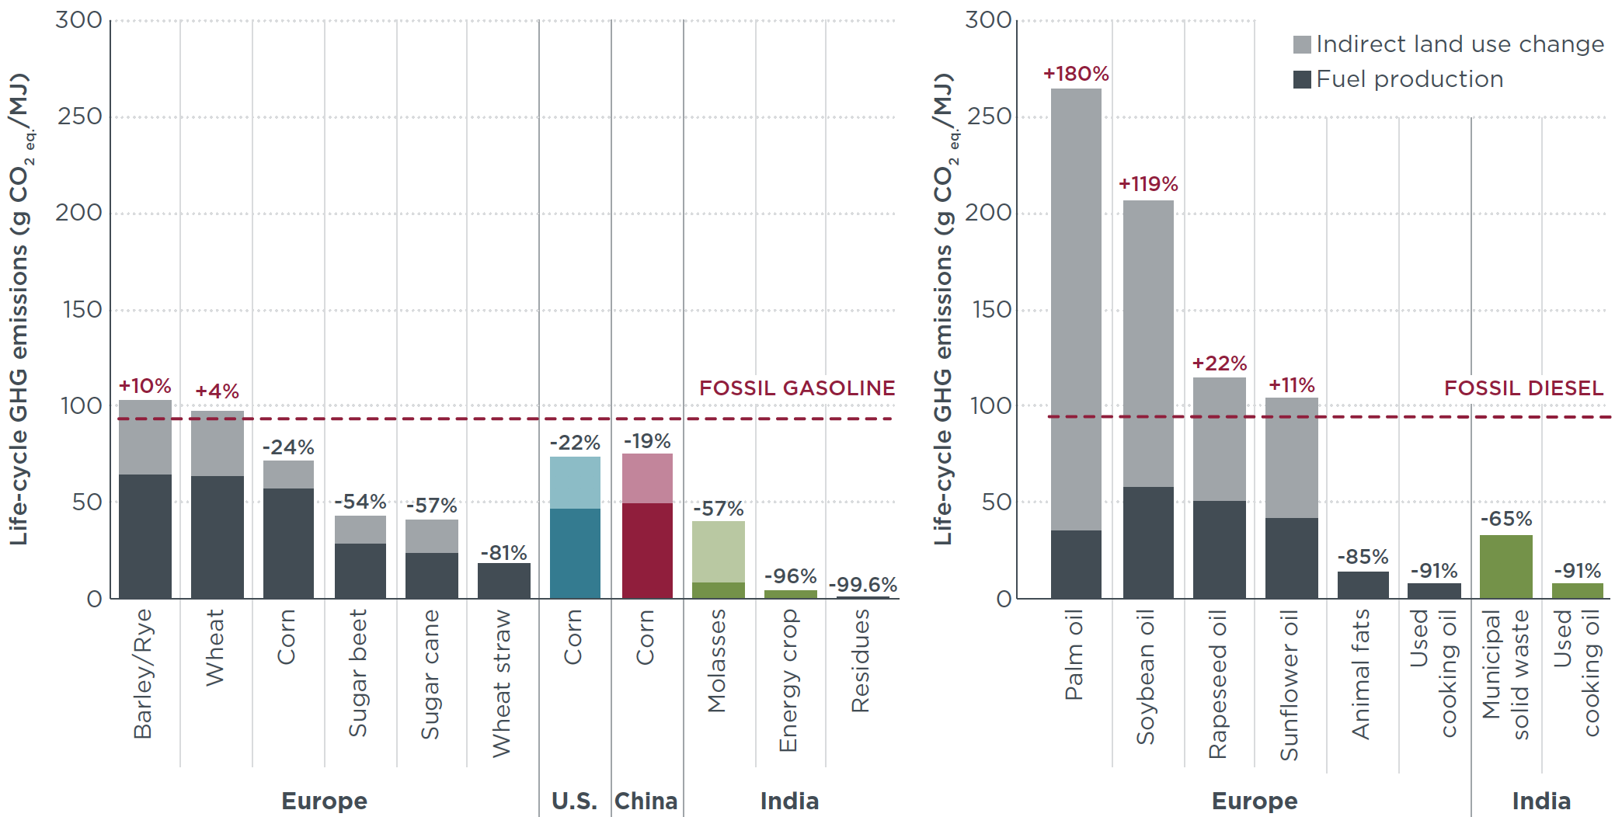
How important are ILUC emissions?
Indirect land use change (ILUC) emission of biofuels:
Food-based biofuels:
high ILUC emissions
Residue- and waste-
based biofuels:
low ILUC emissions
Most biofuels are food-based!
Biofuel production and indirect land use change emissions
ethanol
pathways
biodiesel
pathways
Bieker (2021). A global comparison of the life-cycle GHG emissions
of combustion engine and electric passenger cars.

Slide 5
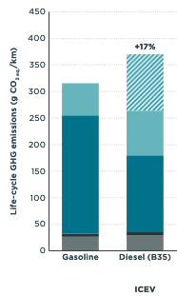
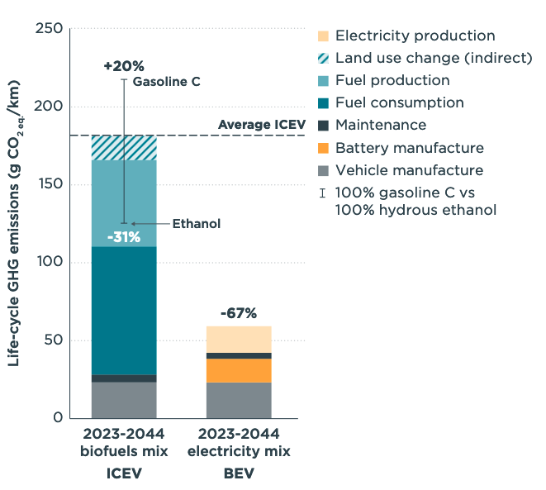

How important are ILUC emissions?
Life-cycle GHG emissions of SUVs in
a) Indonesia b) Brazil
Indirect land use change (ILUC) emission of biofuels:
29% of life-cycle emissions
of diesel ICEVs in Indonesia.
9% of life-cycle emissions of flex-fuel ICEVs in Brazil.
29%
9%
Mera & Bieker (2023a).
Mera & Bieker (2023b).

Slide 6
ILUC emissions in fuels policies
Key consideration in fuels policies & analysis:
European Union Renewable Energy Directive (RED)
United States Renewable Fuels Standard (RFS)
California Low Carbon Fuels Standard (LCFS)
International Civil Aviation Organization (ICAO):
Carbon Offsetting and Reduction Scheme for International Aviation (CORSIA)
…

Slide 7
How to implement indirect land-use change emissions in vehicle LCA?
Notes:
In the context of this working group

Slide 8
Option 1: Including indirect LUC values
(as in ICAO CORSIA)
Approach:
ILUC impact of biofuels from individual feedstock and pathways is estimated with economic models, such as GTAP and GLOBIOM
ICAO CORSIA uses average of the results from GTAP and GLOBIOM
(If spread is >8.9 gCO₂e/MJ, choose lesser of two values and add 4.45 gCO₂e/MJ)
Advantages:
Values are directionally representative of risk magnitude
CORSIA-adopted values have reached international, stakeholder consensus
Risks:
ILUC values add elements of consequential LCA to otherwise attributional approach
Selection of models and modelling assumptions can be subjective

Slide 9
Option 2: Including direct LUC values
Approach:
Estimate change in soil carbon and above-ground biomass associated with clearing land for biofuels: (A) based on IPCC land-use/land-use change (LULUCF) emission factors for primary land types and regions or (B) based on site-level measurements
Combine with crop yields to convert into gCO₂e/MJ
Advantages:
Covers at least the direct land-use impact of expanding biofuel production
Does not combine elements of attributional and consequential LCA
Risks:
Omits secondary (indirect) impacts of feedstock displacement
High variability among site level estimates

Slide 10
Option 3: Not including LUC values, but counting high ILUC-risk biofuels as fossils (as in IMO)
Approach:
High-ILUC risk defined as projects that displace food and feed crops leading to significant land expansion onto areas with high carbon stock
Biofuel pathways with high ILUC risk treated as fossil fuels within life-cycle GHG calculations
Biofuel pathways with moderate and low ILUC risk only consider direct, supply chain emissions
Advantages:
Does not combine elements of attributional and consequential LCA
Adopted definition has reached international, stakeholder consensus
Risks:
Omits emissions of LUC in most cases, accounting only in extreme cases
Selection of eligibility threshold can be subjective

Slide 11
Proposals
Include ILUC values for biofuel pathways, either using values from regional fuels policies (e.g., EU’s Renewable Energy Directive, Annex VIII or the U.S. Renewable Fuel Standard Program) or, if not available, using internationally agreed values (e.g., ICAO’s Default Life Cycle Emissions Values for CORSIA Eligible Fuels).”
if not possible
Include direct LUC values (e.g., based on IPCC land-use, land-use change and forestry (LULUCF) emission factors for primary land types and regions)
if not possible
Do not include direct or indirect LUC values, but at least consider extreme cases of high ILUC-risk feedstock-based biofuels as fossil fuels (risk-based approach)

Slide 12
Thank you! j.omalley@theicct.org g.bieker@theicct.org

