Slide 1
Data elements proposal and results of TRL project
UK Department for Transport
26/03/2024
Notes:
So as well as the spreadsheet documenting the data elements, part of the output of the project was a presentation explaining the rationale behind the project, which I will present a condensed version of here

Slide 2
Contents
TRL Project purpose
Project method
Framework for use of time series data
Example of real-world incidents
Recommendations
UK provided documents
Conclusion

Slide 3
TRL Project purpose
It is recognised that there is a need to optimise the data elements list within DSSAD, to balance the data burden that comes with recording and storing the data, against obtaining all the essential information to confidently understand everything relevant that an ADS did during an incident.
To help with this issue, the UK initiated a project with the Transport Research Laboratory (TRL) to determine the minimum dataset the DSSAD needs to record to understand what an ADS did during an incident, so that this dataset can be the first reference when used to decide if further investigation into an ADS or the incident is necessary.
TRL were tasked to develop this minimum dataset as they have extensive experience in collision investigation and investigation of non-collision incidents involving automated vehicles from trials they have been involved in
The funding for the project was via a particular arrangement, the conditions of which meant that the final project output had to be shared publicly.
This output of this work is the professional view from TRL, without prejudice or influence by what the Informal Working Group has done so far. Hence, some of their output has needed adjustment to better reflect the language already in the guidance document.

Slide 4
Project method
Approach to identifying recommended data elements
Building on VMAD's work on occurrences, the task for TRL was to define the minimum set of time series data elements (including their respective recording interval, sample rate, range, accuracy, and resolution) that should be recorded to provisionally investigate an incident and determine what the vehicle did during this incident. This was done via:
Literature Review:
  A rapid review of international proposals, national legislation, and relevant technical standards to collate a list of data elements and the approaches that are recommended by these sources
  This task mapped those data elements with the recommended data format, range and resolution by reviewing available information.
Expert workshop:
  Develop a recommended minimum dataset for DSSAD by utilising the findings from literature review and our insights from in-depth collision investigations for expert witness, collision data collection programme (Road Accident In-Depth Studies – RAIDS) and TRL's understanding of data used by automated vehicles to perform the dynamic driving task
  TRL’s Collision Investigation and AV Regulation experts reviewed, refined and updated the draft list of data elements

Slide 5
Framework for use of time series data
The general architecture of an Automated Driving System (ADS) typically consists of modules for perception, planning, and action; and
As the DSSAD (Data Storage System for Automated Driving) time-series data is designed to provide information for understanding "what happened" and "what the ADS did," TRL recommends that DSSAD time-series data capture elements relevant to perception and action, while excluding the planning module. Additionally, incorporating vehicle dynamics data is essential to analyze the observed driving behavior.
The following slides outline a framework for assessing the relevance of DSSAD data elements. The framework also identifies potential sources of inconsistencies, which can support the determination of whether further investigation is required.

Slide 6
Framework for use of time series data
Dataset vs. Safety Expectations
DSSAD
Time
Series
Data
Perception
Action
Outcome
Visual Representation
Object Detection
ADS Requested Actions
Vehicle Dynamics
* Visual-based info only
What was in the field of view?
What did ADS observe?
What did the ADS decide to do?
What was the observed driving behaviour?
What ADS recognise as relevant to the operation?
Planning
External factors
e.g. road surface
Event recognition
Context-aware planning
What ADS was expected to (visually) observe?
What happened?
What would be appropriate responses?
What would be expected execution outcome?
What are relevant to the operation?
Expectations
Standard: ‘A Careful and Competent Driver’
Reference: Safety Arguments + Safety Cases
Notes:
These modules are outlined at the top here, what did the ADS perceive, what was the action taken from this perception and what was the outcome of this? These questions listed help to understand what we want to answer around each module and what data elements can help contribute to this. Once we have an overall picture of what happened this can prompt further investigation into the planning of the ADS and understand why it carried these actions out. The reason for planning being greyed out is this looks at more why the ADS carried out a certain action whereas with these data elements we are looking at what happened.

Slide 7
Framework for use of time series data
In what circumstances would the regulator initiate further investigation
Indicators from Time Series Data for Further Investigation
Single incident
  Inconsistency between intended action and observed behaviour
  Inconsistency between expected action and ADS requested action
  Inconsistency between expected outcome and observed outcome
Across instances of the same incident type or the same scenario
  Inconsistency of ADS behaviour
Notes:
The data we want to collect from a DSSAD should be enough that it can give us an idea of whether further investigation is needed, such as inconsistency between intended action and observed behaviour, if the ADS intended to decelerate, was this action recorded but the behaviour not observed? If so, this gives us a strong indicator that further investigation is required to ascertain the cause of this. The same can be said for the expected action and requested action, did we expect the ADS to decelerate because there was an obstacle in front of it and instead it accelerated?

Slide 8
Framework for use of time series data
DSSAD
Time
Series
Data
Perception
Action
Failed Execution
Outcome
Visual Representation
Object Detection
ADS Requested Actions
Vehicle Dynamics
* Visual-based info only
What was in the field of view?
What did ADS observe?
What did the ADS decide to do?
What was the observed driving behaviour?
What ADS recognise as relevant to the operation?
Planning
External factors
Event recognition
Context-aware planning
What happened?
What ADS was expected to (visually) observe?
What would be appropriate responses?
What would be expected execution outcome?
What are relevant to the operation?
Expectations
Standard: ‘A Careful and Competent Driver’
Reference: Safety Arguments + Safety Cases
Notes:
Looking at the data analysis framework we can map out where inconsistencies can occur, if we observe inconsistencies between action and outcome, did the ADS request these actions and if they did, why weren’t carried out why not? If we identify this, this is then something that can be investigated further

Slide 9
Framework for use of time series data
DSSAD
Time
Series
Data
Perception
Action
Outcome
Visual Representation
Object Detection
ADS Requested Actions
Vehicle Dynamics
* Visual-based info only
What was in the field of view?
What did ADS observe?
What did the ADS decide to do?
What was the observed driving behaviour?
What ADS recognise as relevant to the operation?
Planning
External factors
Event recognition
Context-aware planning
What happened?
Inadequate Control – Response and timing
What ADS was expected to (visually) observe?
What would be appropriate responses?
What would be expected execution outcome?
What are relevant to the operation?
Expectations
Standard: ‘A Careful and Competent Driver’
Reference: Safety Arguments + Safety Cases
Notes:
Another example of an inconsistency between action and outcome can be if that the ADS did request an actions were they carried out in time, and if not, why not? This inconsistency is then something that can be investigated further. So with the data elements suggested in our proposal these can help identify any inconsistencies with the ADS behaviour compared to what is expected and a careful and competent driver.

Slide 10
Exemplar real-world incidents
Case summaries
Simplified incident or collision scenarios
  Based on real cases investigated by TRL collision investigation experts
Each case demonstrates need for different time-series data elements
  Particular attention to object detection and identification, and duration of data required

Slide 11
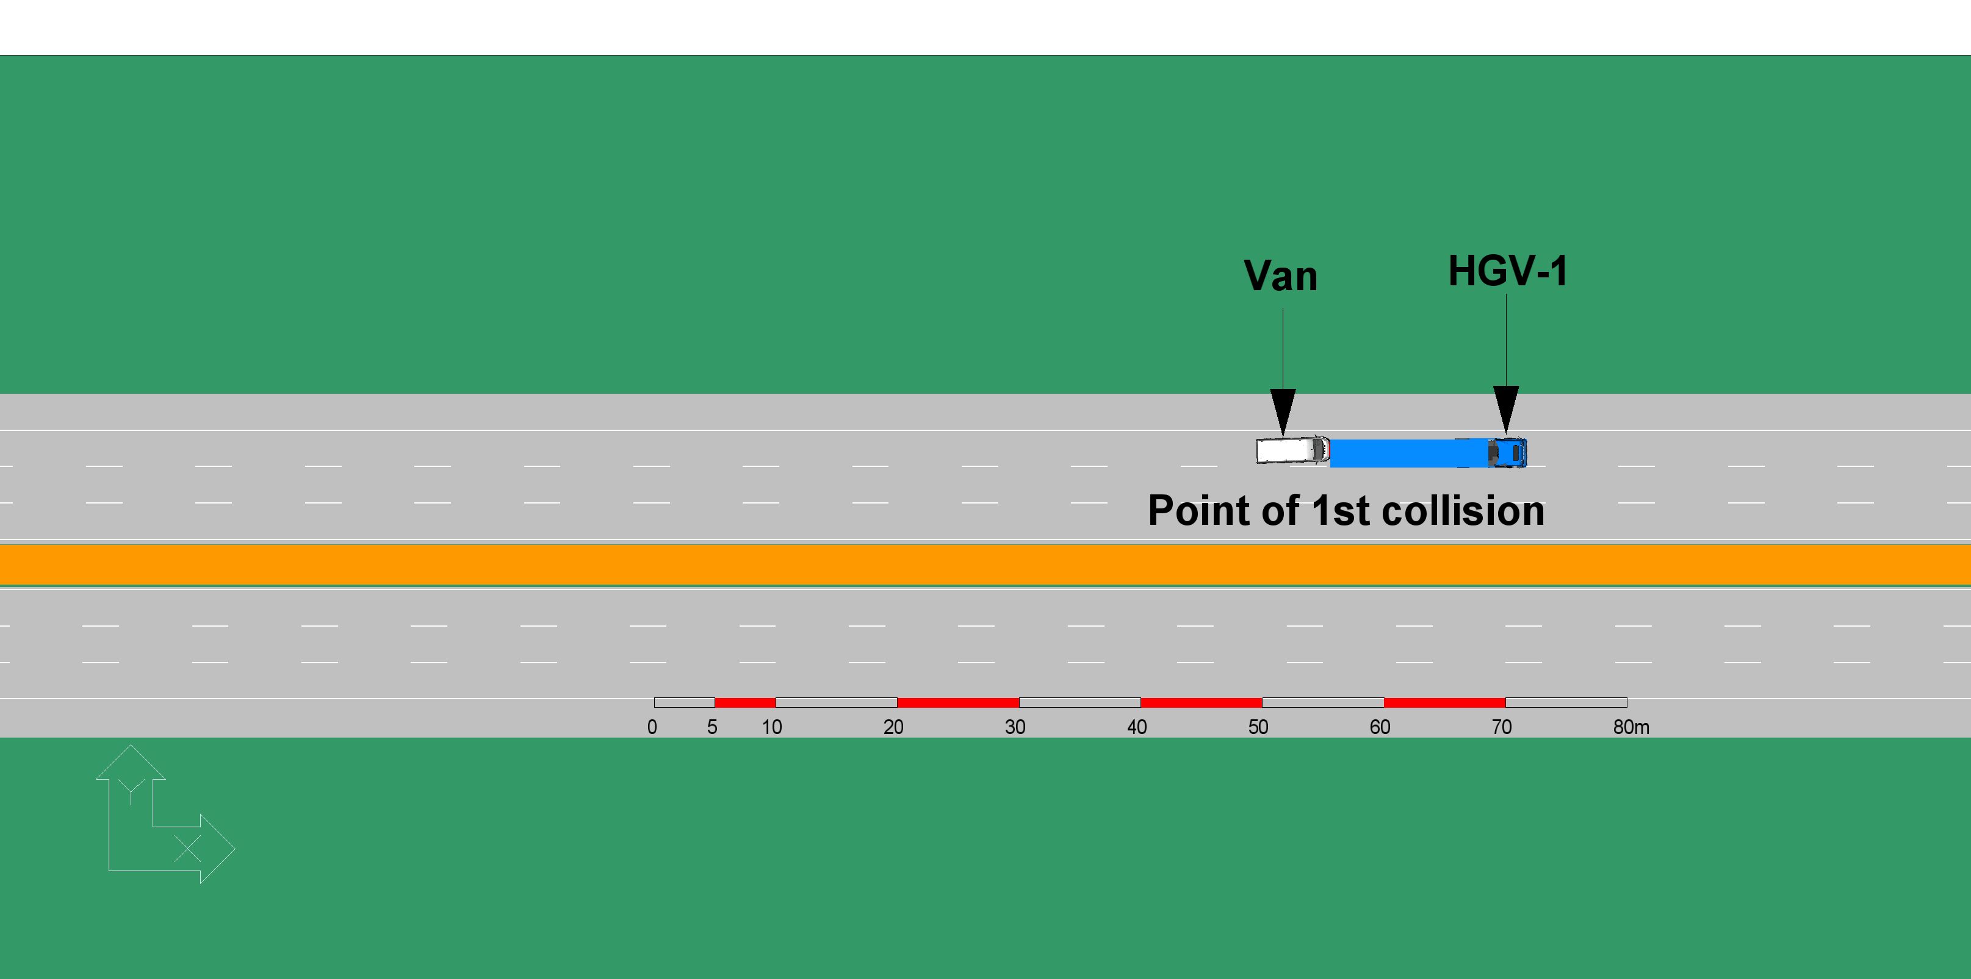
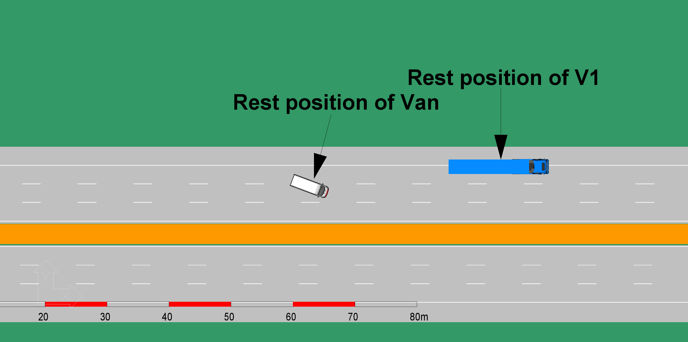
Exemplar real-world incident
Reaction to a previous collision
Scenario
  3-lane motorway at night, no streetlamps
  Incident 1 – A Van rear-ends an HGV (HGV-1) travelling in Lane 1 resulting in
    Van heavily damaged and stationary in Lane 2
    HGV-1 slightly damaged and parked partially on the hard shoulder, partially in Lane 1
Notes:
An example of how these new data elements will come into play can be demonstrated in a real-world incident that TRL has previously investigated. Conspicuity is not something that has previously been considered by the task force, but it is an important part of being a careful and competent driver in alerting others of your presence on the road and following the correct laws on the road when it comes to these secondary systems. This scenario they analysed starts off with a van that has collided with an HGV and are now both obstructing 2 lanes on a motorway which has no streetlamps.

Slide 12
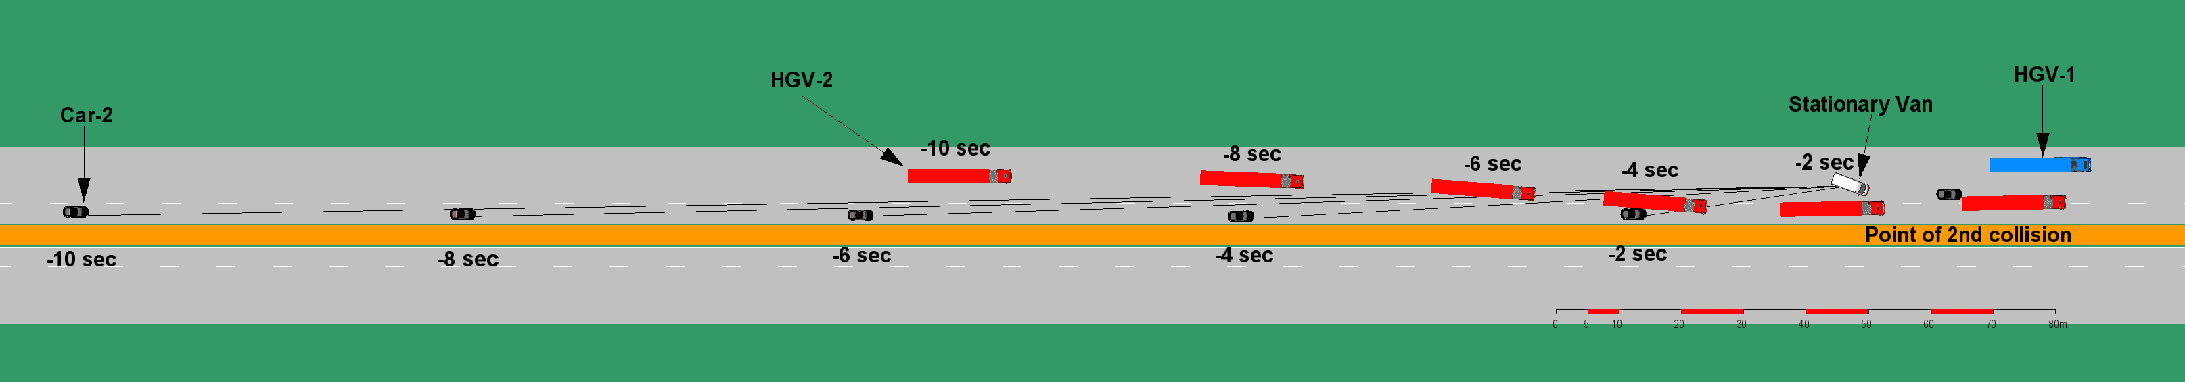
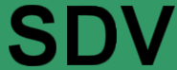
Exemplar real-world incident
Reaction to a previous collision
Scenario (continued)
  Incident 2 – One minute later, a following HGV (HGV-2) approaches the collision scene from Incident 1
    HGV-2 is travelling at 85 km/h in Lane 1
      Realising that Lane 1 is partially blocked by HGV-1, driver of HGV-2 indicates and moves over to Lane 2
      Realising that Lane 2 is blocked by Van, driver of HGV-2 indicates and moves over to Lane 3
    SDV is travelling at 110 km/h in Lane 2 and approaching HGV-2 as it moves from Lane 1 to Lane 2
      SDV moves to Lane 3
      Typical SDV sensor range and enables identification of stationary vehicle (HGV-1) partially in Lane 1 and stationary vehicle (Van) in Lane 2 at 6-7 seconds
      Clear sight lines to HGV-1 and Van are available at multiple time points from 8 seconds before the location
Notes:
The next stage involves an HGV driving along with a SDV shortly following behind, in this scenario, the SDV should have sight of the stationary vehicles are should initiate a more cautious approach. It should also identify the vehicle in front will likely react in the same way and itself and move over in lane. Having this data beforehand helps us to build a picture of what the scenario was and if the ADS responded in a safe manner, if the outcome ended up in a collision, this can be investigated further as to why this occurred, was the perception element faulty and the ADS did not observe the hazards, or was the action element faulty, did the ADS request the wrong action or did the request happen too late, recording these data elements help identify inconsistencies which would require further investigation into the ADS itself, which is what we envisage the DSSAD for. In this scenario, we would expect the driver to have their headlamps on given this was at night, which is a very safety relevant feature. We would also expect the SDV to activate its turn signal when changing lanes, alerting others of its intentions, then after the collision had occurred to activate its hazard lights further signaling to drivers its current state. We can also look into whether it further tried to alert the HGV of its presence by activating it’s horn, essentially we are trying to build a picture of if the ADS did everything as safely as possible before this incident occurred.
The ADS Requested Hazard Flashers, Exterior Lighting, Turn Signals, and Audible Warning System are valuable for:
- Assessing situational awareness: Evaluate ADS's ability to recognise and respond appropriately to various traffic scenarios and potential hazards.
- Identifying communication failures: Unusual or absent use of these signaling systems in scenarios where they are expected could indicate issues with the ADS's perception or decision-making capabilities.
- Detecting system malfunctions: Inconsistencies between signaling requests and the vehicle's actual behavior could point to problems with the lighting, turn signal, or horn systems.
- Assessing emergency response capabilities: Analysing the use of hazard flashers and audible warnings in critical situations can help evaluate the ADS's ability to alert other road users and respond to emergencies.
- Verifying human-machine interface effectiveness: The appropriate use of these systems can indicate how well the ADS communicates its intentions and responds to its environment, which is crucial for safe interaction with other road users.

Slide 13
Exemplar real-world incident
Reaction to a previous collision
SDV likely can identify the potential hazard earlier than a human driver (dark road)
  SDV should expect HGV-2 to continue to move across to Lane 3 and reduce speed early and appropriately
  Having identified the potential hazard, a ‘careful’ approach can be chosen
  If SDV takes the ‘careful’ approach, no data will be recorded
    Data only recorded if the observable hazard is not acted upon AND this results in a collision, near miss or emergency manoeuvre
Why extended data is needed
  Detection of objects supports assessment of observable hazard
  Longer period of data recording shows that the hazard was observable for long enough to support a more cautious decision

Slide 14
Recommendations
Summary of data element implications from literature review and exemplar cases
Data collection pre-event
  Incident sequence and event build-up (scenario)
  General driving behaviour (e.g. lane changing, following distance, acceleration/deceleration)
  Operation status and condition (e.g. operator, system status)
  Interaction between operators (onboard driver, remote assistant or driver, and automated driving system) and vehicle
  Vehicle operation information (e.g. speed, control inputs, impact)
  Compliance with traffic rules (e.g. demonstrating that appropriate, early signalling of and intended manoeuvre was provided to other road users)
  Environmental factors (e.g. traffic conditions, road geometry, lighting)
  Mitigation efforts before the crash and timing of the response
Data collection post-event
  Incident sequence, including impact and vehicle resting state
  Operational actions of the vehicle operator(s) after the crash
  Contributions of other stakeholders to the event and injuries
Recommend up to 10 seconds to record pre-event build-up described in the scenarios above
Recommend up to 10 seconds to record post-event to record the minimum risk manoeuvre in most scenarios that could be envisaged
Notes:
We list in here our reasoning for data collection for both pre-event and post-event. Data collection post-event is crucial too as it helps us to determine the vehicle’s actions post occurrence, did they vehicle activate the hazard lights to alert other road users of its presence, were the vehicles actions still considered safe after the incident occurred, did it move over to a hard shoulder or did it drive away for example? This gives us more information about the minimum risk manoeuvre the self-driving vehicle placed itself in and whether it was the safest manoeuvre possible.

Slide 15
Recommendations
Final data element list – 27-05
EDR-DSSAD-IWG-27-05 Minimum data set for Time Series Data in DSSAD_v2.xlsx
Timestamp (UTC)
Geolocation (horizontal)
Geolocation (vertical)
Vehicle Heading
Visual Representation
ADS Requested Lateral Vehicle Motion Control
ADS Requested Gear
ADS Requested Braking
ADS Requested Longitudinal Vehicle Motion Control
ADS Requested Hazard Flasher
ADS Requested Exterior Lighting
ADS Requested Turn Signals
ADS Requested Audible Warning System (e.g. horn)
ADS Determined - Vehicle (Longitudinal) Speed
ADS Determined - Longitudinal Acceleration
ADS Determined - Lateral Acceleration
ADS Determined - Vertical Acceleration
Vehicle Indicated – Gear Position
Vehicle Indicated – Braking Status (Parking)
Vehicle Indicated – Braking Status (Service)
Vehicle Indicated - Hazard Flasher Status
Vehicle Indicated - Exterior Lighting status
Vehicle Indicated - Turn Signal Status
Audible Warning System Status (e.g. horn)

Slide 16
UK provided documents
27-05
Previously 26-15, this spreadsheet has been produced from the research project with the Transport Research Laboratory (TRL). This lists the minimum dataset TRL have identified to help describe to us what happened during an incident for an ADS and their justifications for it.
27-06
Previously 26-11, this is our formal proposal of data elements to include in the guidance document adapted from 27-05 (26-15) to incorporate with the prevailing work on the guidelines. The justifications for those are on the following slides and can be also found in 27-05

Slide 17
EDR-DSSAD-IWG-27-05 – Minimum data set
There are similarities to the EC/JP proposal (25-05) of time series data elements. That proposal had perception, control and dynamics as categories for their data elements. Whereas TRL have framed these as time, location, perception, control - ADS requested action, and dynamic vehicle data.
EC/JP proposal | TRL project output
Time stamp from time-series data trigger | Time
(Perception - Geolocation) | Location
Perception | Perception
Control | Control - ADS requested action
Dynamics | Dynamic vehicle data

Slide 18
EDR-DSSAD-IWG-27-05 – Control/Dynamics
There are similarities between the data elements in the EC/JP proposal and what has been produced by TRL in 27-05. The table below shows the naming of these data elements in each proposal and the current wording in the guidance document. It is important to note these are not different data elements, they are the same but have slightly different terminology.
EC/JP proposal – data elements | EC/JP proposal - category | Outcome of TRL research project – data elements | Outcome of TRL research project - category | Guidance document equivalent
Accel command | Control | ADS Requested Longitudinal Vehicle Motion Control | Control – ADS requested action | ADS-requested accel demand
Brake command |  | ADS requested braking |  | ADS-requested service braking demand
Steer command |  | ADS requested lateral vehicle motion control |  | ADS-requested steer demand
Indicator command |  | ADS Requested Turn Signals |  | [ADS-requested direction indicator demand]
Vehicle acceleration, longitudinal | Dynamics | ADS Determined – Longitudinal Acceleration | Dynamic vehicle data | Vehicle acceleration, longitudinal
Vehicle acceleration, lateral |  | ADS Determined - Lateral Acceleration |  | Vehicle acceleration, lateral
Vehicle yaw rate |  | - |  | Vehicle yaw rate
Vehicle indicated speed |  | ADS Determined - Vehicle (Longitudinal) Speed |  | ADS determined speed

Slide 19
EDR-DSSAD-IWG-27-06 – Data elements proposal
UK additions to the guidance document have been added in red (added into 26-16), those in bold red are further additions (27-06).
These elements have been extracted from 27-05 to form our proposal for a minimum dataset to be recorded by the DSSAD, however some data elements have been adjusted to reflect the language already being used in the guidance document (e.g. ADS requested lateral vehicle motion control in 27-05 is the same as ADS requested steering demand in 27-06).
The new data elements that have been added are:
Geolocation (horizontal and vertical),
Vehicle heading,
ADS requested gear,
Vehicle indicated direction indictor status, hazard warning signal status, exterior lighting status, audible warning system status
ADS requested direction indictor status, hazard warning signal status, exterior lighting status, audible warning system status - only if ‘failure’ resolution of vehicle indicated equivalent does not include communication failure
Vehicle acceleration, vertical

Slide 20
EDR-DSSAD-IWG-27-06 – Data elements proposal
Geolocation (horizontal and vertical) – replace GNSS positioning as it has inaccuracies and is unlikely to be used to fully locate the vehicle. This is needed understand where the vehicle was during an event and crucial for identifying what lane and section of the road the vehicle was in; it is proposed to use WGS84 which is a commonly used global standard.
Vehicle heading – provides absolute orientation of the vehicle and replaces yaw rate. Heading is more relevant for the ADS’s actions whereas yaw rate is more relevant for the dynamics of a crash. Calculating heading from yaw rate would require additional parameters which would generate a large uncertainty for the calculated heading measurement.
ADS requested gear - can help detect potentially dangerous situations where the ADS selects an inappropriate gear, such as shifting into reverse while moving forward or engaging drive while in reverse.

Slide 21
EDR-DSSAD-IWG-27-06 – Data elements proposal
Vehicle indicated direction indictor status, hazard warning signal status, exterior lighting status, audible warning system status – conspicuity-based elements are critical for the ADS making itself aware to other road users. These are valuable for looking at how the situational awareness of the ADS, and its ability to recognise and respond appropriately to various traffic scenarios and potential hazards.
ADS requested direction indictor status, hazard warning signal status, exterior lighting status, audible warning system status – if the ‘failure’ resolution of vehicle indicated equivalent does not include communication failure between the ADS and the relevant light or auditory source then these are mandatory too so as to understand whether any ADS request is achieved.
Vehicle acceleration (vertical) - this data can reveal rollover events and inconsistencies or anomalies in the ADS's behaviour with respect to road surface irregularities which could have contributed to an incident.

Slide 22
EDR-DSSAD-IWG-27-06 – Data elements proposal
Visual representation – this will present an absolute ground truth for what happened during an incident with the ADS and can be used to assess whether the driving behaviour of an ADS was safe and proportionate to the incident it was involved in. Object detected elements only provide what the ADS interpreted the scene to be so does not represent an objective view of the situation.
Vehicle acceleration (lateral, longitudinal, vertical) - If the ADS utilises a separate sensor to determine acceleration, then the ADS determined acceleration in that plane (e.g. longitudinal, lateral and vertical) shall be recorded as an additional data element. Discrepancies in what the ADS is considering, and the vehicle dynamics could be a contributing factor in an incident.

Slide 23
Conclusion
This proposed revision of the list of data elements is to provide a minimum dataset for a DSSAD to record, which can help with the data burden of storing these data elements.
This is to determine all the actions an ADS carried out during an incident and if these were done in the safest manner possible.
This list will provide an overview for authorised entities to review and assess what happened during an incident and determine if it did not behave like a careful and competent driver and that further investigation into the ADS may be necessary.

