Slide 1

IWG DDADWS #4
(driver drowsiness and distraction warning system)
Industry Feedback to DDADWS-03-02 “ADDW draft” 27/02/2025

Slide 2
Overview:
Definitions
1.4.2. Spot-check for gaze fixation points
5.9. Provisions for PTI
Annex 3 Documentation Package: references to annex 5
Annex 3 Documentation Package: “within system boundaries”
Annex 5 spot check testing procedure: timing []
Annex 5 Spot check testing procedure: “tolerance for gaze fixation points”
Annex 5 Spot check testing procedure : “fixation points on moving parts”
Replacement of “vehicle master control switch”

Slide 3


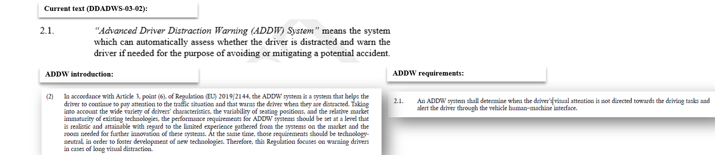
2.4. ADDW System Definition
  Industry proposal:
  2.1. “Advanced Driver Distraction Warning (ADDW) System” means a system that assesses the visual attention of the driver and warns the driver if needed distracted via the vehicle’s human- machine interface.
  Rational for proposal:
  Use definition as in EU regulation ADDW and align structure of definition to DDAW system definition

Slide 4
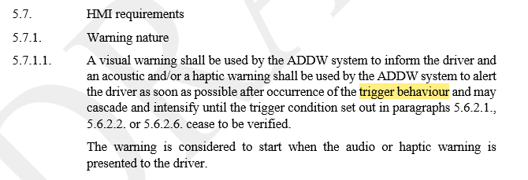
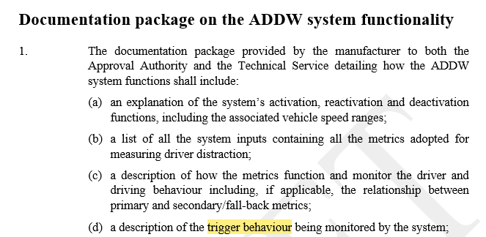
2.8. Trigger behavior Definition
  Industry proposal:
  2.8. “Trigger behaviour” means the vehicle or driver action for which the ADDW system monitors and provides a warning to the driver once this action happens.
  Rational for proposal:
  Following the discussion in IWG #3 we discussed different options, checked with according provisions and concluded to simply reduce definition to “driver action” as all trigger behavior is related to that (Proposal to use “activation criteria” is too close to (crossed out) activation of vehicle master control switch)
DDAW:
Use of “trigger behaviour” in regulation:

Slide 5
2. Definitions
2.2. “Approval of a vehicle type” means the full procedure whereby a Contracting Party to the Agreement certifies that a vehicle type meets the technical requirements of this Regulation.
Industry proposal:
Delete this definition. Rational: As discussed in IWG #2 this definition is not needed as it is the original purpose of that document to support that
2.3. “Biometric personal data” means data resulting from specific technical processing relating to the physical, physiological or behavioural characteristics of a natural person, which allow or confirm the unique identification of that natural person, such as facial images or [dactyloscopic][fingerprint] data.
Industry proposal:
As agreed in IWG #3 the topic of Privacy and Data protection will limited to scope as it is a national topic. Hence, we suggest do delete this definition
2.4. “Common space” means an area on which two or more information functions (e.g. symbol) may be displayed, but not simultaneously.
Industry proposal:
Delete, see feedback to DDAW

Slide 6
2.10 Vehicle type
2.10. “Vehicle type with regard to its ADDW system” means a category of vehicles which do not differ in such essential respects such as:
    (a) the manufacturer’s trade name or mark;
    (b) the type and design of the ADDW system, including but not limited to:
      (i) the method(s) used in detection of a distracted driver;
      (ii) the specifications for the sensor(s) used in the detection system;
      (iii) the warning system methods, strategy and characteristics;
    (c) the other vehicle systems which integrate with the ADDW system for the purpose of it performing its safety function; and
    (d) the vehicle features and systems which significantly influence the performance of the ADDW system as declared in the manufacturer’s documentation package described in Annexes 3 and 4.
Rational for proposal:
    Deleting of (c): see DDAW
    Adaption in (d) as discussed in IWG #3

Slide 7
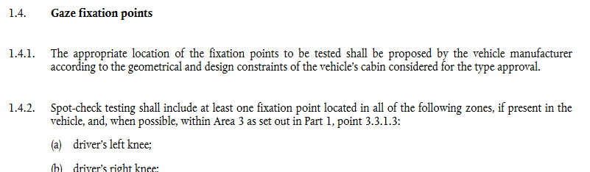
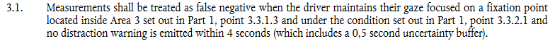
1.4.2. Spot-check for gaze fixation points in
and which are located in area 3
Industry proposal:
2.3.4. All fixation points assigned to the zones set out in point 1.4.2 and which are located in area 3 shall be tested.
Rational for proposal:
There are fixation points defined for spot-check test (in 1.4.2.) which should be tested (in 2.3.4.) but are not considered for the test result (in 3.1.) → chance to adapt as proposed to ease up testing, see also EuCom update on ADDW FAQ

Slide 8
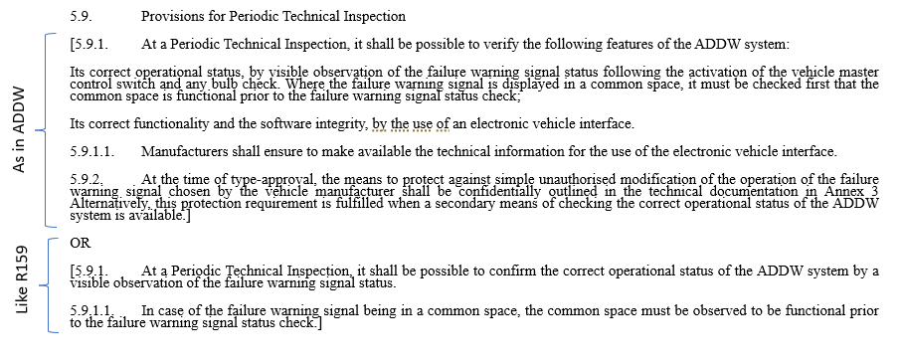
5.9. Provisions for PTI
Industry proposal: go for 2nd bracket as in R159
Rational for proposal:
best would be to deal with PTI in the annex as in R171. Compromise based on R159 could work

Slide 9
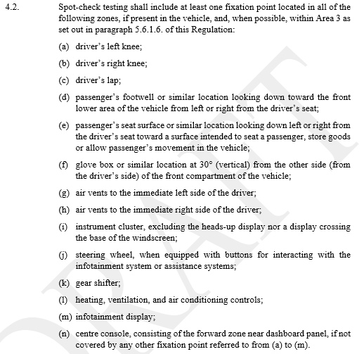
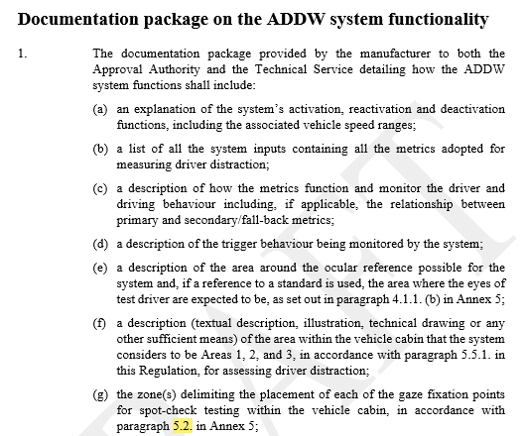
Annex 3 Documentation Package
Annex 3: Annex 5:
4.2. in Annex 5

Slide 10
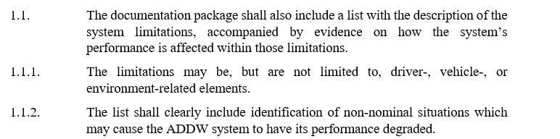
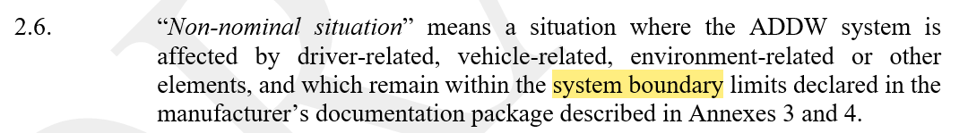
Annex 3 Documentation Package
Industry proposal:
1.1.2. The list shall clearly include identification of non-nominal situations which may cause the ADDW system to have its performance degraded within system boundaries.
Rational for proposal:
Non-nominal situation definition is coupled within system boundaries
as some of the chapters were rearrange a hint on system boundaries would be helpful to avoid new requirements

Slide 11
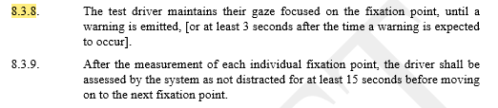
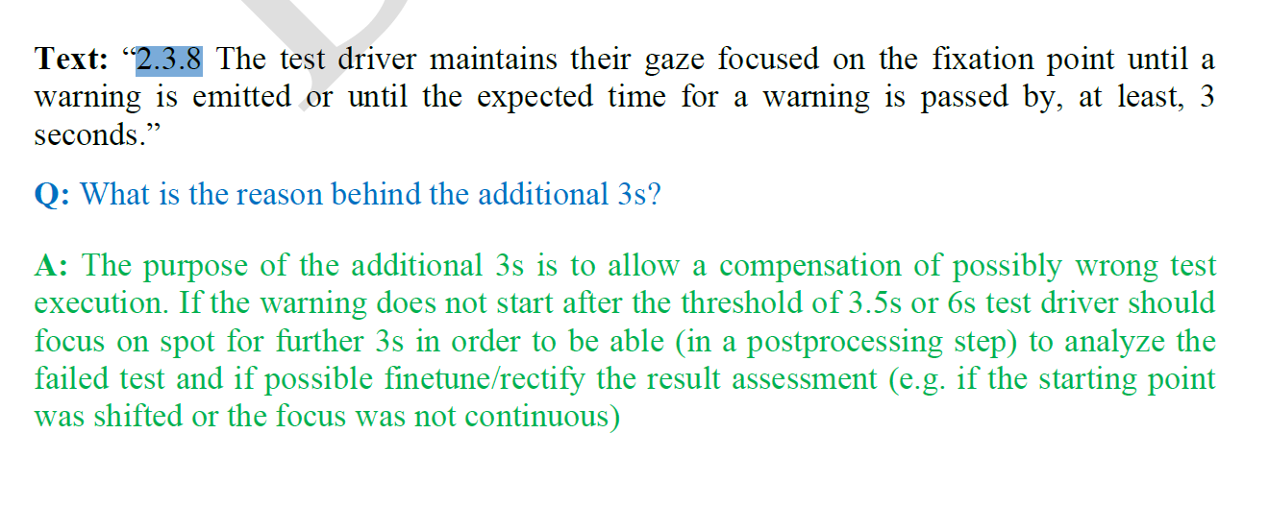
Annex 5 spot-check testing: timing
Industry proposal: remove [ ] and go for 3s as in ADDW
Rational for proposal:
See explanation out of ADDW FAQ for reliable test sequence
Guideline_ADDW_EU_2023_2590_GROW_EC_Draft:

Slide 12
Annex 5: Spot check testing procedure
“Tolerance for gaze fixation points”
  Industry proposal:
  4.2.
  Spot-check testing shall include at least one fixation point located in all of the following zones (a tolerance area of +/-5° around the zone may be excluded), if present in the vehicle, and, when possible, within Area 3 as set out in paragraph 5.6.1.6. of this Regulation:
  Rational for proposal:
  there are many different cockpit set ups
  for some the remaining part of some zones in area 3 (e.g. instrument cluster) are quite small
  still a fixation point needs to be chosen for spot test in that area
  by adding a tolerance area around the different zones (based on the ocular reference point as done for windscreen “area 2” definition) a realistic and technical manageable test procedure is described
Cabin Situation A:
30°
Zone, e.g. cluster display
Cabin Situation B:
For other cabin designs:
Add tolerance area of +/-5°
+/- 5°
30°
Zone, e.g. cluster display
edge of zone
tolerance area excluded

Slide 13
Annex 5: Spot check testing procedure
“Gaze fixation points on movable parts”
Industry proposal:
4. Gaze fixation points
4.1. The appropriate location of the fixation points to be tested shall be proposed by the vehicle manufacturer according to the geometrical and design constraints of the vehicle’s cabin considered for the type approval. For fixation points on movable elements which are not always in area 3, it is allowed to leave out these fixation points from the test.
Rational for proposal:
steering wheels are movable parts which flexible positions in the in cabin
for some steering wheel positions fixation point “button for interaction” might be in area 3, for other angles it is not
allow exemption if fixation point is on movable part causing the situation of being in/out
4.2 j) steering wheel, when equipped with buttons for interacting with the infotainment system or assistance systems;
30°
area 3
button
30°
area 3
button in area 3

Slide 14
2.9 Vehicle master control switch
2.9. “Vehicle master control switch” means the device by which the vehicle’s on-board electronics system is brought, from being switched off, as in the case where a vehicle is parked without the driver being present, to a normal operation mode.
5.4.7. The ADDW system, including HMI warnings, shall be automatically reinstated to normal operation mode upon each activation of the vehicle master control switch initiation of the powertrain*. A new engine start (or run cycle) which is performed automatically, e.g. the operation of a stop/start system, shall not be considered as an “initiation of the powertrain” wherever that term is used in this Regulation. Other automatic reinstatement conditions may be introduced and added by the vehicle manufacturer.
*insert a footnote with proper number on same page: As defined in Mutual Resolution Mutual Resolution No. 2 (M.R.2) of the 1958 and the 1998 Agreements containing vehicle propulsion system definitions, document ECE/TRANS/WP.29/1121.
5.8.1.4. Failures that activate the warning signal, but which are not detected when the ADDW is de-activated, shall be retained upon detection and continue to be displayed from start-up of the vehicle after each activation of the vehicle master control switch initiation of the powertrain, for as long as the failure or defect remains.
Industry proposal:
Delete this definition and replace by “initiation of the powertrain” to align with GRVA #21 wording
Rational for proposal:
→ see DDAW rational

