Slide 1
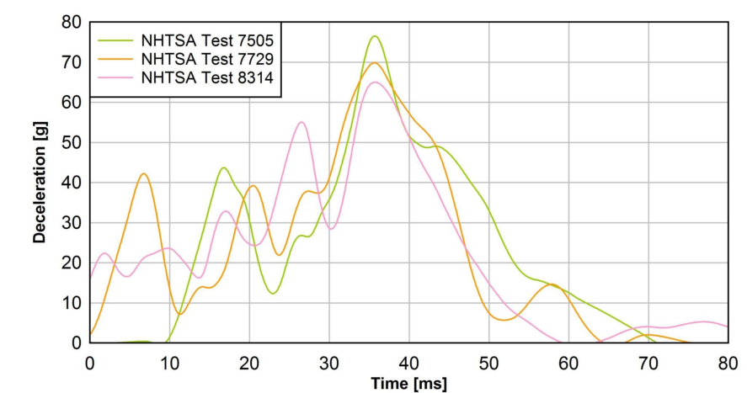
Attachment 1-1 :
EU TRL proposed corridor
Temps mini | Deceleration mini | Deceleration mini (m/s²) | Vitesse mini (en m/s) | Vitesse mini (en km/h) | Vitesse cumulée (en km/h)
0.01 | 0 | 0 | 0 | 0 | 0
0.034 | 65 | 637.65 | 7.6518 | 27.54648 | 27.54648
0.038 | 65 | 637.65 | 2.5506 | 9.18216 | 36.72864
0.046 | 0 | 0 | 2.5506 | 9.18216 | 45.9108
Temps maxi | Deceleration maxi d'origine | Deceleration maxi (m/s²) | Vitesse maxi (en m/s) | Vitesse maxi (en km/h) | Vitesse cumulée (en km/h)
0 | 16 | 156.96 | 0 | 0 | 0
0.025 | 77 | 755.37 | 11.404125 | 41.05485 | 41.05485
0.047 | 77 | 755.37 | 16.61814 | 59.825304 | 100.880154
0.06 | 0 | 0 | 4.909905 | 17.675658 | 118.555812
EU-TRL
EU-TRL

Slide 2
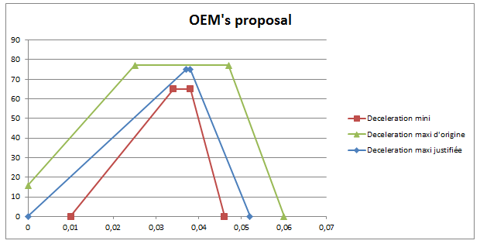
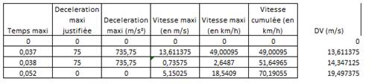
Attachment 1-2 :
Definition of the high-g test pulse : counter-proposal based on LAB data
  LAB (Joint Research center of PSA and Renault) made following proposal based on the analysis in the next slide
  To limit the Energy Equivalent Speed (EEV) up to 70 km/h (average speed that still ensure survivals)
  In addition: some OEM’s & TS are not able to manage pulses more than 60/65g with 1500 kg on sled (75g for 500kg)
LAB analysis
  Example of extrapolation from LAB proposal with 70km/h EEV:
ΔV= 45 km/h
ΔV= 118 km/h
ΔV= 70 km/h

Slide 3
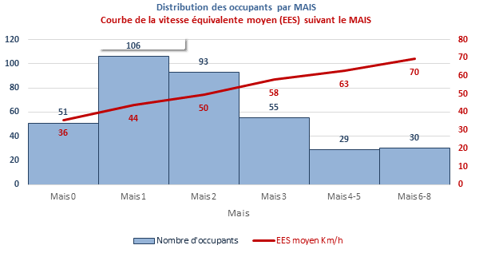


LAB analysis , EES for severe crashes
Issued from statistical analysis,
- Based on following boundary conditions:
    R94 compliant passenger cars produced after 2000,
    frontal crash between 11h-1h ; coverage between 60% and 100%
    All EES* and MAIS*
    * EES = Equivalent Energy Speed (speed gap for a crash on a rigid wall)
    MAIS = Maximum injury severity (from 0 –no damage- to 6-no survivors-)
    => Data from 265 vehicles ; 368 occupants
- The statistics show: -
Based on statistically relevant cases , no occupant survives frontal crashes on an average EES of 70 km/h.

Slide 4
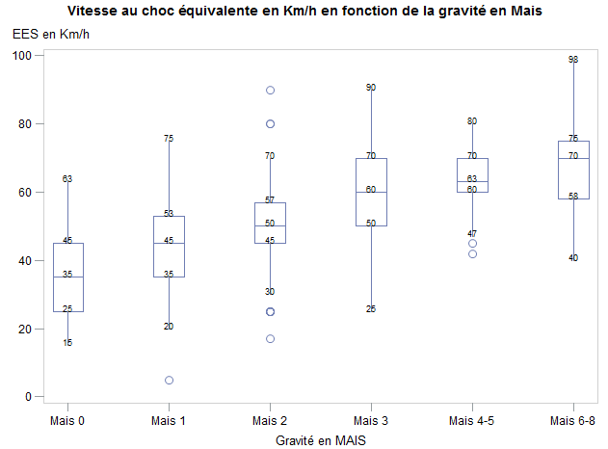
  Statiscal distribution of cases:
According to the LAB few non-lethal severe injuries exist up to EES of 80-90 km/h (which represents the extreme worse cases) that could potentially benefit from immediate rescue services.

